Slide 1
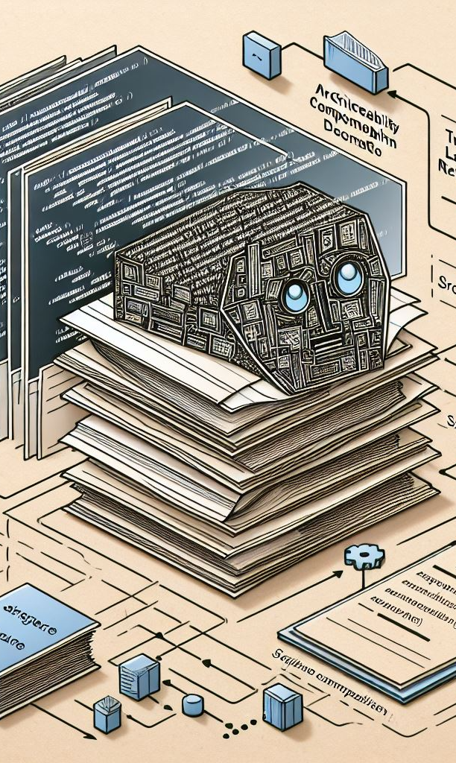

Enabling Architecture Traceability by LLM-based Architecture Component Name Extraction
Dominik Fuchß, Haoyu Liu, Tobias Hey, Jan Keim, Anne Koziolek, KASTEL – Institute of Information Security and Dependability
Notes:
I’d also like to welcome everyone to my presentation about architecture traceability.
My name is Dominik Fuchß, I’m a researcher at the Karlsruhe Institute of Technology .. now let’s dive into the topic … (*click*)

Slide 2
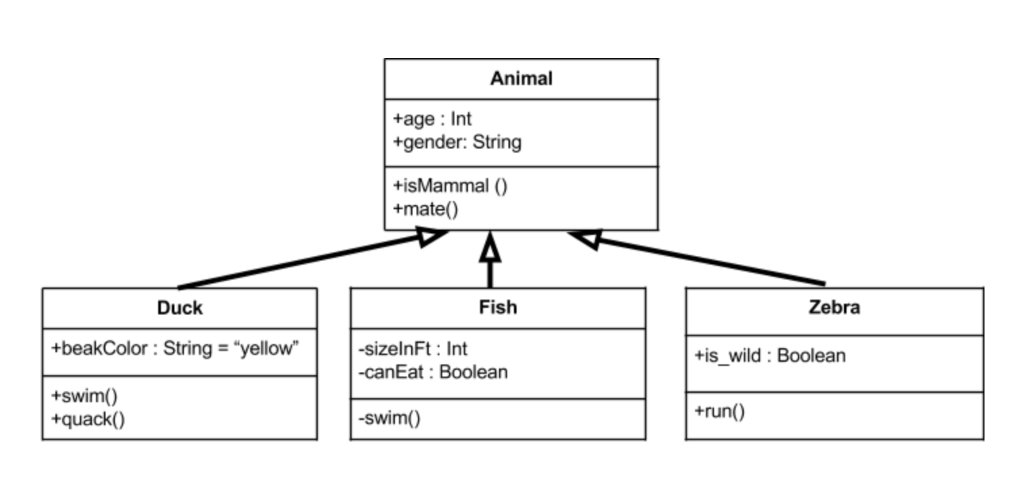

What makes Trace Links important?
Requirements
Design
Issues
Trace links are evidently
useful for
Software Maintenance
Bug Localization
Software Architecture Documentation
Software Architecture Models
Code
Change Impact An.
package network
class Consensus {
…
}
package security
class Encryption {
…
}
System Security
package service
class Controller {
…
}
package dataaccess
class Products {
…
}
class Users {
…
}
…
Artifact
Relation
Notes:
If we look into development process of software …
Typical artifacts that we produce are requirements, sa docs, sa models like UML component diagrams, and of course code.
Between different kinds of artifacts, there can be shared information like the existence of certain elements but also some explicit information that is special to a specific kind of artifact.
* For example, code can contain elements like classes, packages, … while in software architecture documentation, we have design decisions about the entities and also about reasoning or architectural guidelines and patterns.
(*click*) Trace links make explicit, which elements in the different artifacts are related and where the artifacts contain shared information about a certain entity.
(*click*) This way, trace links can improve efficiency for software maintenance, bug localization, change impact analysis, and system security, among others.
(*click*) Since we are sw architects, we will focus on the lower part of these artifacts; for today, we focus on swa doc. and code

Slide 3
Traceability Link Recovery between Documentation & Code
The controller receives incoming requests and verifies them.
Then, it answers requests by querying the persistence component.
Code
Software Architecture
Documentation (SAD)
package service
class Controller {
…
}
package dataaccess
class Products {
…
}
class Users {
…
}
Notes:
Let’s take a quick look at this example ..
If we want to map the highlighted entities, we can already see that we have to tackle different challenges:
Sometimes, we have easy mappings, like controller in SAD is a controller class
Then we have to deal with complexer linguistic stuff like co-references
And finally, we have to deal with semantic gaps like a persistence component that is represented as package dataAccess

Slide 4
Traceability Link Recovery between Documentation & Code
The controller receives incoming requests and verifies them.
Then, it answers requests by querying the persistence component.
Software Architecture
Model (SAM)
Code
Software Architecture
Documentation (SAD)
package service
class Controller {
…
}
package dataaccess
class Products {
…
}
class Users {
…
}
Controller
DataPersistence
Notes:
Since direct TLR appraoches (incl. Information Retrieval / ML) do not work good enough
… 2 years ago ... I think it’s now two years .. my co-author Jan came up with the idea to use architecture models so ease the problem by creating two smaller gaps.

Slide 5
Traceability Link Recovery between Documentation & Code
The controller receives incoming requests and verifies them.
Then, it answers requests by querying the persistence component.
Software Architecture
Model (SAM)
Code
Software Architecture
Documentation (SAD)
package service
class Controller {
…
}
package dataaccess
class Products {
…
}
class Users {
…
}
TransArC: Using Software Architecture Models as intermediate artifact for Documentation to Code TLR significantly improves the TLR results
Keim et al.: Recovering Trace Links Between Software Documentation And Code, ACM/IEEE ICSE 2024
Controller
DataPersistence
Notes:
… and mainly what we found out was that this works .. So using an architecture model as intermediate artifact sign. Impr. The TLR results for doc to code
.. And that’s why we are now here ….

Slide 6
Traceability Link Recovery between Documentation & Code
The controller receives incoming requests and verifies them.
Then, it answers requests by querying the persistence component.
Software Architecture
Model (SAM)
Code
Software Architecture
Documentation (SAD)
package service
class Controller {
…
}
package dataaccess
class Products {
…
}
class Users {
…
}
TransArC: Using Software Architecture Models as intermediate artifact for Documentation to Code TLR significantly improves the TLR results
Keim et al.: Recovering Trace Links Between Software Documentation And Code, ACM/IEEE ICSE 2024
Controller
Can we trace between architecture documentation and code without the need for manually created models?
DataPersistence
Notes:
… because we now asked ourselves the question whether we can do architecture tracability (doc to code) without the need for the manually created models …
… and how did we approach this problem … well …

Slide 7
Traceability Link Recovery between Documentation & Code
The controller receives incoming requests and verifies them.
Then, it answers requests by querying the persistence component.
Simple
Software Architecture
Model (SSAM)
Code
Software Architecture
Documentation (SAD)
package service
class Controller {
…
}
package dataaccess
class Products {
…
}
class Users {
…
}
Controller
Persistence
DataAccess
DataPersistence
Notes:
…. We thought that we could leverage the existing artifacts (doc and code) in this scenario to generate what we need using language models …
.. And what we needed is basically just the component names …
.. [Animations] ..

Slide 8
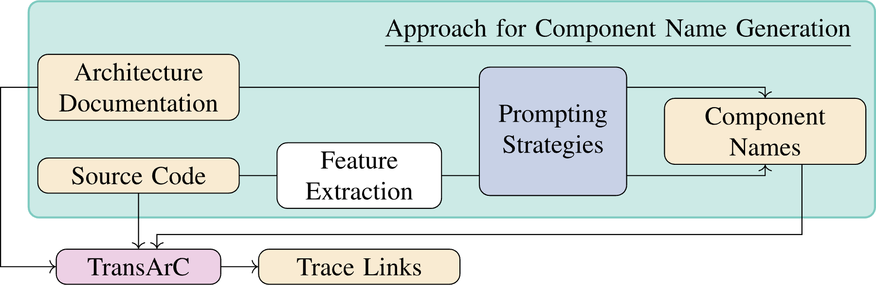
Approach to get a Simple Software Architecture Model
Approach
Architecture Documentation
Prompting Strategies
Component Names
Source Code
Feature Extraction
TransArC
Trace Links
Dataflow
Data
Process
Notes:
Roughly our approach takes arch. Doc +. Code ; for the code we need some feature extraction, because otherwise we’d have too much input for LMs.
Features in case of that paper were package names.
Then we use prompting to get component names … and therefore we have the input we need to run trans arc without manually created arch. Models.

Slide 9
Approach to get a Simple Software Architecture Model
Prompt: Documentation to Architecture
Your task is to identify the high-level components based on the software architecture documentation. In a first step, you shall elaborate on the following documentation: {Software Architecture Documentation}
Notes:
Just that you get a glimpse on how our prompts look like (of couse they are all in the paper & replication package)
After this prompt, we had an extraction prompt.

Slide 10
Eval: Component Names derived from Documentation
RQ 1: Comparable to TransArC ?
RQ 2: Better than SotA w/o SAMs?
RQ 3: Open-Source vs. Closed-Source LLMs?
Ours
F1-Score: Harmonic Mean of Precision and Recall
Notes:
To evaluate the approach, we applied it on 5 projects – Same projects as for ICSE (TransArC).
All these projects have different characteristics like different domains.
The projects also all have differently sized artifacts.
We now tackle our first 3 RQs. Basically they are tackling the performance of TLR using our approach (extrinsic/external evaluation), ..
So how they compare to manually crafted models, whether we can improve SotA, and how different models compare to each other .. (*click*) and for performance, we now use F1-Score, the harmonic mean of precision and recall.
(*click*) now animations for the different approaches ..

Slide 11
Eval: Component Names derived from …
RQ 1: Comparable to TransArC ?
SSAM derived from … | Average F1 | Weighted Average F1
Documentation | 0.76 | 0.86
Code | 0.58 | 0.81
Both (Similarity Aggregation) | 0.73 | 0.86
Both (Prompt Aggregation) | 0.72 | 0.85
RQ 2: Better than SotA w/o SAMs?
RQ 3: Open-Source vs. Closed-Source LLMs?
F1-Score: Harmonic Mean of Precision and Recall
RQ 4: Influence of different artifacts (i.e., Code/SAD)
Notes:
We also investigated how our approach performs using different inputs .. So using only doc, or only code, or both to extract the component names …
Best Results we can achieve using the following artifacts

Slide 12

Conclusion
We use LLMs to derive Simple Software Architecture Models (Component Names) to support the TLR between Architecture Documentation and Code
In the evaluation,
Our approach performs comparable to TransArC (best avg. F1: 0.76)
Extraction based on documentation often performs better than only code (best avg. F1: 0.76 vs. 0.58)
Fusion (Doc + Code) can reach similar, but still less good results
Outlook:
Prompt Optimization might be needed (e.g., dealing with “sub-components” in the results)
Analysis of the different meanings of “Trace Link”
ardoco.de/c/icsa25
Notes:
So let me briefly conclude for now .. Because then we have more time for questions ..

Slide 13
Backup

Slide 14

Traceability Link Recovery between Documentation & Code
The controller receives incoming requests and verifies them.
Then, it answers requests by querying the persistence component.
Code
Software Architecture
Documentation (SAD)
package service
class Controller {
…
}
package dataaccess
class Products {
…
}
class Users {
…
}
Information Retrieval
Machine Learning
Problem: The results of direct TLR approaches are not good enough.
Software Architecture
Model (SAM)
Controller
DataPersistence
Notes:
(*click*) We need to bridge the semantic gap and in the past, many approaches, containing IR and ML approaches, have been applied to TLR problem
(*click*) However …
Information Retrieval:
Vector Space Models
Probabilistic Models
Word Embedding
Machine Learning:
Trained Classifiers
Large Language Models

Slide 15
Eval: Problems with LLM-extracted Simple Models
RQ 1: Comparable to TransArC ?
Example:
GPT-4 Turbo
TEAMMATES
F1-Score
Documentation: 0.80
Code: 0.34
RQ 2: Better than SotA w/o SAMs?
RQ 3: Open-Source vs. Closed-Source LLMs?
RQ 4: Influence of different artifacts (i.e., Code/SAD)

Slide 16
Eval: Setup
Artifact Type |  | MediaStore | TeaStore | TEAMMATES | BigBlueButton (BBB) | JabRef
SAD | #Sentences | 37 | 43 | 198 | 85 | 13
SAM | #Model Elements | 23 | 19 | 16 | 24 | 6
Code | #Files | 97 | 205 | 832 | 547 | 1,979
SAD-Code | #Trace Links | 50 | 707 | 7,610 | 1,295 | 8,240
Notes:
To evaluate the approach, we applied it on 5 projects – Same projects as for ICSE (TransArC).
All these projects have different characteristics like different domains.
The projects also all have differently sized artifacts.
The two projects MediaStore and TeaStore are academic projects; the other three projects are open source software systems.

Slide 17
Eval: Component Names derived from Documentation (F1)
Approach | MediaStore | TeaStore | TEAMMATES | BBB | Jabref | Avg. | w. Avg.
RQ 1: Comparable to TransArC ?
CodeBERT (LLM) | .17 | .36 | .12 | .12 | .61 | .28 | .36
ArDoCode | .09 | .31 | .53 | .13 | .80 | .37 | .62
RAG (GPT-4o mini) | .08 | .38 | .06 | .24 | .05 | .16 | .08
RQ 2: Better than SotA w/o SAMs?
TransArC | .68 | .83 | .80 | .84 | .94 | .82 | .87
GPT-4o mini | .50 | .78 | .80 | .68 | .94 | .74 | .85
GPT-4o | .50 | .79 | .80 | .75 | .94 | .76 | .86
Ours
Codellama 13b | .63 | .79 | .56 | .08 | .94 | .60 | .71
RQ 3: Open-Source vs. Closed-Source LLMs?
Llama 3.1 70b | .49 | .70 | .41 | .51 | .94 | .61 | .68
F1-Score: Harmonic Mean of Precision and Recall
Notes:
To evaluate the approach, we applied it on 5 projects – Same projects as for ICSE (TransArC).
All these projects have different characteristics like different domains.
The projects also all have differently sized artifacts.
The two projects MediaStore and TeaStore are academic projects; the other three projects are open source software systems.

Slide 18


Eval: Component Names derived from Documentation (F1)
RQ 1: Comparable to TransArC ?
RQ 2: Better than SotA w/o SAMs?
RQ 3: Open-Source vs. Closed-Source LLMs?
F1-Score: Harmonic Mean of Precision and Recall
Notes:
To evaluate the approach, we applied it on 5 projects – Same projects as for ICSE (TransArC).
All these projects have different characteristics like different domains.
The projects also all have differently sized artifacts.
The two projects MediaStore and TeaStore are academic projects; the other three projects are open source software systems.

Slide 19
Eval: Problems with LLM-extracted Simple Models
RQ 4: Influence of different artifacts (i.e., Code/SAD)
Example:
Llama 3.1 70b
JabRef
Code: only “components” shown; “sub-components” didn’t affected the TLR task
F1 score
Documentation: 0.94
Code: 0.94
Notes:
Sub Components like:
- Actions - Menus - SidePane - PDF - Search - Undo - PdfModel - SearchModel - Net

Slide 20
TransArC via LLM-extracted Component Names
Prompt: Documentation to Architecture
Your task is to identify the high-level components based on the software architecture documentation.
In a first step, you shall elaborate on the following documentation: {Software Architecture Documentation}
Prompt: Code to Architecture
You get the {Features} of a software project.
Your task is to summarize the {Features} w.r.t. the high-level architecture of the system.
Try to identify possible components. {Features}: {Content}
Prompt: Aggregation
Prompt: List Creation
Prompt: Documentation to Architecture
Prompt: Code to Architecture
Prompt: List Creation

