Slide 1


Recovering Trace Links Between Software Documentation And Code
Jan Keim, Sophie Corallo, Dominik Fuchß, Tobias Hey, Tobias Telge, Anne Koziolek ICSE 2024, Lisbon, Portugal
Notes:
Hello and welcome from my side, I am Jan Keim from the Karlsruhe Institute of Technology (KIT) in Germany and I want to present to you our work on transitive traceability link recovery between documentation and code.
In this work, we used intermediate artifacts to tackle the semantic gaps between artifacts, resulting in major performance improvements compared to existing baseline approaches.
(Alternative: Thank you very much for the introduction! Welcome from my side, I want to present to you our work on transitive traceability link recovery between documentation and code…)

Slide 2
Why should we care about trace links?
Require- ments
Design
Docum.
Issues
Trace links are evidently
useful for
Software Maintenance
Bug Localization
Softw.
Archit. Docum.
Softw.
Archit. Models
Code
Change Impact An.
System Security
…
Notes:
To get into the topic, let‘s first look into the developing process and some of the artifacts that we produce during development.
When developing software, we create different artifacts and especially different kinds of artifacts.
These include requirement documents, design documents like UML class diagrams, software architecture documents and architecture diagrams, issues and obviously code.
Between pairs of different kinds of artifacts, there can be shared information like the existence of certain entities but also some explicit information that is special to a specific kind of artifact.
For example, code contains entities along with execution semantics as well as low-level documentation.
In software architecture documentation, we can have design decisions about the entities but also about reasoning or architectural guidelines and patterns.
(*click*) Trace links make explicit, which entities in the different artifacts are related and where the artifacts exactly contain shared as well as artifact-specific information about a certain entity.
This way, trace links can improve efficiency for software maintenance, bug localization, change impact analysis, and system security, among others.
To easily share and use this knowledge, we want to explicitly document trace links.

Slide 3
Traceability Link Recovery is difficult
The controller receives incoming requests and verifies them.
Then, it answers requests by querying the persistence component.
Code
Software Architecture
Documentation (SAD)
package service
class Controller {
…
}
package dataaccess
class Products {
…
}
class Users {
…
}
Notes:
Let’s take a closer look at this.
Most of us have probably produced some code for a software system; just like the code on the right.
(*click*) Maybe some of you even created documentation like this software architecture documentation on the left, although probably reluctantly.
Between these artifacts, there are several trace links.
While in some cases it is easy to spot the relation between artifacts, like here the „controller“(*click*) highlighted in green, it is hard in many other cases to directly identify which parts should be linked.
For example, in the second sentence, the coreference „it“(*click*) in green needs to be resolved.
Similarly, the “persistence” (*click*) in the documentation in blue has a different naming from the implementation in code.
Manually creating these links is time-consuming and error-prone, this is why there are already some approaches for automated traceability link recovery.
The challenge for these automated approaches is the semantic gap between artifacts.

Slide 4
Approaches need to bridge the semantic gap
Code
The controller receives incoming requests and verifies them.
Then, it answers requests by querying the persistence component.
package service
class Controller {
…
}
package dataaccess
class Products {
…
}
class Users {
…
}
Software Architecture
Documentation (SAD)
Vector Space Models
Word Embeddings
Probabilistic Models
Latent Semantic Idx.
Sem.-Rel. Graphs
Information Retrieval
Machine Learning
RNNs
LLMs
Clustering
Classifiers
Active Learning
Software Architecture
Model (SAM)
Controller
DataPersistence
Notes:
(The challenge for automated approaches is the semantic gap between artifacts.)
To properly recover trace link, approaches need to bridge the semantic gap between artifacts (*click*)
There are different approaches and techniques that are used to try to bridge the gap.
(*click*) For example, there are Information retrieval approaches that process the text and use, for example, vector space models and word embeddings, probabilistic models, latent semantic indexing, or semantic-relationship graphs.
(*click*) Other approaches are more heavily focused on machine learning and make use of recurrent neural networks, cluster algorithms, pre-trained language models and classifiers as well as active learning.
(*click*) While these all are valid options, these approaches have problems with larger semantic gaps and regularly fail to adequately recover trace links.
In our opinion, one way to tackle this problem with the semantic gap is to reduce the gap by using intermediate artifacts.

Slide 5
Intermediate Artifacts to reduce the gap
Software Architecture
Model (SAM)
Code
The controller receives incoming requests and verifies them.
Then, it answers requests by querying the persistence component.
package service
class Controller {
…
}
package dataaccess
class Products {
…
}
class Users {
…
}
Software Architecture
Documentation (SAD)
Controller
DataPersistence
Notes:
(In our opinion, one way to tackle this problem with the semantic gap is to reduce the gap by using intermediate artifacts.)
With intermediate artifacts, we do not have one big gap but two smaller gaps.
In our case, for traceability link recovery between architecture documentation and code, we use component-based architecture models like UML component diagrams as intermediate artifacts.
The idea is that the intermediate artifacts are semantically somewhat in-between the other artifacts and, thus, are semantically closer to each of them.
This allow us to simplify the recovery of trace links.

Slide 6
Transitively combine TLR approaches
TransArC
SAD
SAM
Code
RQ1: Performance
ArDoCo
ArCoTL
RQ2: Performance
RQ3: Comparison
Sentence
Model Element
Class
Notes:
Consequently, this is the main idea of our approach and we use software architecture models as intermediate artifacts.
We first use the existing approach ArDoCo to recover trace links between sentences in the documentation and model elements in the component-based architecture model.
We then use our new ARchitecture to COde Trace Linking, short ArCoTL, to recover trace links between model elements in the architecture model and classes in the code.
(click) When we have these trace links, we can transitively combine them to eventually recover links between documentation and code with our transitive approach TransArC.
As a result, in our work, we looked into three main research questions.
(click) First, we want to assess the performance of ArCoTL.
(click) Then, we evaluate TransArC.
For research question 2, we evaluate the performance of the transitive approach TransArC,
And for research question 3, we compare the performance of TransArC to a number of baseline approaches.

Slide 7
SAD
SAM
Code
ArDoCo
ArCoTL
Notes:
(Transition)
(Let‘s take a brief look at the approach ArDoCo.)

Slide 8
ArDoCo – TLR between SAD and SAM
Existing work [Keim et al. 2021], [Keim et al. 2023]
Entity identification in text
Heuristic-based
Tracing entities to model based on similarity
SAD
SAM
Code
ArDoCo
ArCoTL
[Keim et al. 2021] „Trace Link Recovery for Software Architecture Documentation“, ECSA 2021
[Keim et al. 2023] „Detecting Inconsistencies in Software Architecture Documentation Using Traceability Link Recovery”, ICSA 2023
Notes:
Let‘s take a brief look at the approach ArDoCo.
ArDoCo is an existing and previously published work to recover trace links beween architecture documentation and model.
In short, the approach identifies architectural relevant entities in text using various heuristics.
Using similarity metrics, these entities are compared to entities in the architecture model and trace links are created for entities with high similarity.
(Next: For the second part, we have ArCoTL, the ARchitecture to COde Trace Linking.)

Slide 9
ArCoTL – TLR between SAM and Code
Transform input into intermediate representations
Simplified architecture model
Code model
Computational graph
Heuristics-based
Standalone heuristics
Dependent heuristics
Aggregators and filters
Input: SAM, Code
(Intermediate Representation)
SAD
SAM
Code
ArDoCo
ArCoTL
Output: Trace Links
Notes:
For the second part, we created ArCoTL, the ARchitecture to COde Trace Linking.
The approach first transforms input into intermediate representations.
We do this to be able to uniformly handle input in the main processing steps regardless of specific modeling language or programming language.
For architecture models, we have a simplified model that contains just those parts of the input model that we need for our approach.
For code, we essentially did the same and created a model that is a simplified version of the Knowledge Discovery Model by the OMG.
(*click*) The approach is heuristics-based and we use a computational graph to orderly execute our heuristics.
To process the inputs, the approach uses two kinds of heuristics.
(*click*) First, we have standalone heuristics that operate directly on the input data such as components and classes, packages, and paths.
For example, One simple heuristic compares the names of components and classes.
(*click*) Second, the approach uses dependent heuristics.
These operate both on the input and on the results of other heuristics to adapt the results.
One example is a heuristic that inherits information.
This is handy, for example, when the naming heuristic matches a class and a component to inherit this similarity to the subclasses.
Another heuristic tries to resolve ambiguity with the help of relations.
(*click*) To combine the results of several heuristics, we use aggregators and filters. For example, one aggregator only keeps the highest similarity score between two entities among a specific set of heuristics.

Slide 10
Evaluation Setup
Artifact Type |  | MediaStore | TeaStore | TEAMMATES | BigBlueButton (BBB) | JabRef
SAD | #Sentences | 37 | 43 | 198 | 85 | 13
SAM | #Model Elements | 23 | 19 | 16 | 24 | 6
Code | #Files | 97 | 205 | 832 | 547 | 1,979
SAM-Code | #Trace Links | 60 | 164 | 1,616 | 730 | 1,956
SAD-Code | #Trace Links | 50 | 707 | 7,610 | 1,295 | 8,240
Notes:
For our evaluation, we applied our approaches on 5 projects.
All these projects have different characteristics.
This includes different domains but the projects and their corresponding artifacts are also all differently sized.
The two projects MediaStore and TeaStore are academic projects; the other three projects are open source software systems.

Slide 11
ArCoTL: Evaluation Results
Project | Precision | Recall | F1-Score
MediaStore | 0.98 | 1.00 | 0.99
TeaStore | 0.98 | 0.98 | 0.98
TEAMMATES | 1.00 | 1.00 | 1.00
BigBlueButton | 0.94 | 0.96 | 0.95
JabRef | 1.00 | 1.00 | 1.00
Average | 0.98 | 0.99 | 0.98
SAD
SAM
Code
RQ1 (Performance)
ArCoTL achieves excellent results
ArDoCo
ArCoTL
Notes:
Looking at the evaluation results for ArCoTL to answer research question 1, we can state that the approach achieves excellent results for this task.
The semantic gap between the component-based architecture model and code seems small enough that our approach can confidently recover trace links.
(Next: With ArDoCo and ArCoTL, we now have our two required approaches)

Slide 12
TransArC – Transitive Trace Links
TransArC
SAD
SAM
Code
ArDoCo
ArCoTL
Sentence
Model Element
Class
Notes:
With ArDoCo and ArCoTL, we now have our two required approaches:
We have ArDoCo to create trace links between sentences of architecture documentation and model elements in the architecture models and we created ArCoTL to recover trace links between model elements in the architecture model and classes in the code.
(*click*) To recover trace links between Architecture Documentation and Code, we can now use our transitive approach that we call TransArC.
TransArC simply combines the trace links from ArDoCo with the trace links from ArCoTL. As a result, we have trace links between documentation and code.

Slide 13
TransArC: Evaluation
Same evaluation projects
Four Baseline Approaches for comparison
TAROT: IR-based for Requirements-to-Code-TLR [Gao et al. 2022]
FTLR: IR-based for Requirements-to-Code-TLR [Hey et al. 2021]
CodeBERT: LLM trained to map method documentation and code [Feng et al. 2020]
ArDoCode: ArDoCo that treats code as model
[Gao et al. 2022] „Using Consensual Biterms from Text Structures of Requirements and Code to Improve IR-Based Traceability Recovery“, ASE 2022
[Hey et al. 2021] „Improving Traceability Link Recovery Using Fine-grained Requirements-to-Code Relations”, ICSME 2021 [Feng et al. 2020] „ CodeBERT: A Pre-Trained Model for Programming and Natural Languages”, EMNLP 2020
Notes:
To evaluate the performance of TransArC, we again used the same projects as in our previous evaluation.
For comparison, we need several baseline approaches.
While there is no approach that covers the exact same problem, we can use and adapt approaches that tackle similar problems.
For this, we used and adapted four baseline approaches.
We have the two Information Retrieval-based approaches TAROT and FTLR that are recent well-performing approaches for Requirements-to-code traceability.
Additionally, we have the approach CodeBERT that uses a fine-tuned version of the large language model BERT for traceability.
Lastly, we adapted the ArDoCo approach slightly: We use the code model in place of the architecture model, which allows us to directly create trace links between documentation and code.
This way, we can also evaluate the influence of the intermediate model and transitive approach for covering the semantic gap.

Slide 14

TransArC: Evaluation Results (F1-Scores)
TransArC
SAD
SAM
Code
ArDoCo
ArCoTL
Approach | MediaStore | TeaStore | Teammates | BBB | JabRef | Avg. | W. Avg.
TAROT | 0.13 | 0.27 | 0.11 | 0.10 | 0.49 | 0.22 | 0.29
FTLR | 0.19 | 0.21 | 0.10 | 0.07 | 0.48 | 0.21 | 0.28
CodeBERT | 0.17 | 0.36 | 0.12 | 0.12 | 0.61 | 0.28 | 0.36
ArDoCode | 0.09 | 0.31 | 0.53 | 0.13 | 0.80 | 0.37 | 0.62
TransArc | 0.68 | 0.83 | 0.80 | 0.84 | 0.94 | 0.82 | 0.87
+122%
+40%
RQ2 (Performance)
TransArC achieves excellent results
RQ3 (Comparison)
TransArC significantly outperforms the baseline approaches
Notes:
On this slide, we can see the evaluation results in the form of F1-scores.
Looking at the second research question, we can state that we have excellent results for TransArC on this task.
Further, we can answer research question three by comparing the results of TransArC with the results of the other approaches.
Here, TransArC significantly outperforms the baseline approaches.
(Next: To conclude, we created an approach to transitively recover trace links between architecture documentation and code.)

Slide 15

Conclusion
TransArC
SAD
SAM
Code
ArDoCo
ArCoTL
TransArC transitively combines ArDoCo and the new approach ArCoTL to try to better bridge the semantic gap
In the evaluation,
ArCoTL performs excellently (avg. F1: 0.98)
TransArC significantly outperforms the baseline approaches (avg. F1: 0.82 → +122%)
Outlook
Evaluate on more (different) projects
Experiment with other kinds of artifacts
Explore further intermediate artifacts
Combine our approach(es) with others
ardoco.de/c/icse24
Notes:
To conclude, we created an approach to transitively recover trace links between architecture documentation and code.
Our approach TransArC uses the existing approach ArDoCo and our new approach ArCoTL to try to bridge the semantic gap using software architecture models as intermediate artifacts.
In our evaluation, we showed that the ArCoTL approach performs excellently and TransArC significantly outperforms the baseline approaches.
In future work, we want to further evaluate the approach on more different projects.
We also plan to experiment with other kinds of artifacts, either as source and target artifacts or as intermediate artifacts.
Lastly, we think it would be interesting to combine our approaches with other approaches to improve performance or support other kinds of artifacts.
Following the link or the QR-code on the right, you can find our paper, our replication package as well as these slides.
This was my presentation, thank you All for your attention and I am excited to discuss our work with you!

Slide 16
Appendix

Slide 17
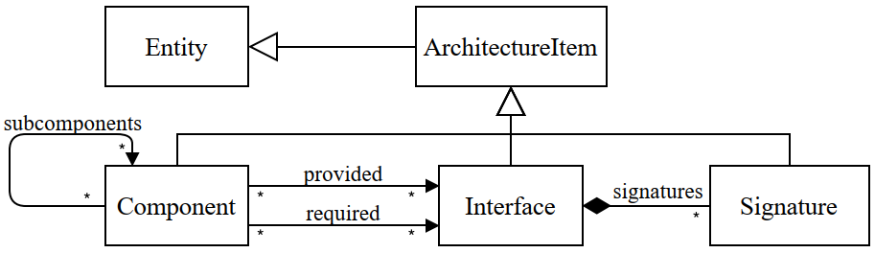
Appendix: Architecture Model

Slide 18
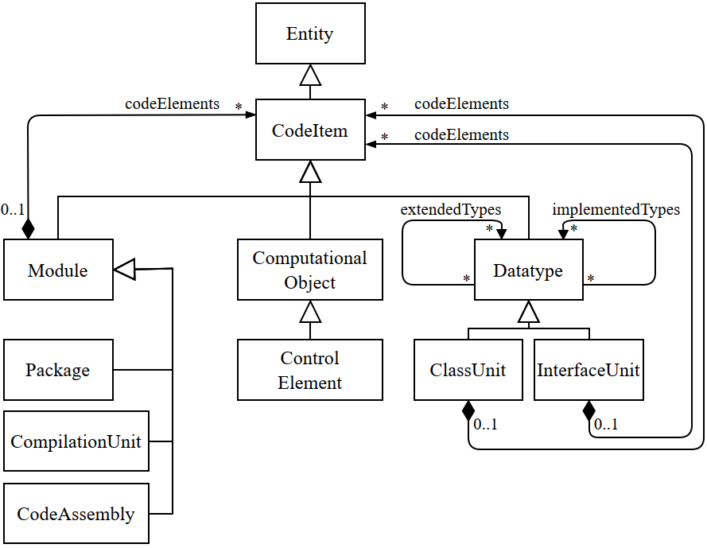
Appendix: Code Model

Slide 19
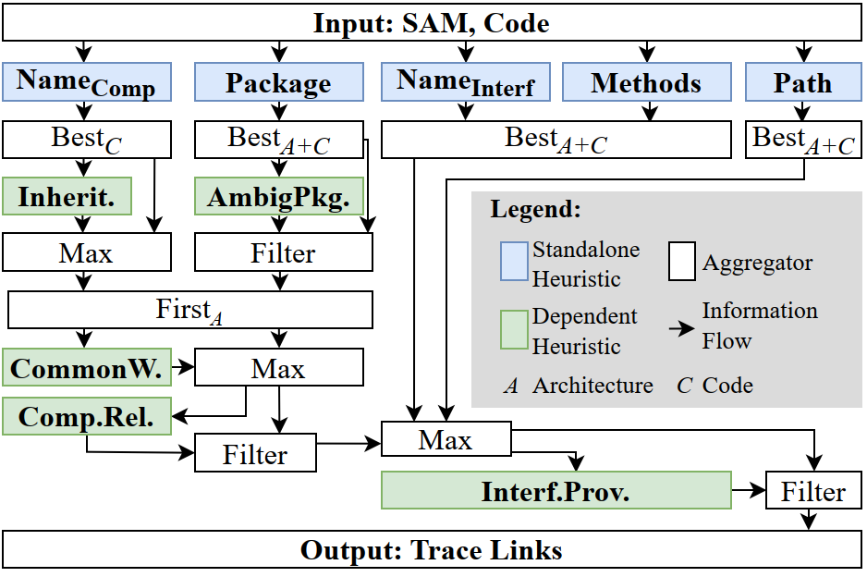
Appendix: Computational Graph
Notes:
Package Compares package name with name of components
Path Compares the path of a compilation unit with the names of components
Method Compares method names with names of signatures
Names Compares names of architecture elements with names of compilation units and datatypes
Hint Inheritance Inherits results from other heuristics (mappings) along extends- and implements-relations.
Common Words Checks if names differ only in common words or prefixes/suffixes (e.g., Test, Impl, I).
Amb. Sub-pkg. Detects ambiguously mapped sub-packages.
Component rel. Looks at relations between components to resolve ambiguity.
Interface prov. Checks if a provide-relation of the architecture exists in the source code.

Slide 20
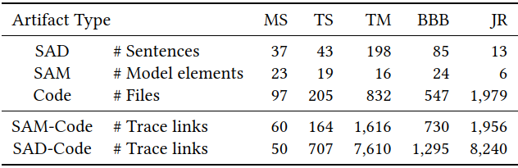
Appendix: Evaluation Data

Slide 21
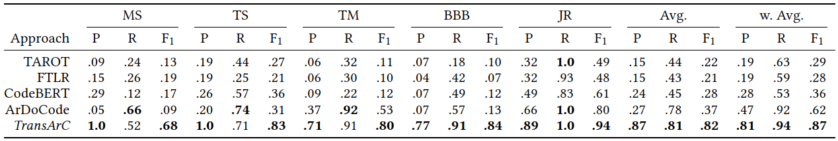
Appendix: Detailed Results TransArC

