Slide 1
DIVIdends Presents:
My Block
By:
Aaron McKoy
Frederick Articuno
Leticia
Ronald Gillison

Slide 2
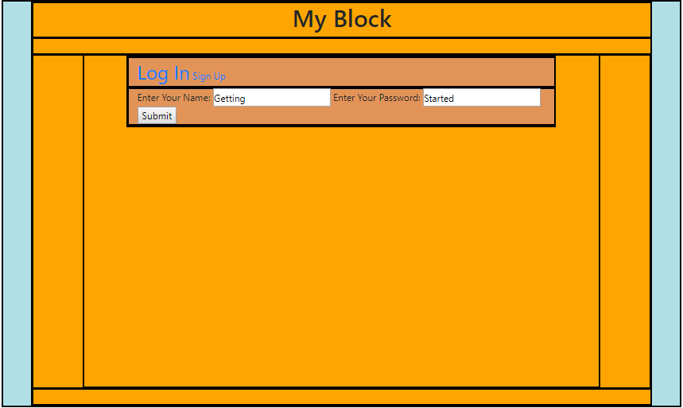
My Block: Logging In
Here you enter your username and password to get started.

Slide 3
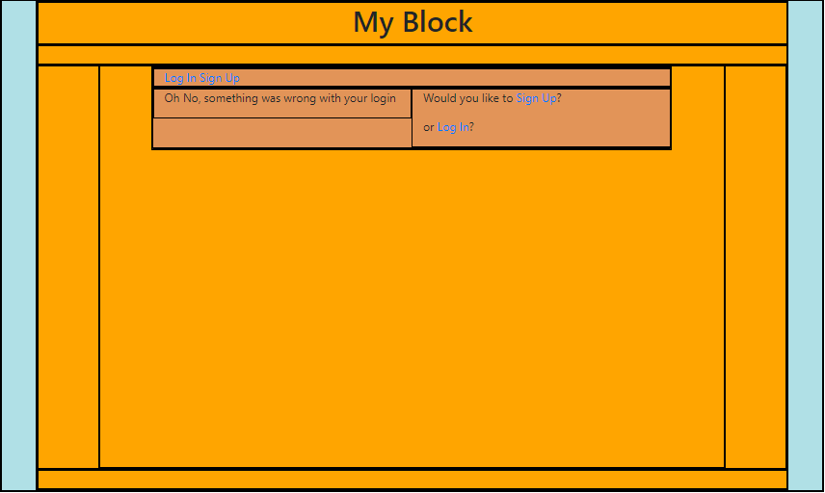
My Block: Signing Up
Oh, you don’t already have a valid username and password?
Well sign up!

Slide 4
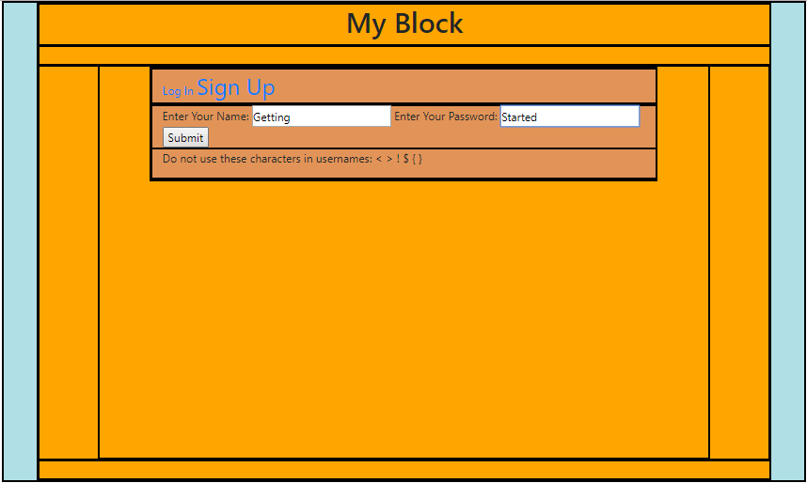
My Block: Swiper, No Swiping
During Signup, to prevent injection attacks, special characters like:
< > | $ [ ]
are prevented. Plus for security all usernames and passwords must be 6+ characters long.

Slide 5
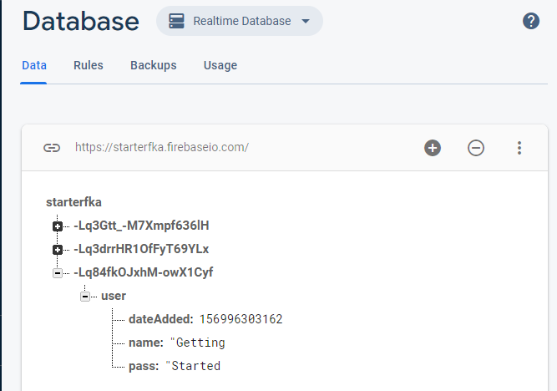
Login info is stored in my database for persistence and will help to build user suggestions in the future.
Please use your full name and SSN for maximum security.

Slide 6
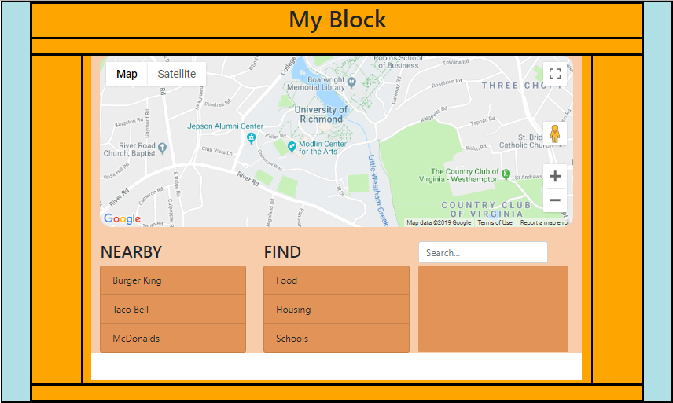
My Block: Your Map
You’ll land on this page, powered by:
GoogleMaps API
Yelp Fusion API
Attom API
CSS animations
Bootstrap
JQuery

Slide 7
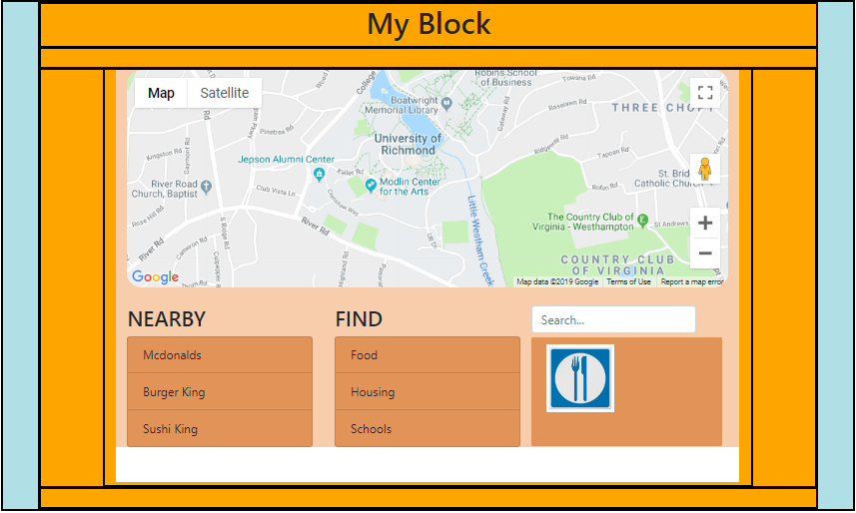
My Block: Make A Selection
Click:
Food | Housing | Schools
To find ‘nearby’ places like McDonalds.

Slide 8
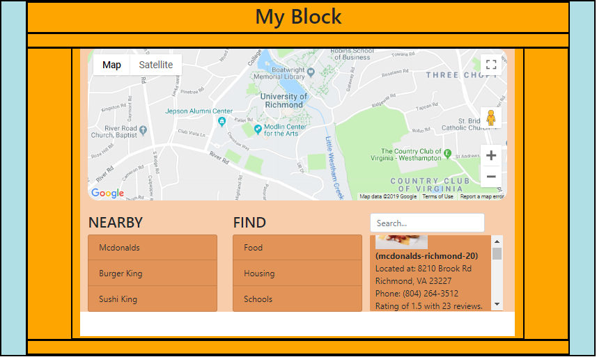
My Block: Quick Info
The far right area will show all kinds of information powered by Yelp fusion like
Location
Phone #
Rating
Lat-Lng

Slide 9
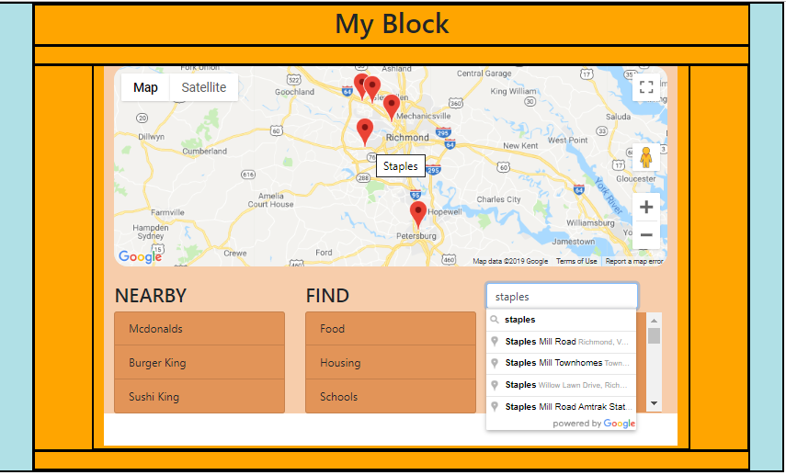
My Block: Specific Selection
Are you looking for something a little more specific?
Just type in your query and let google do the work for you!

Slide 10
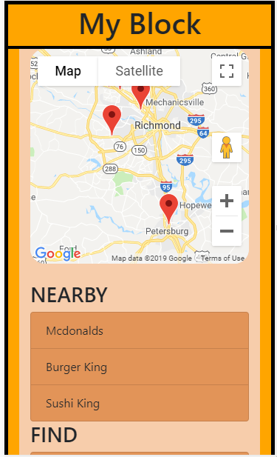
My Block: Mobile
Are you on a mobile device?
My Block is loaded with size responsive code to make the mobile experience just as responsive and immersive as a desktop experience.

Slide 11
My Block: Questions?
My Block
By:
Aaron McKoy
Frederick Articuno
Leticia
Ronald Gillison

