Slide 1

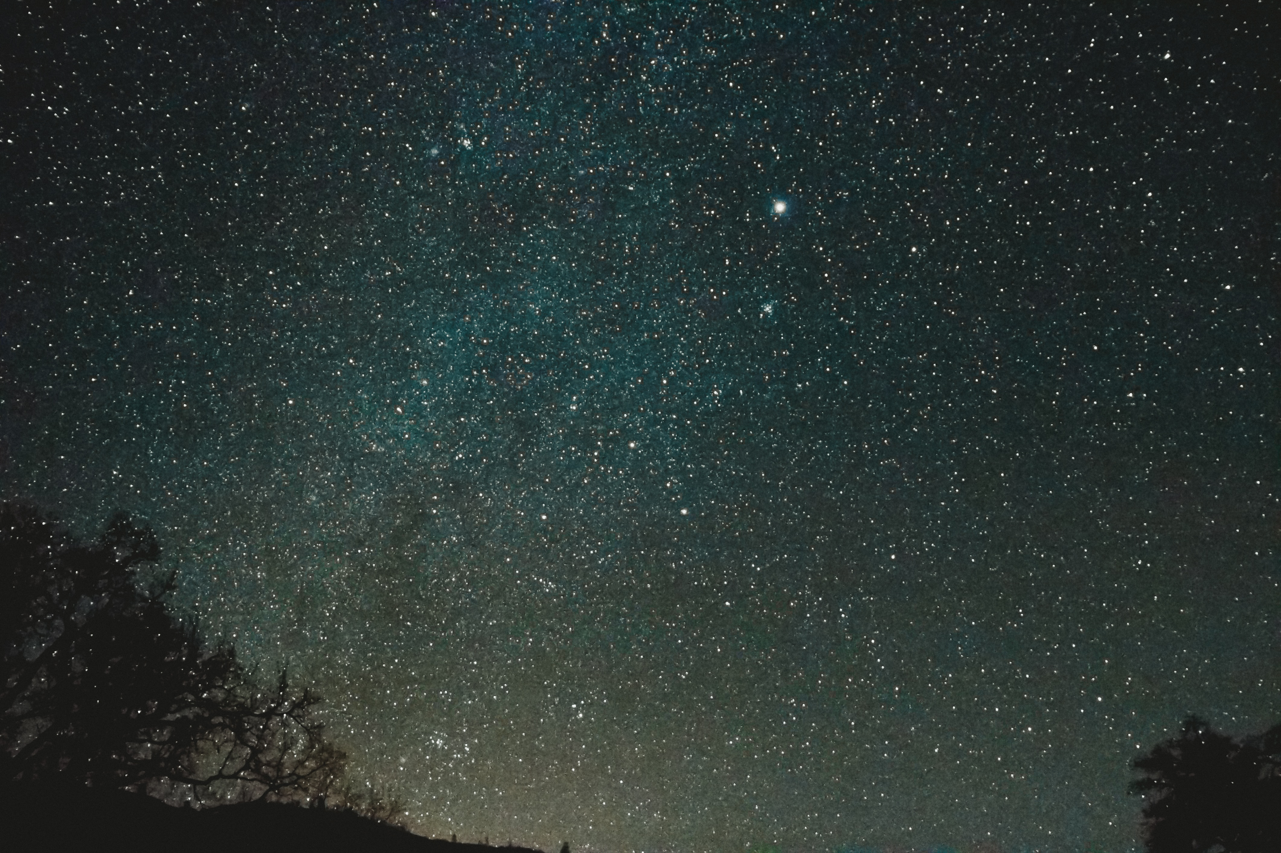

Slide 3


DARK MODE

