Slide 1





Machine Learning
K-MEANS
ON WATER-TREATMENT
Created by:
Muhammad Rizky Aulia Gobel - 1304211002

Slide 2

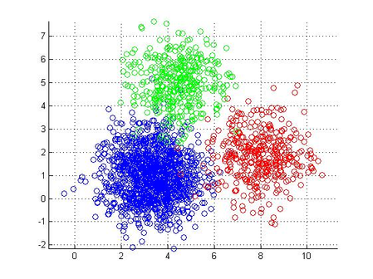
What is K-Means?
K-Means is an algorithm for dividing n observations into k groups in such a way that each observation is included in the group that has the closest mean (midpoint of the group). K-Means aims to minimize the objective function that has been determined in the clustering process. This goal is carried out by minimizing data variations in one cluster and maximizing data variations in other clusters.

Slide 3



Advantage and disadvantage
of K-means
Advantages:
-Easy to understand
-Generally used to group data of various shapes and sizes
-The learning process requires a relatively short time
Disadvantages:
-Overlapping
-Curse of Dimensionality
-Difficulty choosing the right number of clusters

Slide 4
Steps-by-steps

Slide 5
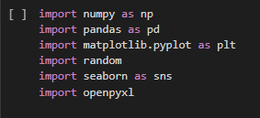
Step 1:Importing library
In this step, I will import a library that will be used for clustering later, I don't use a library like Sklearn KMeans because it conflicts with the specified work rules

Slide 6
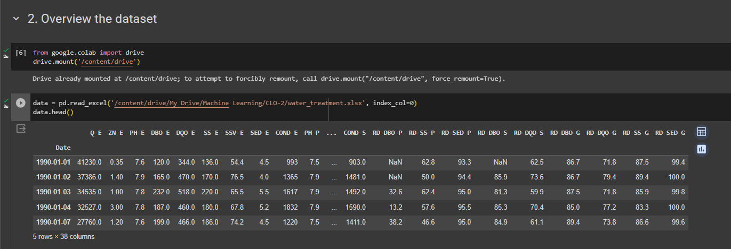
Step 2:Overview the dataset
Then, I will mount google drive, after that. I created a variable called data which will read the xlsx dataset stored on my drive, then data.head() will display the top 5 data

Slide 7
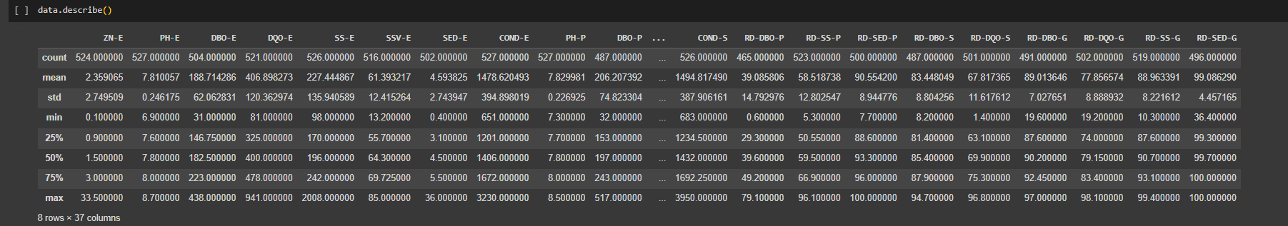
Lastly, I ran data.describe() to find out a complete description of the dataset, this will be the end of overviewing the dataset

Slide 8
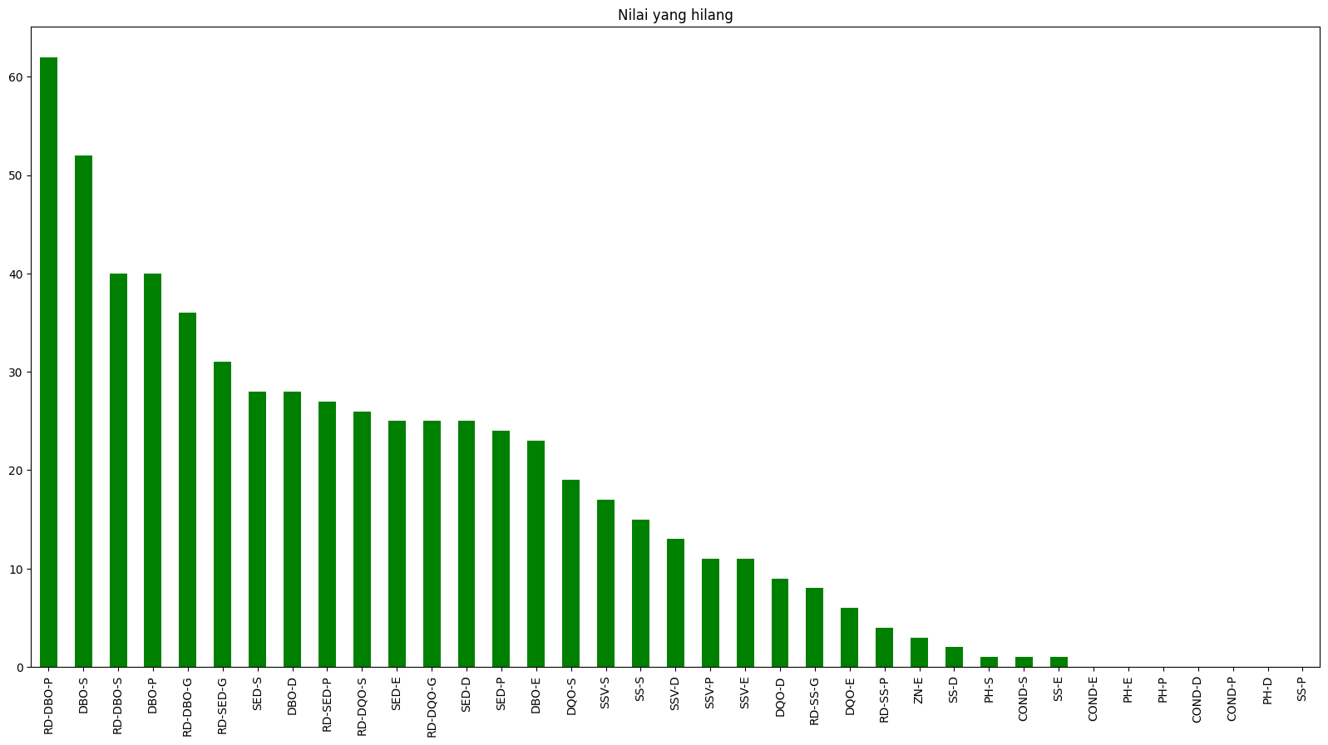
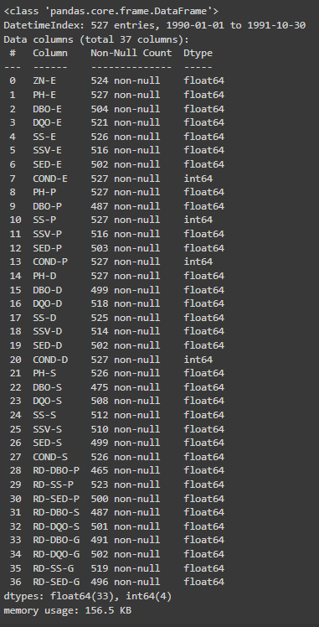
Step 3:Pre-processing
In this step, I want to normalize the data and fill in the empty values, before I import the dataset into colab, I’ve found that there are several rows that have question marks, this can cause inaccuracies and the k-means algorithm does not work properly

Slide 9
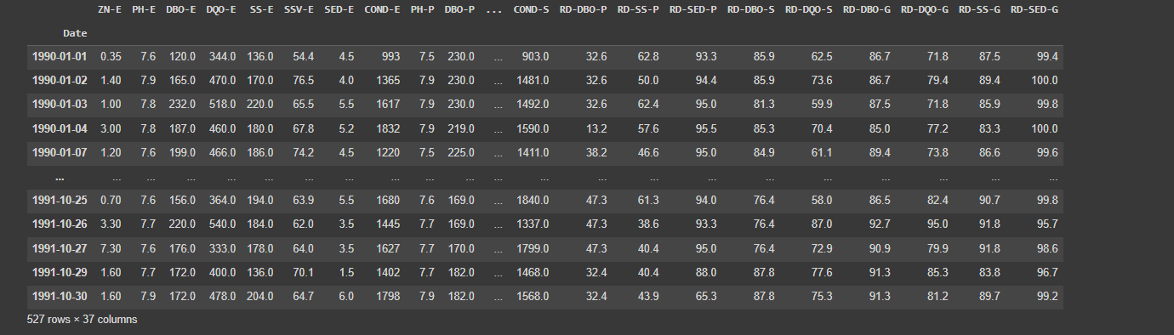
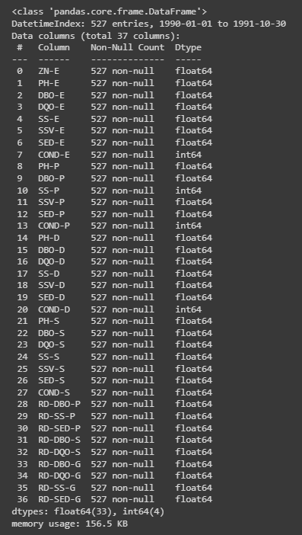
To fill the empty rows, I used bfill and ffill to fill in the blank values. bfill is used to fill empty data from top to bottom while ffill is used to fill empty data from bottom to top

Slide 10
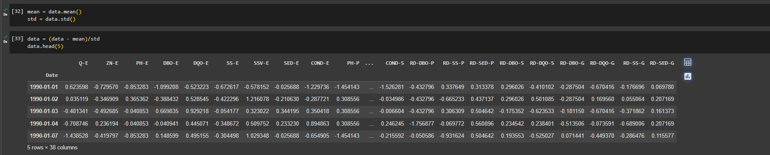
Then I will normalize the data using the z-score method, this normalization will make it easier for the k-means algorithm to learn patterns in the data

Slide 11
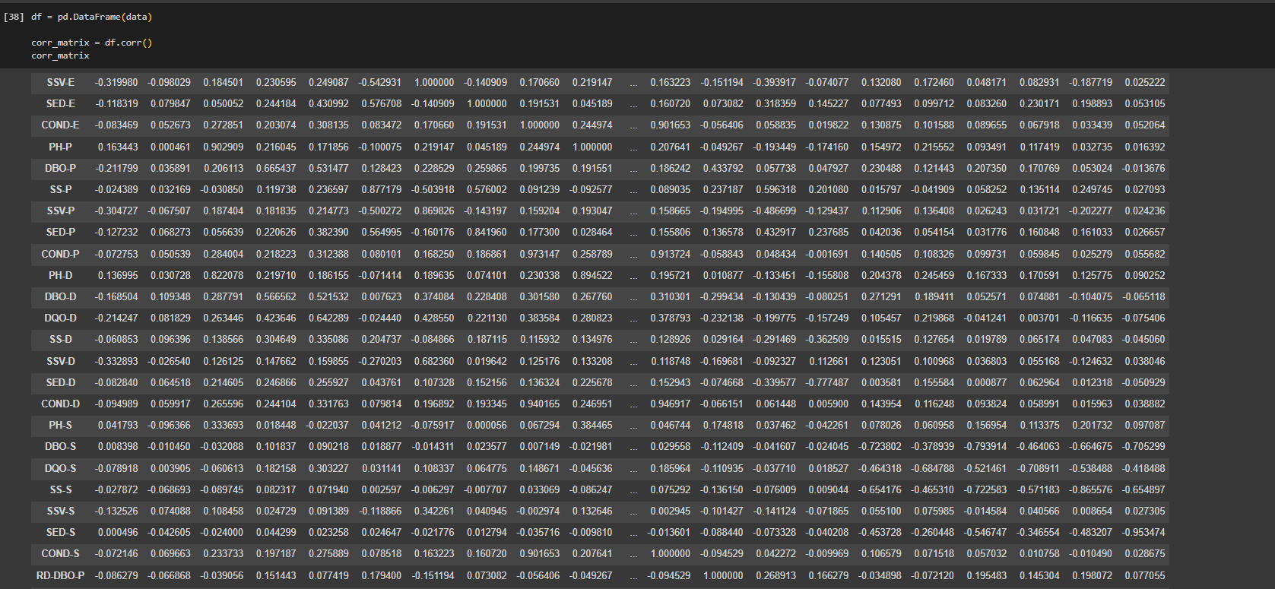
Before performing k-means clustering, i will create a correlation matrix, correlation matrix is table that summarizes the correlation coefficients between every pair of variables in a dataset. It is often used in data exploration and analysis to identify relationships between variables

Slide 12
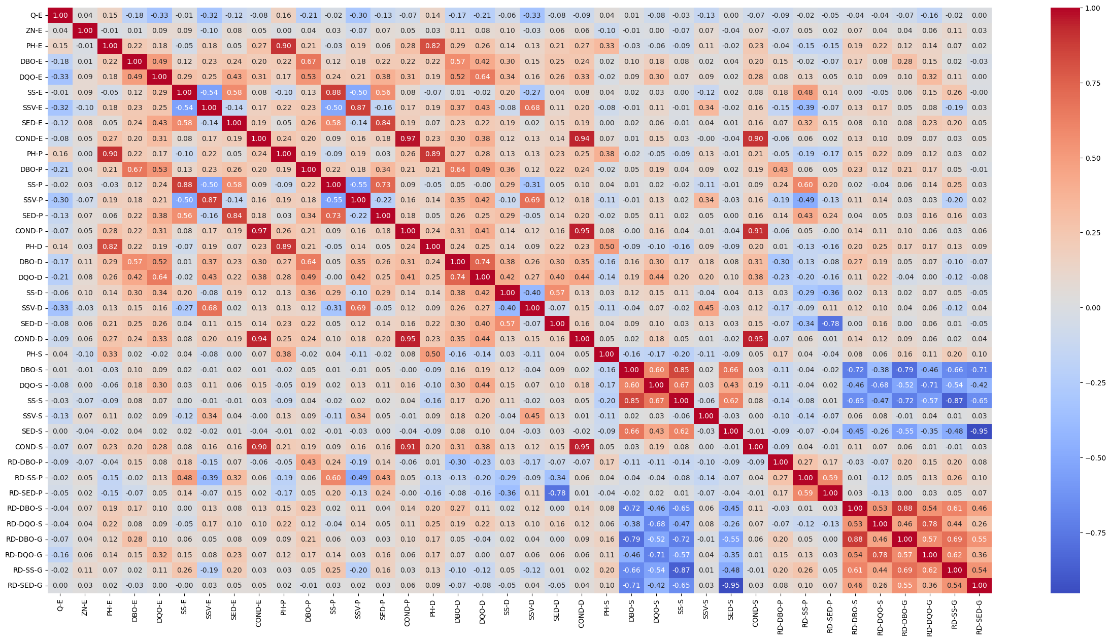
After correlation matrix is created, we can create a heatmap, heatmap used to visualize correlation matrices, which are tables that summarize the correlation coefficients between every pair of variables in a dataset. We can choose which cluster we want to use on k-means

Slide 13
The algorithm and results will be explained in Google Colab

Slide 14
That’s all from me, i’m sorry if there’s any mistake during my presentation
Thank You!

