Slide 1
CE377- AWT
Middleware in nodeJs

Slide 2
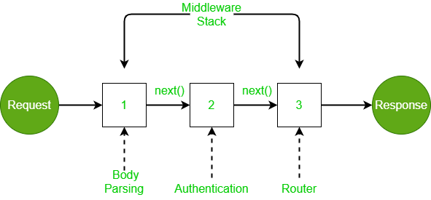
What is Middleware?
Middleware functions are attached to one or more route handlers in an Express application and execute in sequence from the time an HTTP request is received by the application till an HTTP response is sent back to the caller.
This capability is based on single responsibility principle(SRP).
https://reflectoring.io/single-responsibility-principle/

Slide 3
What is Middleware?
Middleware functions are functions that have access to the request object (req), the response object (res), and the next function in the application’s request-response cycle. The next function is a function in the Express router which, when invoked, executes the middleware succeeding the current middleware. ---- expressjs.com
Middleware functions can perform the following tasks:
Execute any code.
Make changes to the request and the response objects.
End the request-response cycle.
Call the next middleware in the stack.
If the current middleware function does not end the request-response cycle, it must call next() to pass control to the next middleware function. Otherwise, the request will be left hanging.

Slide 4
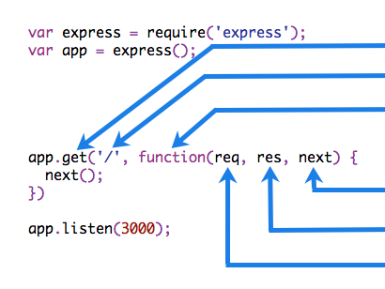
Middleware: Elements of a middleware function
HTTP method for which the middleware function applies.
Path (route) for which the middleware function applies.
The middleware function.
Callback argument to the middleware function, called "next" by convention.
HTTP response argument to the middleware function, called "res" by convention.
HTTP request argument to the middleware function, called "req" by convention.

Slide 5
Types of Middleware
Middleware functions in Express are of the following types:
Application-level middleware which runs for all routes in an app object
Router level middleware which runs for all routes in a router object
Built-in middleware provided by Express like express.static, express.json, express.urlencoded
Error handling middleware for handling errors
Third-party middleware maintained by the community

Slide 6
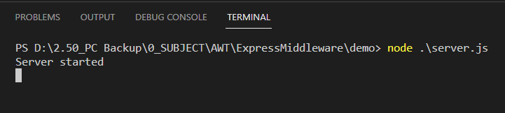
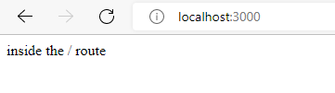
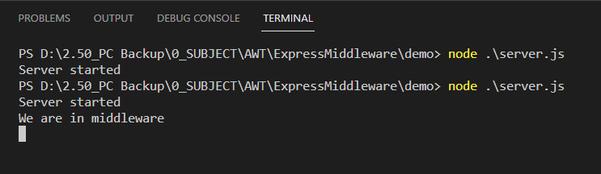
Middleware: Example
const express = require('express');
const app = express();
const middlewareFunction = function (req, res, next) {
console.log('We are in middleware');
next();
};
app.use(middlewareFunction);
app.get('/', (req, res) => {
res.send('inside the / route');
});
app.listen(3000, () => {
console.log('Server started');
});

Slide 7
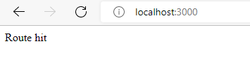
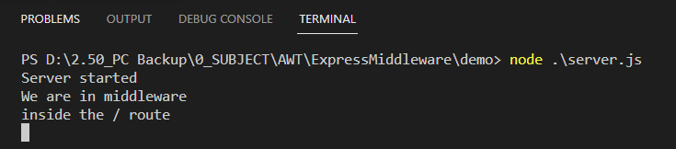

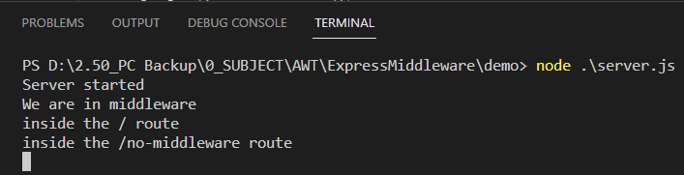
Middleware: Example
const express = require('express');
const app = express();
const middlewareFunction = function (req, res, next) {
console.log('We are in middleware');
next();
};
// remove app.use(middlewareFunction);
app.get('/', middlewareFunction, (req, res) => {
console.log('inside the / route');
res.send('Route hit');
});
app.get('/no-middleware', (req, res) => {
console.log('inside the /no-middleware route');
res.send('<b>No middle ware Route hit</b>');
});
app.listen(3000, () => {
console.log('Server started');
});

Slide 8
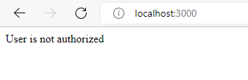
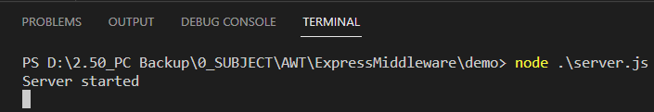

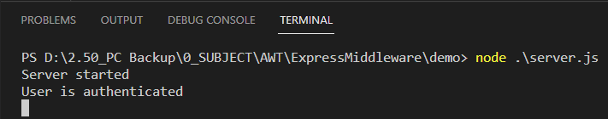
Middleware: Example
const express = require('express');
const app = express();
const authmiddlewareFunction = function (req, res, next) {
const random = (min, max) =>
Math.floor(Math.random() * (max - min)) + min;
const isAuthenticated = random(0, 2);
if (isAuthenticated)
next();
else res.send('User is not authorized');
};
app.get('/', authmiddlewareFunction, (req, res) => {
console.log('User is authenticated');
res.send('<b>Welcome User</b>');
});
app.get('/no-middleware', (req, res) => {
console.log('inside the /no-middleware route');
res.send('<b>No middle ware Route hit</b>');
});
app.listen(3000, () => {
console.log('Server started');
});

