Slide 1
Overview of Microarray Data
Visualization Programs
Jeff Landgraf
Arabidopsis Functional Genomics Consortium
MSU-DOE Plant Research Laboratory
Michigan State University

Slide 2
Software packages for data visualization
Cluster/Treeview- Mike Eisen
GeneSpring- Silicon Genetics
GeneSight- Biodiscovery
Spotfire- Spotfire
Resolver- Rosetta Inpharmatics
Lucidea- Amersham/Pharmacia Biotech
Many others…

Slide 3
General Functions
Data normalization
Various graphing/filtering capabilities
Clustering
  Hierarchical
  SOMs
  K-Means
  Principal component analysis

Slide 4
Genome Formats- GeneSpring
“name list”
  single column list of gene names
“name function”
  gene name + function
“mapped”
  systematic name, common name, map position, EC number, description, product, phenotype, function, keywords, GenBank locus, synonym, sequence, custom

Slide 5
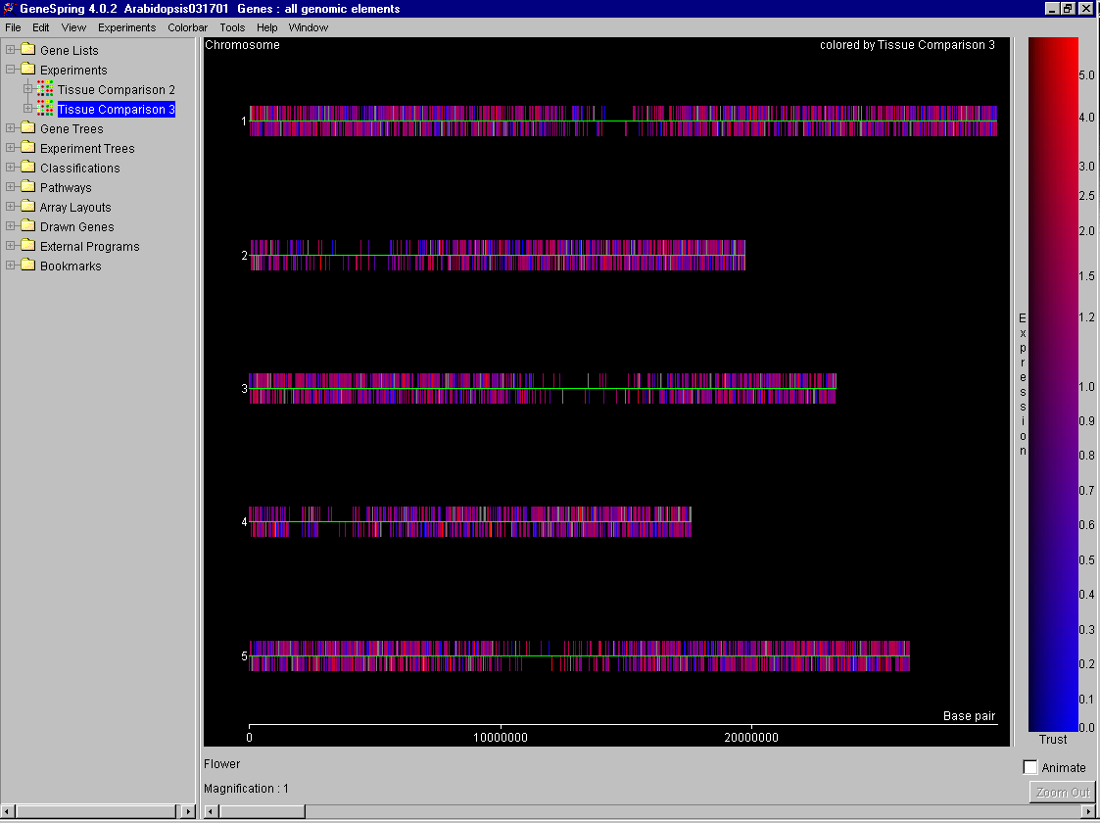

Slide 6
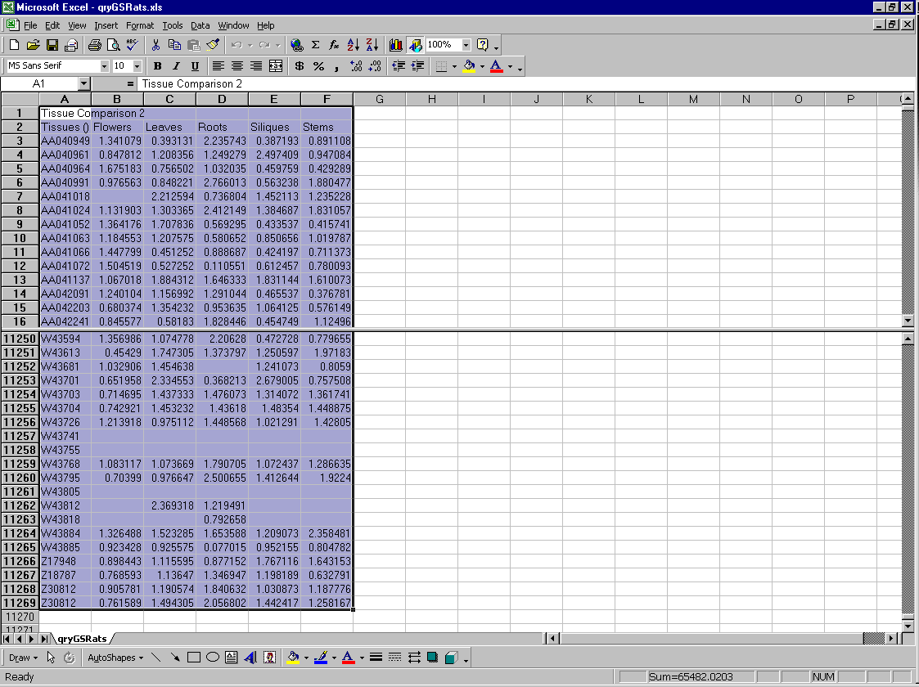

Slide 7
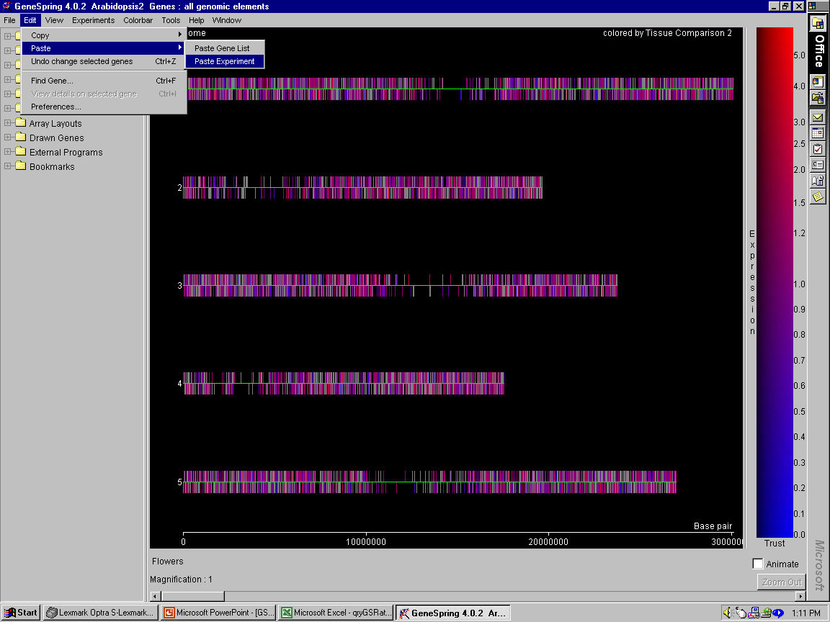

Slide 8
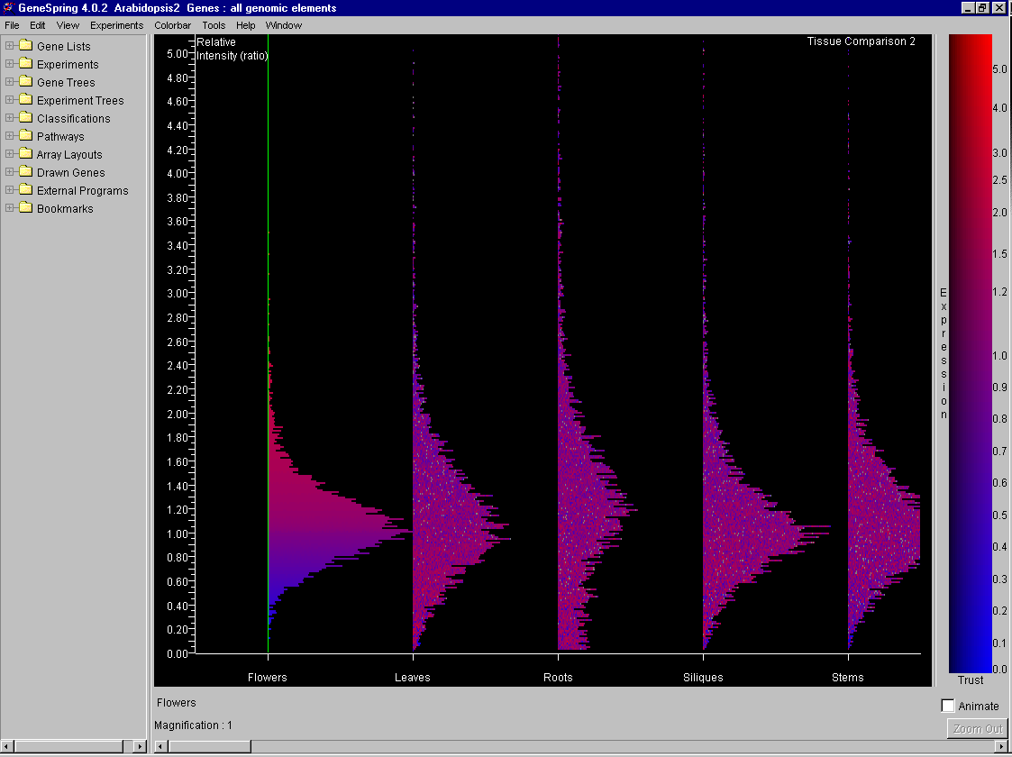

Slide 9
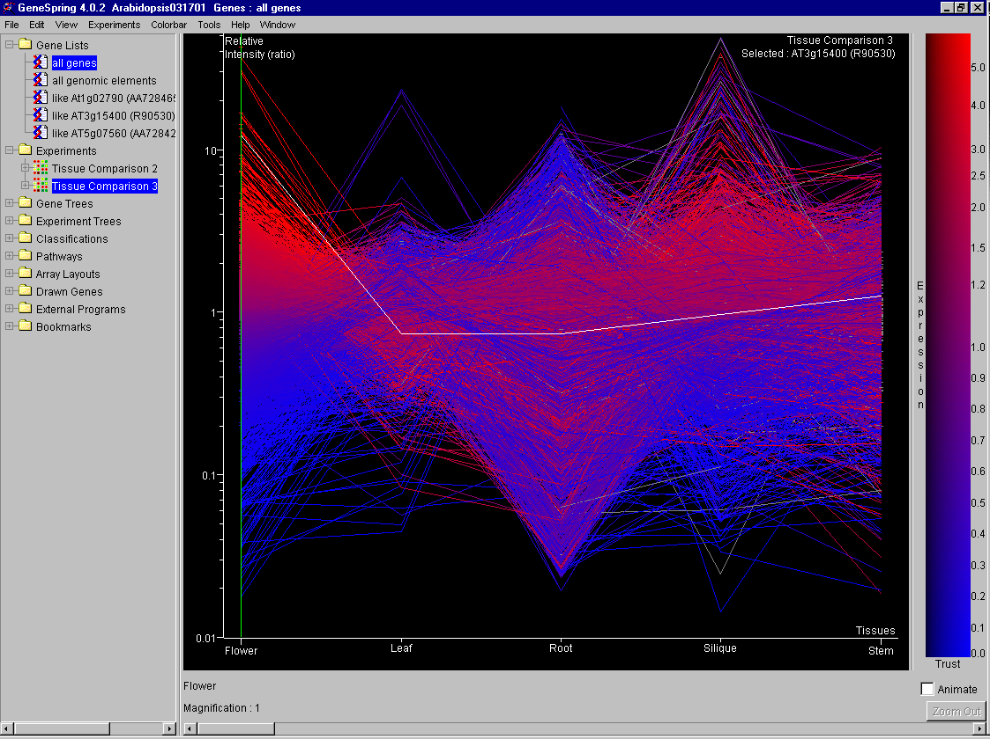

Slide 10
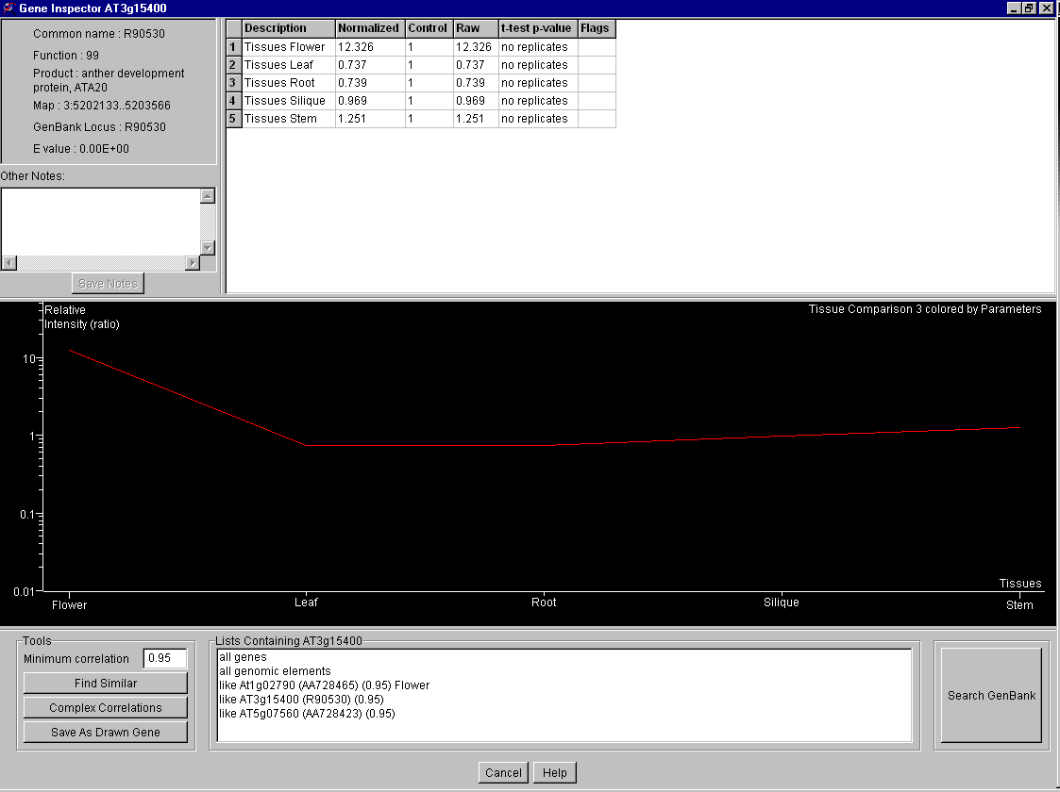

Slide 11
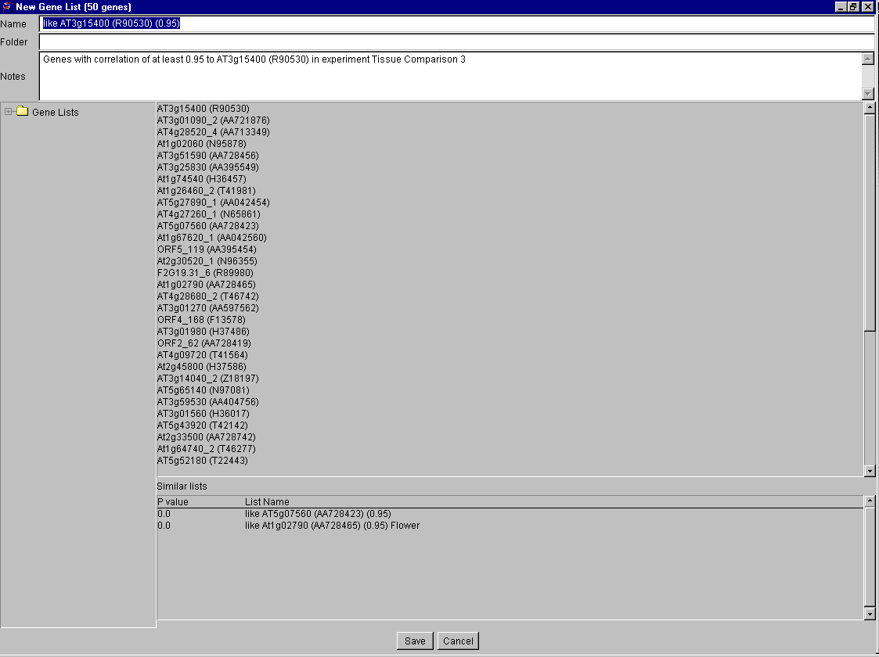

Slide 12
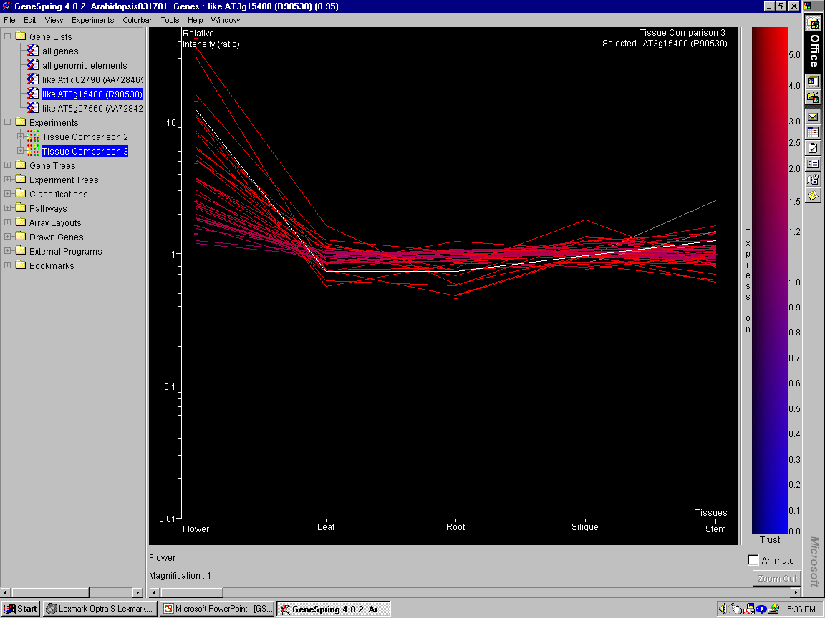

Slide 13
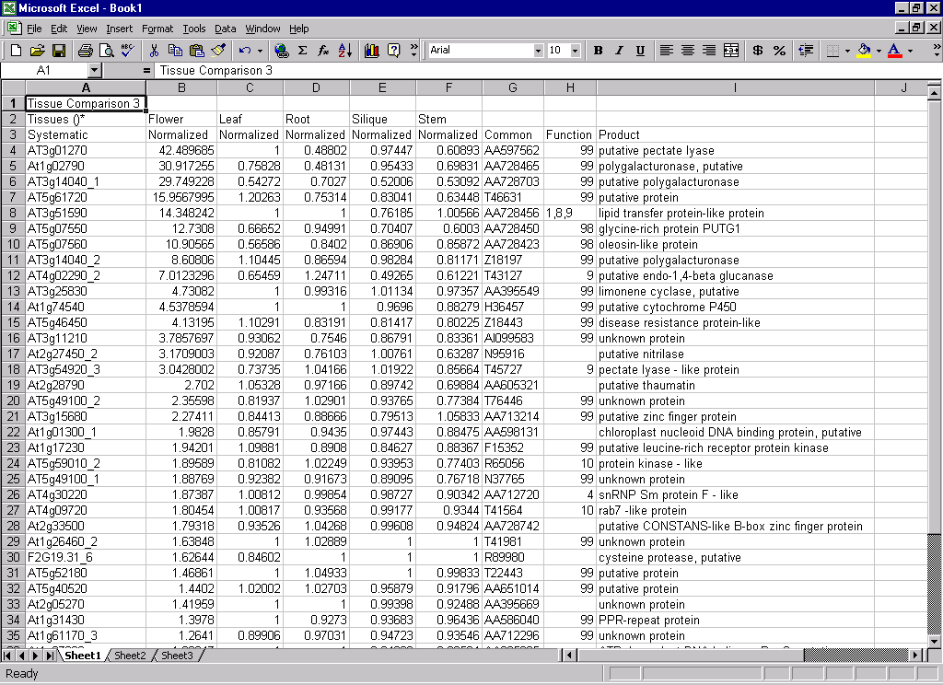

Slide 14
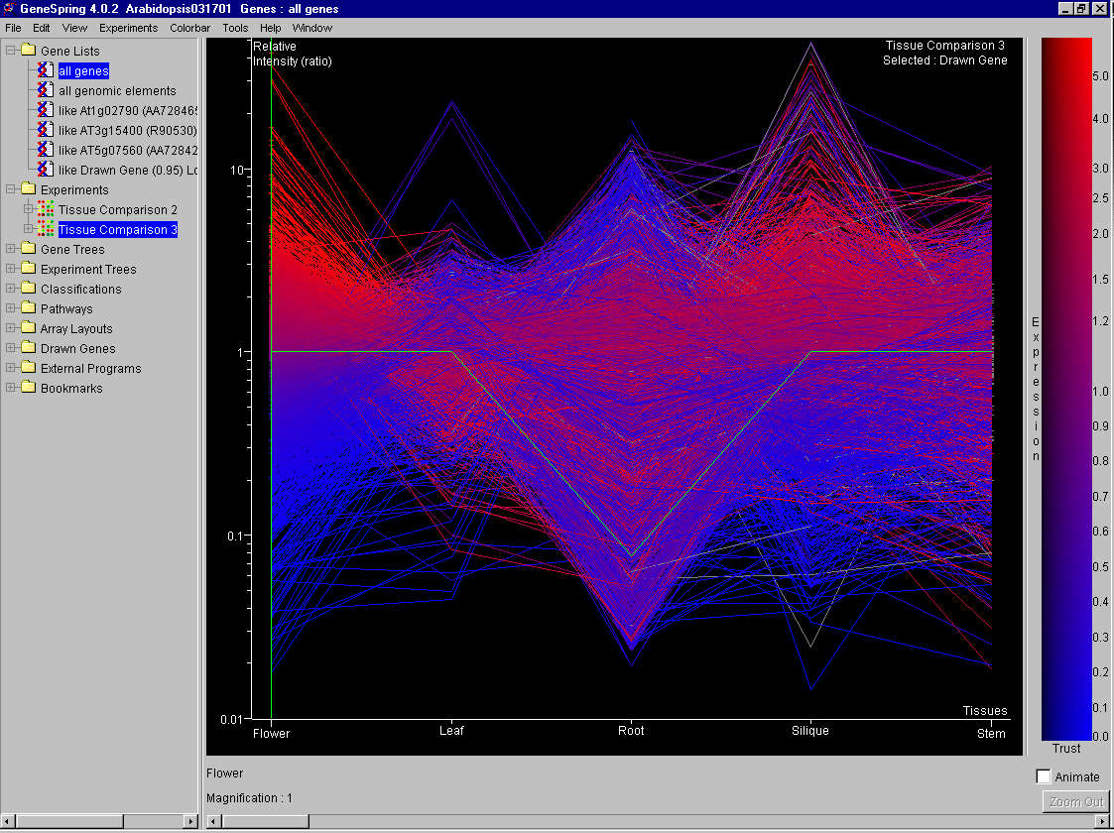

Slide 15
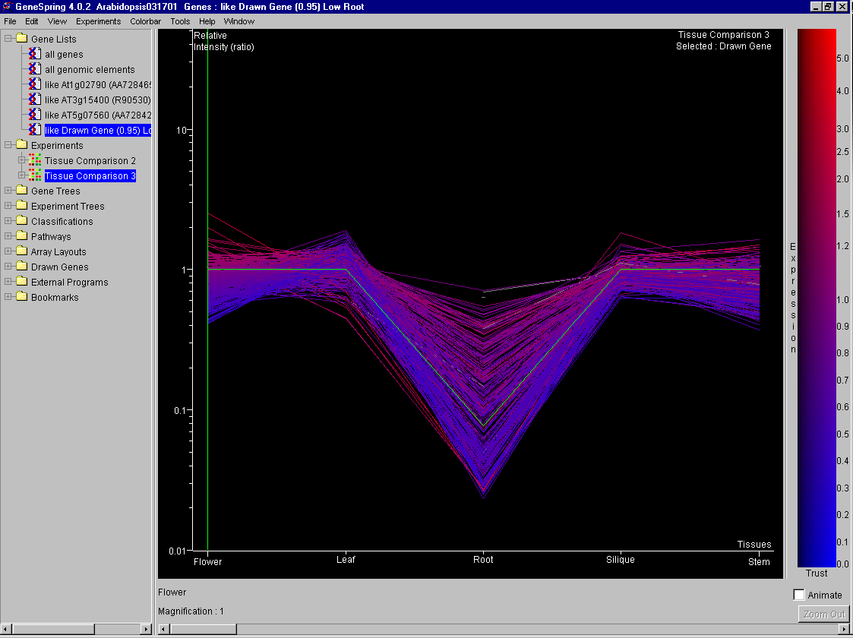

Slide 16
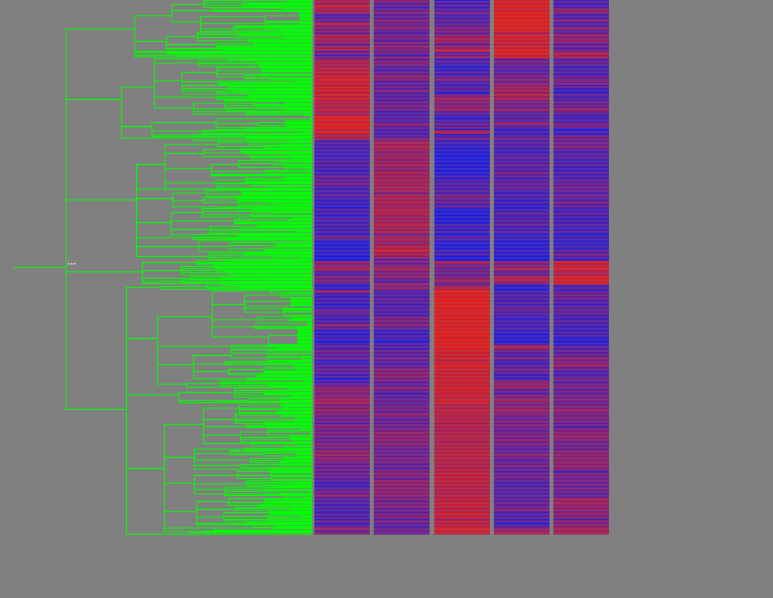
Tissue Specific Cluster
F/C L/C R/C Si/C St/C

Slide 17
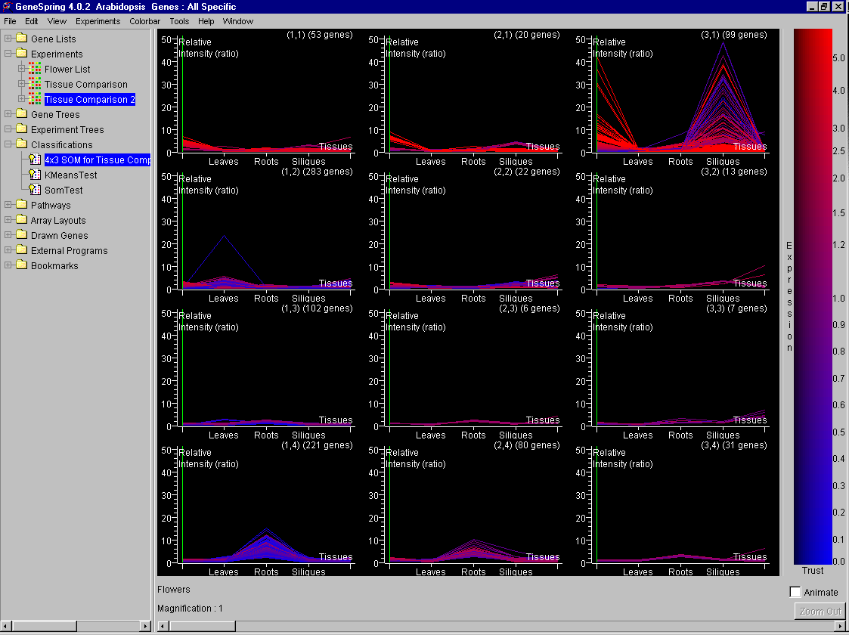

Slide 18
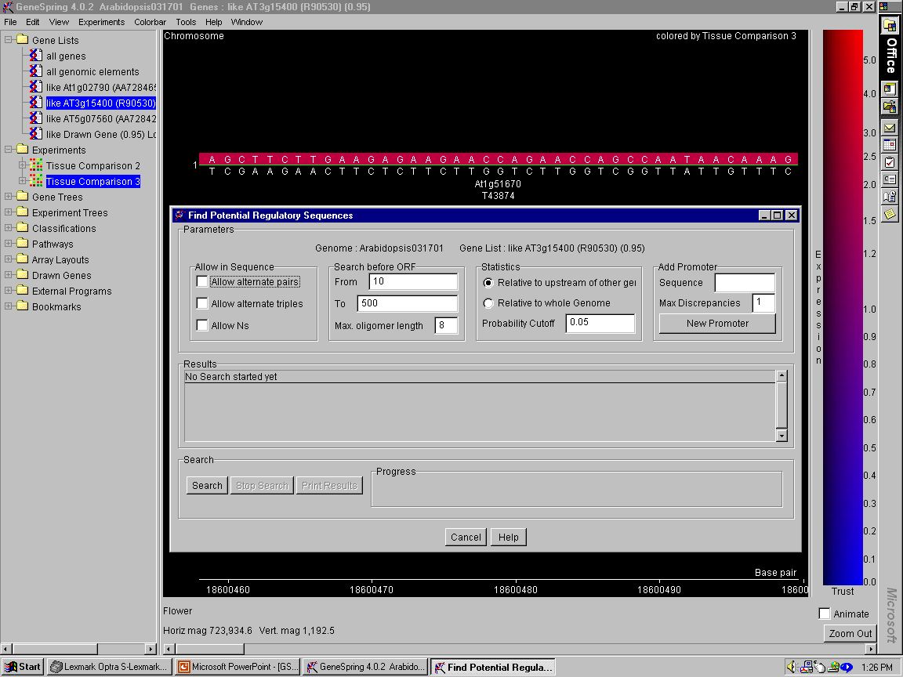

Slide 19
Acknowledgements
MSU-Microarray Lab
Ellen Wisman
Robert Schaffer
Monica Accerbi
Verna Simon
Scott Lewis
Kim Trouten
David Green
Pieter Steenhuis
Green Lab
Pam Green
Rodrigo Gutierrez

