Slide 1
New normalisation methods for microarrays
Robert Schaffer
MSU-DOE Plant Research Laboratory
Michigan State University
E-mail Schaff21@msu.edu
Notes:
New method. Some people use it some disagree
We have only been using it for 3 months, and it was developed by a couple of different groups, so I am certainly not an expert

Slide 2
Why normalise?
During probe preparations technical variations can be generated including:
    Dye properties
    Differences in dye incorporation
    Differences in scanning

Slide 3
Normalisation methods
Most global normalisation methods assume the two dyes are related by a constant factor
R=k*G
Or in log space
log₂ R/G – c
c=log₂ k

Slide 4
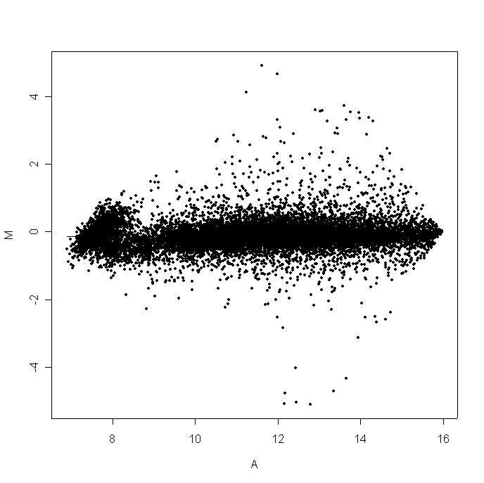
Expected distribution of ratios
Slide A
log (Ratio)
log (Average intensity)

Slide 5
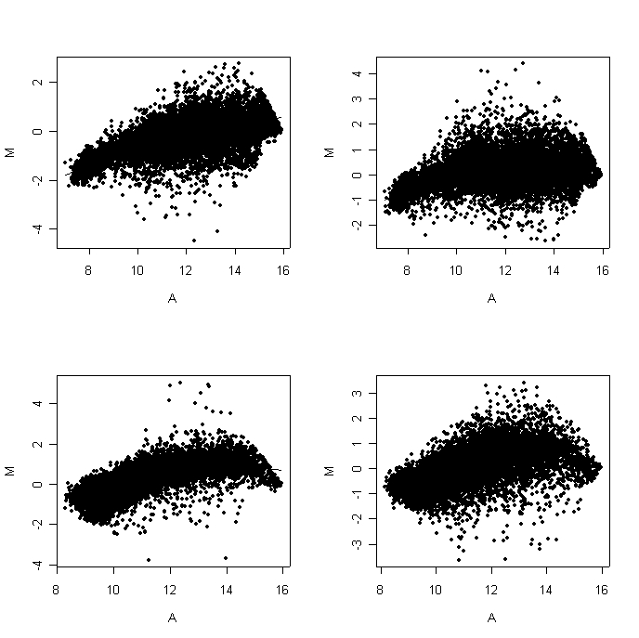
Some slides show an intensity bias
Slide B
Slide C
Slide D
Slide E

Slide 6
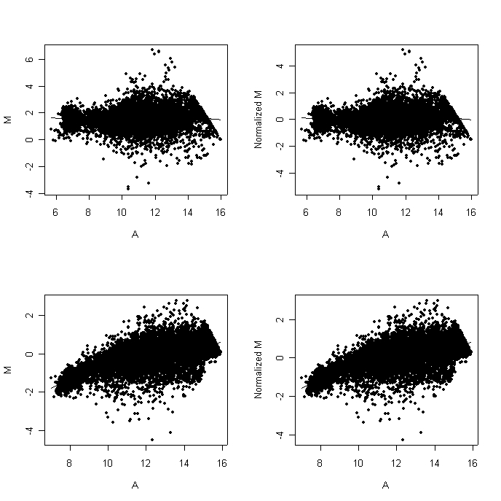
Traditional normalisation methods
Slide F no norm
Slide F log norm
Slide B no norm
Slide B log norm

Slide 7
Intensity dependent normalisation
Premis that the majority of spots at any intensity will have a ratio of 1
Calculate a intensity dependent constant to reduce intensity dependent bias
log₂ R/G-c(A)
R statistical software package has a lowess function which performs local linear fits (Speed’s group)
Non linear method as an Excel macro (Bumgarner’s group)
Notes:
Roger Bumgarners method uses a floating mean

Slide 8
Terry Speed’s group
UC berkeley/WEHI
Web site:
http://www.stat.berkeley.edu/users/terry/zarray/Html/index.html

Slide 9
“R”
Freeware
Statistical software package
http://www.r-project.org/
Need to add a library module
http://www.stat.berkeley.edu/users/terry/zarray/Software/smacode.html
Quick and easy way to normalise data

Slide 10
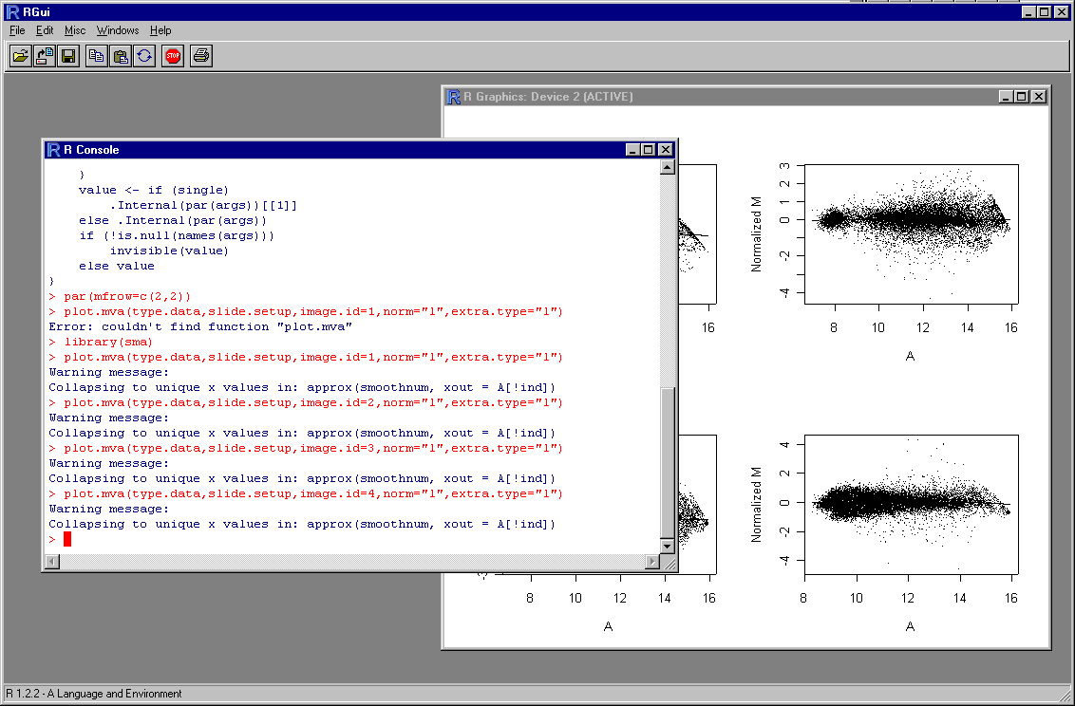
R Gui interface

Slide 11
statistical microarray analysis (sma) module
sma will normalise, compare slides, and do statistical tests on data
Allows simultaneous multiple slide analysis
To process the data
  load experiments into R
  describe slide printing configuration
  load experiments into a working data set
  Analyse data

Slide 12
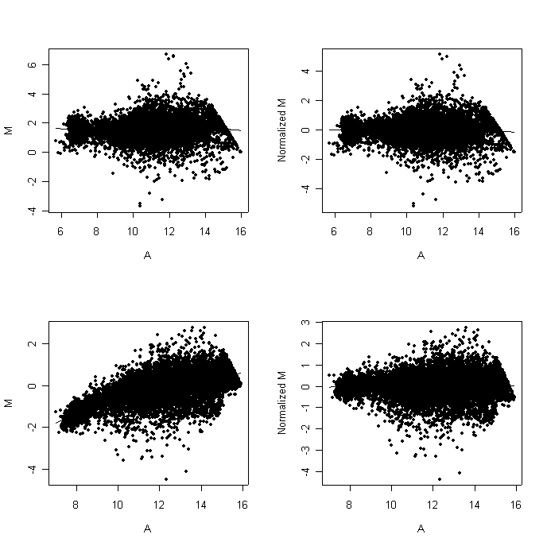
Normalisation by lowess function
Slide F no norm
Slide F Lowess norm
Slide B no norm
Slide B Lowess norm
Notes:
Log normalisation compresses the ratios compared to lowess normalisation

Slide 13
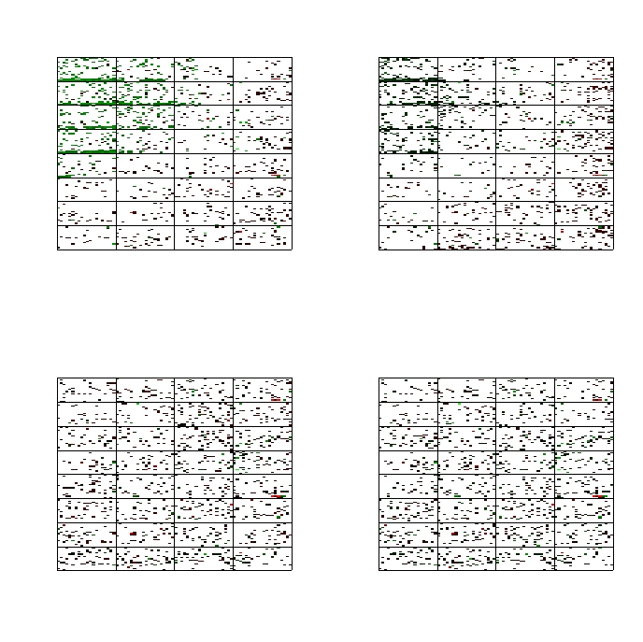
Local lowess normalisation removes gradient effects
Slide D
Global
lowess normalisation
No normalisation
Gradient on the array
Lowess normalisation
by pin
Lowess normalisation
by scale

Slide 14
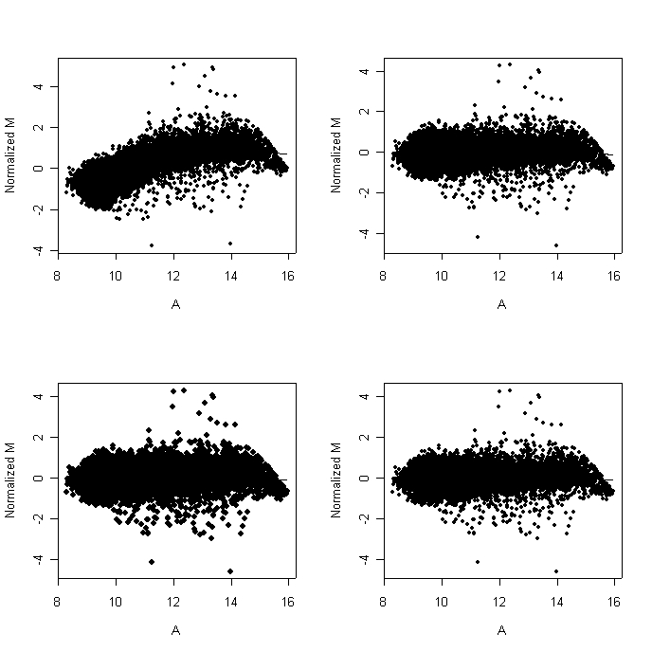
M vs A plots do not show gradients
Slide D
Global
lowess normalisation
No normalisation
Lowess normalisation
by pin
Lowess normalisation
by scale

Slide 15
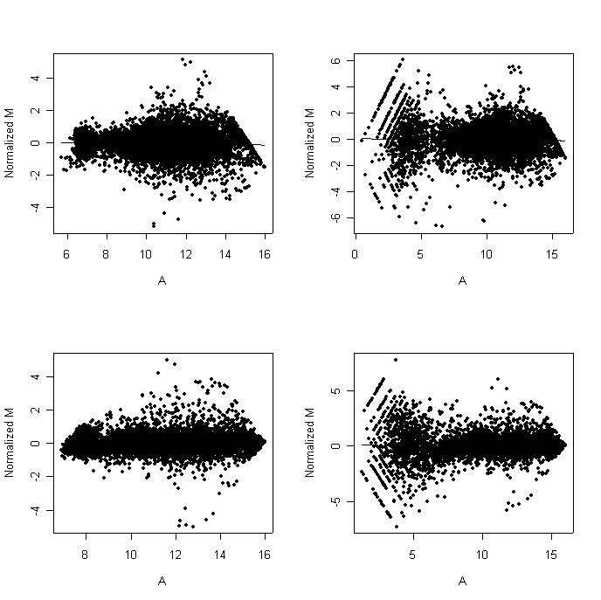
background subtraction
Slide F with NO
background subtracted
Slide F with
background subtracted
Slide A with NO
background subtracted
Slide A with
background subtracted
Notes:
Low intensity clones removed

Slide 16
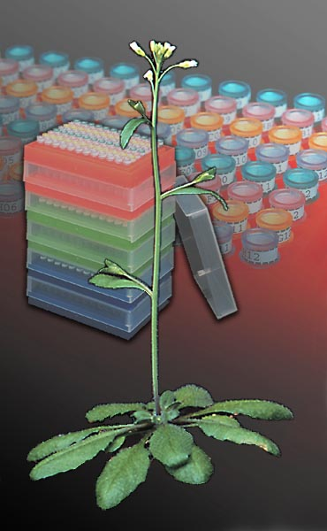
Acknowledgements
MSU Microarray group
Ellen Wisman
Robert Schaffer
Jeff Landgraf
Verna Simon
Monica Accerbi
Scott Lewis
Kim Trouten
David Green
Pieter Steenhuis
Arabidopsis Functional Genomics Consortium
Funded by NSF

