Slide 1
2-color DNA Microarrays:
Normalization and Systematic Bias
Presenter: David Finkelstein

Slide 2
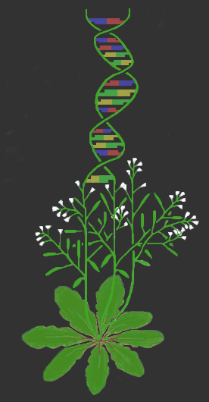
Arabidopsis Functional Genomics Consortium
Multi-site service grant
Michigan State University
Yale University
University of Wisconsin
Carnegie Institution at Stanford University
Focus: Microarrays
Gene Knockouts
AFGC

Slide 3
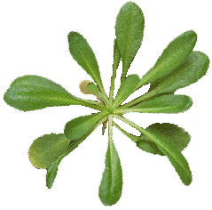
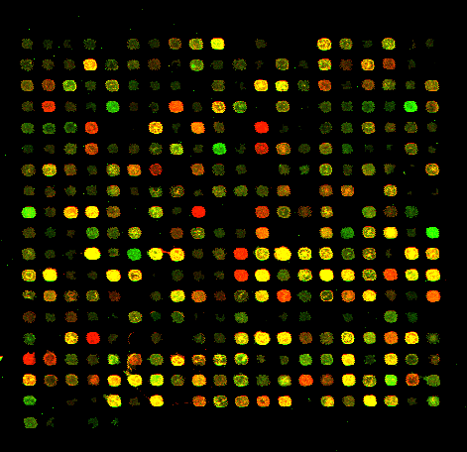
2-color DNA microarray
AFGC
Normalization
Treated Control
Data extraction
Scanning
mRNA mRNA
Simultaneous
hybridization
Cy5 Probe Cy3 Probe

Slide 4
Normalization
What is normalization?
correction for systematic technical measurement errors
Causes of error include:
dye chemistry
hybridization and washing
scanner settings
data extraction
AFGC

Slide 5
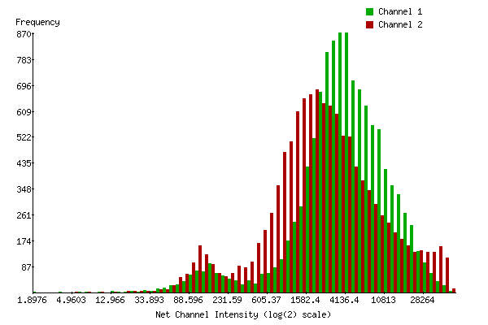
Before Normalization
AFGC

Slide 6
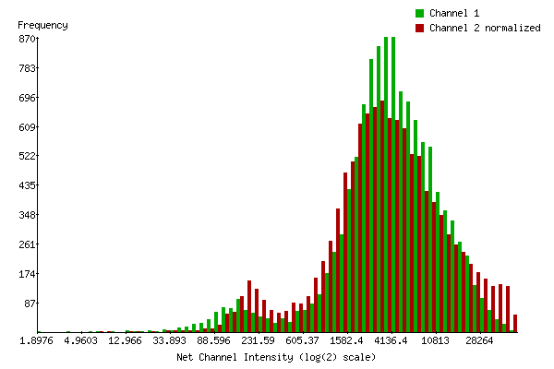
After Normalization
AFGC

Slide 7
Complex normalization Methods
AFGC
Multivariate: categorical analysis
(Finkelstein et al, in prep)
Singular value decomposition:
data driven, linear combination
(Alter et. al, 2000)
Permutation methods:
nonparametric confidence
(Goss et. al, to appear)

Slide 8

Normalization methods
AFGC
Mean correction:
assumes ratio of 1 is average
Housekeeping genes
Student’s T or Z normalization:
adjusts in proportion to standard error
Linear model:
slope and intercept
Fitted Methods:
nonlinear function

Slide 9
Iterative Linear Method
1. Log transform Cy3 and Cy5
2. Linear regression
log(Cy3) = log(Cy5)*m + b
3. Find residuals
(expected - observed)
4. Remove outliers
5. Repeat steps 1-3
(stop when fit stabilizes)
6. Normalize
apply normalization function
re-scale data
create logratios
AFGC

Slide 10
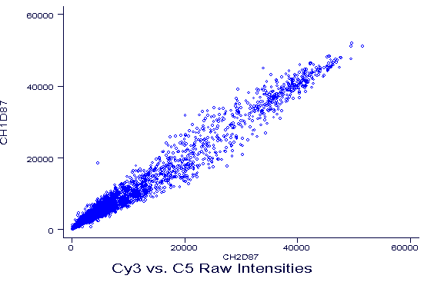
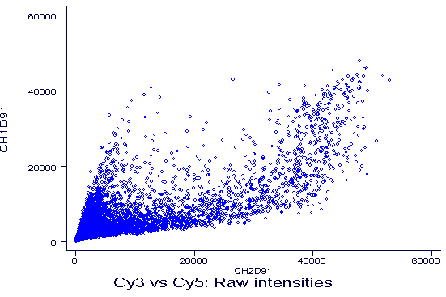
Biological Replicates
AFGC
Cy3 vs. Cy5
Cartesian scale

Slide 11
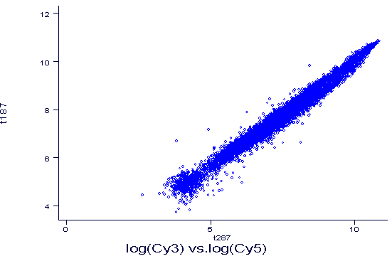
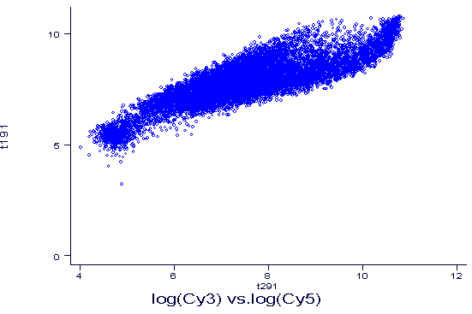
Biological Replicates
Cause of difference: spatial bias
AFGC
logCy3 vs. logCy5
log scale

Slide 12
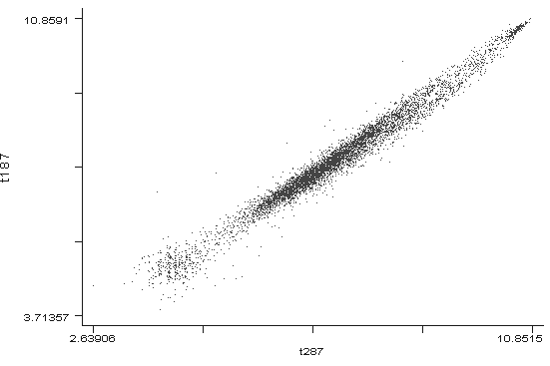
Abundance Pattern
AFGC
logCy3 vs. logCy5

Slide 13
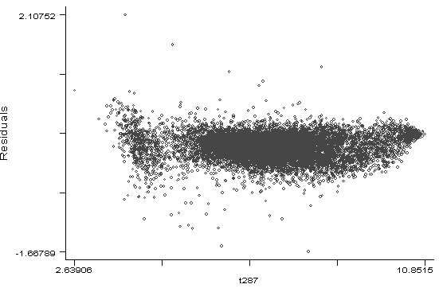
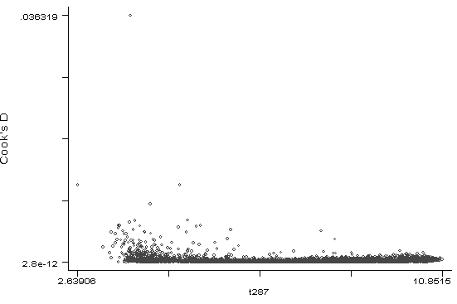
Outlier Detection
AFGC
Residuals Cooks D
Outlier identification method
effects normalization

Slide 14
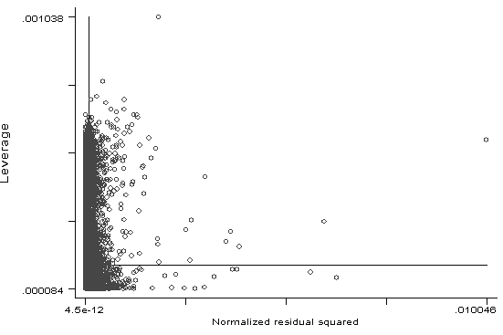
Different methods find different outliers
AFGC
Leverage Cooks D
Residuals squared

Slide 15
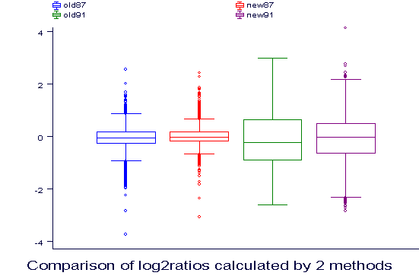
Distribution of log₂ratios
AFGC
Note reduced quartile range

Slide 16
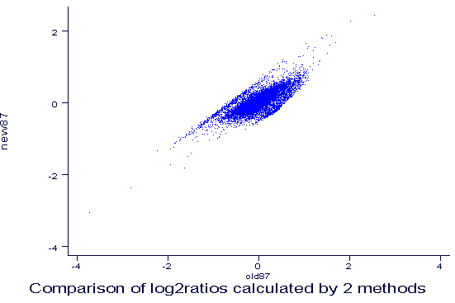
Differences in log₂ratios
AFGC
Iterative logratios
Mean corrected logratios

Slide 17
Assumptions of Linear model
AFGC
Ratio of typical spot = 1
y = m X +b
where m = 1 and b = 0
Differential expression is independent
of abundance
Range of abundance begins at 0
Assumes differential genes are outliers

Slide 18
Limits of Linear Model
AFGC
Lack-of-Fit test Nonlinear Model:
y = B₀ + B₁x + B₂x² +B₃ x³ +B₄x⁴ …..
where x = signal intensity
Systematic model: continuous variables
y = B₀ + B₁x + B₂x² +B₃ x³ +B₄x⁴ + B₅row + B₆column + B₇Conc_{DNA} + B₈Temp_{melting}

Slide 19
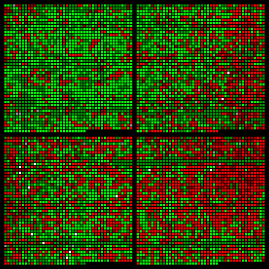
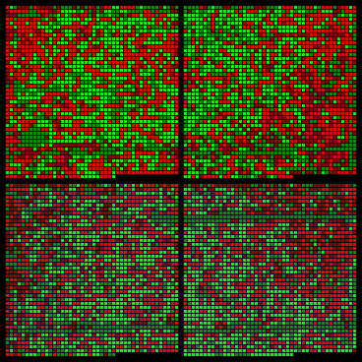
Spatial Bias
(Spellman et. al, 1998)
SMD Iterative
AFGC
Bias detected by ANOVA (ratio = sector) or Kruskal-Wallis test

Slide 20
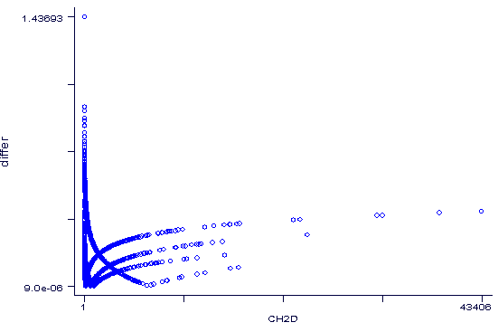
Difference in logratio due to methods
AFGC
Difference
Intensity
Each line represents a distinct sector

Slide 21
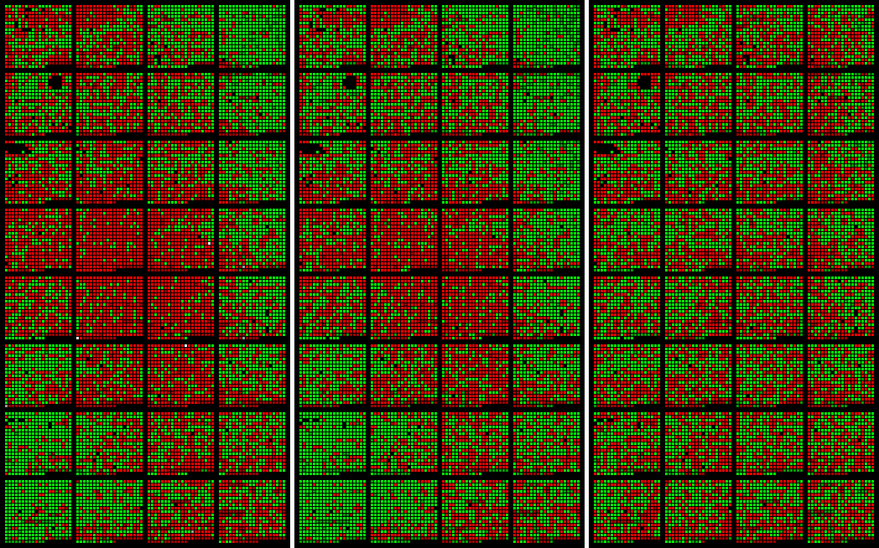
Spatial bias is not corrected by intensity alone
Mean Global Linear Linear Sector
AFGC

Slide 22
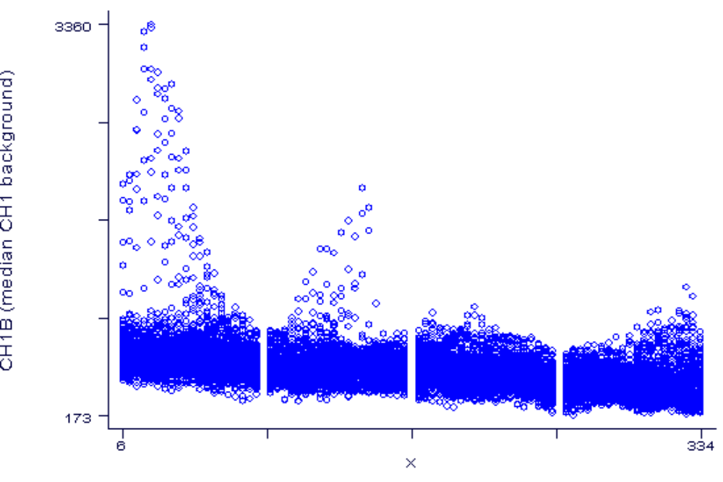
Linear pattern in background by column
AFGC
Note: edge effect
background Cy3
column

Slide 23
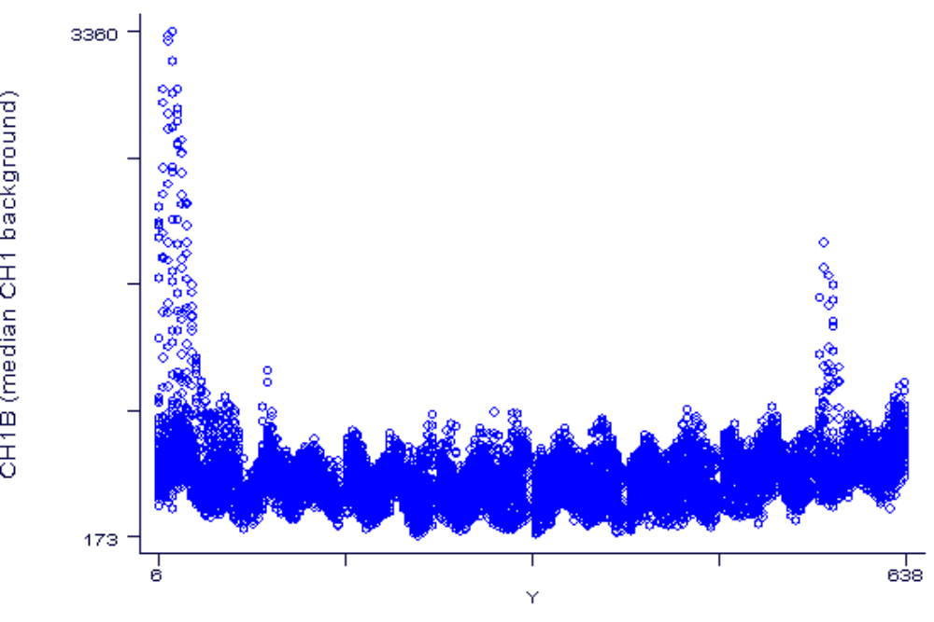
Parabolic pattern in background by row
AFGC
Note: Sinusoidal pattern
and edge effect
background Cy3
row

Slide 24
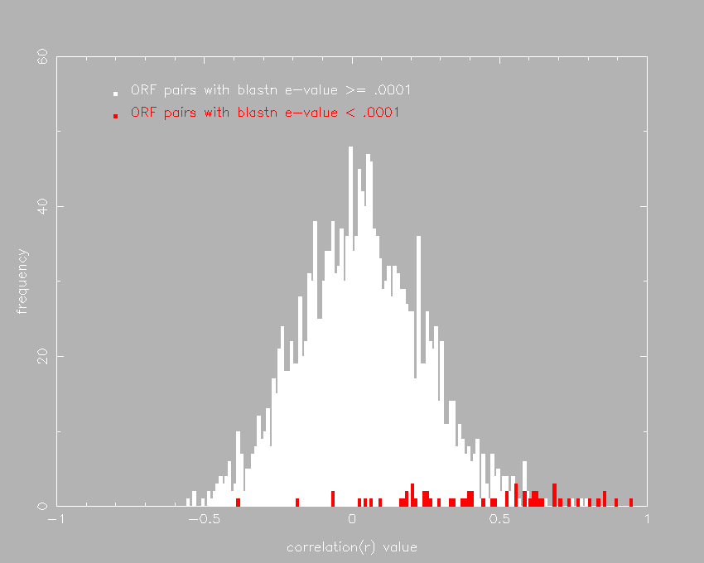
Similar sequences have similar expression profiles
AFGC
Frequency
Correlation of EST pairs

Slide 25
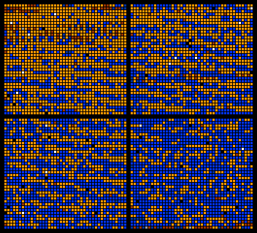
Undefined fine scale spatial bias:
AFGC

Slide 26
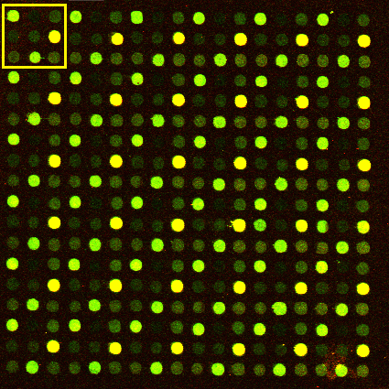
Statistical Test Array
AFGC
3 x 3 pattern of 8 clones and ssDNA
replicated 36 times/pin or 576 times /array

Slide 27
Experimental Design
9 clones:
8 cDNAs and salmon sperm control
40 slides:
2 slide surfaces
Test factors:
slide, sector, clone, plate, and array
One RNA pool: all reactions
One experimenter: entire process print-data analysis
AFGC

Slide 28
Experimental design details
AFGC
9 clones:
8 cDNAs and salmon sperm control
length
abundance
2 slide surfaces:
Superamine™ (commercial)
Polylysine (lab. prep)

Slide 29
Test factor details
slide: tests chemistry
sector: tests pin and spatial effects
clone: sequence specific effects
plate: handling effects or PCR
array : remainder slide specific effects
Categorical variables: rough measures
AFGC

Slide 30
ANOVA filtered data
AFGC
Model rat2n = slide surface + sector + clone + plate + array
F Prob > F
Model 312 0.0001
array 539 0.0001
clone 104 0.0001
sector 76 0.0001
plate 1.66 0.0619
slide surface 0.34 0.5576
Model R-squared = 0.1273

Slide 31
Channel backgrounds are different for
Superamine™ only
AFGC
CH1B CH2B %diff Prob.
Superamine™ 519 628 21.0% P<.0001
highly significant by 2 way t-test
Polylysine 400 402 0.5% P<.2143
no significant difference

Slide 32
ANOVA interaction models
AFGC
Model ratio = factor₁*factor₂
Interaction r-squared F
array * clone 0.501 449
array * sector 0.200 63
array * plate 0.118 78
array * slide surface 0.117 543
slide surface * clone 0.030 294
sector * clone 0.014 16
sector * slide surface 0.012 62
clone * plate 0.011 15
sector * plate 0.011 8
slide surface * plate 0.007 43

Slide 33
Categories of Clone
AFGC
abundance CV
rare 0.38
moderate 0.31
common 0.20
length CV
short 0.39
medium 0.30
long 0.22
Categorical variables are proxy for continuous variables

Slide 34
Clone*Array Interaction
Model ratio = factor₁*factor₂
ANOVA Model r-squared F
array*clone 0.586 667
array*abundance*length 0.388 602
array*abundance 0.229 377
array*length 0.209 335
clone 0.006 126
abundance*length 0.002 93
abundance 0.001 85
length 0.001 75
AFGC
Note: data filtered, ssDNA spots removed

Slide 35
Reducing Variance
AFGC
Filtering reduces CV ~3 fold
Ratios reduce CV ~4 fold
Background correction ~2-20%

Slide 36
Empirical Methods
Spatial Controls:
replicate controls
throughout the array
Spiking Controls:
verification of labeling
DNA concentration controls
TOTO staining reference
Negative Controls
additive correction
AFGC

Slide 37
Experimental Annotation
AFGC
RNA sample ontology
controlled vocabularies
hierachial structure
categorical meta-analysis
standardization
TAIR, GEO, MAML, MGED

Slide 38
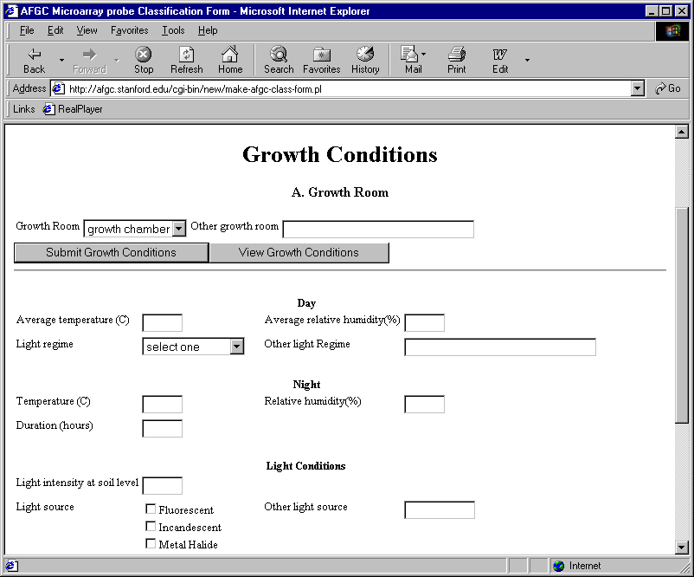
AFGC

Slide 39
Acknowledgements
AFGC
Post Docs: Principal Investigators:
Rob Ewing J. Michael Cherry
Jeremy Gollub S. Somerville
Fredrik Sterky
Programming:
Mira Kaloper
Lalitha Subramanian Thank you

