Slide 1

Funding Opportunities at NSF
Jane Silverthorne
International Arabidopsis
Consortium Workshop
January 15, 2011

Slide 2
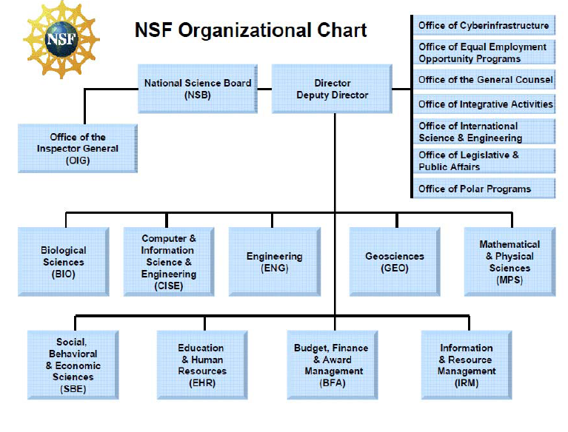
Opportunities are available across NSF…

Slide 3
Advances in Biological Informatics (ABI)
Encourages new approaches to the analysis and dissemination of biological knowledge
Development of informatics tools and resources that have the potential to advance or transform research supported by the BIO Directorate
Two types of proposal
  Innovation awards to pioneer new approaches to the application of informatics to biological problems
  Development awards to provide robust cyberinfrastructure to enable transformative biological research
Annual deadline is second Tuesday in July

Slide 4
Plant Genome Research Program
Tools and Resources for Plant Genome Research (TRMS)
  Development of novel technologies and analysis tools to enable discovery in plant genomics
  Focus is on economically-important crops but comparative resources that include non-crop plants are welcome
  Annual target date in January each year

Slide 5
Core Programs in BIO
Division of Integrative Organismal Systems
  Developmental Systems
  Physiological and Structural Systems
Division of Molecular and Cellular Biosciences
  Biomolecular Dynamics, Structure and Function
  Cellular Processes
  Genetic Mechanisms
  Networks and Regulation

Slide 6
CISE Computing Research Infrastructure (CRI)
Community Infrastructure awards support the planning and operations for computing research infrastructure, or the creation of new computing infrastructure, or the enhancement of existing computing research infrastructure for broadly-based communities
Annual deadline is the first Wednesday in August

Slide 7
CIF21
Dear Colleague Letter: CyberInfrastructure Framework for 21st Century Science and Engineering (CF21) http://www.nsf.gov/pubs/2010/nsf10015/nsf10015.jsp?org=OCI
  Development of a strategic, long-term vision that includes high-performance computing, lining activities, facilities, as well as education and outreach

Slide 8
CIF 21 Programs
Software Infrastructure for Sustained Innovation (SI²)
  Solicitation NSF 10-551
  Catalyzing new thinking, paradigms and practices in using software to understand natural, human and engineered systems
  Three award classes: Scientific Software Elements, Scientific Software Integration, and Scientific Software Innovation Institutes
Strategic Technologies for CyberInfrastructure (STCI)
  PD 11-7684
  Proposal windows March 15-31 and October 3-17, 2011
  Development of experimental/innovative hardware or software systems that enable leading-edge science and engineering research with broader impacts across society

Slide 9
Best Practices
Think broadly about community needs
Anticipate challenges of scope and scale
Be proactive in development
Develop a sustainability plan from the outset that includes a broad base of support
Leverage other investments in Arabidopsis informatics
Consider relationship to other initiatives in the US and internationally
Look at programs throughout NSF
Talk to relevant Program Directors prior to submitting a proposal

