Slide 1

– PROJECT NAME – CITY FLOW - ONLINE BUS TICKET BOOKING APPLICATION
Developed BY:
Arabinda Pradhan
Bikash Nayak
Satyabrata Sahu
Biswajit Nayak

Slide 2
INTRODUCTION:
In today’s fast-paced world, efficient travel solutions are essential for both personal and business needs. Our Bus Ticket Booking System aims to simplify the process of purchasing bus tickets, making it, user-friendly.
City Flow is an Android-based bus booking application designed to help users book tickets, track buses, and manage travel history. Built using Kotlin with Jetpack Compose and Firestore.
Key features of our APP include:
User-Friendly Interface
Real-Time Availability
Customer Support
Booking History
QR-based Ticket Verification for Conductors

Slide 3
OBJECTIVE:
OUR GOAL is To empower users with a simple and complete bus ticket booking experience.
Our aim :
Connect travelers across the state.
Show all bus options from both government and private services.
Help users see their search history for easy choices.
Benefits:
More options for planning trips.
A faster and easier booking process.

Slide 4

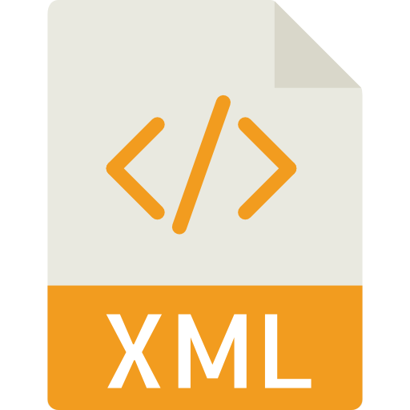


TECHNOLOGY USED:
Frontend Technologies
XML
Backend Technologies
Kotlin
Firestore
Text Editor/IDE
Android Studio
Authentication
Firebase Authentication

Slide 5
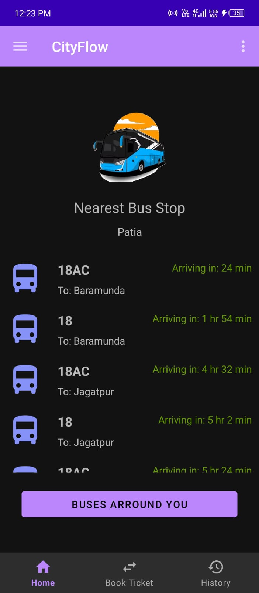
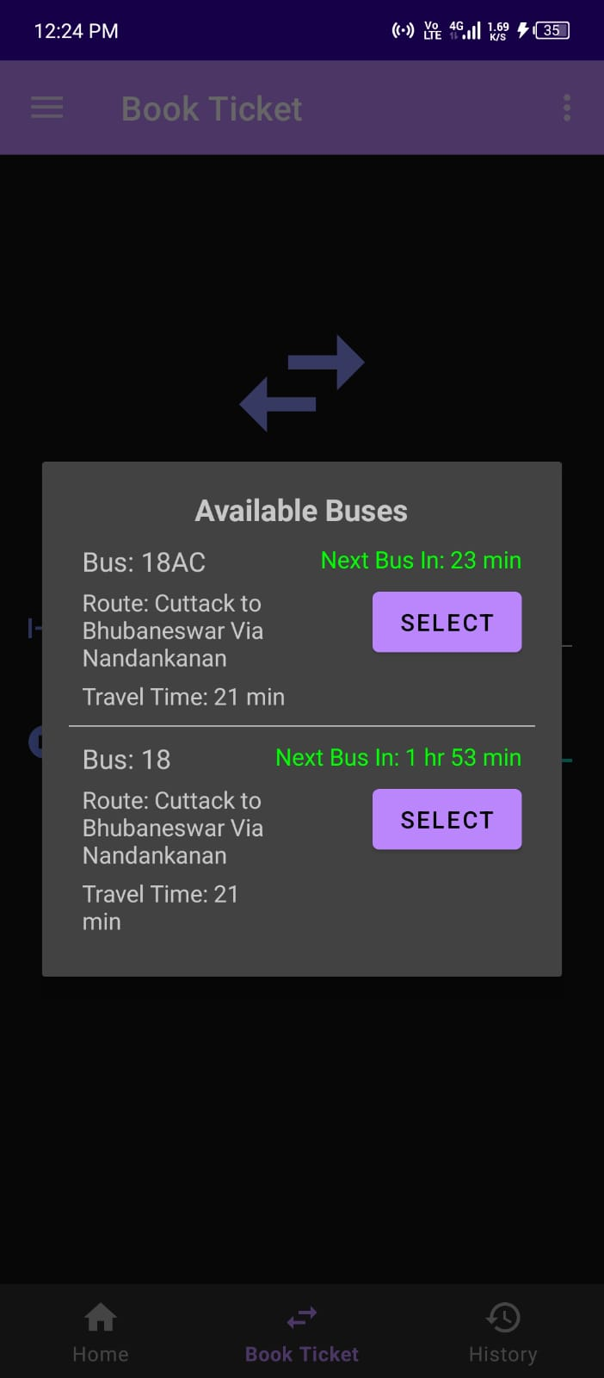
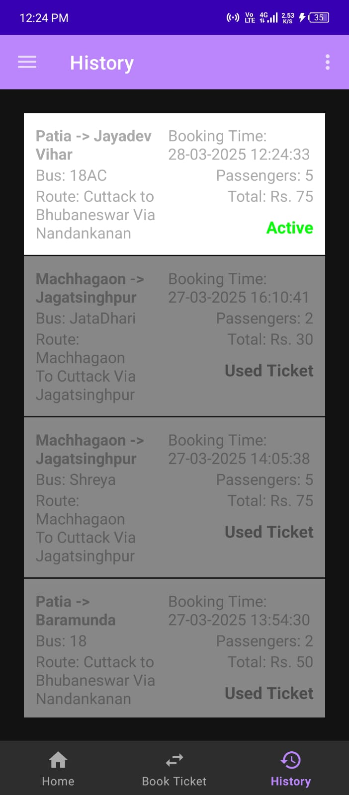
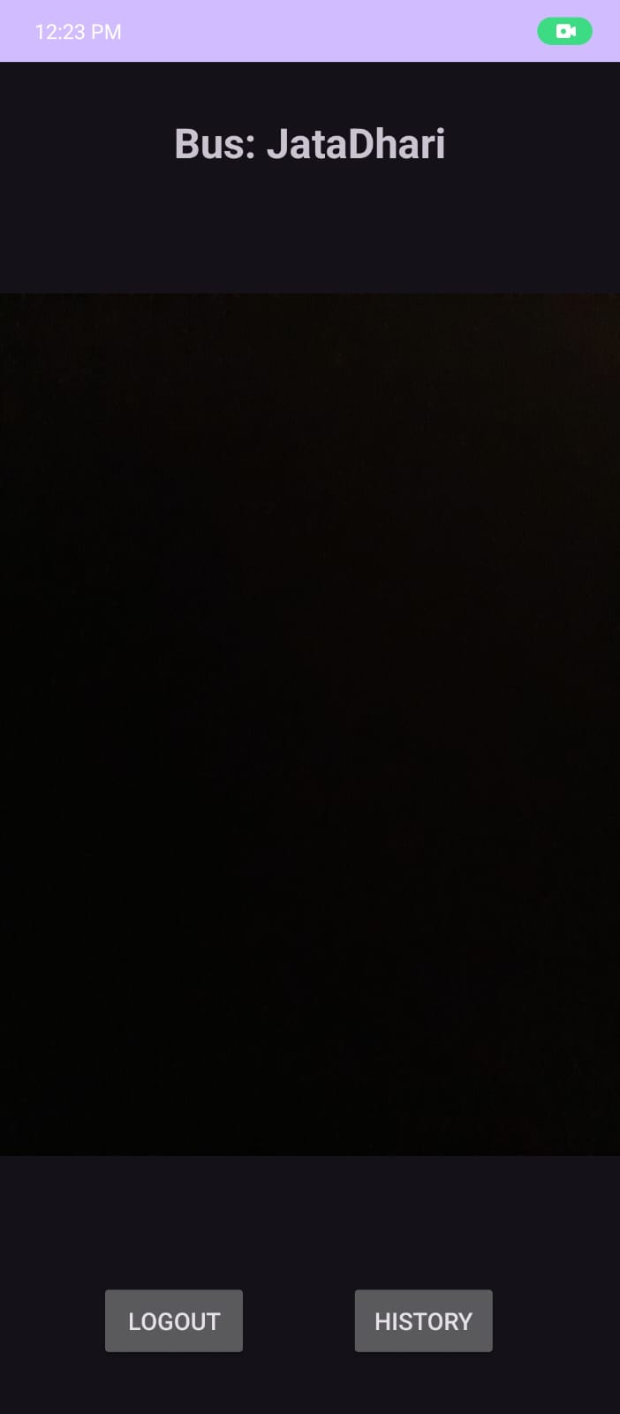
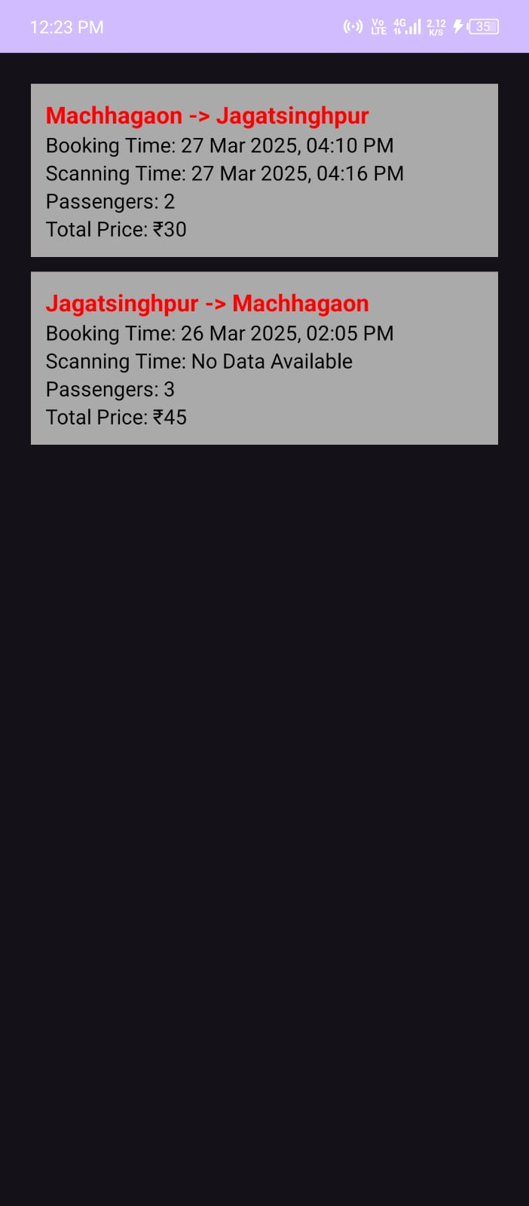
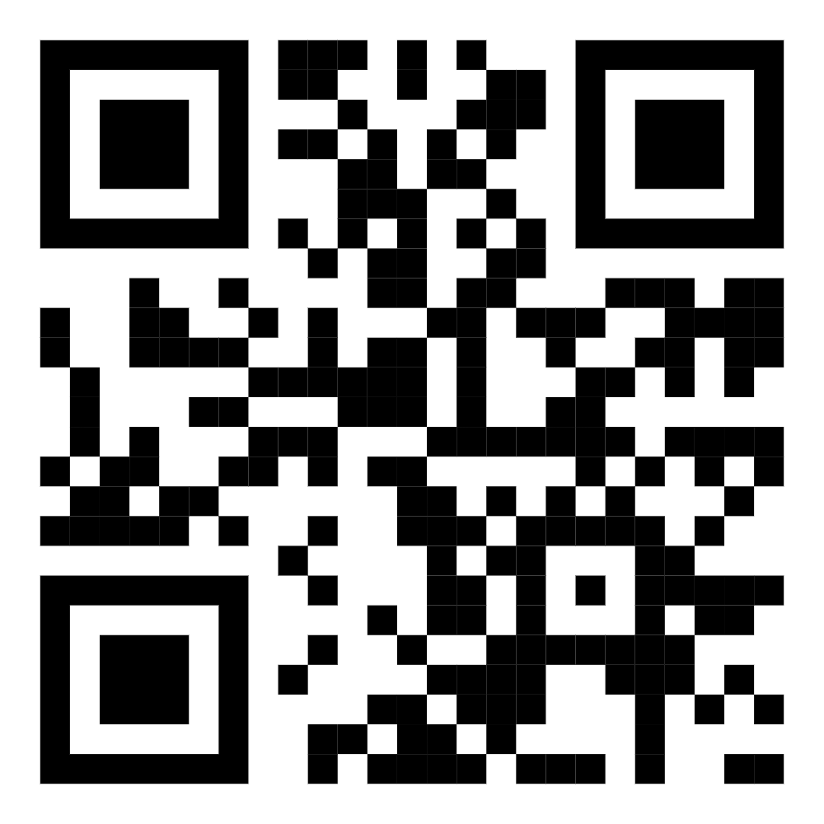
CityFlow User App
CityFlow Conductor App

Slide 6
Level 0-DFD
ONLINE BUS TICKET BOOKING SYSTEM
ADMIN
USER
BUS PARTNER

Slide 7
Level 1-DFD
Admin
1.1
User1.2
Bus
1.3
0nline Bus Ticket Booking System
1.0

Slide 8
Level 2-DFD
ADMIN 1.1
LOG IN 1.1.1
MANAGE BUS 1.1.2
ADD BUS 1.1.2.1
ADD ROUTE 1.1.2.2
VIEW DETAILS 1.1.3
BUS DETAILS 1.1.3.1
ROUTE DETAILS 1.1.3.2
VIEW BOOKINGS 1.1.3.3

Slide 9
Level 2-DFD
USER
(1.2)
Login
(1.2.1)
About Us
(1.2.2)
Contact Us
(1.2.3)
Book Ticket
(1.2.4)
History
(1.2.5)

Slide 10
Level 2-DFD
BUS PARTNER
(1.3)
Login
(1.3.1)
Verify Bus Ticket
(1.3.2)
Confirmed Tickets
(1.3.3)

Slide 11
SITE MAPPING
HOME
ADMIN (1.1)
USER (1.2)
BUS PARTNER (1.3)
LOG IN
1.1.1
LOG IN
1.2.1
LOG IN
1.3.1
MANAGE BUS
1.1.2
VERIFY BUS TICKET
1.3.2
ABOUT US
1.2.2
ADD BUS
1.1.2.1
CONTACT US
1.2.3
CONFIRMED TICKETS
1.3.3
ADD ROUTE
1.1.2.2
VIEW DETAILS
1.1.3
BOOK TICKET
1.2.4
BUS DETAILS
1.1.3.1
ROUTE DETAILS
1.1.3.2
HISTORY
1.2.4
VIEW BOOKINGS
1.1.3.3

Slide 12
ER Diagram
B_Name
Regd_number
User
Date_time
Bus ticket booking website
M
Pass_key
mob
1
View & Verify
M
Tickets
no_of_pass
password
Bus Partner
1
Price
1
M
Book & View
departure
Has
Has
Deparature_time
Bus_type
arrival
1
Route_id
1
Arrival_time
1
1
Manage & View
M
M
Search
M
Admin
Bus
User
B_Name
1
Facilities
password
Has
FirstName
Name
Password
Regd_Number
Mobile No
1
lastName
mob
M
Routes
email
Route_name
Start_Point
Route_id
End_Point
Stoppage

Slide 13
CONCLUSION:
Overall, the system performs well, and while it does not include all of the features that may have been desired, it lives up to initial expectations. The majority of features that are included work flawlessly and the errors that do exist are minor or graphical.

Slide 14
FUTURE SCOPE :
The Bus Ticket Booking System has a solid foundation, but there are numerous opportunities for enhancement and expansion. The following areas outline potential future developments:
Real-Time Bus Tracking
Payment Gateway Integration
Optimized Database Queries
Faster Ticket Verification
Feedback and Rating System
AI and Machine Learning

Slide 15
THANK YOU

