Slide 1
Software Engineering
CS 13 Methods in Software Testing

Slide 2
BSDCH ZC343 - Software Engineering

Slide 3
Coverage
  Testing Tactics
  WBT, BBT
  MBT and other techniques
  Debugging techniques
September 6, 2025
BSDCH ZC343 - Software Engineering

Slide 4
Text Ref.
T1: Pressman, R.S., Software Engineering: A Practitioner's Approach
Ch 18 Testing Conventional Applications
Ch 19 Testing Object Oriented Application
September 6, 2025
BSDCH ZC343 - Software Engineering

Slide 5
Methods in Software Testing

Slide 6
Testing Methods
Black Box Testing
White Box Testing
September 6, 2025
BSDCH ZC343 - Software Engineering

Slide 7
White-box Testing
You can derive test cases that
guarantee that all independent paths within a module have been exercised at least once,
exercise all logical decisions on their true and false sides,
execute all loops at their boundaries and within their operational bounds, and
exercise internal data structures to ensure their validity.
September 6, 2025
BSDCH ZC343 - Software Engineering

Slide 8
Basic Path Testing
September 6, 2025
BSDCH ZC343 - Software Engineering

Slide 9
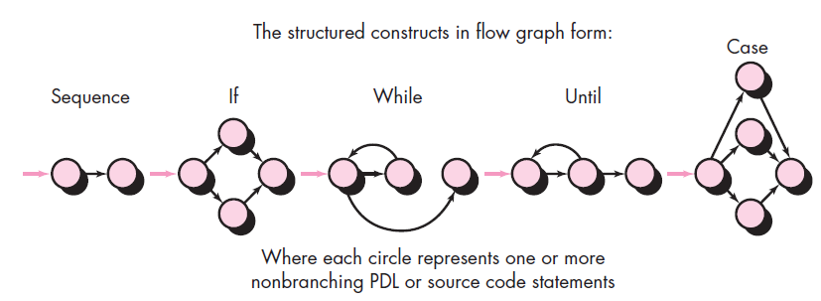
Flow Graph Notation
September 6, 2025
BSDCH ZC343 - Software Engineering

Slide 10
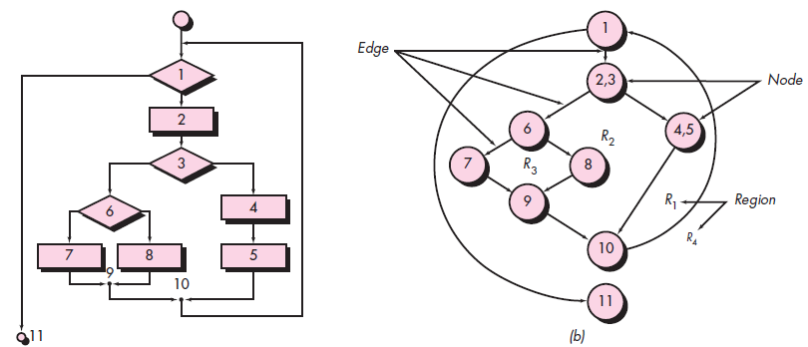
Flowchart and
Flow graph
September 6, 2025
BSDCH ZC343 - Software Engineering

Slide 11
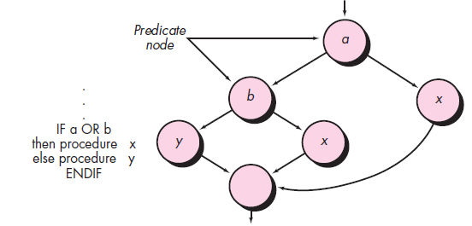
Compound Logic
BSDCH ZC343 - Software Engineering

Slide 12
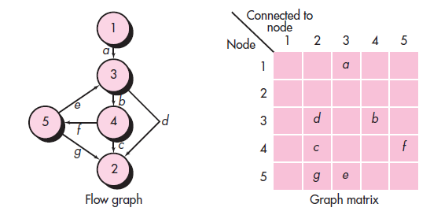
Graph Matric
BSDCH ZC343 - Software Engineering

Slide 13
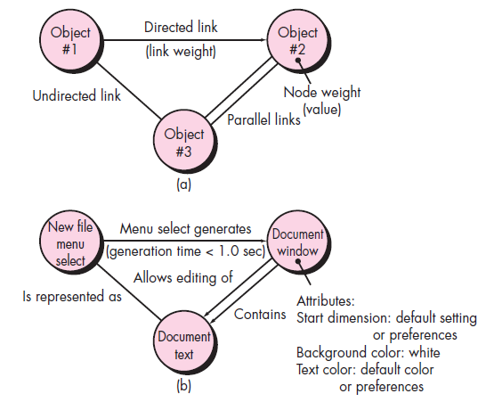
Graph-Based Methods
To understand the objects that are modeled in software and the relationships that connect these objects
In this context, we consider the term “objects” in the broadest possible context. It encompasses data objects, traditional components (modules), and object-oriented elements of computer software.
BSDCH ZC343 - Software Engineering

Slide 14
Equivalence Partitioning
user
queries
output
formats
FK
input
mouse
picks
data
prompts
BSDCH ZC343 - Software Engineering

Slide 15
Sample Equivalence Classes
Valid data
user supplied commands
responses to system prompts
file names
computational data
physical parameters
bounding values
initiation values
output data formatting
responses to error messages
graphical data (e.g., mouse picks)
Invalid data
data outside bounds of the program
physically impossible data
proper value supplied in wrong place
BSDCH ZC343 - Software Engineering

Slide 16
Boundary Value Analysis
user
queries
output
formats
FK
input
mouse
picks
data
prompts
input domain
output
domain
BSDCH ZC343 - Software Engineering

Slide 17
Comparison Testing
Used only in situations in which the reliability of software is absolutely critical (e.g., human-rated systems)
  Separate software engineering teams develop independent versions of an application using the same specification
  Each version can be tested with the same test data to ensure that all provide identical output
  Then all versions are executed in parallel with real-time comparison of results to ensure consistency
BSDCH ZC343 - Software Engineering

Slide 18
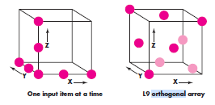
Orthogonal Array Testing
Used when the number of input parameters is small and the values that each of the parameters may take are clearly bounded
BSDCH ZC343 - Software Engineering

Slide 19
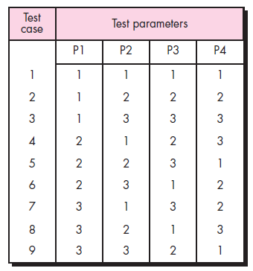
L9 Orthogonal Array
BSDCH ZC343 - Software Engineering

Slide 20
Model Based Testing
Analyse an existing behavioural model for the software or create one.
Traverse the behavioural model and specify the inputs that will force the software to make the transition from state to state.
Review the behavioural model and note the expected outputs as the software makes the transition from state to state.
Execute the test cases.
Compare actual and expected results and take corrective action as required.
BSDCH ZC343 - Software Engineering

Slide 21
Testing Methods
Fault-based testing
  The tester looks for plausible faults (i.e., aspects of the implementation of the system that may result in defects). To determine whether these faults exist, test cases are designed to exercise the design or code.
Class Testing and the Class Hierarchy
  Inheritance does not obviate the need for thorough testing of all derived classes. In fact, it can actually complicate the testing process.
Scenario-Based Test Design
  Scenario-based testing concentrates on what the user does, not what the product does. This means capturing the tasks (via use-cases) that the user has to perform, then applying them and their variants as tests.
BSDCH ZC343 - Software Engineering

Slide 22
TESTING FOR SPECIALIZED ENVIRONMENTS,
ARCHITECTURES, AND APPLICATIONS
Testing GUIs
Testing of Client-Server Architectures
Testing Documentation and Help Facilities
Testing for Real-Time Systems
BSDCH ZC343 - Software Engineering

Slide 23
Testing of Client-Server Architectures
Application function tests.
Server tests.
Database tests.
Transaction tests.
Network communication tests.
BSDCH ZC343 - Software Engineering

Slide 24
Testing for Real-Time Systems
Task testing.
Behavioral testing.
Intertask testing.
System testing.
BSDCH ZC343 - Software Engineering

Slide 25
System Characteristics Tested
Are interrupt priorities properly assigned and properly handled?
Is processing for each interrupt handled correctly?
Does the performance (e.g., processing time) of each interrupt-handling procedure conform to requirements?
Does a high volume of interrupts arriving at critical times create problems in function or performance?
BSDCH ZC343 - Software Engineering

Slide 26
Testing Patterns
Pattern name: pair testing
  Abstract: A process-oriented pattern, pair testing describes a technique that is analogous to pair programming (Chapter 4) in which two testers work together to design and execute a series of tests that can be applied to unit, integration or validation testing activities.
Pattern name: separate test interface
  Abstract: There is a need to test every class in an object-oriented system, including “internal classes” (i.e., classes that do not expose any interface outside of the component that used them). The separate test interface pattern describes how to create “a test interface that can be used to describe specific tests on classes that are visible only internally to a component.” [LAN01]
Pattern name: scenario testing
  Abstract: Once unit and integration tests have been conducted, there is a need to determine whether the software will perform in a manner that satisfies users. The scenario testing pattern describes a technique for exercising the software from the user’s point of view. A failure at this level indicates that the software has failed to meet a user visible requirement. [KAN01]
BSDCH ZC343 - Software Engineering

Slide 27
Testing Object-Oriented Applications

Slide 28
OOT—Test Case Design
Berard [BER93] proposes the following approach:
1. Each test case should be uniquely identified and should be explicitly associated with the class to be tested,
2. The purpose of the test should be stated,
3. A list of testing steps should be developed for each test and should contain [BER94]:
  a. a list of specified states for the object that is to be tested
b. a list of messages and operations that will be exercised as a consequence of the test
c. a list of exceptions that may occur as the object is tested
d. a list of external conditions (i.e., changes in the environment external to the software that must exist in order to properly conduct the test)
e. supplementary information that will aid in understanding or implementing the test.
BSDCH ZC343 - Software Engineering

Slide 29
OOT Methods: Random Testing
Random testing
  identify operations applicable to a class
  define constraints on their use
  identify a minimum test sequence
    an operation sequence that defines the minimum life history of the class (object)
  generate a variety of random (but valid) test sequences
    exercise other (more complex) class instance life histories
BSDCH ZC343 - Software Engineering

Slide 30
OOT Methods: Partition Testing
Partition Testing
  reduces the number of test cases required to test a class in much the same way as equivalence partitioning for conventional software
  state-based partitioning
    categorize and test operations based on their ability to change the state of a class
  attribute-based partitioning
    categorize and test operations based on the attributes that they use
  category-based partitioning
    categorize and test operations based on the generic function each performs
BSDCH ZC343 - Software Engineering

Slide 31
OOT Methods: Inter-Class Testing
Inter-class testing
  For each client class, use the list of class operators to generate a series of random test sequences. The operators will send messages to other server classes.
  For each message that is generated, determine the collaborator class and the corresponding operator in the server object.
  For each operator in the server object (that has been invoked by messages sent from the client object), determine the messages that it transmits.
  For each of the messages, determine the next level of operators that are invoked and incorporate these into the test sequence
BSDCH ZC343 - Software Engineering

Slide 32
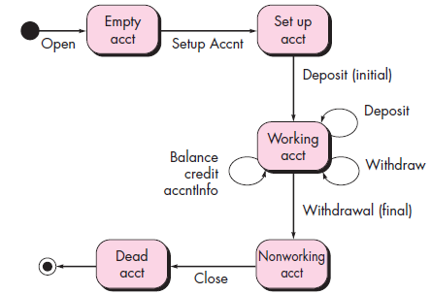
OOT Methods: Behavior Testing
The tests to be designed should achieve all state coverage [KIR94]. That is, the operation sequences should cause the Account class to make transition through all allowable states
BSDCH ZC343 - Software Engineering

Slide 33
End
Thank you.
September 6, 2025
BSDCH ZC343 - Software Engineering

