Slide 1

Webscraping projedt
Sami hassouneh
Age :9years old

Slide 2

What I did in this project?
I made an app that works with python code I made it to give us the sraping information .

Slide 3
What editor I worked on ?
I made this app in virtual studio code.

Slide 4
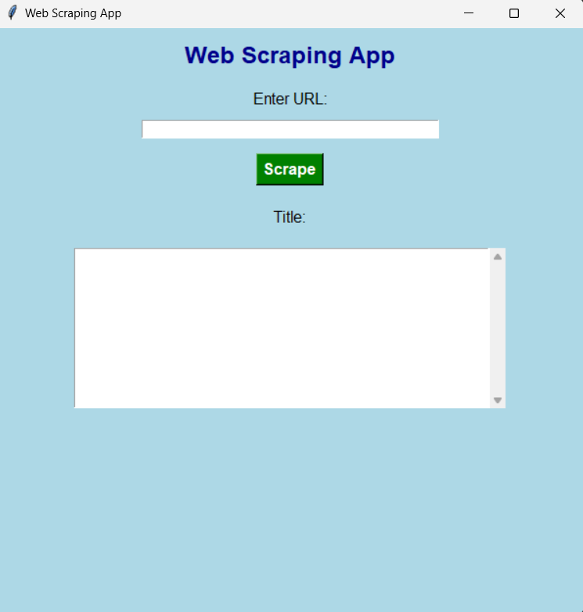
What the app look like?

Slide 5
Some information in the app
I made this app with bs4

Slide 6
The meming of every line in the code

