Slide 1
Blinkit Grocery Sales Dashboard
Power BI Project – Task 4 | Data Analyst Internship

Slide 2
Project Objectives
- Build an interactive Power BI dashboard
- Analyze sales, outlet, and item performance
- Use KPIs, visual charts, and filters
- Provide business insights to stakeholders

Slide 3
Key Metrics (KPIs)
- Total Sales
- Total Unique Items
- Average Sales
- Average Rating

Slide 4
Visualizations Used
- Sales Trend by Year (Line Chart)
- Sales by Item Type (Bar Chart)
- Item Fat Content Distribution (Pie Chart)
- Sales by Outlet Type/Size
- KPI Cards & Slicers for filtering

Slide 5
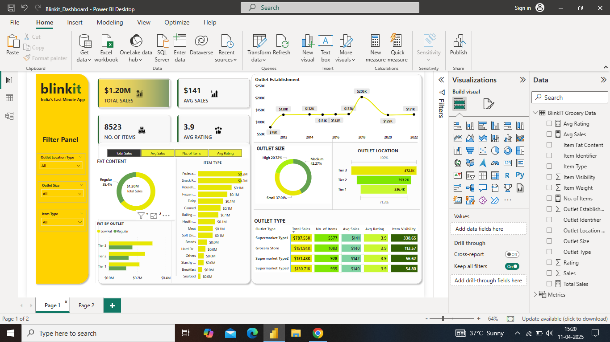

Slide 6
Conclusion
- The dashboard provides a clear view of Blinkit’s grocery sales data
- Enables better decision-making using trends and category-wise insights
- Easy-to-use filters help with focused analysis

