Slide 1

Seasonal Agricultural Performance Analysis
Aradhya Guha
Institute of Engineering & Management, Salt Lake (Kolkata)
AICTE STU ID : STU6a05f98b83df21778776459

Slide 2

PROBLEM STATEMENT
Agricultural activities are influenced by seasonal variations in environmental conditions, farming practices, resource availability and market conditions.
As a result, agricultural performance may differ from one season to another.
However, raw agricultural data does not clearly explain how agricultural performance changes across seasons or what patterns can be observed in different seasonal conditions.
The problem is to analyze the given agricultural dataset and investigate seasonal differences in agricultural performance by identifying meaningful patterns, trends, relationships and variations within the available data.

Slide 3
Project Description
Raw Dataset
Data Cleaning
The project explores how crop performance, environmental conditions, resource usage and profitability change across seasons.
The analysis combines exploratory data analysis, visualization, correlation analysis and statistical testing to identify meaningful patterns.
Exploratory Analysis
Seasonal Comparison
Correlation & Statistical Testing
Insight & Recommendations

Slide 4

WHO ARE THE END USERS?
Farmers/ Farm Managers
Understand seasonal yields, resource and profitability patterns.
Agricultural Planners
Support seasonal planning using historical observations.
Agricultural Analysts
Explore relationships between environmental and agricultural variables
Agricultural Organizations
Identify trends and areas requiring further investigation.

Slide 5

Technology Used
Programming – Python
Data Analysis – Pandas, Numpy
Visualization – Matplotlib, Seaborn
Statistical Analysis – Spearman Correlation, Kruskal-Walls
Platform – Google Colab Notebook

Slide 6
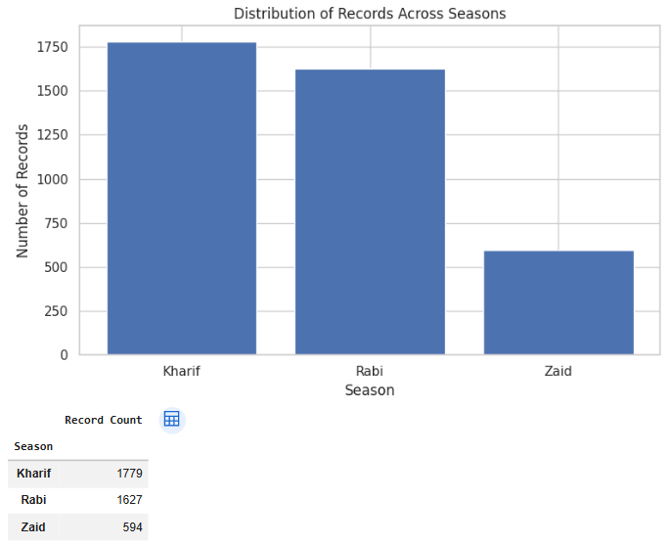
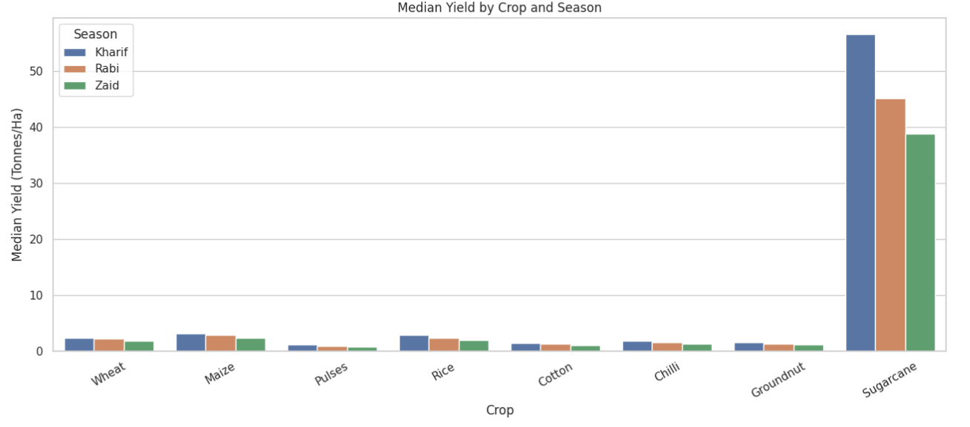
RESULTS
- Seasonal & Crop Performance
Key finding
Kharif recorded the highest median yield at 1.94 tonnes/ha, while Zaid recorded the lowest at 1.46 tonnes/ha. Kharif also had the largest representation with 1,779 observations.

Slide 7
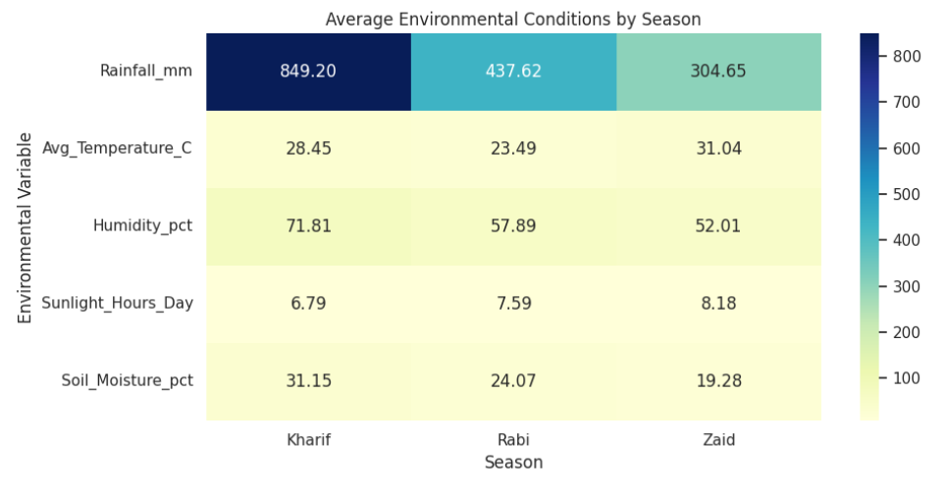
RESULTS
— Environmental & Resource Patterns
What Stands Out?
Kharif recorded the highest average rainfall at approximately 849.2 mm.
Seasonal differences were also visible in temperature, humidity, sunlight and soil moisture.
Take - away
Environmental conditions varied across seasons, showing why agricultural planning should consider seasonal conditions.

Slide 8
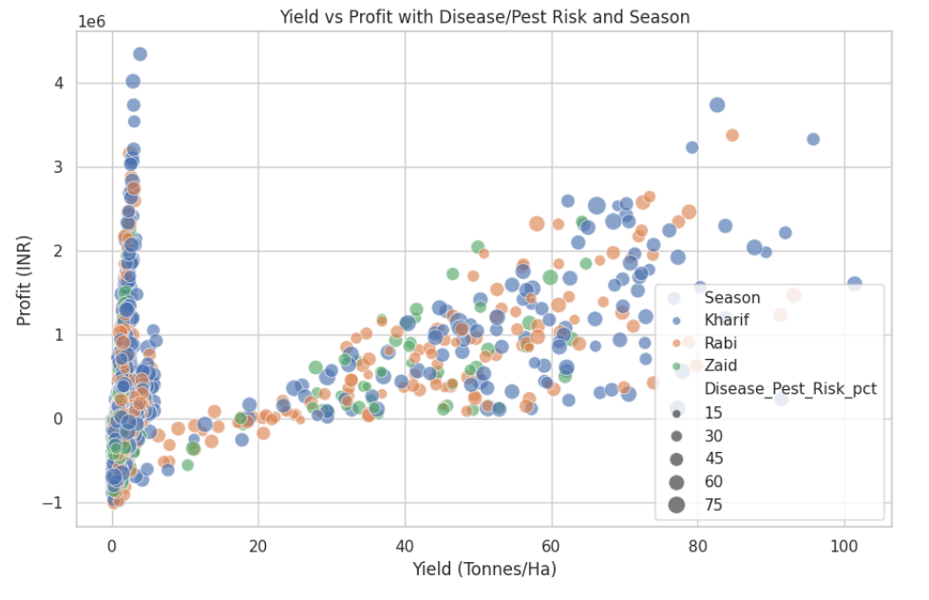
RESULTS
— Yield, Profitability & Risk
Key Finding
Higher yield generally corresponded with higher profit, although the relationship varied across seasons and disease/pest risk levels.
Take – away
Yield improvement can contribute to profitability, but production outcomes are influenced by multiple factors rather than yield alone.

Slide 9
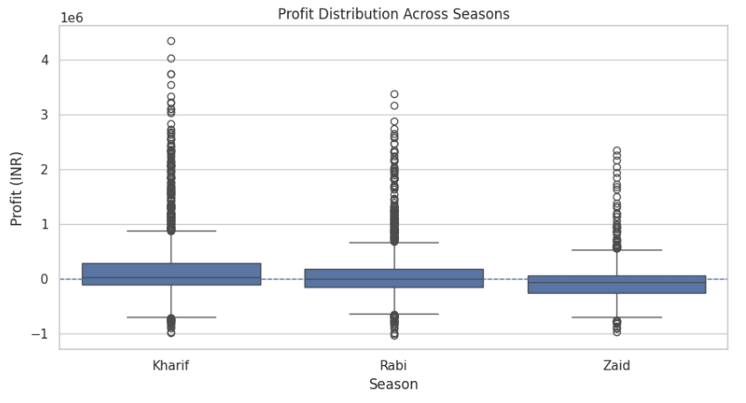
RESULTS
– Profitability Across Seasons
Key Finding
Profitability varied considerably across seasons. Kharif showed the highest median profit, while Zaid recorded the lowest median profit.
Take – away
Seasonal performance should be evaluated using profitability along with yield, since higher production does not necessarily mean higher profit.

Slide 10
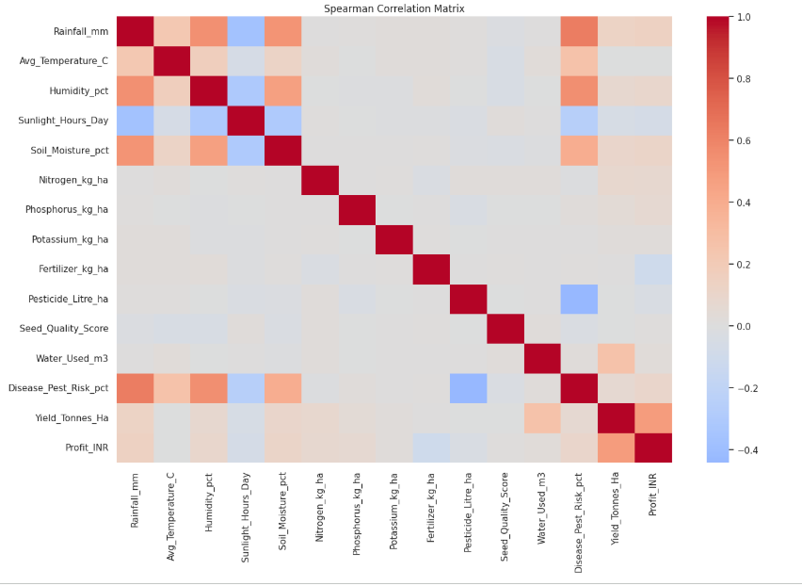
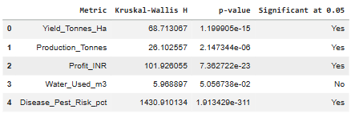
RESULTS
— Correlation & Statistical Evidence
Statistical Finding : Yield, Production, Profit and Disease/Pest Risk showed significant seasonal differences at the 5% level.
Take-away:
The analysis shows that seasonal differences are statistically meaningful, while relationships between variables provide additional insight into agricultural performance.
Correlation Finding : Profit had the strongest absolute Spearman association with Yield (ρ = 0.49), indicating a moderate positive relationship.

Slide 11
Future scope
The current analysis provides a foundation for a broader agricultural The current analysis provides a foundation for developing a more comprehensive agricultural decision-support system.
1. Predictive Analysis
Predict future yield and profitability using historical data.
2. Real-Time Weather Data
Incorporate live rainfall, temperature and weather information.
3. Regional Analysis
Extend the analysis to district/state-level agricultural patterns.
4. Crop Recommendation
Develop models that recommend suitable crops based on seasonal and environmental conditions.
Future work can combine historical agricultural data, real-time weather and market information to make the analysis more actionable.

Slide 12
GitHub Link
GitHub Repository :
https://github.com/AradhyaGuha/Seasonal-Agriculture-Performance-Analysis.git

Slide 13

VOIS Course Completion Certificate Course name - Data Visualization

Slide 14
Thank You
Seasonal Agricultural Performance Analysis
Turning agricultural data into meaningful seasonal insights.
Presented By
Aradhya Guha
.

