Slide 1
STEGANOGRAPHY IN IMAGE, AUDIO AND VIDEO

Slide 2
Abstract:
Data is an important asset for any individual or organization and must be protected from intruders or hackers. The need to hide data from hackers has existed since ancient times, and nowadays, there are developments in digital media, such as audio, video, images, and so on. To secure secret information, different media methods are used and steganography is one. Steganography hides the data under other data without any differentiable changes. Many individual steganography tools can be used to transfer data securely and, in this paper, a new tool is proposed that decreases time and effort. Using this tool, we hide the text in audio, video, or images in one place, so there is no need to have access to multiple tools.

Slide 3
Comparative Study of different tools :
On Basis of Image Format
Properties/Tools |  | DarkCryptTC | MP3Stego | Mr. Crypto | OpenPuff | OpenStego | S-Tools | Steghide
Image Format | BMP | ü | -- | ü | ü | ü | ü | ü
 | JPG/JPEG | ü | -- | -- | ü | -- | -- | ü
 | TIFF | ü | -- | ü | -- | -- | -- | --
 | PNG | ü | -- | ü | ü | ü | -- | --
 | PSD | ü | -- | -- | -- | -- | -- | --
 | TGA | ü | -- | -- | ü | -- | -- | --
 | MNG | ü | -- | -- | -- | -- | -- | --
 | GIF | -- | -- | -- | -- | -- | ü | --

Slide 4
Comparative Study of different tools :
On Basis of Audio Format
Properties/Tools |  | DarkCryptTC | MP3Stego | Mr. Crypto | OpenPuff | OpenStego | S-Tools | Steghide
Audio Format | WAV | ü | -- | -- | ü | -- | ü | ü
 | MP3 | -- | ü | -- | ü | -- | -- | --
 | AU | -- | -- | -- | -- | -- | -- | ü

Slide 5
Comparative Study of different tools :
On Basis of video Format
Properties/Tools |  | DarkCryptTC | MP3Stego | Mr. Crypto | OpenPuff | OpenStego | S-Tools | Steghide
Video Format | 3gp | -- | -- | -- | ü | -- | -- | --
 | MP4 | -- | -- | -- | ü | -- | -- | --
 | MPEG-1 | -- | -- | -- | ü | -- | -- | --
 | MPEG-2 | -- | -- | -- | ü | -- | -- | --
 | VOB | -- | -- | -- | ü | -- | -- | --
 | SWF | -- | -- | -- | ü | -- | -- | --
 | FLV | -- | -- | -- | ü | -- | -- | --

Slide 6
Comparative Study of different tools :
On Basis of Document Format
Properties/Tools |  | DarkCryptTC | MP3Stego | Mr. Crypto | OpenPuff | OpenStego | S-Tools | Steghide
Document Files | TXT | ü | -- | -- | -- | -- | -- | --
 | HTML | ü | -- | -- | -- | -- | -- | --
 | XML | ü | -- | -- | -- | -- | -- | --
 | ODT | ü | -- | -- | -- | -- | -- | --
 | PDF | -- | -- | -- | ü | -- | -- | --

Slide 7
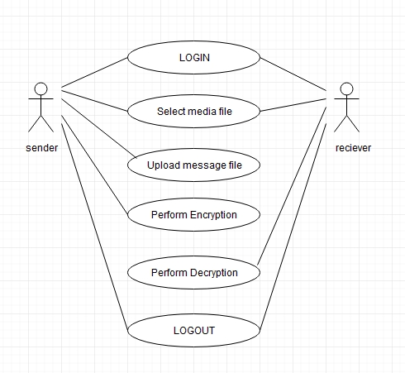
UML DIAGRAMS
1)Use-Case Diagram

Slide 8
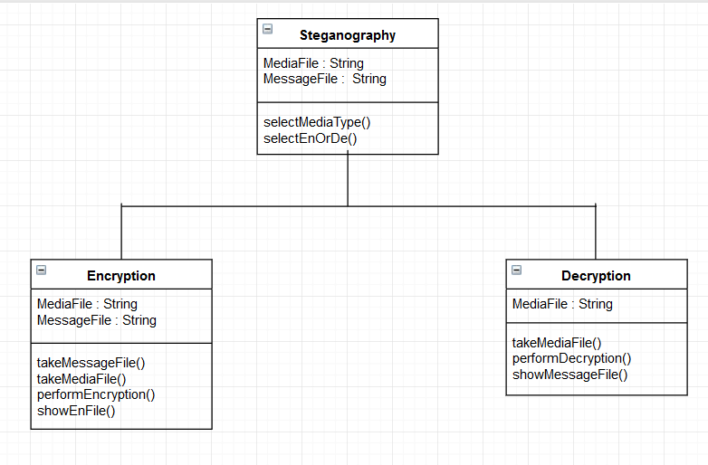
2)Class Diagram

Slide 9
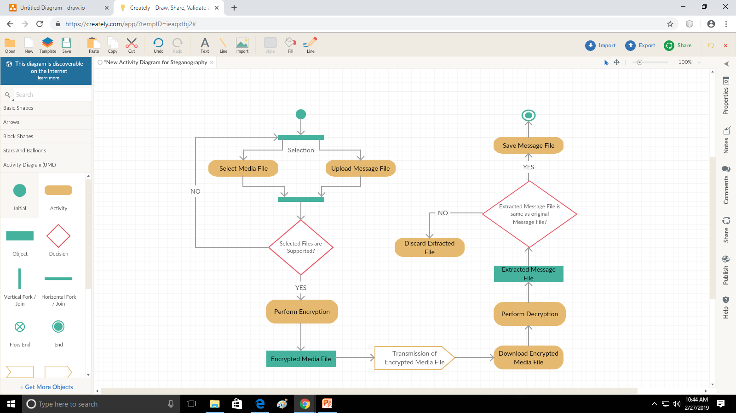
3)Activity Diagram

Slide 10
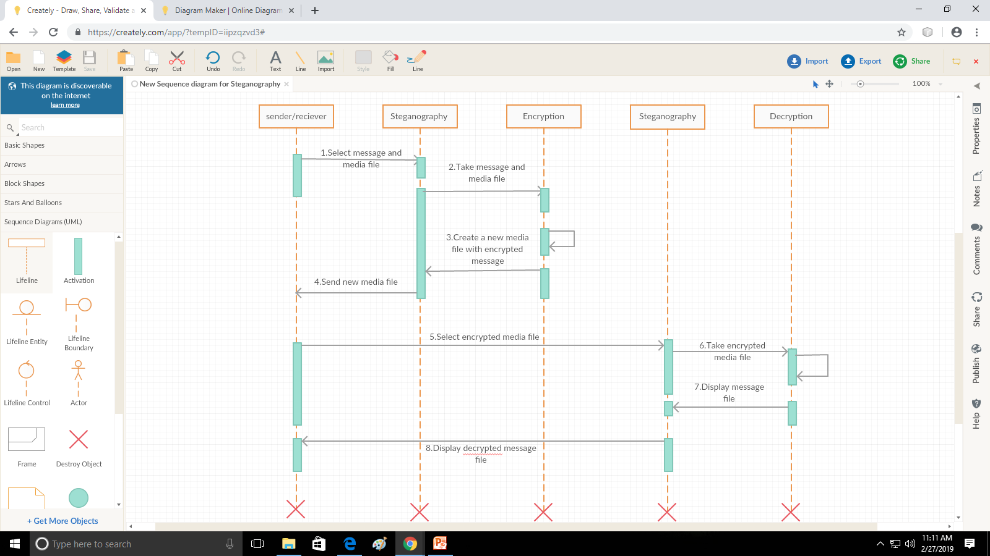
4)Sequence Diagram

Slide 11
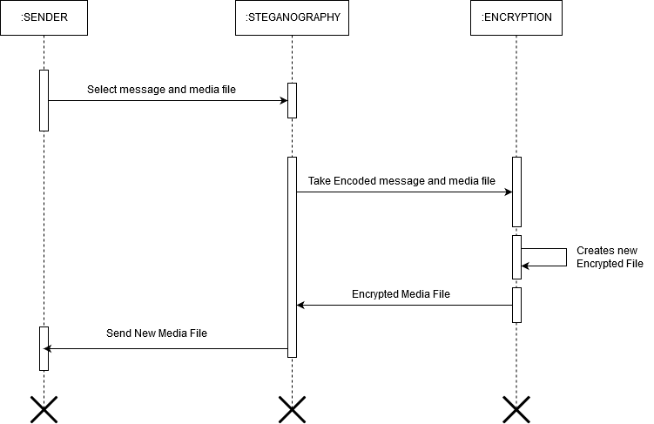
Sender’s Sequence Diagram

Slide 12

Receiver's Sequence diagram

Slide 13
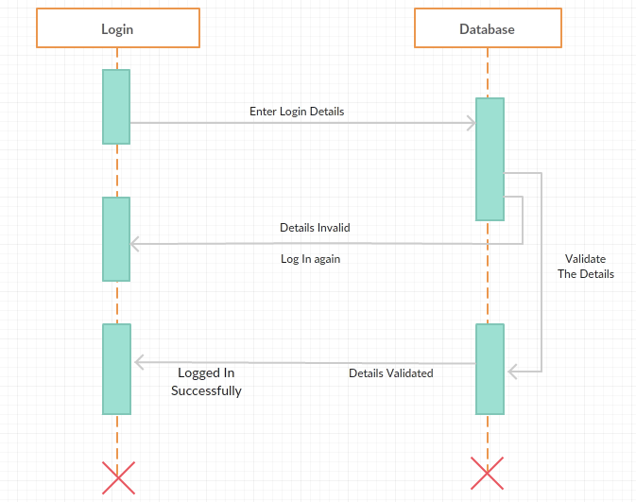
Login Sequence diagram

Slide 14
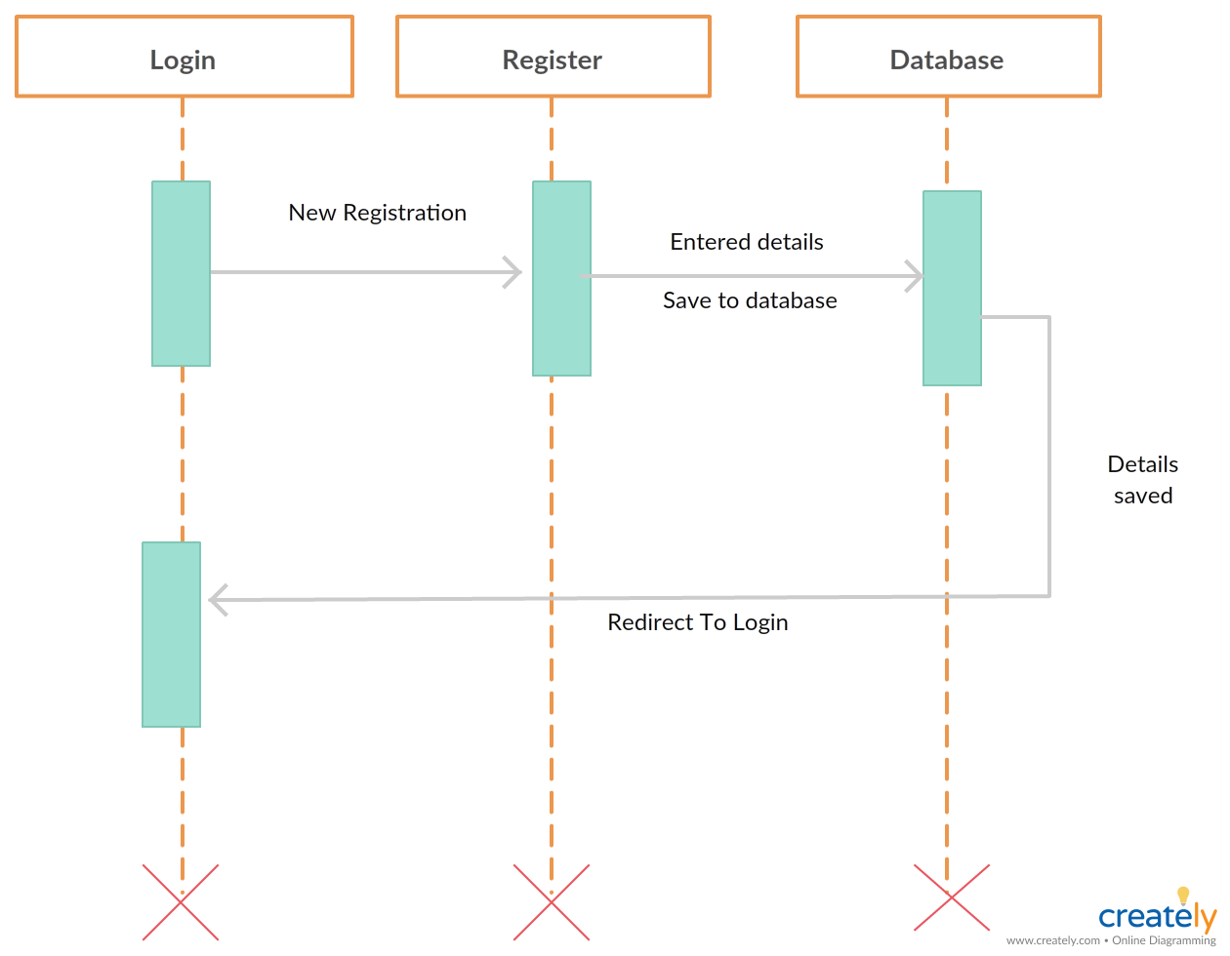
Registration Sequence Diagram

