Slide 1
SNAPSHOTS OF THE WORKING PROJECT

Slide 2
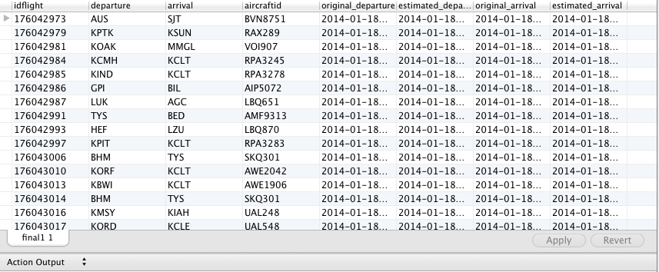
Successful Loading of data

Slide 3
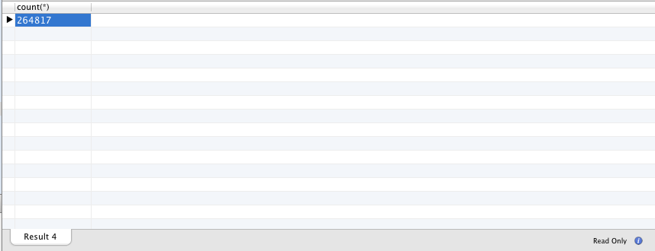
Successful count showing all records have been loaded

Slide 4

Example - 1

Slide 5

Example – 1 output

Slide 6

Example - 2

Slide 7

Example – 2 Output

