Slide 1
◉
WEB MONITORING SYSTEM
PageSight
Solo Project • UID 25MCC20042
Spring Boot • React

Slide 2
!
Problem Statement
The Challenge
The PageSight Approach
Tracking changes on a webpage today means manually writing and maintaining CSS selectors, a task that requires technical knowledge most users don’t have.
Selectors break silently when a site’s layout changes, so monitors quietly stop working without any warning.
Existing tools are fragmented, there is no single place to configure, track, and review monitored content and its history.
Select any element on a live page with a single click, no CSS knowledge needed.
Automatically monitor the selected content on a schedule and detect changes as they happen.
Notify users instantly and centralize every monitor in one dashboard with usage statistics.
Use Cases
Product prices • Documentation updates • Job postings • News articles • Blog updates • Key webpage content
PageSight
2

Slide 3
⚙
Technology Used
S
Spring Boot
R
React
BACKEND
FRONTEND
REST APIs, monitoring services, scheduling, and core application logic.
Dashboard, popup interface, and the visual element selector.
No external libraries beyond the core Spring Boot and React frameworks are used in this implementation.
BACKEND
FRONTEND
DESIGN
REST APIs, scheduling, persistence
Dashboard, popup, visual selector
Clean, dependency-light codebase
PageSight
3

Slide 4
✓
What’s Completed So Far
✓
Authentication & User Management
✓
Dashboard & Usage Statistics
JWT-based auth with BCrypt encryption; login & registration UI.
Monitor counts, favorites, and total checks performed, live in the UI.
✓
Monitor Management
✓
Favorites System
Create, view, pause/resume, manual check, and delete monitors.
Flag important monitors for quick access.
✓
Automatic Change Detection
✓
In-App Notifications
Scheduled checks every minute, page fetch, and change comparison.
Alerts on detected changes, with read/unread filtering and a badge count.
PageSight
4

Slide 5
What’s Left To Do
Backend foundation, scheduling engine, auth, notifications, and core dashboard: complete.
Visual Selector
Popup Interface
○
Point-and-click element picker on the live page, currently a manual CSS-selector input.
Lightweight popup for quick access to favorite monitors.
○
○
Snapshot Diff Viewer
Visual before/after diff of exactly what changed on the monitor detail page.
PageSight
5

Slide 6
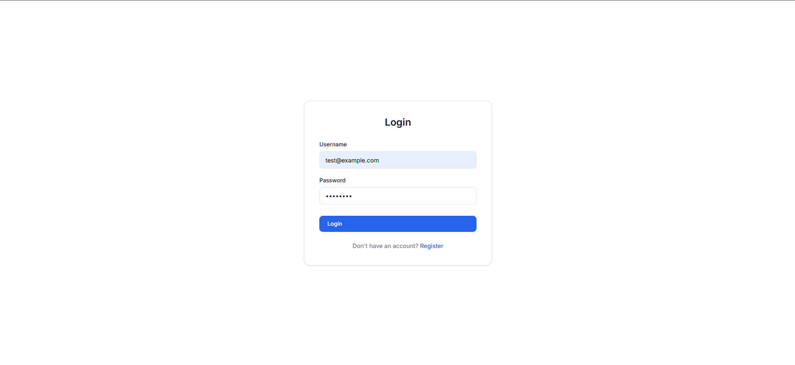
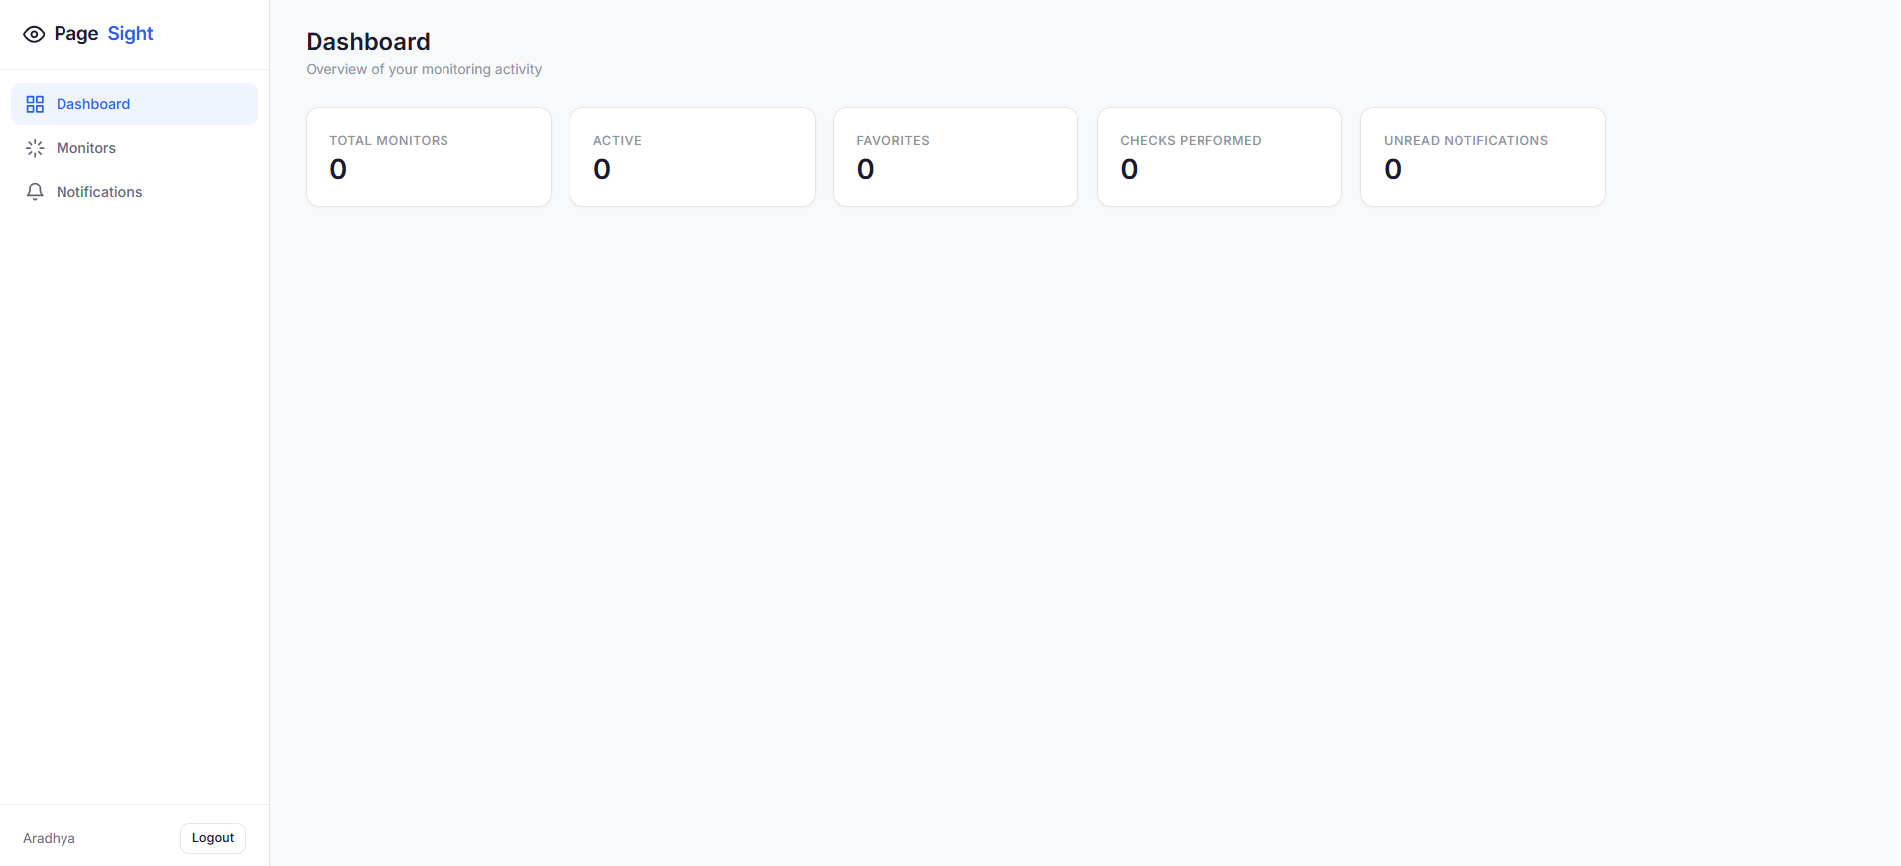
Application Walkthrough
PageSight
6

Slide 7
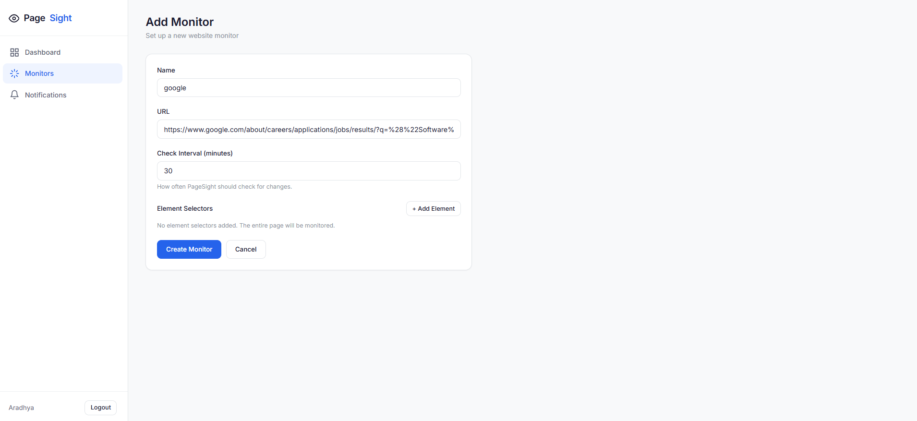
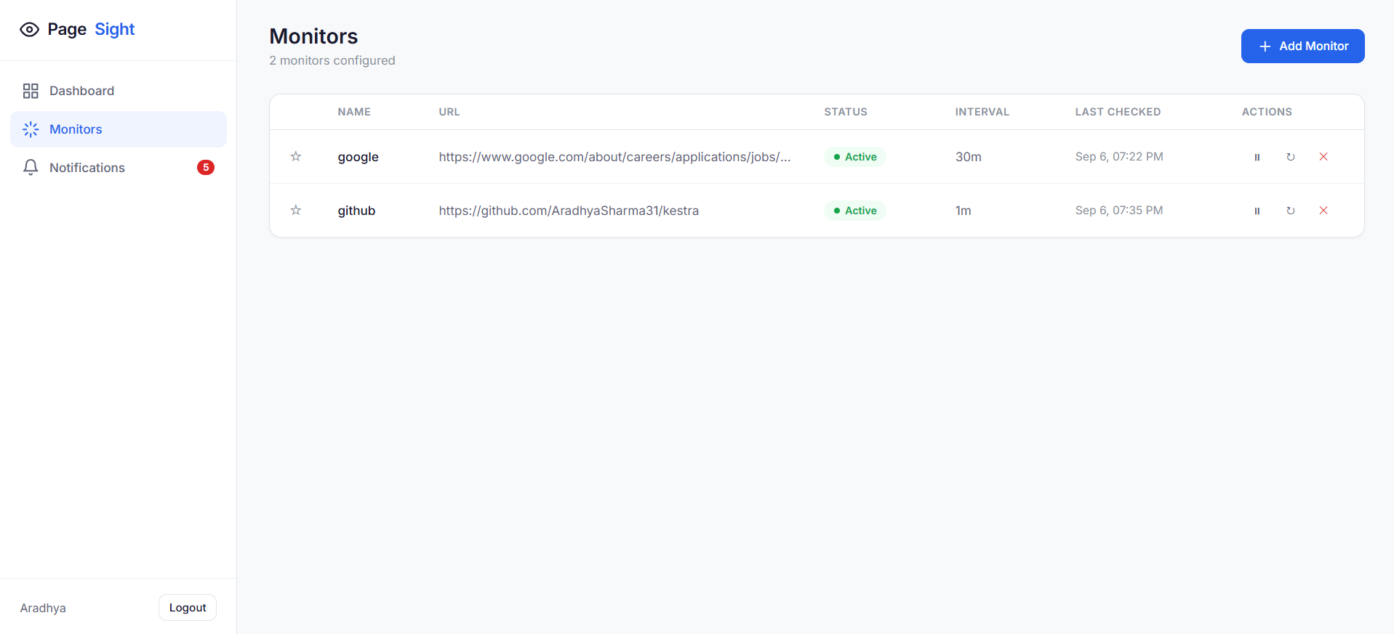
Application Walkthrough
PageSight
6

Slide 8
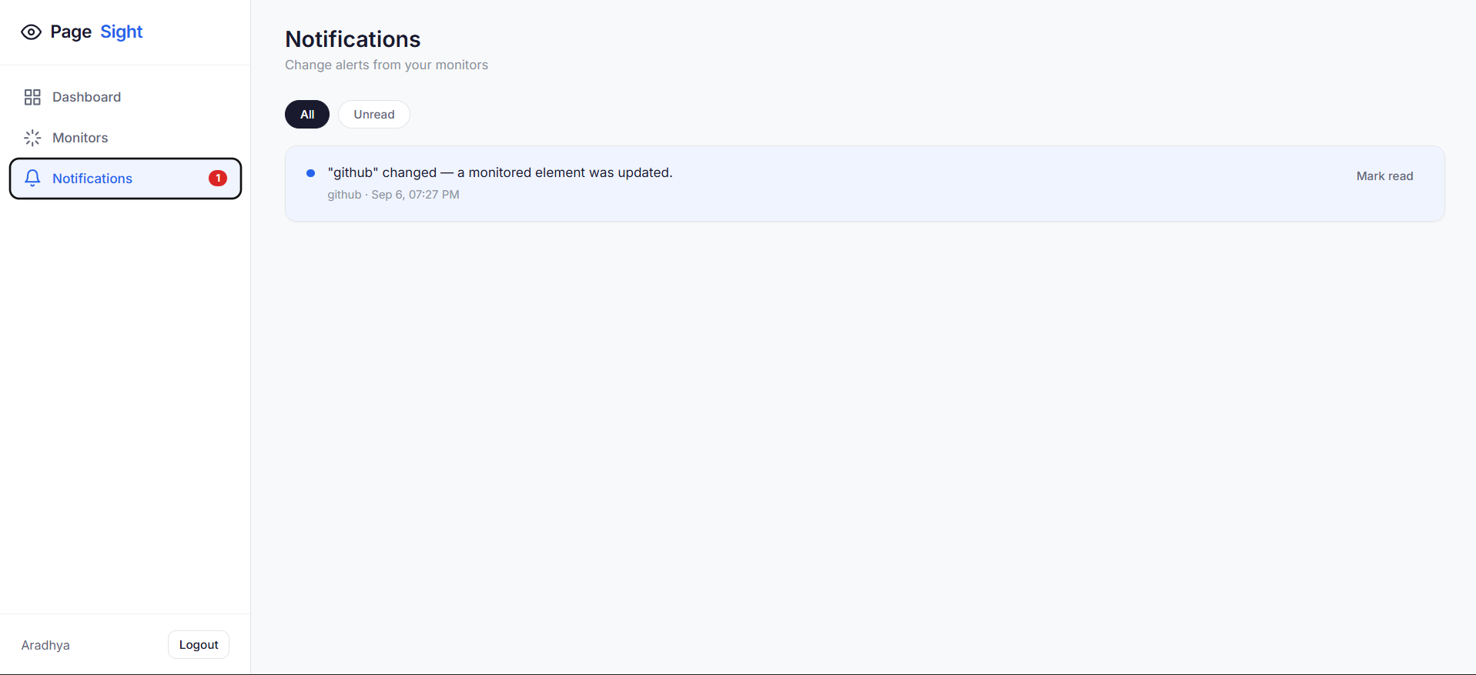
Application Walkthrough
PageSight
6

