Slide 1

MACHINE LEARNING
TM
KAN:KOLMOGOROV ARNOLD NETWORKS
NAME | USN | ROLL NO.
NIHAL JAIN | 01FE22BCI022 | 120
VIGNESH CHOUGULE | 01FE22BCI007 | 107
ARADHYA GAONKAR | 01FE22BCI019 | 117
NIKHIL DESHPANDE | 01FE22BCI017 | 115

Slide 2
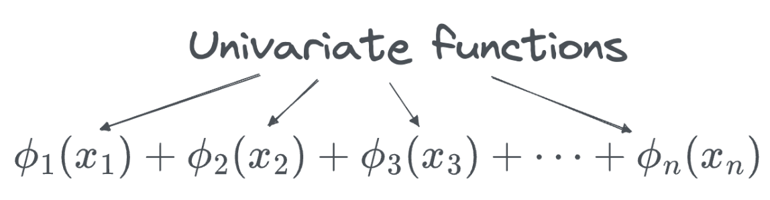
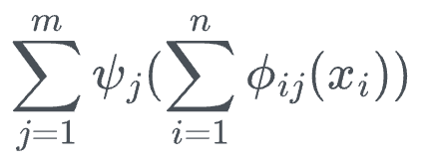
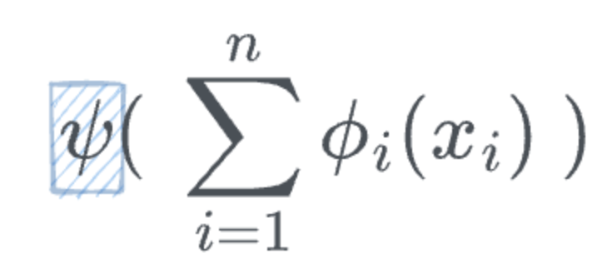
MACHINE LEARNING
TM
What is Kolmogorov Arnold Networks(KAN)?
Kolmogorov-Arnold Networks (KANs) refer to a theoretical concept in mathematics and neural networks that draws from the Kolmogorov-Arnold representation theorem. This theorem provides a powerful insight into the ability to represent multivariable continuous functions as a superposition of simpler, univariate functions.

Slide 3
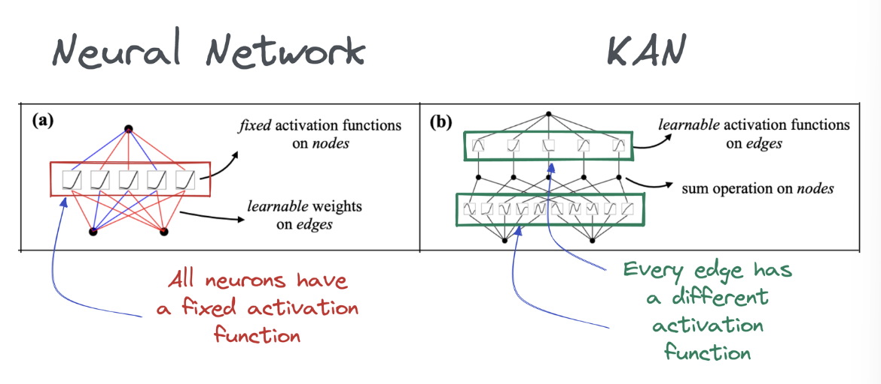
MACHINE LEARNING
TM

Slide 4
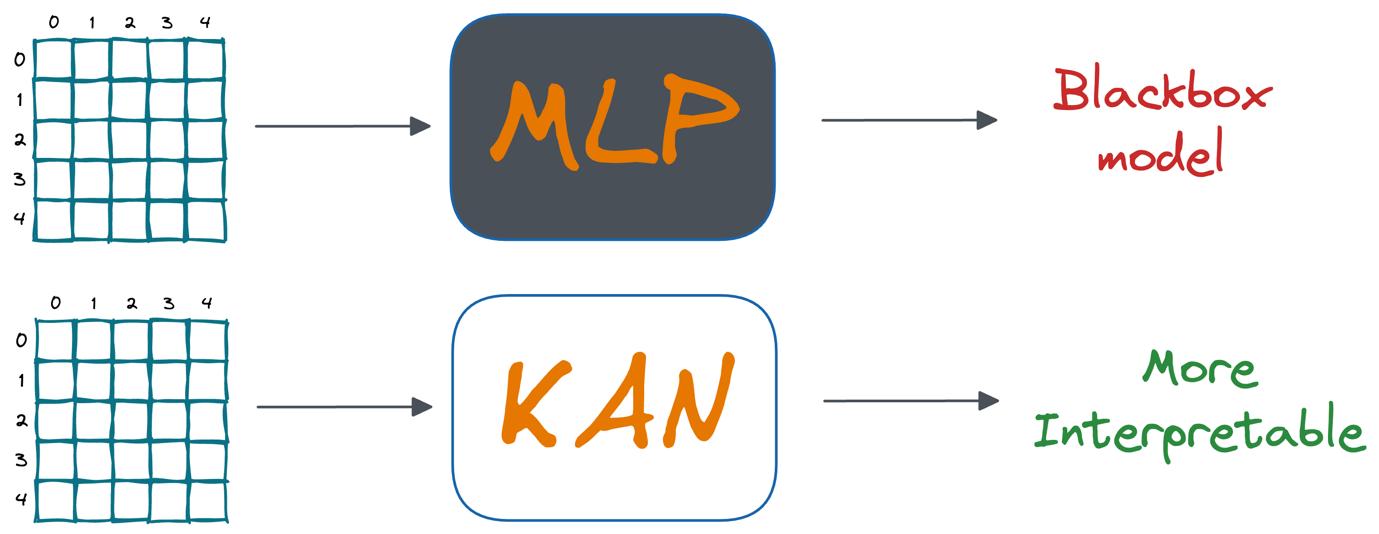
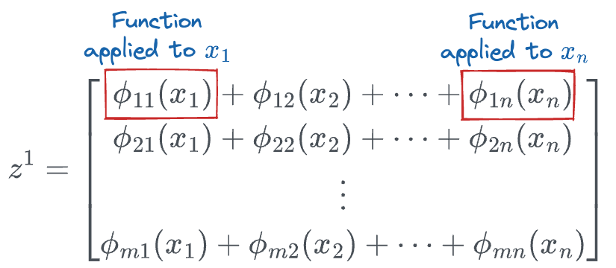
MACHINE LEARNING
TM
Key Differences
Scope:
Universal Approximation: For neural networks to approximate any continuous function.
Kolmogorov-Arnold: Broader theorem, now used in neural networks for precise function representation.
Approach:
Universal Approximation: Function approximation.
Kolmogorov-Arnold: Exact representation via sums of univariate functions for higher accuracy.
Application:
Universal Approximation: Validates neural network capability in ML.
Kolmogorov-Arnold: Enables efficient, precise function representation in networks like KAN

Slide 5
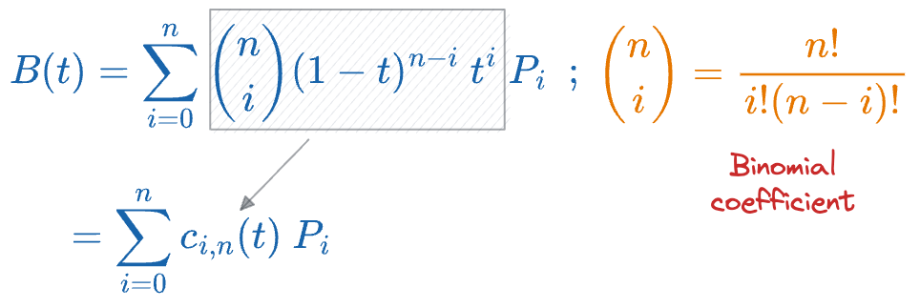
MACHINE LEARNING
TM
How do we make Functions Learnable?
Control Points!
Bezier Curves were used first for making the continuous curves using control points. But they have a problem, i.e., having 100 data points will result in a polynomial of degree 99, which will be computationally expensive. Moreover, the factorial terms are going to be equally hard to compute as well.

Slide 6
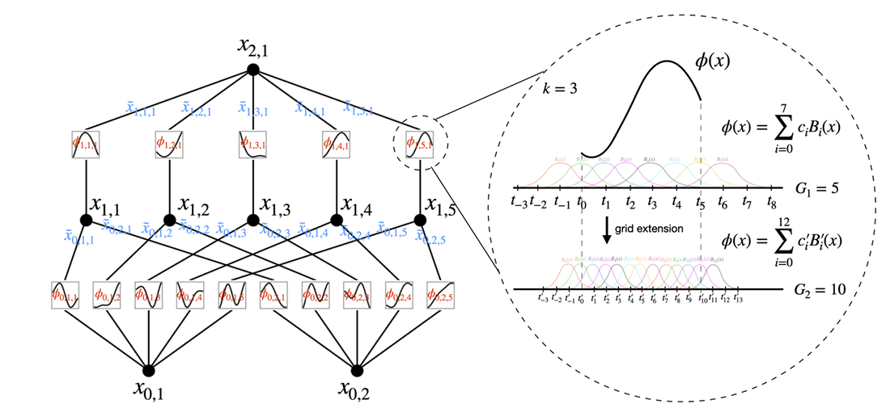
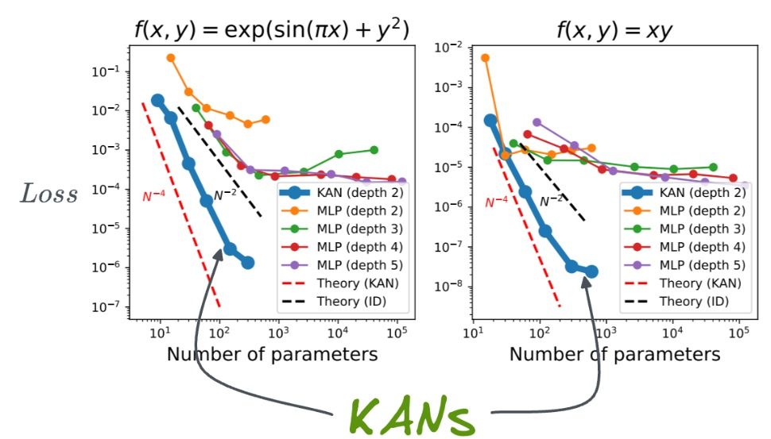
KAN:KOLMOGOROV–ARNOLD NETWORKS
TM
Problem Statement : Multi-Layer Perceptrons (MLPs), while key in deep learning, face issues like poor interpretability and inefficiency in function approximation, especially with high-dimensional data. MLPs use fixed activation functions, limiting adaptability.
Implementation:
KANs use learnable B-splines for univariate functions.
Layers contain trainable 1D functions.
Better than MLPs in accuracy and interpretability.
Ideal for compositional data tasks.
Results: KANs match or surpass larger MLPs in accuracy for function fitting tasks, showing faster scaling. They also enhance interpretability through their structure, allowing intuitive visualization. Case studies in knot theory and Anderson localization highlight KANs' potential to help scientists rediscover mathematical and physical laws, showcasing their value as collaborative tools.
Objectives:
KANs use learnable edge-based activations.
Better accuracy and interpretability than MLPs.
Ideal for function fitting and small-scale tasks.
Conclusion: The findings support the hypothesis that KANs are promising alternatives to MLPs, with potential implications for improving deep learning models that currently rely heavily on MLP architectures.
References:
Sergei Gukov, James Halverson, and Fabian Ruehle. Rigor with machine learning from field theory to the poincaréconjecture. Nature Reviews Physics, 2024
Methodology:
KANs are based on the Kolmogorov-Arnold theorem, which represents multivariate functions as compositions of univariate functions.
Weights are replaced by learnable spline functions, and nodes perform summations without non-linearities.
The architecture is flexible and supports deep networks.
Simplification and grid extension techniques improve interpretability and accuracy.
KANs outperform MLPs in tasks like data fitting and solving PDEs.

Slide 7
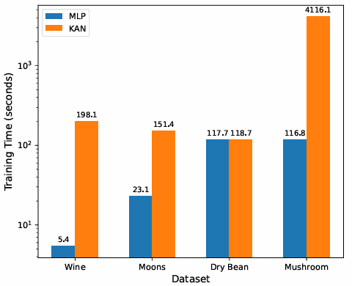
Exploring the Limitations of Kolmogorov-Arnold Networks in Classification: Insights to Software Training and Hardware Implementation
TM
Problem Statement : To assess the practical efficiency and hardware performance of Kolmogorov-Arnold Networks (KANs) in classification tasks, comparing them to the widely used Multi-Layer Perceptrons (MLPs).
Implementation :
Data Preparation: Each dataset was preprocessed, ensuring a suitable format for model training.
Model Configuration: Model configurations included specific neuron counts per layer for MLPs and established parameters such as grid size and model dimensions for KANs.
Training Process: Both models underwent training, with performance metrics recorded, including:
Results : Performance Metrics: KANs demonstrated lower accuracy than MLPs on complex datasets while consuming more hardware resources. Training Times: Training durations varied significantly; for example, training times for KANs were notably longer across all datasets compared to MLPs. Loss Curves: The loss curves indicated that MLPs generally achieved lower loss values more quickly than KANs during training phases. Overall, the findings suggest that while KANs have potential, further optimization is necessary to enhance their practical applicability in classification tasks.
Methodology:
Datasets: Four classification datasets were selected to evaluate the models: Moons (binary classification), Wine (three-label), Dry Bean (seven-label), and Mushroom (binary classification).
Model Training: Both KANs and MLPs were trained on each dataset, tracking accuracy and loss over epochs. MLPs used varying architectures with different neuron counts and activation functions, while KANs were configured with B-spline functions based on the Kolmogorov-Arnold theorem.
Hardware Implementation: The models were implemented using Vitis high-level synthesis (HLS) to analyze resource utilization and performance metrics
Objective:
To assess the classification accuracy of KANs relative to MLPs across diverse datasets.
To evaluate the efficiency of KANs in hardware implementations compared to MLPs.
To identify trade-offs between model accuracy and resource utilization for both neural network types
Conclusion : The study finds that KANs do not consistently outperform MLPs in classification tasks, especially on complex datasets. Despite their theoretical advantages, KANs often demand more computational
resources without significant
accuracy gains, making MLPs the
more effective choice for practical
applications.
References:
L. C. Evans, Partial differential equations. American Mathematical Society, 2022, vol. 19.
Xilinx, “Vitis high-level synthesis user guide,” 2023.

Slide 8
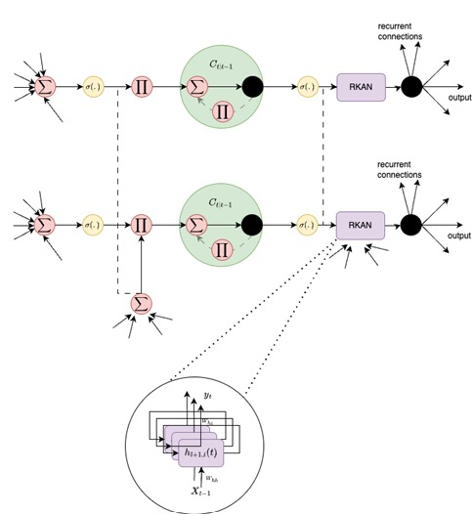
TKAN: Temporal Kolmogorov-Arnold Networks
TM
Problem Statement : Traditional models like RNNs, LSTMs, and MLPs struggle with capturing long-term dependencies in time series forecasting, resulting in poor multi-step prediction accuracy. These models face challenges like vanishing gradients, instability, and computational inefficiency, limiting their performance on complex sequential data.
Implementation:
Model design: TKAN combines RKAN layers with a modified LSTM cell for handling sequential data.
Memory management: RKAN layers manage short-term memory, while LSTM gating mechanisms control long-term information retention for multi-step forecasting.
Data preprocessing: Two-stage preprocessing (moving medians and MinMax scaling) ensures stable learning.
Experiments: TKAN is tested on real-world cryptocurrency data, predicting Bitcoin's notional volume over multiple steps.
Results: Short-term prediction (1-3 steps): TKAN performs similarly to GRU and LSTM, with small differences in accuracy. Long-term prediction (6-15 steps): TKAN significantly outperforms GRU and LSTM, with R-squared values over 25% higher from 6 steps onward. Model stability: TKAN shows better training and validation stability, reducing loss consistently without overfitting. Memory retention: RKAN layers, combined with LSTM-like cells, improve long-term forecasting accuracy. Computational efficiency: TKAN is efficient while managing memory, making it suitable for real-world multi-step forecasting.
Methodology:
Model: Introduces Temporal Kolmogorov-Arnold Network (TKAN), combining RKANs and LSTM-like mechanisms.
RKAN Layers: Based on Kolmogorov-Arnold's theorem, using B-spline activations to handle nonlinearities.
Memory management: Efficiently retains short- and long-term dependencies with LSTM-like gating mechanisms.
Data: Trained on real-time cryptocurrency market data from Binance for volume forecasting across multiple assets.
Training: Uses an 80/20 training/testing split, Adam optimizer, RMSE as the loss function, and R-squared (R²) for performance evaluation.
Conclusions: TKAN enhances multi-step time series forecasting by using RKAN layers with memory management and LSTM-like gating, improving long-term dependency capture. It outperforms GRU and LSTM in experiments on market data, achieving higher R-squared values and more stable predictions.
Objective:
Create a neural network that handles long-term dependencies in time series forecasting.
Combine Kolmogorov-Arnold Networks (KAN) with LSTM-like memory management.
Improve multi-step prediction accuracy and ensure computational efficiency.
Outperform traditional methods like LSTMs and GRUs, especially for long-term
Provide more reliable and stable results for complex, real-world data applications.
References:
1. Z. Liu, Y. Wang, S. Vaidya, F. Ruehle, J. Halverson, M. Soljaˇ ci´ c, T. Y. Hou, and M. Tegmark, “Kan: Kolmogorov-arnold networks,” arXiv preprint arXiv:2404.19756, 2024.
2. B. Lim, S. Ö. Arık, N. Loeff, and T. Pfister, “Temporal fusion transformers for interpretable multi-horizon time series forecasting,” International Journal of Forecasting, vol. 37, no. 4, pp. 1748–1764, 2021.

Slide 9
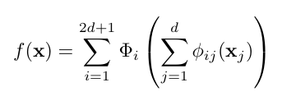
KAGNNs: Kolmogorov-Arnold Networks meet Graph Learning
TM
Problem Statement : using Kolmogorov-Arnold Networks (KANs) to replace multi-layer perceptrons in Graph Neural Networks (GNNs) to improve performance in node and graph classification and regression tasks.
Implementation:
Datasets: Conducted experiments on various benchmark datasets for node classification (e.g., Cora, Citeseer), graph classification (e.g., MUTAG, IMDB), and graph regression (ZINC-12K, QM9).
Hyperparameters: Tuned using Optuna with key hyperparameters like grid size, spline order, and learning rate optimized per dataset.
Training Process: Models were trained using the Adam optimizer with early stopping. Performance was validated using cross-validation for reliable results.
Results Node Classification: KAGIN outperformed GIN in 6 of 7 datasets with up to 20% accuracy improvement on Cora and Citeseer, while KAGCN slightly exceeded GCN in 3 datasets, particularly on homophilic networks; KAN models also excelled on heterophilic networks compared to MLP-based models. Graph Classification: KAGIN outperformed GIN on 5 out of 7 datasets, though the difference in performance was small. Training Time: KAGIN had slightly higher computational costs than GIN, especially with larger grid sizes and spline orders, but the improvement in performance justified the increased training time.
Methodology:
Developed KAGIN (Kolmogorov-Arnold Graph Isomorphism Network) and KAGCN (Kolmogorov-Arnold Graph Convolutional Network) as GNN variants replacing MLPs with KANs.
Utilized Kolmogorov-Arnold Theorem, which represents multivariate functions using sums of univariate functions.
Applied KAN layers in place of fully-connected MLP layers for node updates in GNNs, ensuring theoretical universal approximation power.
Evaluated these models on node classification, graph classification, and graph regression tasks
Emphasized the use of splines for univariate function approximation in KANs, adding a layer of smoothness and interpretability to the models.
Objective:
Explore the expressive power, training efficiency, and suitability of KANs for regression tasks.
Assess the performance of KANs compared to MLPs in graph learning tasks.
Investigate the impact of KANs on node and graph classification tasks.
References:
Minjong Cheon. Kolmogorov-arnold network for satellite image classification in remote sensing. arXiv preprint arXiv:2406.00600, 2024.
Remi Genet and Hugo Inzirillo. Tkan: Temporal kolmogorov-arnold networks. arXiv preprint arXiv:2405.07344, 2024.
Conclusion:KANs outperform MLPs in GNNs, especially in graph regression tasks, due to their superior performance, expressivity in low dimensions, and better interpretability for smooth and structured functions...

Slide 10
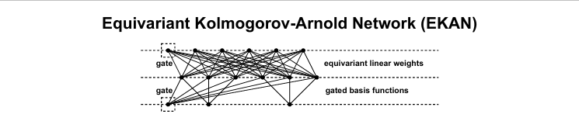
EKAN-Equivariant Kolmogorov-Arnold Network
TM
Problem Statement: The paper "Equivariant Kolmogorov-Arnold Networks (EKAN)" enhances KANs by integrating matrix group equivariance, improving accuracy and parameter efficiency for tasks requiring symmetry, like particle scattering and three-body problems, where traditional KANs underperform.
Implementation:
Architecture: Stacks layers of gated spline basis functions, solving for equivariant linear weights.
Lift Layer: Preprocesses raw input to align it with the feature space.
Applications: Tested on symmetry tasks like particle scattering and three-body problem.
Comparison: Evaluated against baseline models like EMLP and KAN across varied training set sizes.
Results: 1. EKAN reduced test mean square error (MSE) by several orders of magnitude compared to MLPs and KANs in particle scattering tasks. 2. In the three-body problem, EKAN consistently outperformed baseline models, saving up to 90% of parameter overhead. 3. EKAN achieved comparable results to EMLP in top quark tagging tasks using only 26% of the parameters. 4. EKAN exhibited robustness across various training set sizes, maintaining high accuracy even with small datasets. 5. The model demonstrated improved generalization on symmetry-related tasks, outperforming KANs and matching or surpassing EMLP’s performance.
Methodology:
Proposal: EKAN embeds matrix group equivariance into KANs using gated spline basis functions and equivariant linear weights.
Symmetry: Ensures the network respects inherent data symmetry.
Layers: Consist of gated input/output spaces, aligned via a lift layer.
Application: Tested on symmetry-related tasks, comparing performance to MLPs, KANs, and EMLP models.
Objective:
Enhance Kolmogorov-Arnold Networks by embedding matrix group equivariance.
Extend application to tasks involving symmetry, like physical simulations and particle physics
Improve accuracy and parameter efficiency, particularly in symmetry-related tasks.
Conclusion : EKAN successfully integrates equivariance into KANs, enabling them to outperform non-equivariant models like MLPs and KANs on tasks with known symmetries. The results demonstrate that EKAN provides higher accuracy and requires fewer parameters than its counterparts, particularly in tasks involving symmetry, such as particle scattering. EKAN shows promise as a general framework for applying KANs to a wide variety of fields, potentially broadening their applicability to areas like computer vision and natural language processing.
References:
Minjong Cheon. Demonstrating the efficacy of Kolmogorov-Arnold networks in vision tasks. arXiv preprint arXiv:2406.14916, 2024a.
Minjong Cheon. Kolmogorov-Arnold network for satellite image classification in remote sensing. arXiv preprint arXiv:2406.00600, 2024b.
Taco Cohen and Max Welling. Group equivariant convolutional networks. In International Conference on Machine Learning, pp. 2990–2999. PMLR, 2016

Slide 11
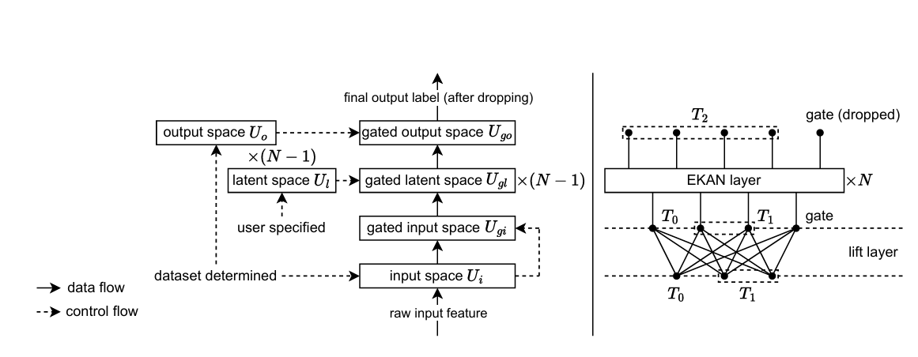
EKAN-Equivariant Kolmogorov-Arnold Network
TM
Gated Spline Basis Functions:
Gated splines ensure basis functions are modified based on symmetry constraints (e.g., rotational or reflectional).
Maintains symmetry-aware activations through gate scalars.
Equivariant Linear Weights:
Ensures transformations respect symmetry requirements.
Uses constraints to make linear transformations invariant under group operations (e.g., rotation matrices).
Lift Layer:
Aligns input space with the equivariant requirements of the architecture.
Ensures data is preprocessed correctly for the EKAN layers.

Slide 12
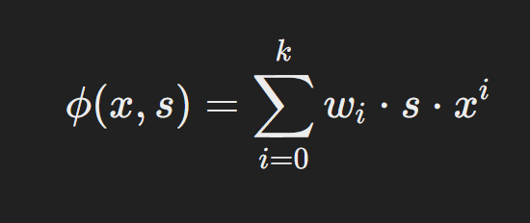
EKAN-Equivariant Kolmogorov-Arnold Network
TM
Tasks and Results:
Particle Scattering:
EKAN achieves lower test error than KAN and EMLP with fewer parameters.
Demonstrates EKAN’s accuracy and parameter efficiency on tasks with known symmetries.
Three-Body Problem:
EKAN outperforms baseline models by orders of magnitude.
Shows EKAN’s robustness in handling chaotic systems with rotational symmetry.
Top Quark Tagging:
EKAN performs comparably to EMLP with only 26% of the parameters, indicating its efficiency even in complex non-symbolic tasks.

Slide 13
EKAN-Equivariant Kolmogorov-Arnold Network
TM
Conclusion and Future Directions
Conclusion:
EKAN combines symbolic representation (KAN) with symmetry-awareness (EMLP).
Outperforms both KANs and EMLP on tasks requiring both attributes.
Potential Applications:
Scientific computing, computer vision, and natural language processing.
Could be used as a general framework for tasks that require respecting data symmetry.
Future Work:
Extending EKAN to broader fields.
Refining equivariant constraints for specific real-world applications.

Slide 14
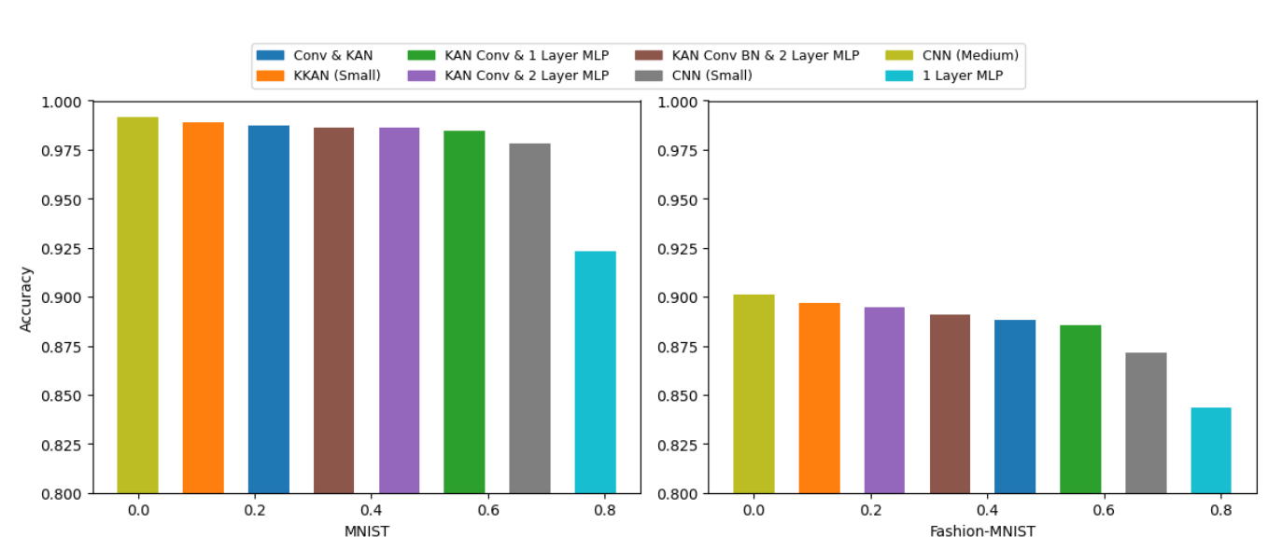
Convolutional Kolomogrov-Arnold Networks
TM
Problem Statement : The paper addresses the challenge of traditional Convolutional Neural Networks (CNNs) being inefficient when it comes to handling complex data. It proposes Convolutional KANs as a solution that uses fewer parameters while maintaining similar accuracy.
Implementation:
Architecture Design: Each connection in the network uses spline functions instead of static weights.
KAN Convolutions: The convolution operation is adapted to use these spline-based functions, allowing for more flexible responses to input data.
Results : Convolutional KANs perform similarly to traditional CNNs in terms of accuracy but require about half the number of parameters. This reduction in parameters allows for faster training and better efficiency in learning from complex datasets.
Objective:
The main goal is to show that Convolutional KANs can achieve high accuracy with fewer parameters compared to traditional CNNs, making them more efficient for image processing tasks.
Methodology:
Integration of KANs: The authors adapt the KAN architecture to convolutional layers, replacing fixed activation functions with learnable spline functions.
Empirical Testing: They compare the performance of Convolutional KANs against traditional CNNs using datasets like MNIST and Fashion-MNIST.
Conclusion :
Convolutional KANs represent a significant advancement in neural network design, offering a more efficient way to model complex relationships in images. They set a new standard for future research in deep learning architectures.
References:
Bodner, A. D., Spolski, J. N., Tepsich, A. S., & Pourteau, S. (2024). Convolutional Kolmogorov-Arnold Networks. Universidad de San Andrés
Ziming Liu. Kan: Kolmogorov–arnold networks. arXiv preprint arXiv:2404.19756, 2024.

Slide 15
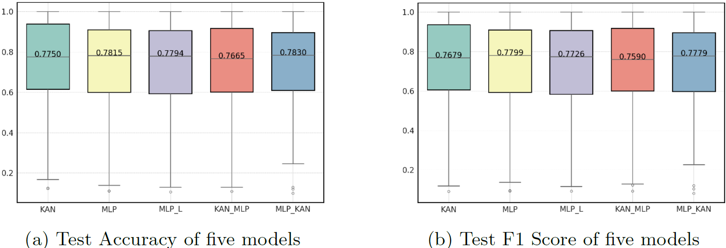
Kolmogorov-Arnold Networks (KAN) for Time Series Classification and Robust Analysis
TM
Problem Statement:
The paper investigates the use of Kolmogorov-Arnold Networks (KAN) for time series classification, comparing their performance and robustness to traditional MLPs.
Implementation :
Use UCR 128 time series datasets for model training.
Construct a multi-layer KAN with B-spline activations and batch normalization
Train the model with the AdamW optimizer for 1000 epochs.
Test robustness via PGD adversarial attacks and compare performance with MLP and hybrid models.
Results : KANs outperformed MLPs on certain time series datasets, especially in terms of robustness. KAN models maintained higher accuracy with fewer parameters compared to MLPs. KANs showed superior resistance to adversarial attacks, improving stability in challenging scenarios. Ablation studies revealed that the base function played a more significant role than the B-spline component in classification accuracy. Larger grid sizes complicated optimization, leading to performance drops in some cases.
Methodology:
Conduct a comparison across 128 UCR time series datasets between KAN, MLP, and hybrid models (KAN-MLP, MLP-KAN).
Train KAN models with multi-layer architecture using B-spline activations.
Perform an ablation study on the contributions of KAN’s spline and base components by varying grid sizes.
Use batch normalization to keep inputs within the B-spline fitting interval.
Assess model robustness through adversarial attacks using PGD with different perturbation magnitudes.
Objective:
Evaluate the performance of KAN for time series classification compared to MLP and hybrid models.
Analyse the contribution of KAN’s B-spline and base components in classification accuracy.
Assess KAN’s robustness against adversarial attacks.
Investigate the impact of varying grid sizes on KAN performance and optimize model configurations.
Conclusions: The paper concludes that Kolmogorov-Arnold Networks (KANs) perform as well as, or better than, traditional MLPs in classifying time series data. KANs are especially robust against adversarial attacks, meaning they can resist attempts to mislead the model, while maintaining accuracy. Their ability to achieve this with fewer parameters makes them efficient alternatives to MLPs.
References:
Liu, Z., Wang, Y., Vaidya, S., et al. "Kolmogorov-Arnold Networks." arXiv preprint
arXiv:2404.19756, 2024.

Slide 16
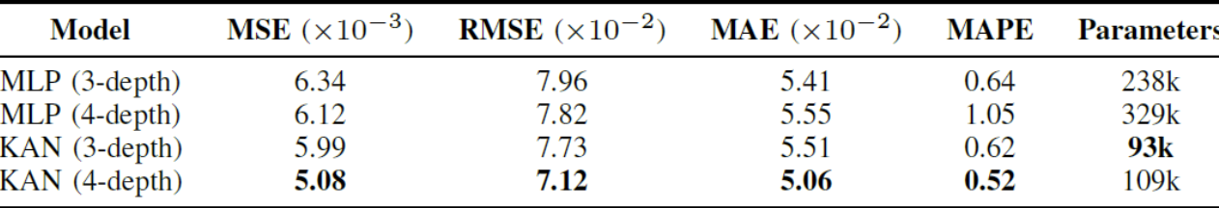
Kolmogorov-Arnold Networks (KANs) for Time Series Analysis
TM
Problem Statement:
The paper aims to apply KANs to time series forecasting, focusing on real-world satellite traffic data, to improve prediction accuracy.
Implementation:
Use satellite traffic data with context/prediction lengths of 168/24 hours.
Construct KAN and MLP models with 3- and 4-layer architectures.
Train using Adam optimizer and evaluate performance on test beams.
Analyse KAN-specific parameters (nodes, grid sizes).
Results : Lower Errors: KAN models outperformed MLPs in error metrics (MSE, RMSE, MAE), offering more accurate predictions. Fewer Parameters: KANs used fewer parameters (109k vs. 329k for MLP) while maintaining high accuracy. Adaptability: KANs handled sudden traffic shifts better than MLPs, adjusting quickly to dynamic changes. Parameter Impact: Larger grid sizes and more nodes improved KAN’s performance. Generalization: KANs maintained robust performance across different satellite beams.
Methodology:
Use KANs with adaptive spline-based activations.
Compare KANs with MLPs in satellite traffic forecasting.
Conduct an ablation study on KAN parameters.
Train models with a 168-hour context and 24-hour prediction length.
Objectives:
Demonstrate the effectiveness of KANs in time series forecasting, focusing on satellite traffic data.
Compare the forecasting performance of KANs and MLPs to evaluate accuracy and parameter efficiency.
Analyze the impact of KAN-specific parameters (nodes and grid sizes) on model performance.
Highlight the advantages of KANs in reducing the number of trainable parameters while maintaining high prediction accuracy.
Conclusion: KANs consistently outperform MLPs, providing better forecasting accuracy with fewer parameters. Their parameter efficiency makes them suitable for real-world traffic forecasting, especially when computational resources are limited.
References:
O. B. Sezer, M. U. Gudelek, and A. M. Ozbayoglu, “Financial time
series forecasting with deep learning: A systematic literature review:
2005–2019,” Applied soft computing, vol. 90, p. 106181, 2020.

Slide 17
SUMMARY
Promising Alternative to MLPs: KANs are considered promising alternatives to Multi-Layer Perceptrons (MLPs), showing potential for improving deep learning models, particularly in terms of parameter efficiency and performance in various domains.
Limitations in Complex Classification: While KANs have theoretical advantages, they do not consistently outperform MLPs in classification tasks on complex datasets. They also tend to require more computational resources without significant accuracy improvements in practical applications.
Superior Performance in Time Series Forecasting (TKAN): Temporal Kolmogorov-Arnold Networks (TKAN) enhance multi-step time series forecasting, outperforming GRU and LSTM models. TKAN excels in capturing long-term dependencies and provides higher R-squared values and stable predictions.
Efficiency in Graph Learning (KAGNN): KANs outperform MLPs in graph neural network (GNN) tasks, particularly in graph regression. Their expressivity in low dimensions and parameter efficiency make them suitable for resource-constrained environments like traffic forecasting.
Advancements in Image Processing (Convolutional KANs): Convolutional KANs offer an efficient way to model complex relationships in image data, advancing neural network design and setting new standards for future research in deep learning architectures.
Equivariance in KANs (EKAN): EKAN integrates equivariance into KANs, significantly improving performance on tasks involving symmetry, such as particle scattering. EKAN requires fewer parameters and delivers higher accuracy compared to non-equivariant models, demonstrating its broader applicability in fields like computer vision and natural language processing.
Robustness in Time Series Classification: KANs perform as well as or better than traditional MLPs in time series classification tasks. They are particularly robust against adversarial attacks, maintaining accuracy while using fewer parameters, making them efficient and reliable alternatives for time series analysis.

