Slide 1
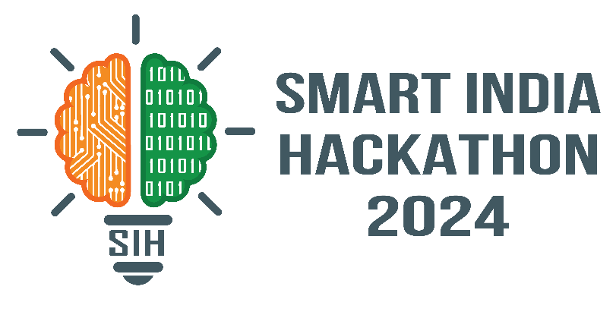
PolluxPenguin
Problem Statement ID – 1593
Problem Statement Title – Student Innovation
Theme- Robotics and Drones
PS Category – Software
Team ID –
Team Name (Registered on portal)- Polluxpenguin

Slide 2
PolluxPenguin
PolluxPenguin
What is PolluxPenguin?:
PolluxPenguin is an AI-Enabled Agentic System that aims at automating and optimizing UAV applications in cinematography, survey, agriculture, defense, emergencies and search and rescue.
The Basic concept is as such:
An RAG(Retrieval Augmented Generation)-LLM sits at the core of the system, generating drone executable code for any particular situation or desired workflow
The LLM is supported by an LVM(Large Vision Model) that provides contextual and visual information of the drone’s environment
This system Provides a framework for LLMs to efficiently interact with a wide range of UAVs and hardware already used in many industries
UAV Industry Problems Solved by PolluxPenguin:
Complex programming requirements
Limited flexibility for hardware integration
D
High costs for customization and maintenance
Inability to adapt quickly to new tasks
Inconsistent real-time performance
Unique Value Propositions (UVP) :
Use of Generative AI in cooperation with traditional Computer Vision to enhance information extraction from the environment.
Simple text-based customization provides unprecedented flexibility
Adaptability to various hardware already used in industry makes adoption seamless and easy

Slide 3
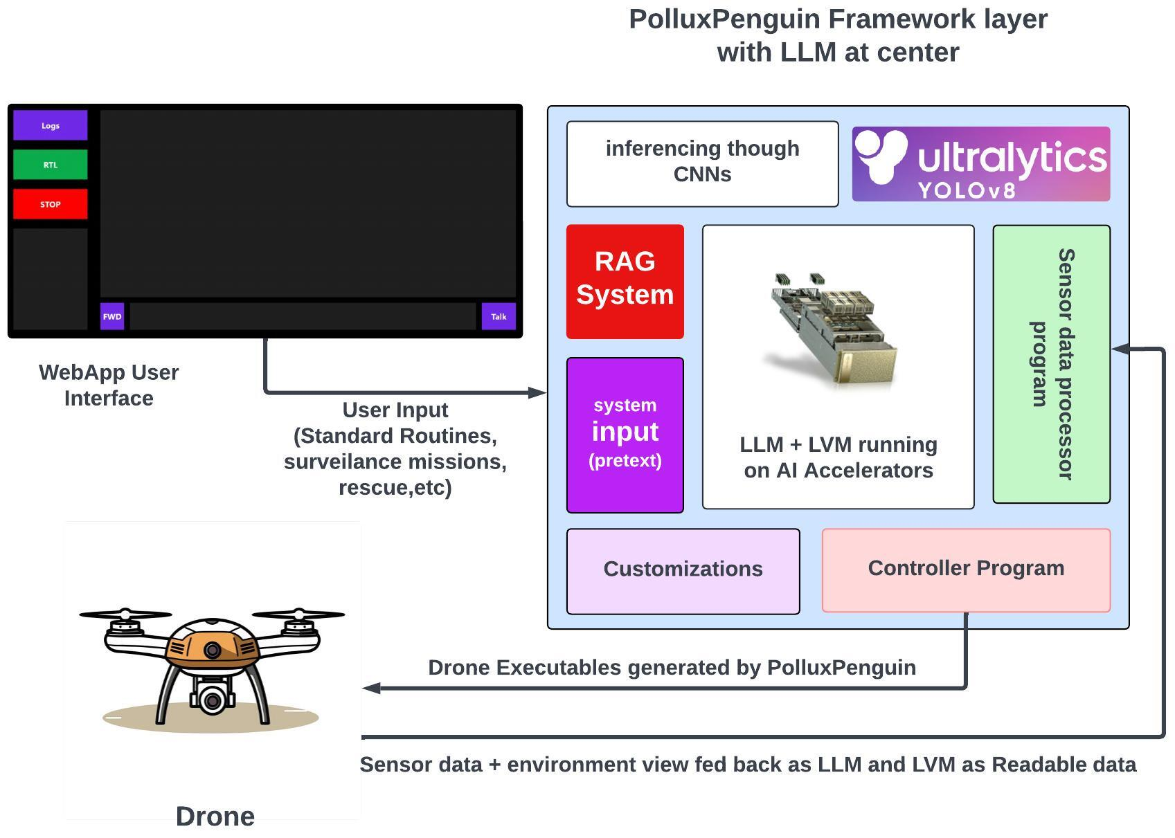
TECHNICAL APPROACH
PolluxPenguin
System Architecture Implementation:
Python and Bash- to implement the system core. LangChain - to build the RAG system.
YOLOv8 is used as the CNN*
Application Development:
React JS + Vite for the frontend web application with Node.js used for backend Framework testing:
Different Ports were written for proprietary LLMs (Google’s Gemini, OpenAI’s ChatGPT, Anthropic’s Claude Sonnet, their frontier and free-tier models)
and Open-Source models (LLAMA 3.1, Phi2, Mixtral, Llama 2, SmOL LM, etc)
PolluxPenguin was connected to Ardupilot’s Iris arducopter (a virtual quadcopter) simulated on GAZEBO simulator running on Ubuntu 20.04 to test the system practically
SYSTEM ARCHITECTURE
*
WebApp UI
to
*CNN = Convolutional Neural Network

Slide 4
FEASIBILITY AND VIABILITY
PolluxPenguin
Feasibility:
Technical: Integrating LLM with RAG for MAVLink* is feasible due to its simple structure. Vision capability boosts navigation, and natural language input enables scalability across virtually every industry using UAVs.
Financial: Initial GPU or cloud costs may be high, but integration with latest lightweight open-source models can lower long term expenses, with strong market demand supporting investment.
Market & Operational: The system’s adaptability to hardware and sub-systems already used in Industry makes adoption extremely easy and simple
Potential challenges and risks:
Challenges include real-time accuracy, hardware compatibility and high computational costs. Robust testing and troubleshooting will be crucial for success.
Strategies for overcoming these challenges:
Use modular testing for hardware
integration.
Fine-tune LLMs with existing protocols.
Optimize algorithms to reduce computation costs.
Implement safety protocols and redundancy.
Use reinforcement learning for adaptability across environments.
*MAVlink = A communication protocol widely used by UAVs

Slide 5
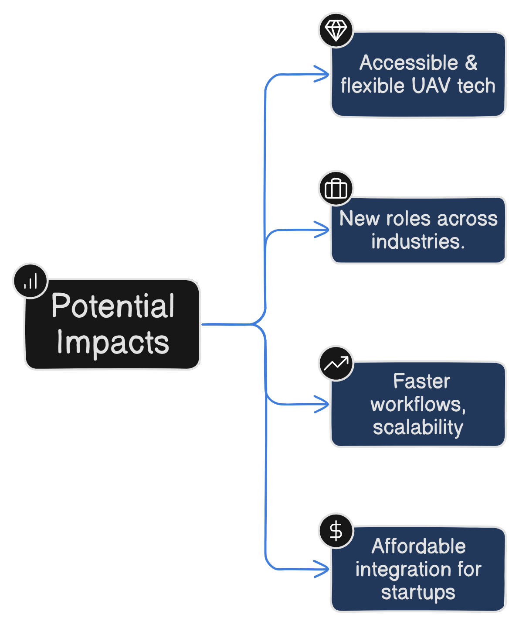
IMPACT AND BENEFITS
PolluxPenguin
Lower Barriers: Reduced technical expertise required for UAV operation improves access, making the technology more affordable and empowering startups and small businesses.
Job Creation: Easier implementation empowers more companies to adopt UAV services, resulting in new job creation across industries and providing an economic boost.
Increased Productivity: Parallelization of workflows boosts productivity, allowing industries to scale efficiently and tap into niche markets, further driving economic growth.
Cost-Effective Integration: LLMs' adaptability reduces overhead costs for UAV integration, leading to faster adoption and minimizing risks associated with complex deployments.
Benefits of the Solution
Improved Access: The system can empower individuals, especially vulnerable populations, by providing quick access to security, such as deploying drones for safety in emergencies.
Empowerment: By simplifying UAV use, it gives people and industries more control over their surroundings.
Reduction: It helps reduce risks in unsafe situations, providing real-time solutions such as deploying a drone for surveillance in case of emergencies, like a woman feeling unsafe.
Economic: Governments can easily implement the system for law enforcement, encouraging investments in UAV infrastructure and creating more jobs.

Slide 6
RESEARCH AND REFERENCES
PolluxPenguin
LLM-informed Drone Visual Inspection for Civil Infrastructure
Authors: Jiucai Liu, Chengzhang Chai, Haijiang Li, Yan Gao, Xiaofeng Zhu
Institution: BIM for Smart Engineering Centre, School of Engineering, Cardiff University, UK
link:https://orca.cardiff.ac.uk/id/eprint/170899/1/%28PrintVersion%29LLM-informed%20drone%20visual%20inspection%20for%20infrastructure.pdf
TypeFly: Flying Drones with Large Language Models
Authors: Guojun Chen, Xiaojing Yu, Lin Zhong
Institution: Yale University
Link: https://arxiv.org/abs/2312.14950
LLM as A Robotic Brain: Unifying Egocentric Memory and Control
Authors: Jinjie Mai, Jun Chen, Bing Li, Guocheng Qian, Mohamed Elhoseiny, Bernard Ghanem
Link: https://repository.kaust.edu.sa/handle/10754/692551
Enhancing the LLM-Based Robot Manipulation Through Human-Robot Collaboration
Authors: Haokun Liu, Yaonan Zhu, Kenji Kato, Atsushi Tsukahara, Izumi Kondo, Tadayoshi Aoyama, Yasuhisa Hasegawa
Link: https://arxiv.org/abs/2406.14097
`

