Slide 1
PolluxPenguin
emini

Slide 2
Talk to your drone
PolluxPenguin
et tasks done
It’s that simple

Slide 3
How does it work?

Slide 4
How do drones work?

Slide 5
How do drones work?
Ground Station
drone
Mavlink messages
(Any Computer, server, which has hardware that connects to the drone’s microcontroller)

Slide 6
Mavlink messages
Special communication Protocol which is used by most open source autopilot firmware distributions
Is basically text in a particular format that the drone’s firmware can interpret

Slide 7
Tr
Is basically text in a particular format that the drone’s firmware can interpret
Traditonally, we have always used API and function calls to generate text as per our requirements
But now, we have a better way of generating text as per our requirements
Large Language Models

Slide 8
Core Components
App/frontend
LLM
Controller – interprets to MAVLINK
Vision modules

Slide 9
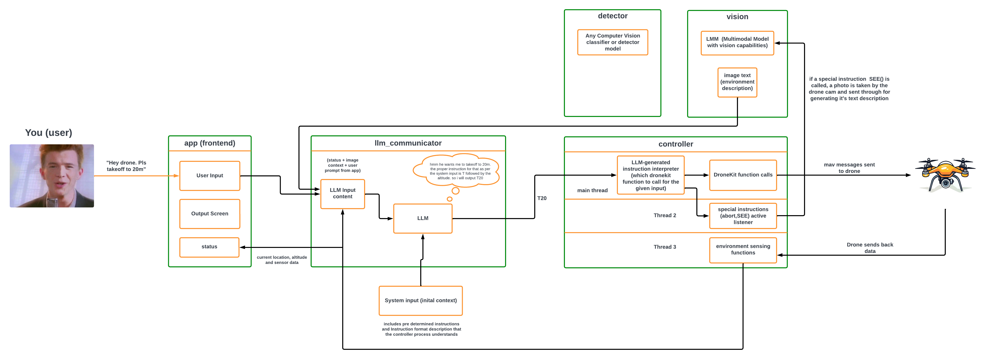

Slide 13
APPLICATIONS
emini

Slide 14
Effortless Food Deliveries
Efficient Logistics
Faster Service
Reduced Costs
PolluxPenguin's precise navigation and autonomous flight capabilities make drone-based food delivery a seamless and reliable reality.
With drones, food can be delivered directly to customers' doorsteps in a fraction of the time, enhancing the overall customer experience.
Drone delivery eliminates the need for traditional transportation, resulting in significant cost savings for businesses and consumers.

Slide 15

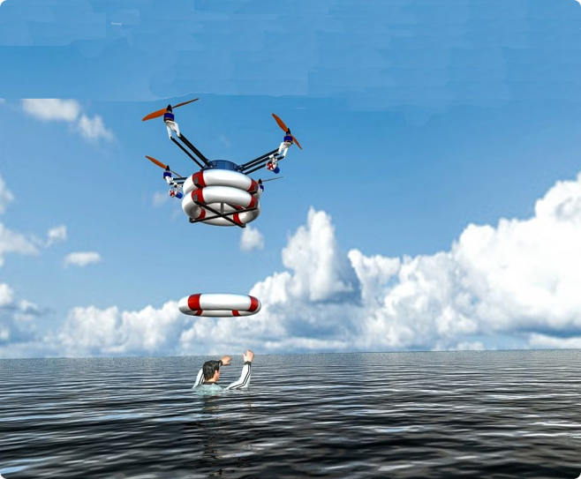
Revolutionizing Rescue Missions
1
Rapid Response
Drones can be deployed quickly to reach remote or inaccessible areas, providing vital aid and support during emergency situations.
2
Aerial Surveillance
PolluxPenguin-powered drones can survey disaster zones, identify survivors, and guide rescue teams to maximize the effectiveness of rescue efforts.
3
Delivery of Supplies
Drones can transport essential supplies, such as medical kits, food, and water, directly to those in need during emergency situations.

Slide 16


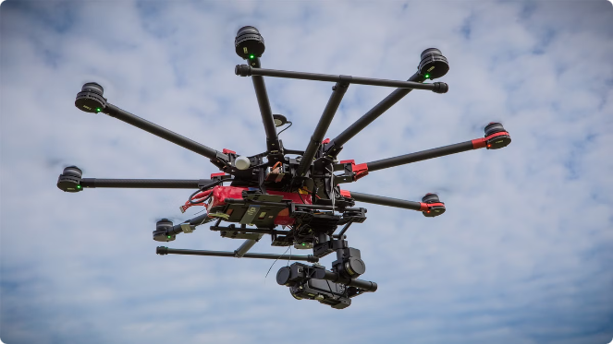


Empowering Filmmakers
Aerial Cinematography
PolluxPenguin's user-friendly interface allows filmmakers to capture breathtaking aerial footage without the need for extensive drone piloting skills.
Artistic Expression
Drones equipped with PolluxPenguin's advanced capabilities unlock new creative possibilities, enabling filmmakers to tell their stories in innovative ways.
Streamlined Production
PolluxPenguin's automated flight and stabilization features save filmmakers time and resources, allowing them to focus on their craft.

Slide 17

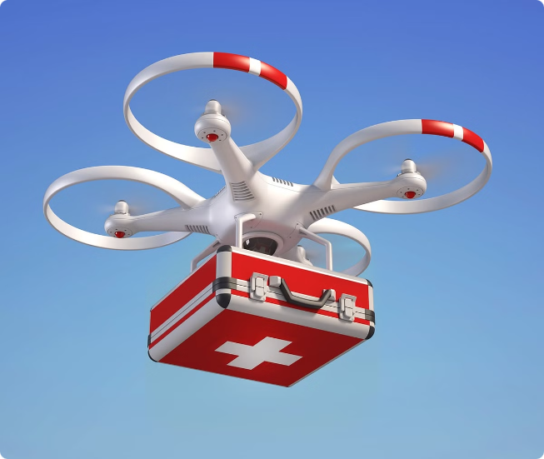



Lifesaving Medical Deliveries
Emergency Response
PolluxPenguin-powered drones can rapidly transport critical medical supplies to remote or inaccessible areas during emergencies.
Reduced Delivery Time
Drones can reach their destinations much faster than traditional ground-based transportation, potentially saving lives in critical situations.
Improved Access
PolluxPenguin's advanced navigation capabilities enable drones to access areas that may be difficult or impossible for other vehicles to reach.

Slide 18

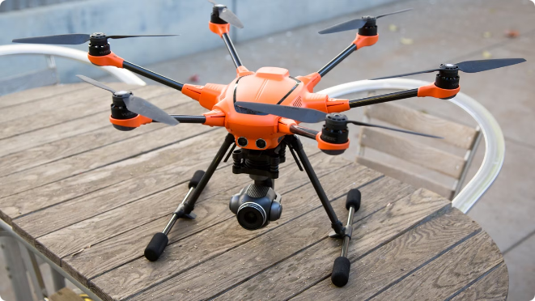
Versatile Applications
1
Agricultural Monitoring
PolluxPenguin-equipped drones can provide farmers with real-time data on crop health, irrigation needs, and pest management, optimizing agricultural operations.
2
Infrastructure Inspection
Drones can be used to inspect bridges, power lines, and other infrastructure, helping to identify potential issues and prioritize maintenance efforts.
3
Environmental Conservation
PolluxPenguin's drones can assist in wildlife tracking, habitat monitoring, and anti-poaching efforts, contributing to the preservation of natural ecosystems.
4
Search and Rescue
Drones equipped with PolluxPenguin's advanced sensors and navigation can aid in search and rescue operations, locating and assisting individuals in need.

Slide 19

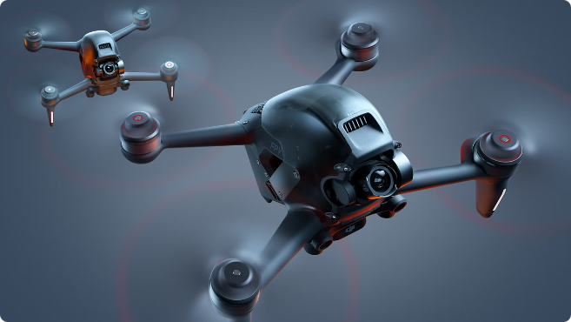
Summary
Automated Flight
PolluxPenguin's algorithms enable drones to navigate and perform complex maneuvers autonomously, reducing the need for manual control.
Precision Sensing
Drones equipped with PolluxPenguin can utilize advanced sensors to gather detailed data and insights, enhancing decision-making capabilities.
Contextual Awareness
Contextual awareness ensures that emergency situations are handled properly

