Slide 1

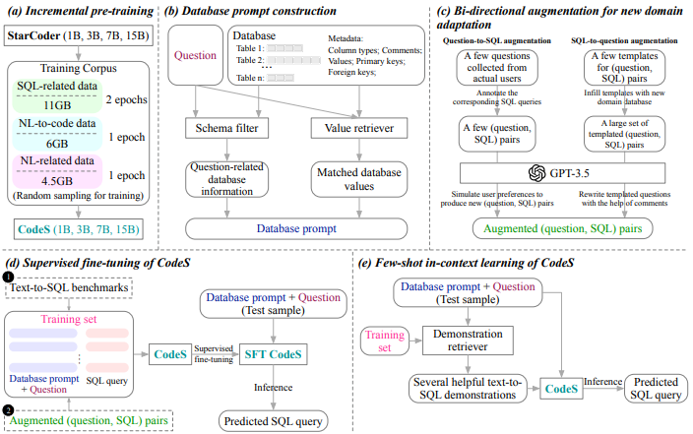
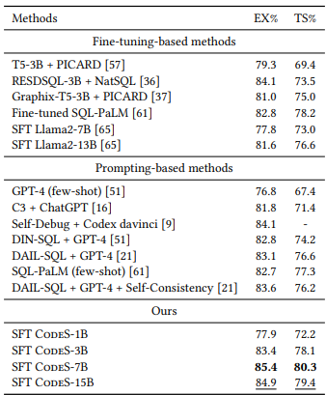
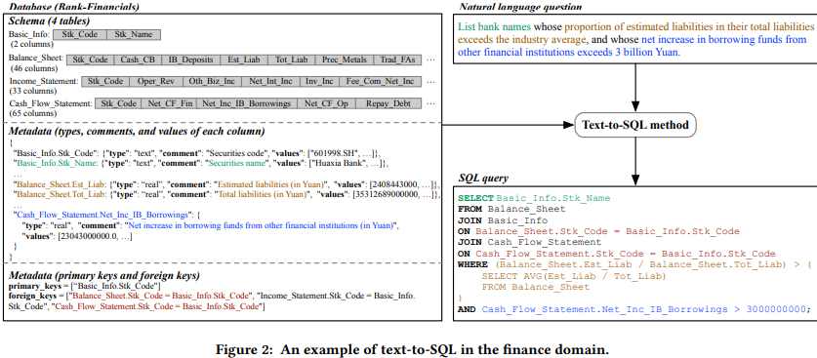
CodeS: Towards Building Open-source Language Models for Text-to-SQL
By: Haoyang Li, Jing Zhang, Hanbing Liu , Ju Fan , Xiaokang Zhang , Jun Zhu , Renjie Wei , Hongyan Pan , Cuiping Li , Hong Chen
TM
Problem Statement : Addressing the limitations of closed-source LLMs for Text-to-SQL with an efficient, open-source alternative.
Implementation:
Figure 3: Illustration of the comprehensive framework
CodeS that is incrementally pre-trained on top of StarCoder using our specially curated SQL-focused dataset.
Our unique method for database prompt construction.
The proposed bi-directional data augmentation technique for adapting to new domains. CodeS can be employed in two distinct manners:
1. Inferring after a supervised fine-tuning of CodeS on a training dataset, sourced from text-to-SQL benchmarks along with our enriched (question, SQL) pairs.
2. Direct inference through few-shot in-context learning on CodeS.
Results: SFT CodeS-3B outperforms the leading GPT4-based method (i.e., DIN-SQL and DAIL-SQL), illustrating the potential of smaller models to excel as text-to-SQL parsers after finetuning. SFT CodeS-7B and SFT CodeS-15B achieve new SOTA performance on Spider’s development set. SFT CodeS-15B demonstrates strong generalization, achieving near SOTA results while remaining significantly smaller than closed-source models like GPT-4.
Methodology:
Incremental pre-training on a curated SQL-related dataset to enhance SQL reasoning.
Schema filtering to handle schema linking (matching database elements with user queries).
Bi-directional data augmentation for generating more text-to-SQL training data in various domains.
Use of smaller LLMs (1B-15B parameters) for efficiency and reduced computational costs.
Objective: To develop an efficient, open-source LLM (CodeS) for Text-to-SQL tasks, to overcome the limitations of existing closed-source models by reducing computational costs, enhancing privacy, and improving adaptability but with state-of-the-art performance on SQL generation results.
References:
Li, H., Zhang, J., Liu, H., Fan, J., Zhang, X., Zhu, J., Wei, R., Pan, H., Li, C., & Chen, H. CodeS: Towards Building Open-source Language Models for Text-to-SQL (2024). arXiv:2402.16347. https://arxiv.org/abs/2402.16347
Conclusion: CodeS achieves state-of-the-art or better results on key text-to-SQL benchmarks (e.g., Spider), outperforming some large closed-source models in certain aspects while offering significant advantages in efficiency, cost, and is also open-source.

Slide 2
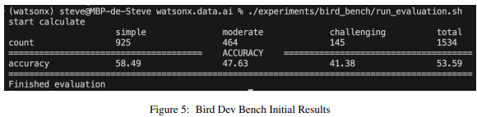
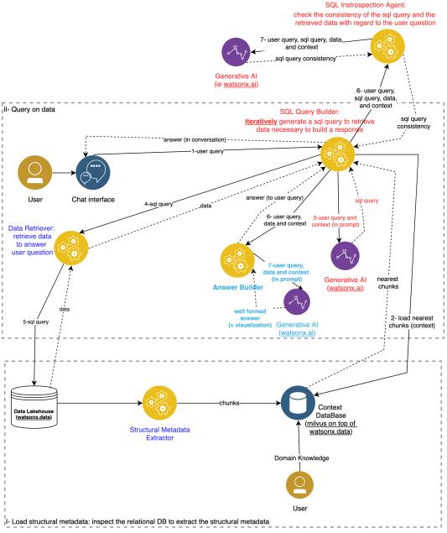
Natural Language Query Engine for Relational Databases using Generative AI
By: Steve Tueno Fotso
TM
Problem Statement : Developing a natural language query engine that accurately translates user queries into SQL while integrating complex business rules and also ensuring syntactic and semantic correctness.
Implementation:
Technology Stack:
Milvus Vector Database: Used to store vectorized representations of the database schema and business rules.
IBM watsonx.data: Acts as the relational database, using its SQL engine (Presto) to handle database queries.
IBM watsonx.ai: Provides Large Language Models (LLMs) like LLama 3 and Mixtral for natural language processing, SQL generation, and natural language responses.
Python for Orchestration: Manages interactions between components and powers the frontend (Streamlit) for user interaction.
SQL Generation and Validation:
SQL Generation: LLMs generate SQL queries based on user input and database structure.
Validation: Ensures the SQL is correct both syntactically (SQL syntax) and semantically (align business rules).
Prototyping and Evaluation:
The system was tested using the BIRD Benchmark to assess its ability to handle various queries, including complex ones with multi-table joins and business rules.
Results: Accuracy on Different Difficulty Levels: The system was tested using the Bird Dev Bench and got an overall accuracy of 53.59%. It worked best with easy queries, getting 58.49% accuracy, while for medium difficulty queries it got 47.63%, and for harder ones it dropped to 41.38%. Testing on IBM’s watsonx Platform: When tested on IBM's watsonx.data and watsonx.ai platforms, the system showed good results, with more than 50% of the queries being correct. Over 90% of the responses in natural language were rated as "excellent" by users who were not technical experts, showing that users were happy with the results.
Methodology:
Figure 4: Architecture of the Prototype of the Natural Language Assistant for Relational Databases
The system first analyzes and vectorizes the database schema (tables, columns, relationships) and stores it in a vector database for quick retrieval during query processing.
Business rules are embedded into the query generation process by vectorizing domain-specific rules and applying them dynamically during SQL generation.
Generated SQL queries go through multiple validation steps—both syntactic and semantic—with iterative adjustments, ensuring accurate results
Objective: To develop a natural language query engine for relational databases using generative AI, which translates user queries into SQL, ensuring syntactic and semantic correctness while also integrating business rules for accurate data retrieval and response generation​.
References:
Fotso, S. T. Natural Language Query Engine for Relational Databases using Generative AI (2024). arXiv:2410.07144. https://arxiv.org/abs/2410.07144
Conclusion: The system makes use of generative AI and vector databases to enable intuitive, natural language querying of relational databases, ensuring SQL accuracy and semantic correctness while enhancing accessibility for all users including people who aren’t familiar with technology.

