Slide 1

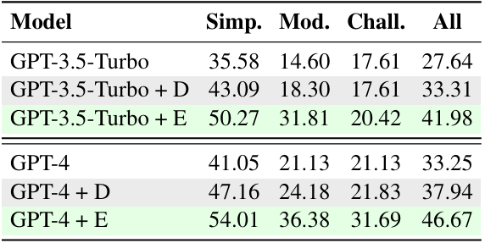
Knowledge-to-SQL: Enhancing SQL Generation with Data Expert LLM
TM
Problem Statement : Generating accurate SQL from natural language queries is challenging because it requires understanding both the user's question and database schema. Large language models often fail when key knowledge is missing, leading to inaccurate or unusable SQL, especially in complex cases
:using PLDBF, which evaluates the generated SQL based on the correctness of its execution and contribution to query accuracy.
SQL Generation: The refined DELLM generates expert knowledge, which is then integrated into the SQL generation process by off-the-shelf text-to-SQL models like GPT-3.5-Turbo or GPT-4.
Results : The experimental results show that incorporating DELLM-generated knowledge improves execution accuracy (EX) and valid efficiency score (VES) across different models: GPT-3.5-Turbo: +5.67% EX, +7.48% VES GPT-4: +4.69% EX, +6.23% VES The results indicate that DELLM improves the performance of even advanced SQL generation models like GPT-4, especially in handling complex or domain-specific queries​(2402.11517v3).
Methodology:
Table Reading: Relevant tables from the database are selected using semantic similarity to the user’s query.
Supervised Fine-tuning (SFT): DELLM generates expert knowledge based on the query and database schema to assist in SQL generation.
Preference Learning via Database Feedback (PLDBF): Feedback is provided based on how well the generated SQL performs, refining DELLM’s knowledge generation capabilities through database execution and ground-truth SQL comparison.
Objective::
To develop a framework that automatically generates expert knowledge to improve text-to-SQL accuracy.
To enhance SQL generation for complex, real-world database queries by incorporating domain-specific and expert-level knowledge without requiring human input.
To create a robust, open-source tool for further research and application in SQL generation tasks.
Conclusion : The Knowledge-to-SQL framework significantly enhances the accuracy and efficiency of SQL generation by large language models. Through the integration of DELLM and its ability to provide expert knowledge, the system is capable of bridging knowledge gaps between the user's natural language query and the underlying database schema. The results demonstrate the effectiveness of the model across multiple datasets, showing considerable improvements in execution accuracy and efficiency.
Implementation :
Supervised Fine-Tuning: This involves training DELLM on a dataset of user queries, associated schemas, and expert-annotated knowledge. The SFT process matches queries to relevant sub-tables and generates the required knowledge.
Preference Learning: After SFT, the model is further refined
References:
Zijin Hong and Jian Liu. 2024. Towards better ques tion generation in qa-based event extraction. arXiv preprint arXiv:2405.10517.
OpenAI. 2023. Gpt-4 technical report. arXiv preprint arXiv:2303.08774.

