Slide 1

Hypothesis
Aksadur Rahman
aksadur@yahoo.com

Slide 2

What is a hypothesis?
A hypothesis is a potential explanation for something that you observe and think to be true. It can also help determine the relationship between two or more variables that you think might relate to each other.
A hypothesis (plural hypotheses) is a proposed explanation for a phenomenon.
For a hypothesis to be a scientific hypothesis, the scientific method requires that one can test it.

Slide 3
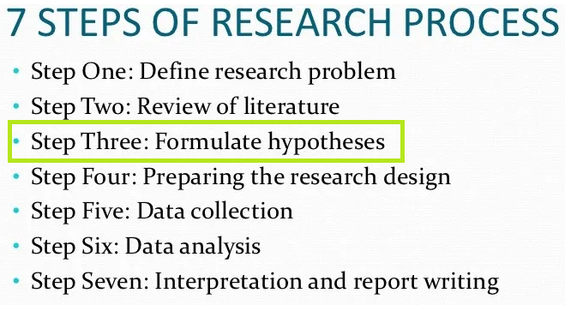

Slide 4
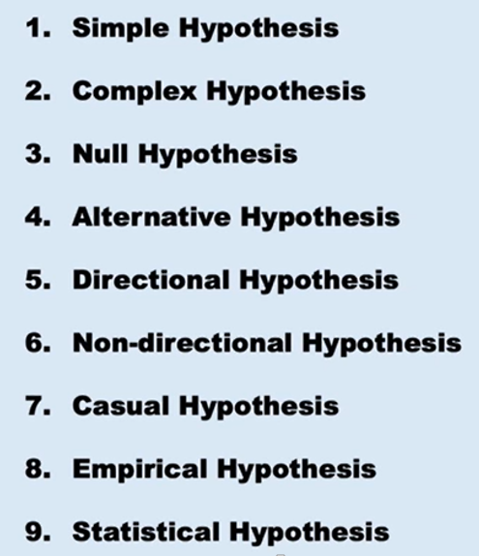
Types of Hypothesis

Slide 5
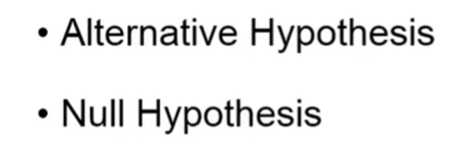
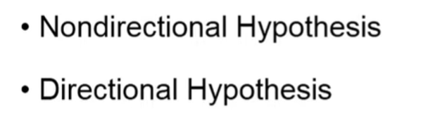
Types of Hypothesis

Slide 6
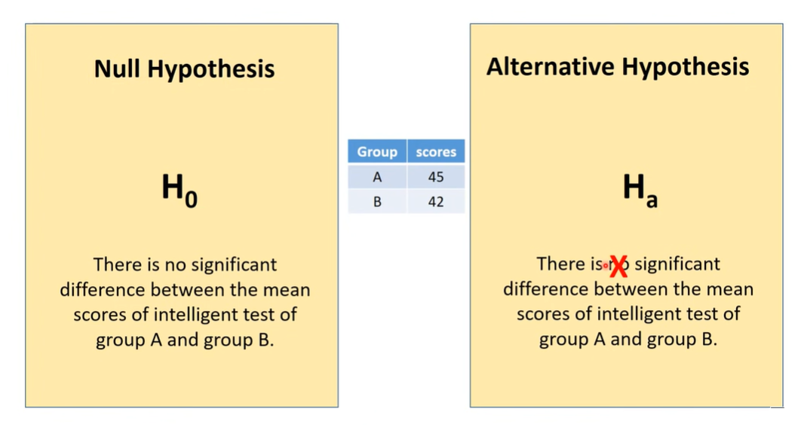

Slide 7
