Slide 1

A Retrieval-Augmented based Agentic Chatbot
Md. Arafat Hossain ID:232220

Slide 2
Introduction
How to design and run a Retrieval-Augmented -based Agentic Chatbot
The system is designed to provide smart response creation with precision, scalability, and friendly interaction with the users.

Slide 3
Limitation of Existing Works
AI creates the wrong or fake information. Which is called hallucination.
AI responses aren’t directly linked to sound source documents.
Getting enhanced learning experiences from AI is difficult.

Slide 4
Problem Statement
No system exists that is efficient, AI-driven and lets users: Use a lot of PDF documents.
Extract, organize and save text information automatically to use it later.
Ask natural language questions and get specific answers, rooted in context, without manual search.

Slide 5
Objective
1. A system that allows students to prepare for their exams by retrieving relevant information stored in the uploaded PDF files (textbook, lecture notes, and study guides).
2. The goal of creating an AI-powered chatbot that provides learners with authentic and interactive feedback to their questions.
3. This platform will be designed to accommodate and serve several heterogeneous groups of users, i.e., students, teachers, and self-learners, into a easy study environment. And users can save time by using this platform

Slide 6
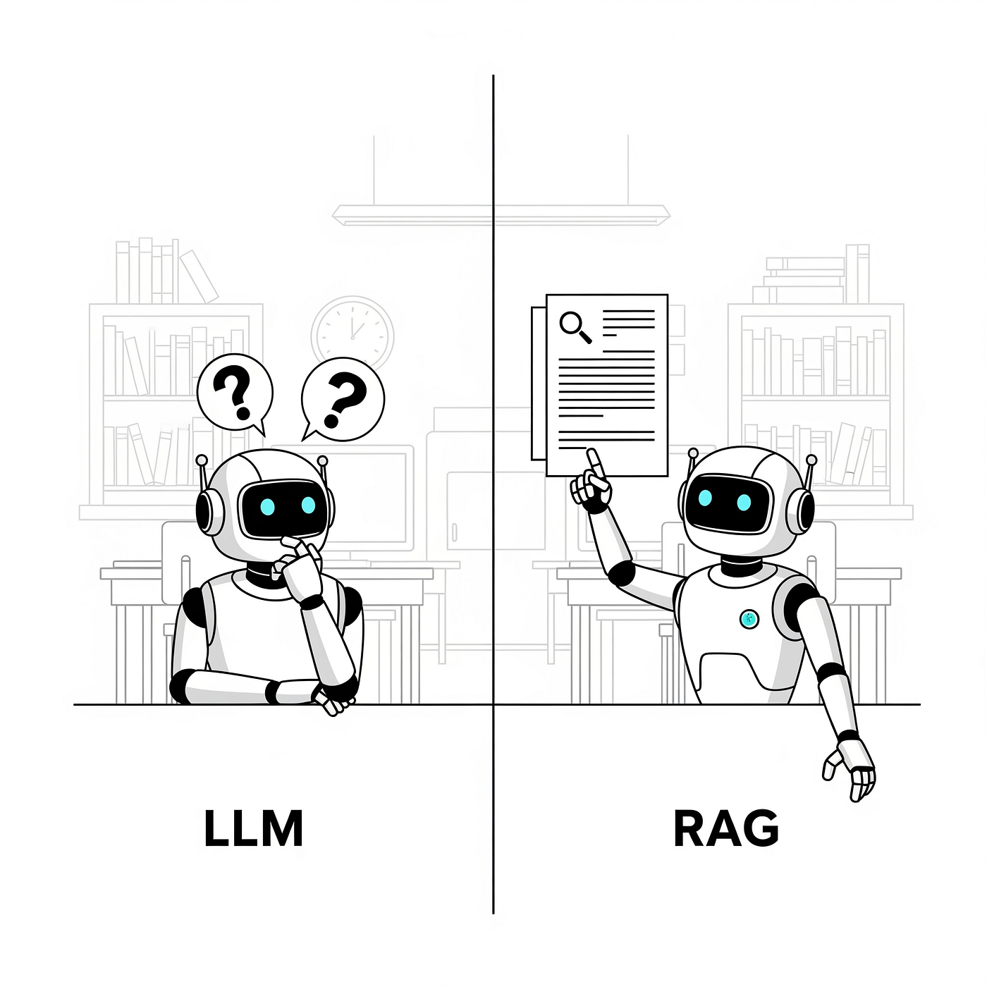

RAG
RAG merges information retrieval and generative models to reduce hallucinations and to keep replies grounded in documents. RAG enhancements expand to query rewriting, multi-hop retrieval, iterative RAG that learns when and what to retrieve.

Slide 7
Types of RAG
Simple RAG Simple RAG with Memory Branched RAG HyDe (Hypothetical Document Embedding) Adaptive RAG Corrective RAG (CRAG) Self-RAG Agentic RAG

Slide 8
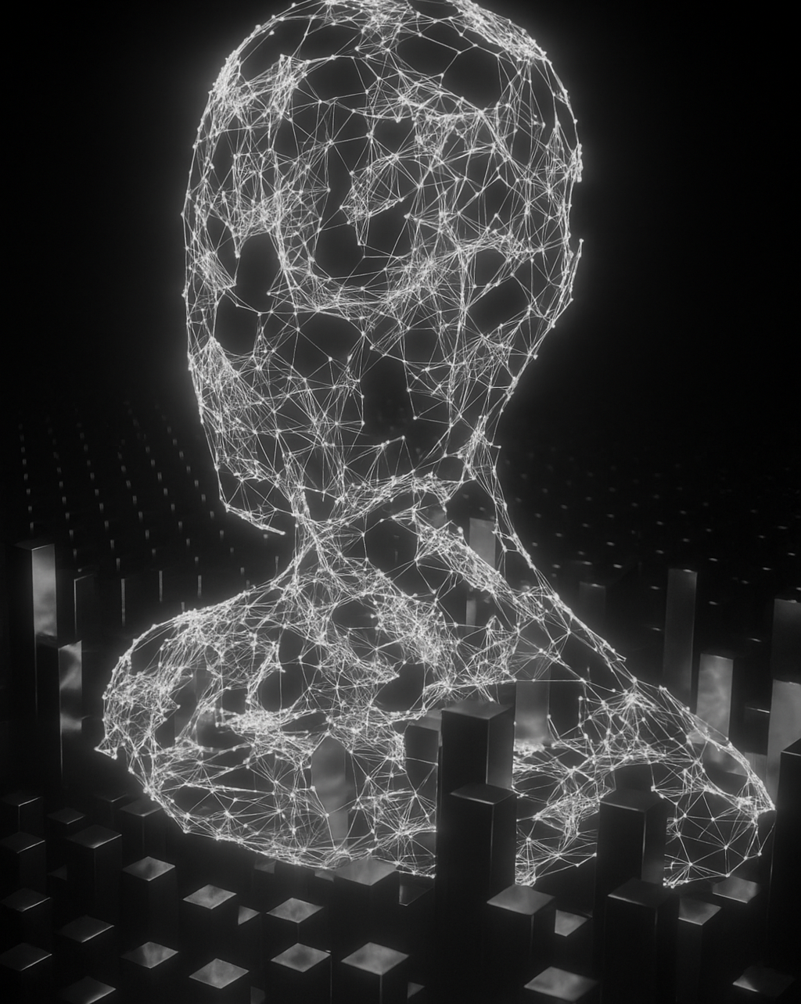
Proposed System Model MODEL
The user upload PDF in frontend React web interface. Which is simple and user friendly. The React frontend sends files to the server via HTTP request. After uploading the PDF, user asked a question related to the PDF content. Then the frontend send the question with the PDF ID to the server. Then backend server processes the uploaded PDF with PDF Parse. Then the text will be chunked and keywords extracted. Then the query will be processed. In this processing, MongoDB search the best chunk matched with the question. After getting relevant chunks, these chunks and questions sent to Gemini AI. Then Gemini AI understand the question and relevant chunks and generate a context-based answer. The answer will be generated from the chunks of PDF strictly. After processing by AI, then the answer send to the server. Then the server sent it to the React frontend for the user. And it is the final response.

Slide 9
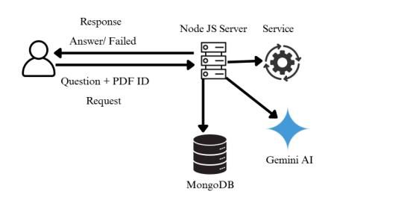

Slide 10
Discussion about System
The goal of this chatbot is to answer questions from the uploaded PDF. Normally, an individual tries to find out the answer from the PDF manually, but it is not that easy to get the correct answer from the PDF or documents. Although it is laborious and not easy to navigate.
Firstly, user upload their PDF. These PDFs are stored securely. Then the system creates chunks from the PDF. These optimized chunks are stored in MongoDB. When a user asks question then the system tokenize the question. And the system analyzes the queries. And match the question with the selected PDF. Then it returns a selected text. Finally, sent the question and the selected text send to AI. Then AI provides a better answer.

Slide 11
Implementation
Server Setup
Artificial Intelligence
MongoDB

Slide 12

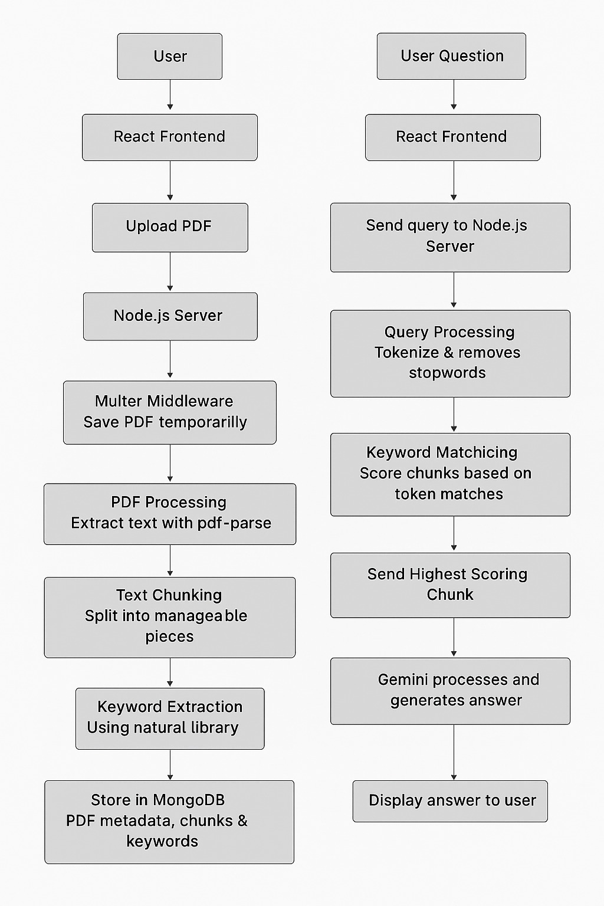
Dataflow

Slide 13
Artificial Intelligence
By handling digital documents like PDFs, Artificial Intelligence (AI) is becoming a revolutionary technology.
AI plays an important part in structuring and categorizing PDFs.
Thousands of files with many different formats find in large organizations.
Which is very difficult to organize. AI systems can be used to characterize PDFs automatically based on their subject.
Why Gemini 2.5 Flash
Low latency
Lower cost
For agentic use cases
High performance

Slide 14
MongoDB Database
MongoDB Atlas used in this project as a database.
Simple way of deployment
Easily manageable database
Highly scalable
MongoDB simplifies data management with its intuitive document model, mapping unique objects to distinct documents.

Slide 15
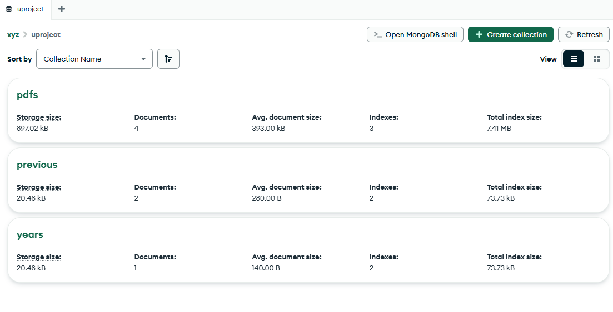
MongoDB Database

Slide 16
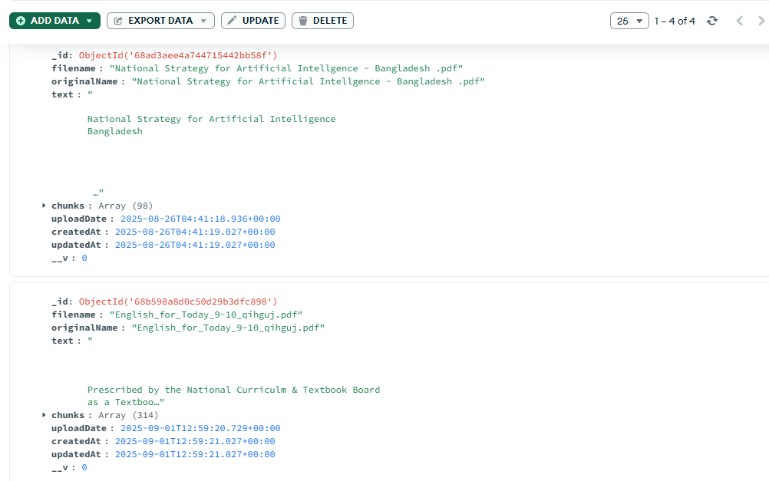
MongoDB Database

Slide 17
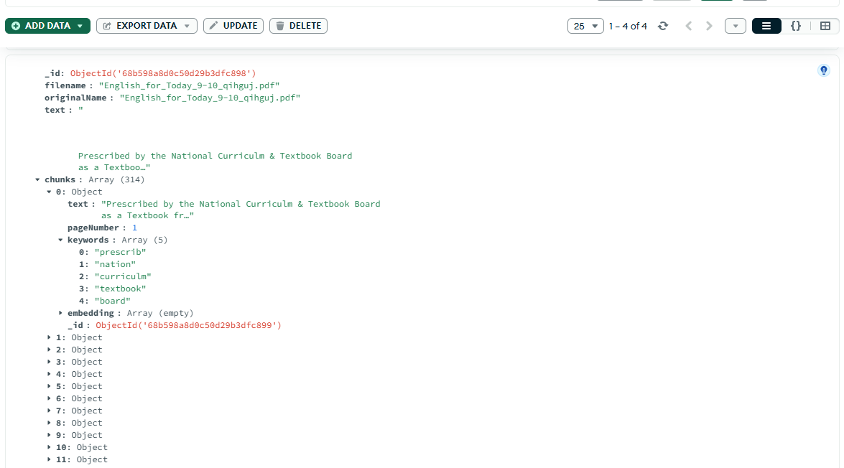
MongoDB Database

Slide 18
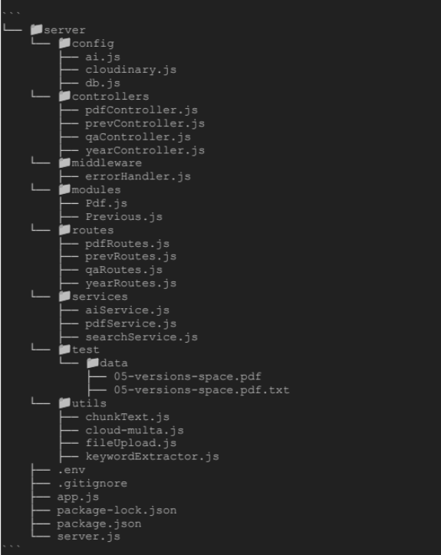
Backend file structure

Slide 19
Frontend
In frontend, the React library is used.
The Vite framework is used to make
folder structures and for the project.

Slide 20
Component section
React.js and Tailwind CSS are used.
Created some panels, for instance: Chat ask panel, side bar, navigation bar, login module, previous year panel, pdf viewer, footer etc.

Slide 21
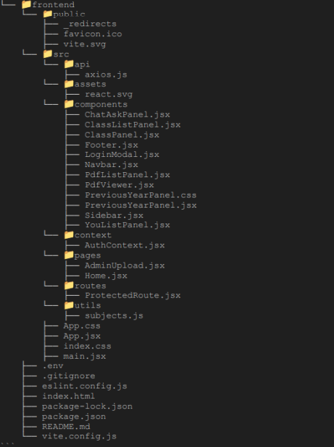
Frontend File Structure

Slide 22
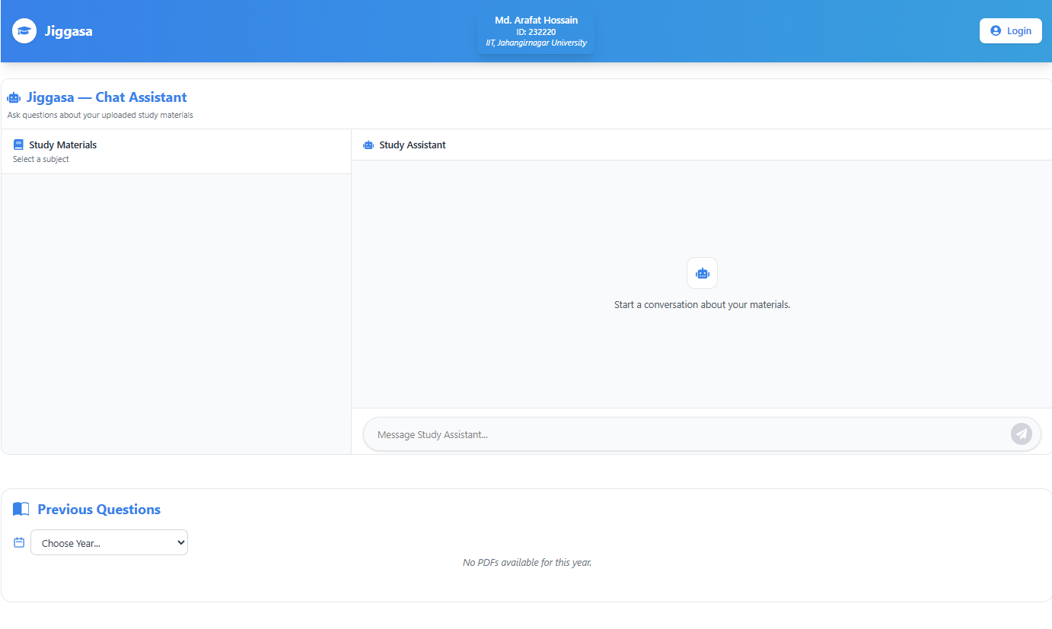
Frontend

Slide 23
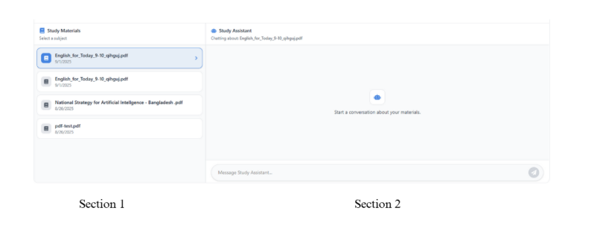
Ask Panel

Slide 24
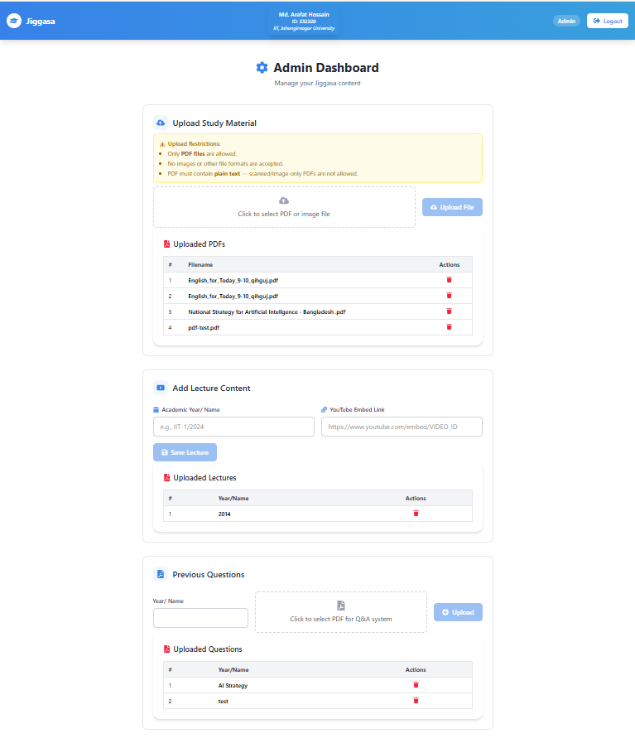
Admin Dashboard

Slide 25
Achievement of OBJECTIVE
The Chunk size will be optimized for getting the objective
Increase keyword length size for a better match.
Optimize the database query
Gemini AI instruction improvement.
Reduce hallucination by using improved instruction sets.

Slide 26
Result Analysis
A set of 250 questions used to test the ability of the “Jiggasa” Chatbot to answer them. The types of questions will be as follows:
"Descriptive questions" - in which detailed explanations are required.
"Wh questions" -like what, how, which and when. Fill-in-the-blank questions to test knowledge and recall.
Multiple Choice Questions (MCQs) with a number of choices to choose from.

Slide 27
This project works to fill the gaps
Integrating RAG with a backend to enable accurate context and also enable question answering.
Intelligent responses, versus simple keyword matches, using AI and NLP to provide an intelligent response.
Introducing a chatbot interface for interactive learning and retrieval.
Implementing file handling and storage using access control
Ensuring performance and reliability with modern development practices.

Slide 28
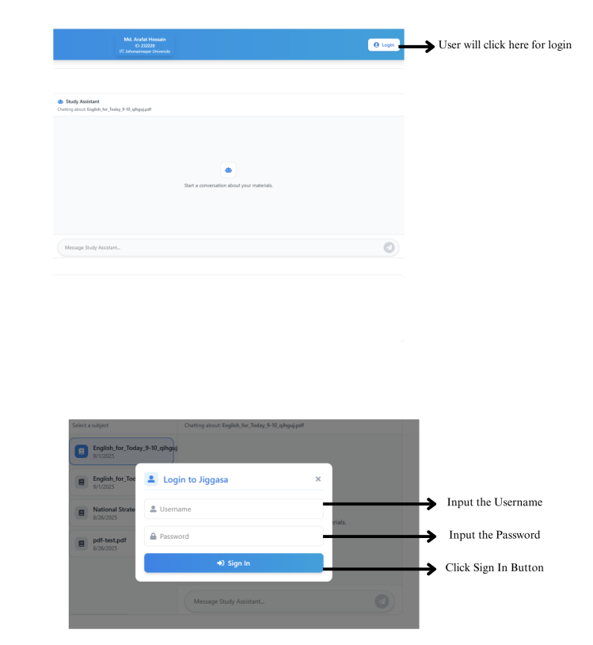
User Manual

Slide 29
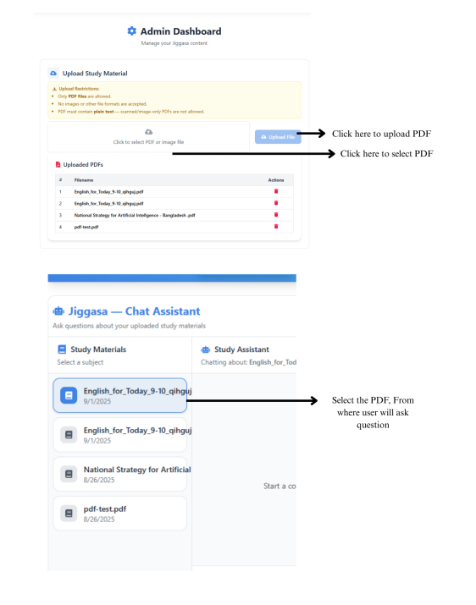
User Manual

Slide 30
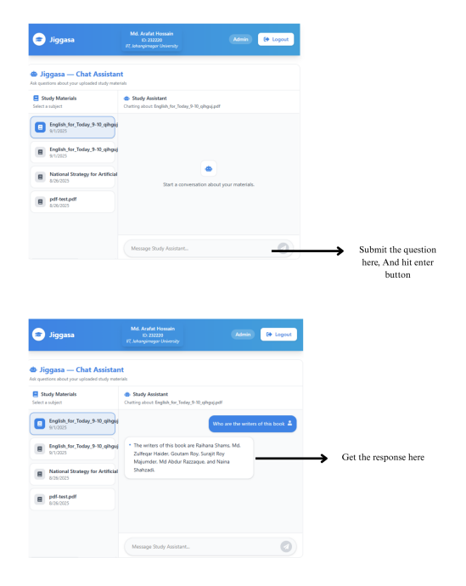
User Manual

Slide 31
Thanks to all

