Slide 1
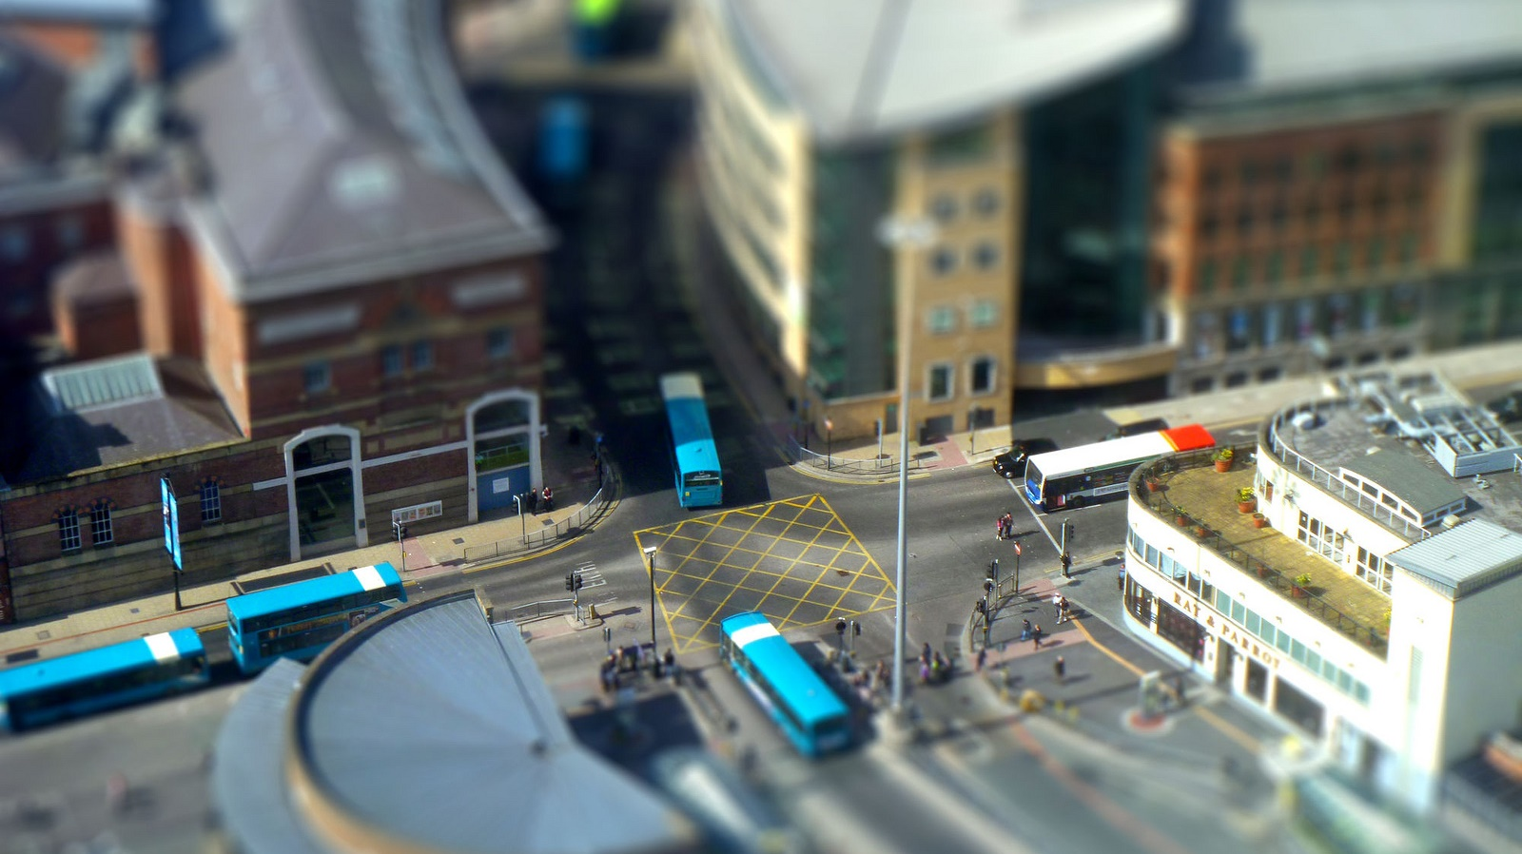
Routing
Getting from A to B the thoughtful way

Slide 2
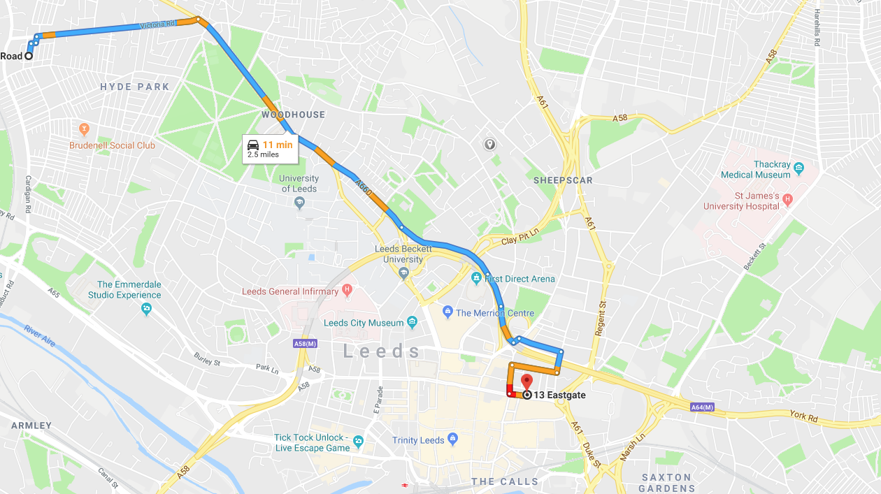
What is routing
Finding the “shortest” path between two locations
Distance
Time
Other factor

Slide 3
Content
Graph Theory
Shortest Path Routing
Practical Routing in R
Going beyond A to B routing

Slide 4
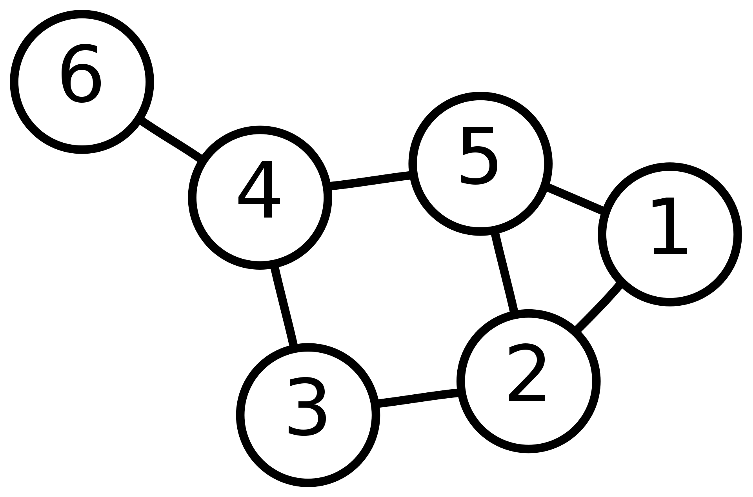
Graph Theory
Branch of mathematics about graphs (networks)
Vertex (Node)
Edge (Link)

Slide 5
Basic Properties of a Graph
Directed or Undirected
Do edges have a direction
Weighted or Unweighted
Are all edges equal or do they have a value
Complex or Simple
Allow loops
Allow multiple edges
Contracted or Uncontracted
Are there straight lines (vertices with 2 edges)
Connected or Unconnected
All parts of the graph connected

Slide 6
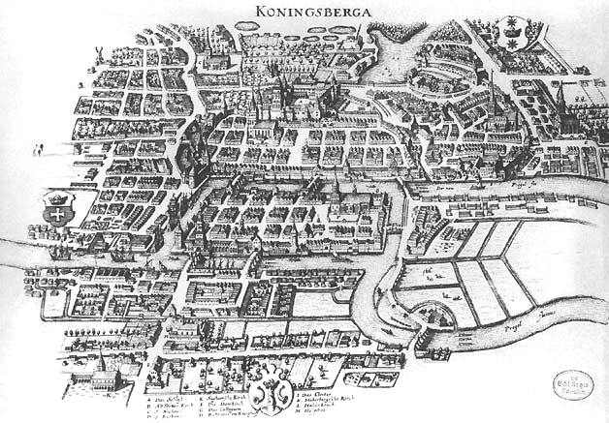
The Königsberg Bridge problem
Path though the city crossing each bridge once
Solved by Euler in 1736
Foundation of graph theory

Slide 7
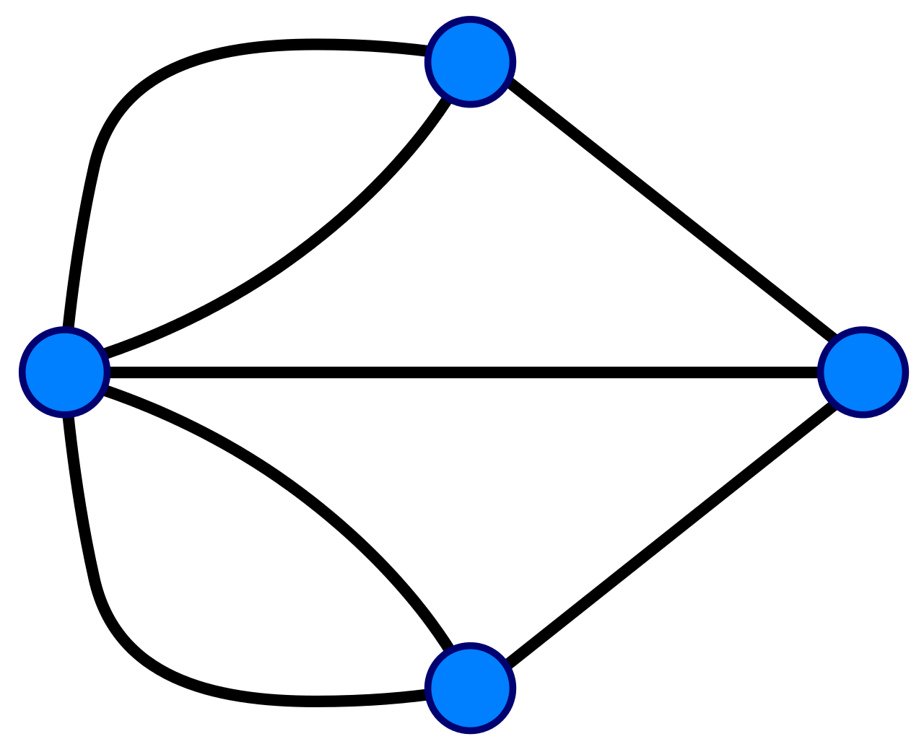
The Königsberg Bridge problem
3
Degree: Number of edges connected to a vertex
Strength: Weighted number of edges
Euler Observed:
Vertices must have even degree except the start and end
So there is no solution
5
3
3

Slide 8
The Königsberg Bridge problem
Bonus Problem
Where would you add a bridge such that you could start at the Red vertex and finish at the Yellow vertex
What would the path be?

Slide 9
Shortest Path
Dijkstra Algorithm
Visits each unvisited node counting cumulative distance
Prioritised by distance, thus excludes options longer than current shortest route
O(|V|²) unprioritized
O(|E| + |V|log|V|) when using a priority heap
Source: https://en.wikipedia.org/wiki/File:Dijkstra_Animation.gif

Slide 10
Shortest Path
A* Search Algorithm
Widley used and faster than Dijkstra Algorithm
Prioritises the next path by both:
The total distance so far
A heuristic to estimate the remaining distance (e.g. straight line distance)
ALT
A* search, landmarks, and triangle inequality
Modified for road networks
Source: https://commons.wikimedia.org/wiki/File:Astar_progress_animation.gif

Slide 11
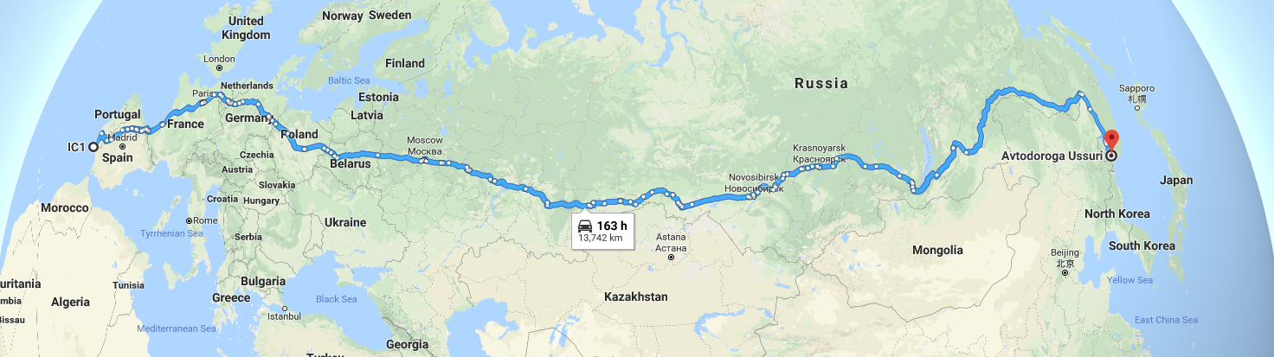
Shortest Path
Best algorithms now precompute parts of routes
Finding useful shortcuts
E.g. using motorways for long distance travel

Slide 12
Practical Routing In R
Packages to use routing services
Packages for inbuilt routing

Slide 13
Routing Services in R
Google Maps
googleway package https://cran.r-project.org/web/packages/googleway/
Open Source Routing Machine (OSRM)
osrmr package https://cran.r-project.org/web/packages/osrmr/
Open Route Service https://maps.openrouteservice.org
ORS Package https://giscience.github.io/openrouteservice-r/
Transport API
UK only but does public transport
Prototype package https://github.com/mem48/transportAPI
CycleStreets
Cycling only https://cran.r-project.org/web/packages/cyclestreets

Slide 14
Local Routing in R
OSRM (again)
Require separate setup of OSRM
dodgr https://cran.r-project.org/web/packages/dodgr
New package still in development
stplanr https://cran.r-project.org/web/packages/stplanr
Some basic routing functions based on igraph
igraph https://cran.r-project.org/web/packages/igraph
General graph analysis not specific to transport
OpenTripPlanner https://github.com/ITSLeeds/opentripplanner
Work in progress for multimodal planning
Requires separate setup of OTP
Gtfs-router https://github.com/ATFutures/gtfs-router
For integrating GTFS public transport timetables

Slide 15
Isochones

Slide 16
Network Analysis

Slide 17
References
Types of Graph: http://www.personal.kent.edu/~rmuhamma/GraphTheory/MyGraphTheory/defEx.htm

Slide 18
The Königsberg Bridge problem
3
Bonus Problem
Where would you add a bridge such that you could start at the Red vertex and finish at the Yellow vertex
What would the path be?
5
4
4

