Slide 1


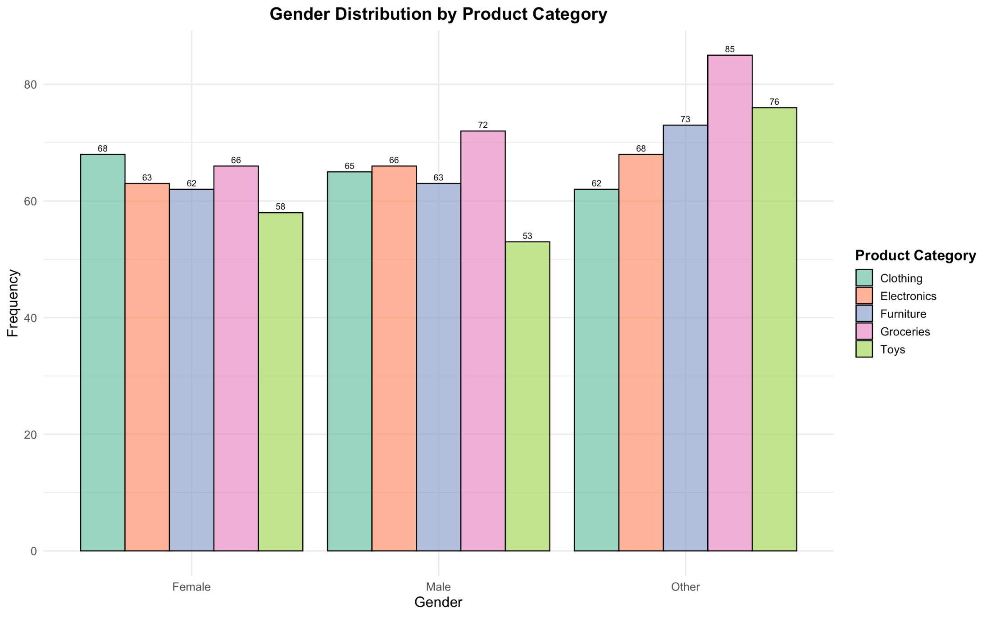
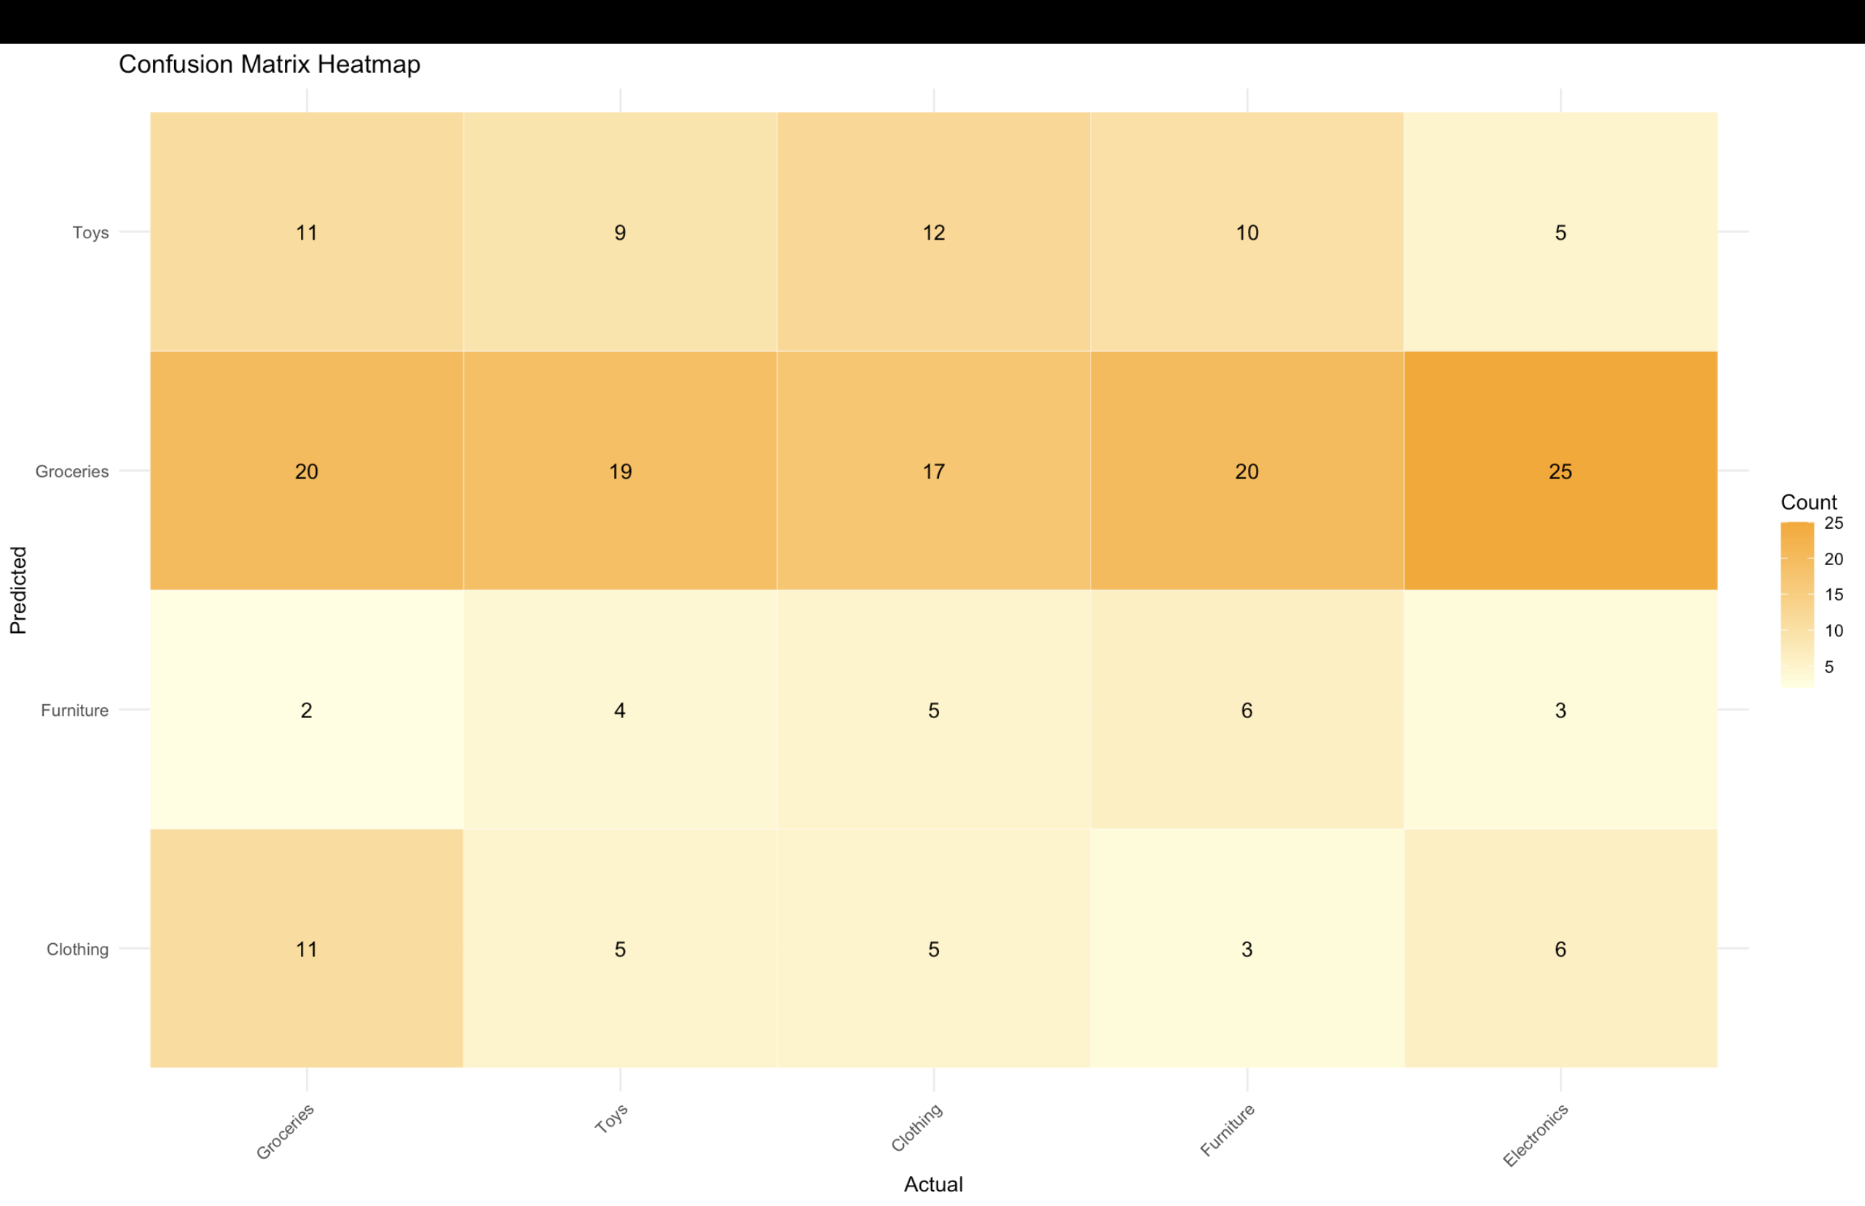
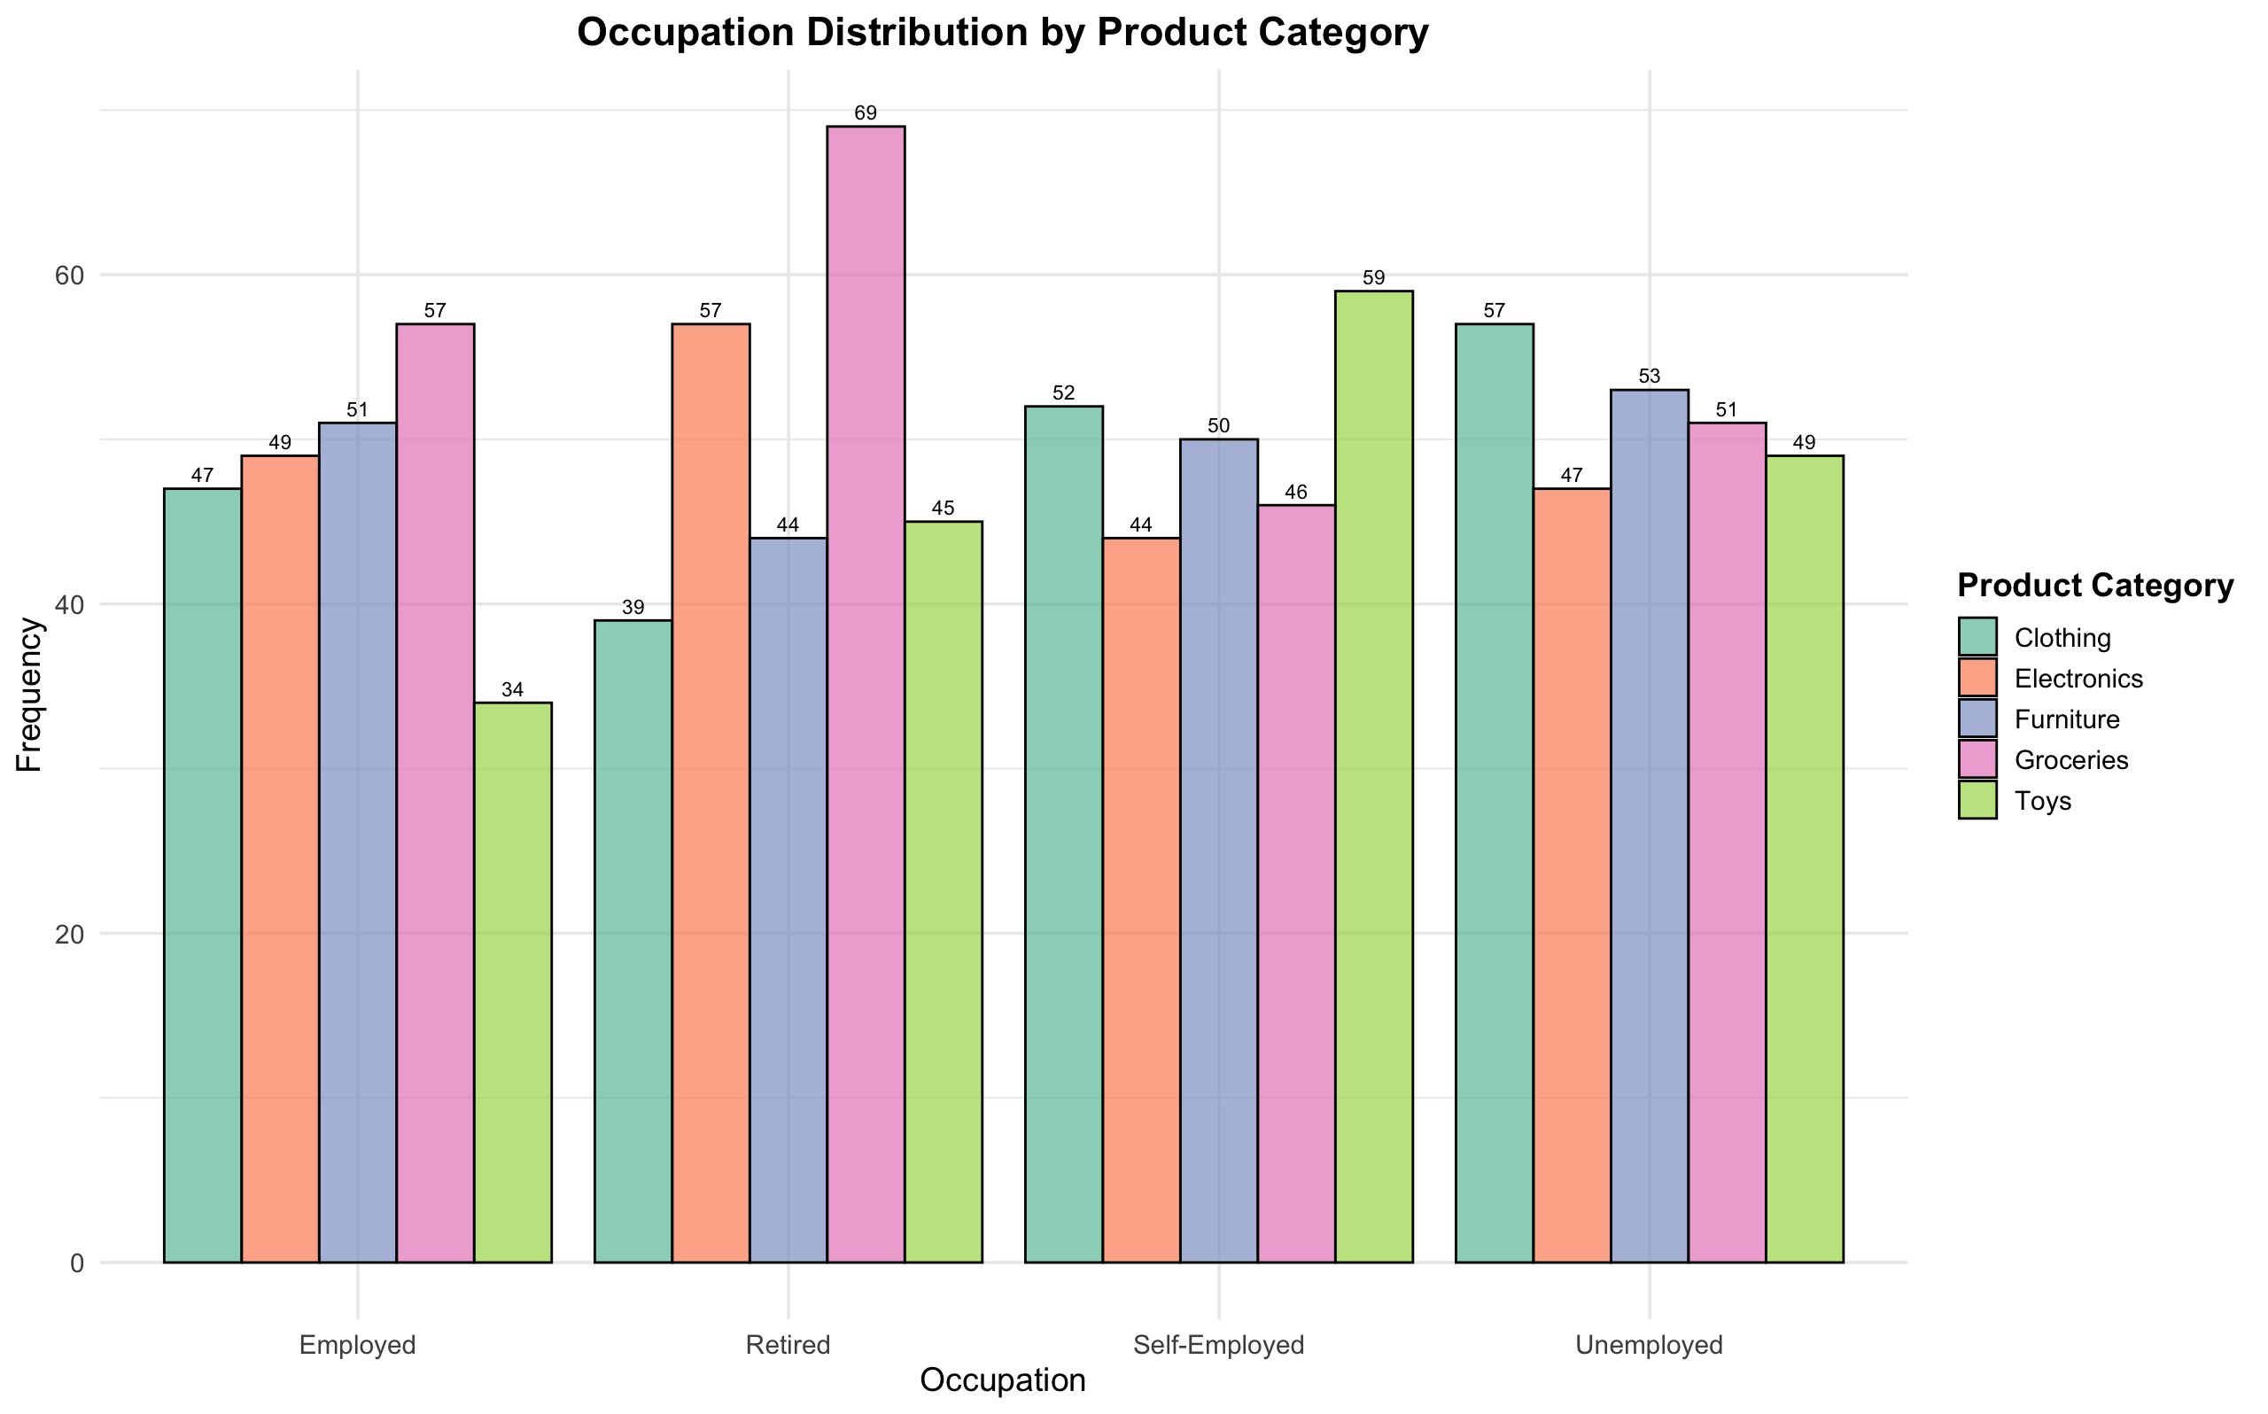
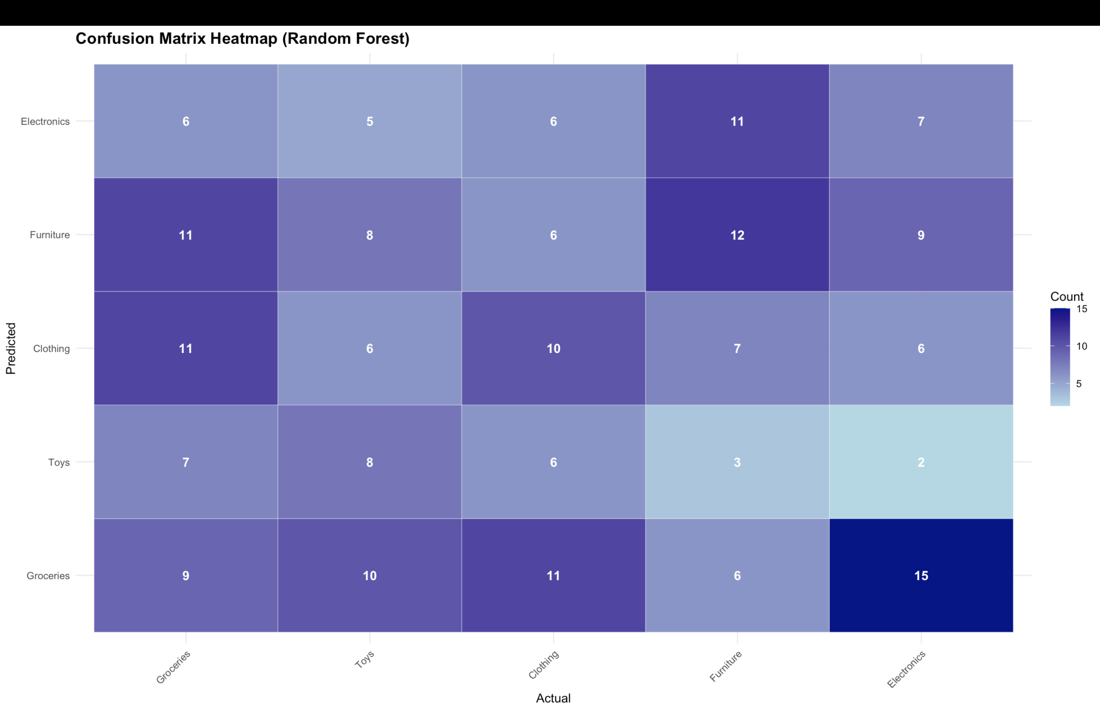
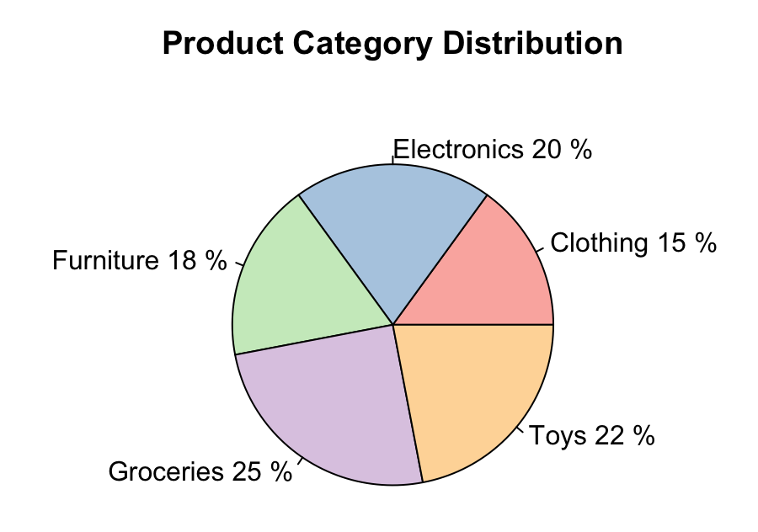
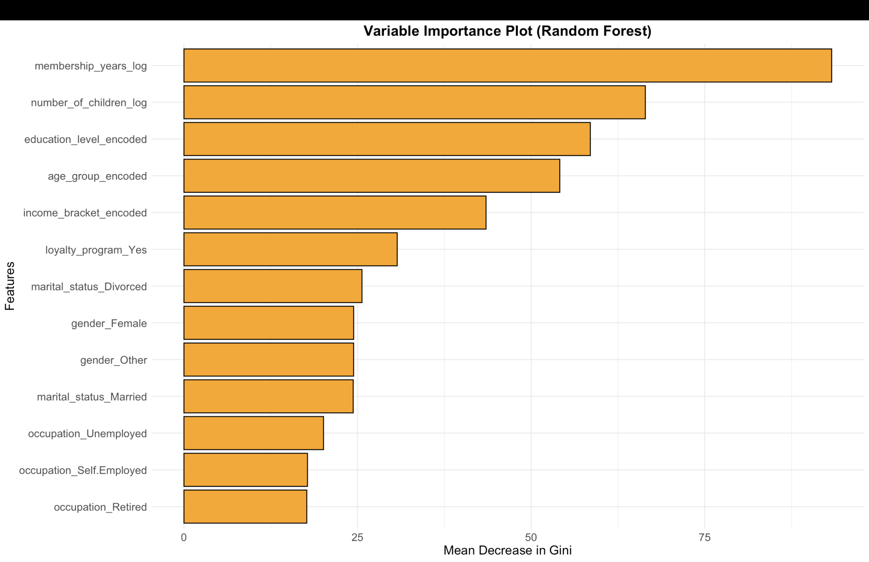
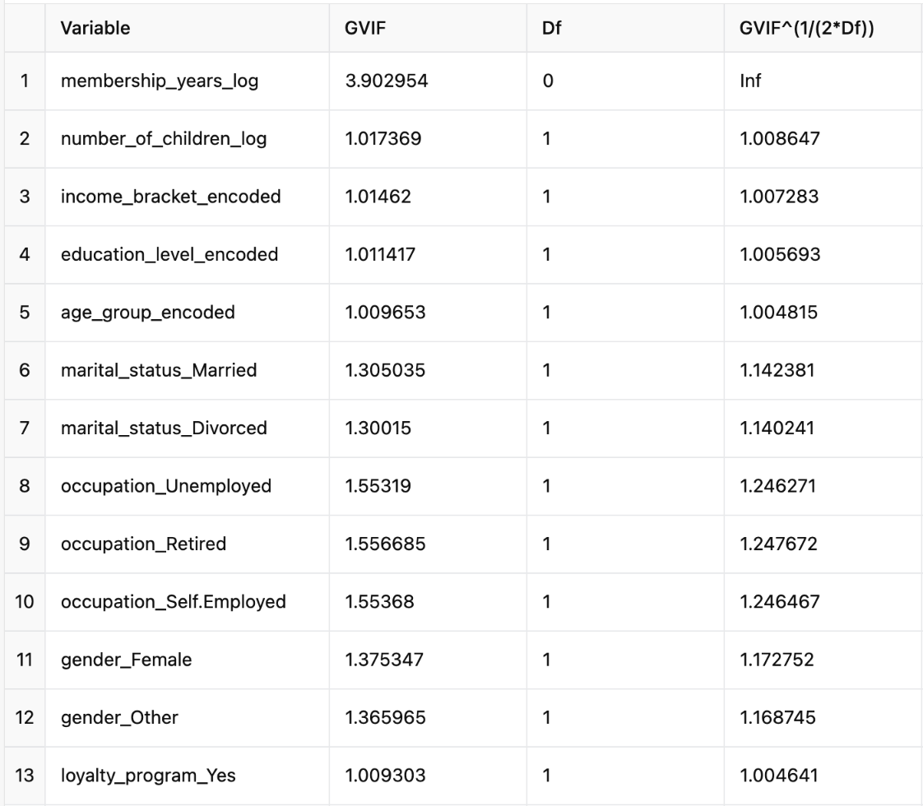
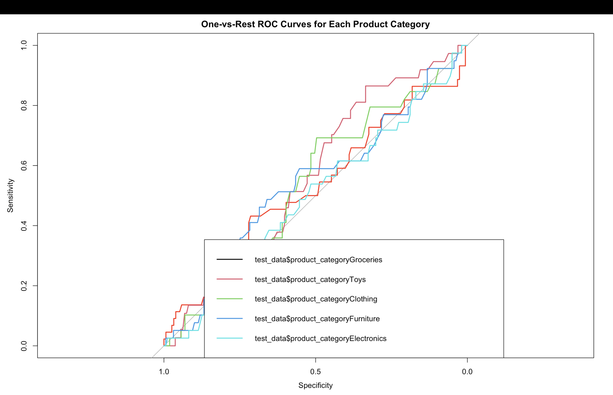


ANALYZING THE IMPACT OF CUSTOMER DEMOGRAPHICS ON PRODUCT CATEGORY PREFERENCES
Arafat Okino Sadiq
INTRODUCTION
Supervised by: Dr. Ruvini Jayamahaa
DISCUSSION
Introduction: Understanding how customer demographics relate to product category preferences is essential for businesses aiming to optimize marketing strategies and boost customer retention. By analyzing factors such as age, income, and education level, companies can better tailor their offerings to meet specific customer needs, ultimately improving satisfaction and loyalty.
Objective: This study seeks to identify key demographic factors influencing customer preferences for various product categories, providing actionable insights to guide targeted marketing and product development.
Data Source: The analysis uses data from the Kaggle Retail Sales Customer Behavior Analysis dataset.
Background: Based on demographic segmentation theory, this research highlights how demographic traits like age, gender, and income influence consumer behavior. By uncovering these relationships, the study supports businesses in personalizing customer experiences, optimizing promotions, and aligning inventory with demand to enhance customer satisfaction and retention.
This study examined demographic features to predict customer product category preferences, aiming to support targeted marketing. Using Lasso Regression and Random Forest models, key demographic factors such as income, education, age, marital status, employment status, gender, and loyalty membership emerged as potential influencers of product choices. However, the models showed limited accuracy, indicating that demographics alone may not fully explain consumer behavior.
The findings suggest that while demographic insights are useful, they should be supplemented with behavioral and psychographic data (e.g., purchase history, lifestyle) for a more accurate understanding. Businesses could benefit from creating multi-dimensional customer profiles that integrate demographics with transactional data, enhancing targeted marketing, product recommendations, and inventory management to better meet diverse customer needs.
Fig 1.0
Fig 6.0 Confusion Matrix Heatmap For Logistic Regression Model
Performance
METHODS
Fig 2.0
Fig 7.0 Confusion Matrix Heatmap For Random Forest Model
Performance
Log transformation for skewed numerical features
One-hot and label encoding for categorical variables
Cross-validation for performance consistency
Accuracy evaluated across models
LIMITATIONS
Limitations: This study’s focus on demographic data presents limitations, as it excludes personal and contextual factors, such as past purchasing behavior, lifestyle, and interests, which are known to impact consumer choices. Relying solely on demographic factors may oversimplify the diversity within customer preferences and limit the accuracy of predictions. Future research could address these gaps by integrating more comprehensive datasets, including behavioral and psychographic data, to provide a richer, multidimensional view of customer product preferences.
Conclusion: The findings suggest that demographic data, while informative, may require augmentation with additional variables to improve prediction accuracy. By expanding on this approach, businesses could gain deeper insights into consumer behavior, thereby enhancing personalized marketing and product offerings.
Feature Transformation and Encoding
Model Evaluation
Fig 3.0
Fig 8.0
Data Cleaning and Preprocessing
Modeling Approach
Handle missing values, outliers, duplicates
Standardize numerical variables
Multinomial Logistic Regression:
Initial model for prediction => Low accuracy observed from the regularized Lasso Regression
Feature selection by shrinking less relevant features and
Identified key demographic predictors
Random Forest:
Ensemble model to capture complex relationships
Slightly improved accuracy, regardless still very low.
RECOMMENDATION
RESULTS
Fig 4.0 Generalized Variance Inflation Factor (GVIF)
Explore Advanced Models: Test complex algorithms like Gradient Boosting and Neural Networks to better capture demographic-product relationships.
Optimize Segmentation: Combine demographic data with customer activity insights (e.g., loyalty data) to improve targeted marketing.
Personalize Campaigns: Use demographic insights to design focused marketing strategies and product recommendations.
Two models : Lasso Regression and Random Forest were applied to predict customer product category preference based on demographic data.
Model Performance:
Both models showed limited predictive accuracy, indicating that demographic data alone may not sufficiently predict product choices. Lasso helped identify key predictors by shrinking irrelevant variables, while Random Forest explored complex relationships but offered only slight accuracy improvement.
Key Predictors Identified:
Both models highlighted the following significant demographic features:
(1)Income Bracket (2)Education Level (3)Age Group (4)Marital Status (married/divorced) (5)Employment Status (retired/unemployed) (6)Gender(Female/Other) (7)Loyalty Program Membership
Conclusion:
While these demographic factors were identified as influential, their predictive power was limited. This suggests that adding behavioral or transactional data could enhance model accuracy for future analyses.
Fig 9.0
Data Source
Arafat Okino Sadiq
Fig 5.0 Model Accuracy evaluation
Model Summary | Multinomial Logistic Model Regularized(Lasso) | Random forest
Accuracy | 21% | 23%

