Slide 1



ROAD DAMAGE
DETECTION PROJECT
ICT-2403
M.I.M ARAFATH - ICT/2023/142 - 6119
M.I.F ILMA - ICT/2023/146 - 6336
K. IFFATH - ICT/2023/145 - 6121
B.G.N.D.N. KUMARI - ICT/2023/141 - 6118
GROUP 29

Slide 2
TABLE OF CONTENTS
01
Introduction
02
Objectives
03
Data Acquisition
04
Dataset preparation
05
Enhancement Process
06
Enhancement results
07
Segmentation Process
08
Segmentation Results
09
Final Integration
10
Evaluation Metrics
11
Limitations / Challenges
12
Conclusion

Slide 3

INTRODUCTION
Road damage is a critical issue in transportation
Common types: cracks, potholes, surface wear
Affects safety and vehicle performance
Manual inspection is slow and costly
Need for automated detection systems

Slide 4
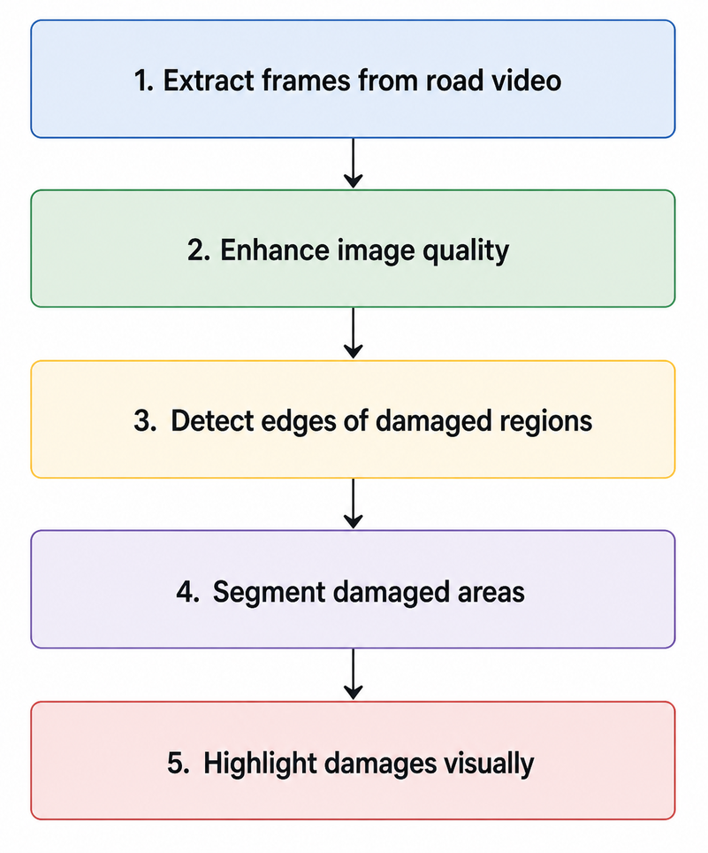
OBJECTIVES
Main Objective:
Detect road damage using image processing
Specific Objectives:
1
Extract frames from road video
2
Enhance image quality
3
Detect edges of damaged regions
4
Segment damaged areas
5
Highlight damages visually

Slide 5
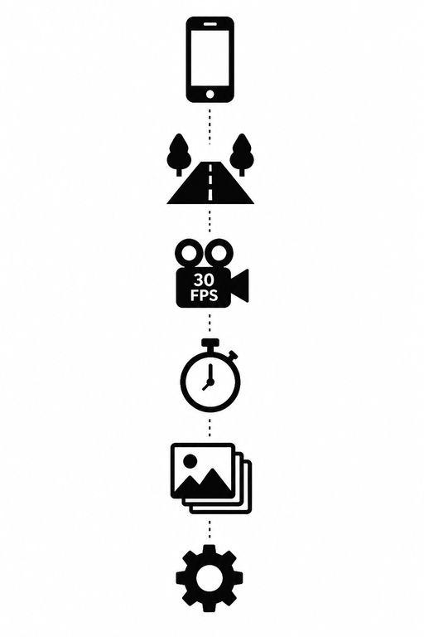
DATA ACQUISITION
Road video was captured using a mobile phone
Resolution - 1920 × 1080 - Full HD
The captured video has a frame rate of 30 FPS.
The video duration is 31 seconds.
Camera height 1 - 1.5m, 45° angle downward
Video recorded under low-light conditions

Slide 6
DATASET PREPARATION
The frame extraction rate is 1 frame per second.
31
The total video duration used is 31 seconds.
FRAMES
Therefore, 31 frames are used for testing.
The frames are resized to 640 × 480.
640×480
All outputs are saved in separate folders.
RESOLUTION

Slide 7
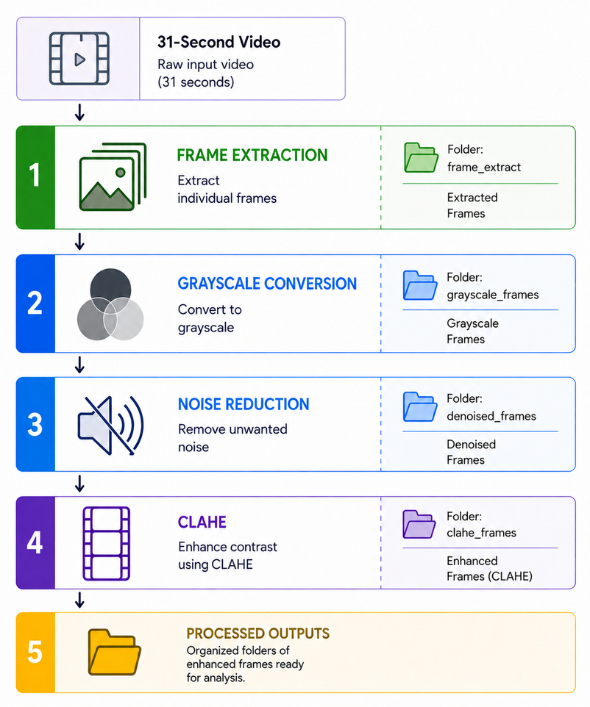
ENHANCEMENT PROCESS
Frame Extraction
Grayscale Conversion
Noise reduction using Gaussian Blur
Contrast enhancement using CLAHE
Improves visibility of road damages
Reduces noise and lighting issues

Slide 8
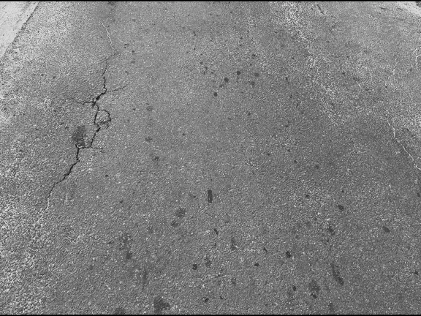
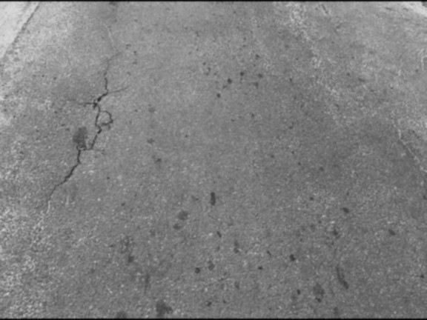
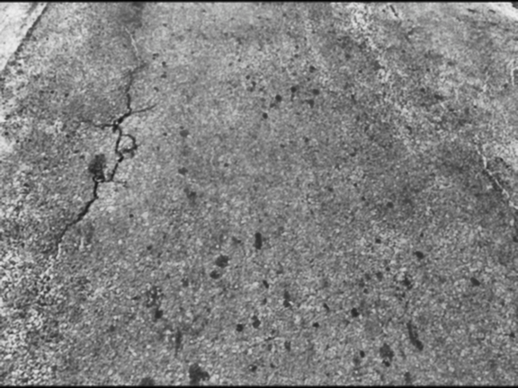
ENHANCEMENT RESULTS
GRAYSCALE IMAGE
DENOISE IMAGE
CONTRAST IMAGE
IMAGE ENHANCEMENT IMPROVED CRACK VISIBILITY AND REDUCED NOISE BEFORE SEGMENTATION.

Slide 9
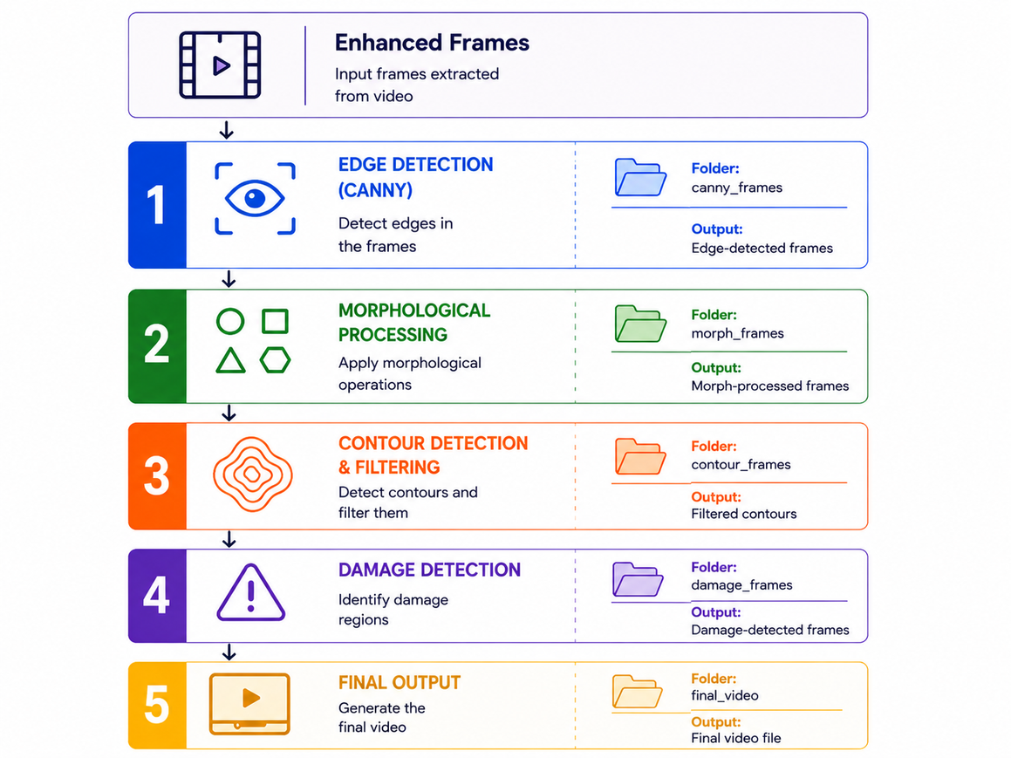
SEGMENTATION PROCESS
1
Canny Edge Detection for boundary detection
2
Morphological operations (dilation)
3
Contour detection to identify damaged areas
4
Area filtering to remove noise
5
Final segmentation of road damages

Slide 10
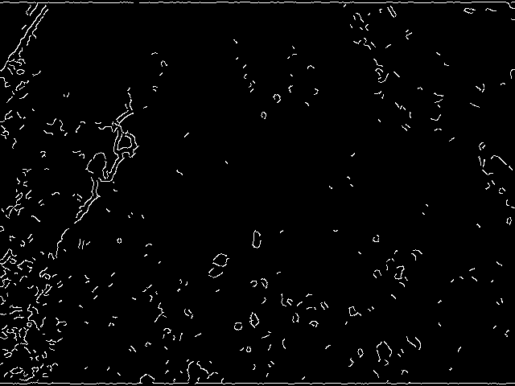

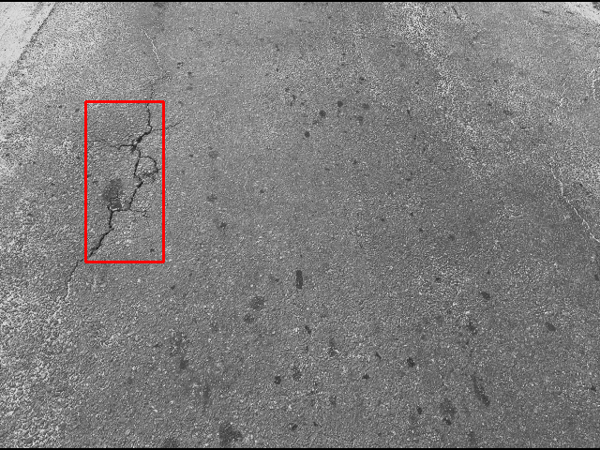
SEGMENTATION RESULTS
CANNY IMAGE
CONTOUR IMAGE
SEGMENTED OUTPUT

Slide 11
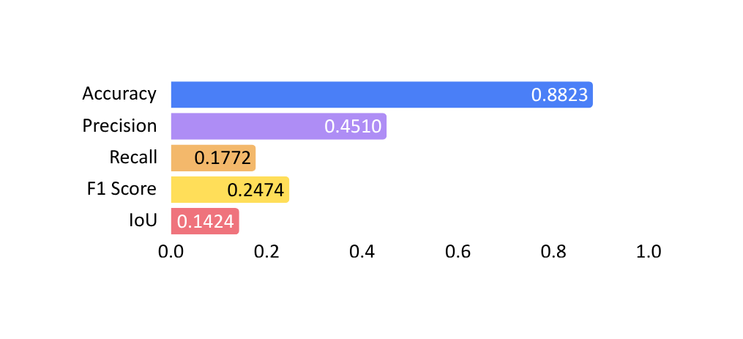
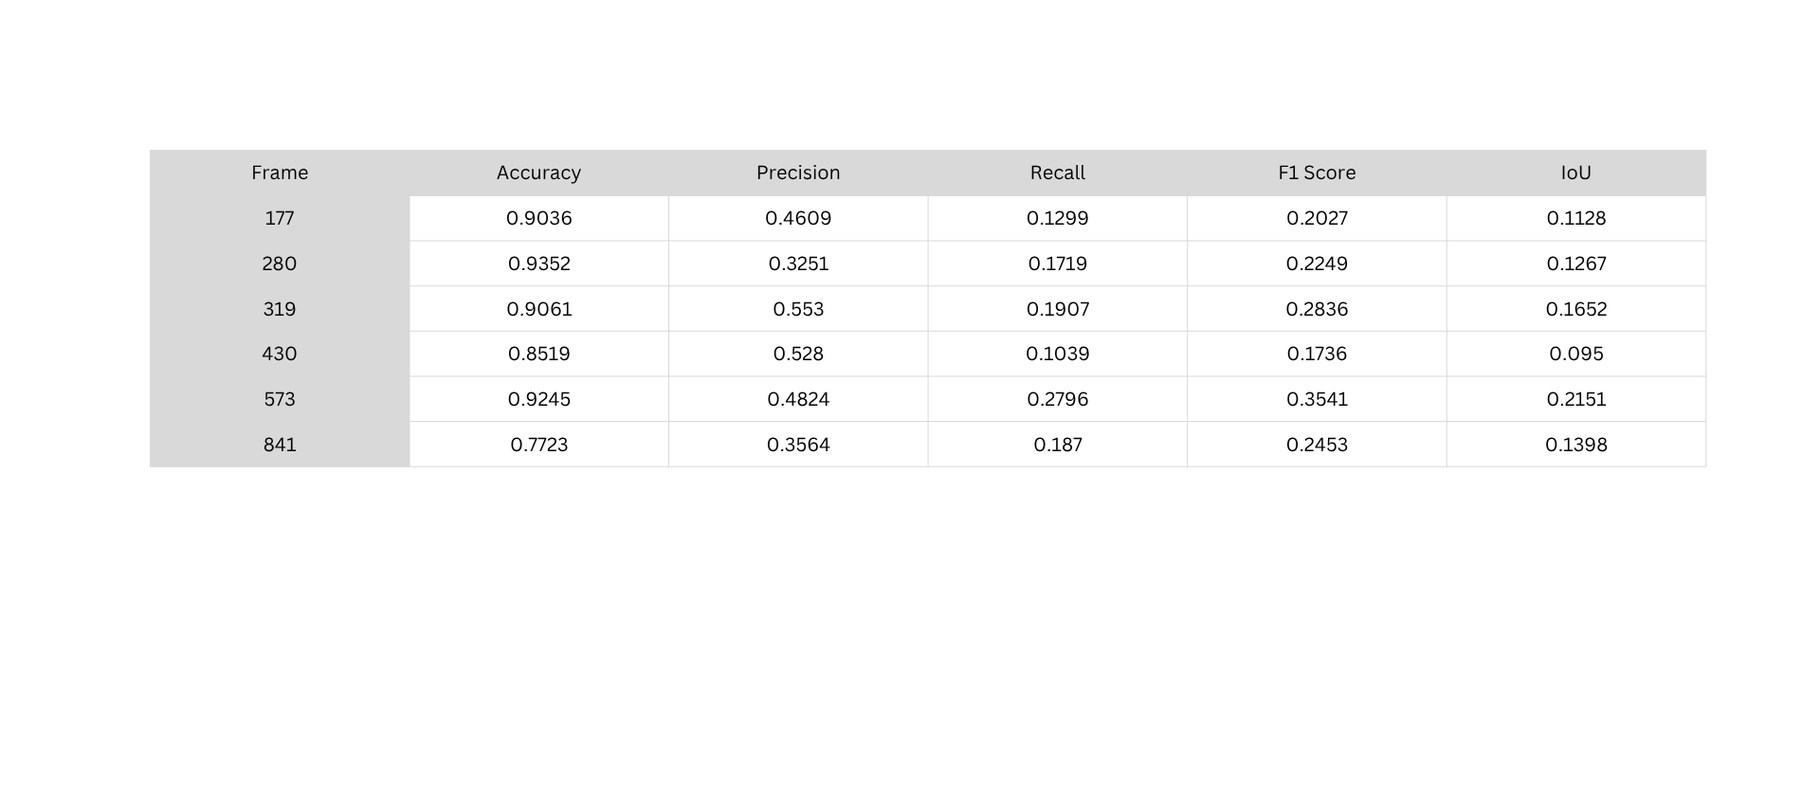
EVALUATION METRICS
Selected contour output images for evaluation
Ground truth images created using Paint
Compared predicted output with ground truth
Overall Average of Five Frames

Slide 12
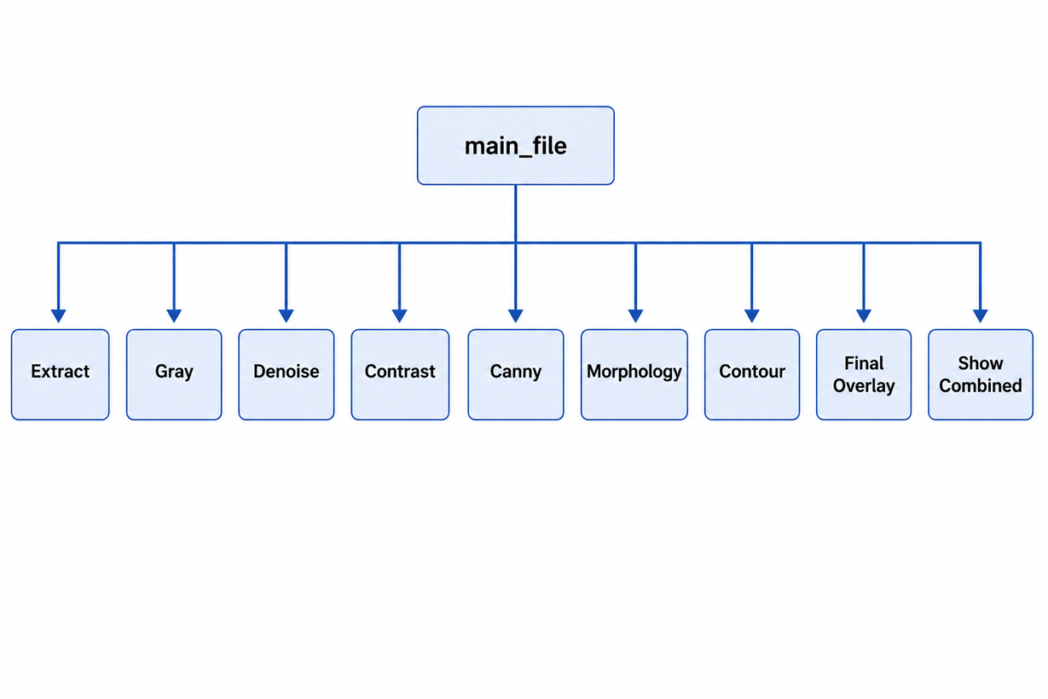
FINAL INTEGRATION
The complete processing pipeline is divided into separate functions
A main Python file controls and calls all processing functions
Automated frame-by-frame processing is performed sequentially
Generates the final detected road damage output

Slide 13
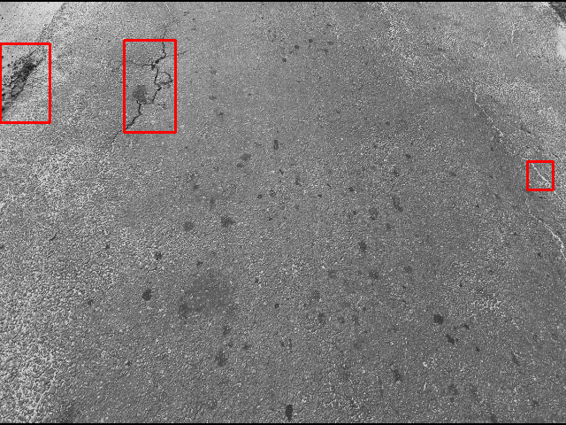
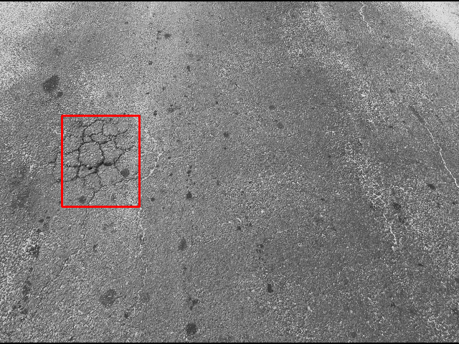
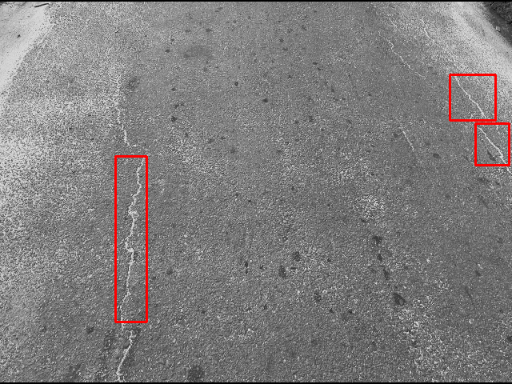
SYSTEM RESULTS
ACCURATE DETECTION OF MAJOR DAMAGES
Edge Cracking
Alligator Cracking
Transvers Cracking

Slide 14

CONCLUSION
Successfully detected road damages
Image processing approach is effective
Reduces manual inspection effort
Provides a base for future improvements
Can be enhanced using AI techniques

Slide 15
THANK YOU

