Slide 1



Engram checks a medical recall against your stock — and shows you the proof for every answer.
BUILT ON
Open Agent Hackathon 2026 · Track 2: The Agent That Can Explain Why
Meterless Nightshift
Ahmed Rahimi · medical student, building tools for hospital teams
NVIDIA Nemotron 3.5 Super
Notes:
Engram checks a recall against your stock and shows the proof.

Slide 2
02
In a real 2025 recall, two official documents disagree by one character.
The distributor letter says
The FDA and the manufacturer say
23IJA103
≠
23JJA103
FDA recall Z-1706-2025: Medline 100 mL saline with leaking bottle seals, 32 affected lots. Match the wrong code and recalled bottles stay on the shelf — or safe stock gets thrown away.
Notes:
Real public documents. Engram flags this discrepancy and keeps it visible instead of silently fixing it.

Slide 3
03
Today, a hospital recall coordinator does all of this by hand, for every notice.
Read the notice
(and every update)
Find matching
stock and lots
Pull affected
stock
Keep every site
supplied
Record what was
decided and why
“Repeated notice review, fragmented communication and local operational work.”
How practitioners from Mayo, Yale New Haven and Froedtert describe it — Healthcare Value Analysis Magazine, “Speed to Safety” roundtable.
Who it’s for: recall coordinators, hospital pharmacy, materials and value-analysis teams.
Notes:
We have not yet interviewed coordinators ourselves; this is our proposed first user.

Slide 4
04
You ask one question. Engram answers with evidence and a plan you can check.
ENGRAM ANSWERS
YOU ASK
120 bottles
are taken out of supply — their lots match the FDA list
“Which stock is affected by this recall, and can every site still cover its demand?”
10 bottles
wait for a human — their lot code is missing
30 bottles
move from site B to site A — every site stays above its safety reserve
Every number links back to the exact source row or notice text. Nothing is physically moved — approvals are recorded in a sandbox only.
Notes:
Numbers from tonight’s live run on fictional hospital data served through Zetaris.

Slide 5
05
The agent reads and decides what to check. Code does the maths. A checker signs off.
Meterless
Hospital data:
inventory, shipments,
demand, sites, FDA scope
AI agent: NVIDIA Nemotron
chooses what to read and
which checks to run
Checker
Every claim needs
a quote or a
computed number
One locked
snapshot
per question
Public recall notices
(FDA, MHRA, manufacturers)
Code: matches lots,
computes stock and the
transfer plan
Answer
Refuse
Engram shows the evidence and says “human review required” when a claim can’t be proven.
Notes:
The model never does arithmetic and never decides whether a specific stock row is affected; code does.

Slide 6
06
If a sentence can’t be traced to a source, Engram won’t show it.
All proven → shown
Agent writes
a draft report
Checker reads
every sentence
Not proven → reasons
sent back (max 3 tries)
Still failing → bad parts
withheld, or the whole
report refused
WHAT IT HAS CAUGHT (paraphrased from real rejected drafts)
A number with no source
A change the notice never made
A claim about stock the model can’t see
“23 batches” when the table lists 22
“the new notice narrows the recall”
“these records are safe”
Notes:
Examples from real drafts during development. The checker verifies sources and specific claim patterns; it does not prove every paraphrase is right, so a human still reviews.

Slide 7
07
Tonight’s live run, step by step: 3 minutes 53 seconds from question to checked plan.
21:29:30
21:29:36
21:31:12
21:32:04
21:32:18
21:32:25
21:33:23
Read 6 Zetaris views
Agent reads the notices
Checker rejects draft 1
Checker accepts draft 2
Code calculates the plan
Plan re-checked
Every number verified
one locked snapshot
FDA scope, actions, lot list
a count had no source
zero issues
30 bottles B → A
independently, from scratch
against the snapshot
Live on a laptop: Zetaris → Meterless → Nemotron (11 model calls) → checked plan.
Hospital data is fictional; the recall is real.
In the same run, Meterless H-MEM saved this investigation to memory for the next one.
Notes:
Run 00ee3741. Earlier tonight the same case failed until we stopped letting the model skip the calculation step.

Slide 8
08
Where it works today, and where it refuses.
Live stock check (Medline saline, FDA)
Answered — every number verified
UK notice update (ChloraPrep, MHRA)
Partly answered — 3 findings shown, 2 withheld
Device notice update (Olympus ViziShot)
Refused — a claim about stock it couldn’t prove
Pump notice update (Medtronic MiniMed)
Refused — said “narrows the recall” without proof
A refusal is the safe failure: you see the evidence and “human review required”, never a confident wrong answer. The three notice cases were used while building, so they are not an independent test.
Notes:
442 automated tests pass. Manual audit of the accepted text against the source notices found it accurate.

Slide 9
09
Real recall notices. A made-up hospital. Nothing about patients.
REAL — public documents
MADE UP — served through Zetaris
FDA recall Z-1706-2025 — Medline saline, 32 lots
3 sites with stock, demand and safety reserves
MHRA ChloraPrep recalls — May and July 2025
Shipments, routes and QA records
Olympus ViziShot letters — 2025 and 2026
Earlier decisions to re-check
Medtronic MiniMed notices — 2019 and 2021
Each question locks its own data snapshot
Prototype — not a medical device and not a regulatory tool.

Slide 10
10
Zetaris holds the hospital data. Meterless runs the AI model and remembers past reviews.
Meterless
NVIDIA
The hospital’s data source. Engram reads 6 SQL views through the Zetaris REST API and locks them as one snapshot, so every number in an answer traces back to a row.
Tonight: 6 views in 34.6 s.
Nightshift is the only way Engram reaches the model; the model route is verified on every reply.
H-MEM memory engine: reviewer decisions are recalled before each investigation, and each run is stored for the next (used live tonight; covered by tests).
Nemotron 3.5 Super runs every agent step — choosing sources, calling tools and writing the report the checker reviews.
Built with Claude Code and Codex. Cursor is optional per the organisers’ HackOS announcement of 22 October.

Slide 11
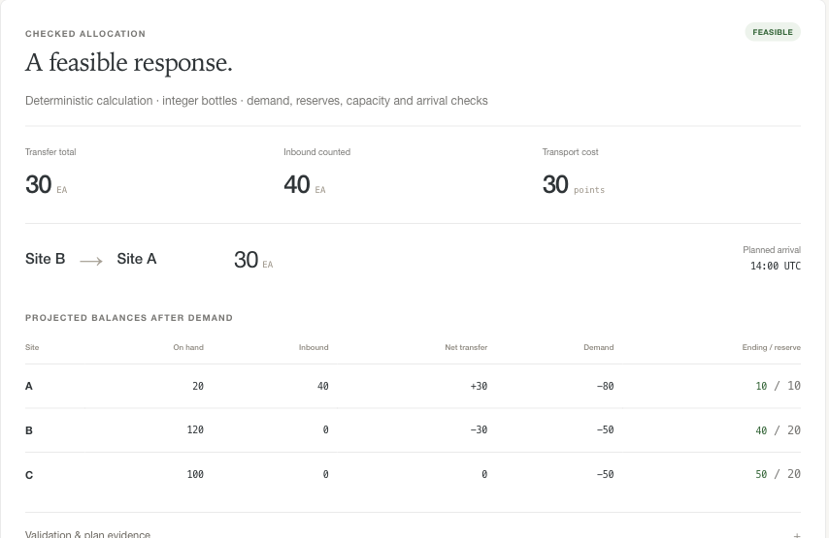
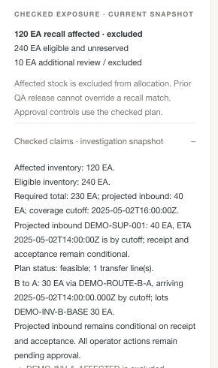
11
What a recall coordinator sees: the plan, and the checked claims behind it.
The checked plan: who sends how many bottles, and what each site has left after demand.
Verified claims, each linked to its source.

Slide 12
What’s next
Test on recall notices it has never seen
Catch “offer” vs “requirement” wording errors
Check device details, not only lot and product
Pilot with real recall coordinators
A recall assistant that shows its proof — and says so when it has none.
Engram · Ahmed Rahimi · Open Agent Hackathon 2026

