Slide 1


INSTITUTE OF AERONAUTICAL ENGINEERING
Research based Learning (RBL)
III B. Tech VI semester
Topic: Computaional approach for analysing the local blood flow in a vascular network at high altitude pressure using neural networks.
DEPARTMENT OF AERONAUTICAL ENGINEERING
MENTOR: DR.B.ASHLESHA
NAGA SURAJ(20951A2146)
A.Naveenkumar(20951A2148)

Slide 2
CONTENTS
Abstract
Introduction
Literature review
Methodology
Result and discussion
Conclusion
Reference

Slide 3
ABSTRACT
Flying at high altitude presents significant challenges for the human body, particularly regarding hemodynamics in the vascular network. In this study, we present a new method using neural networks to analyze local blood flow in vascular networks during flight. Leveraging the power of deep learning, our approach aims to gain a deeper understanding of complex hemodynamic responses in high-pressure environments in high-pressure environments. Using the properties of blood and its vessels, we design and train a neural network architecture specifically for complex spatio-temporal data processing of vascular networks. The model's ability to learn and expand vascular behavior demonstrates its effectiveness in capturing dynamic changes in blood flow; this can have a significant impact on air medicine and passenger safety during high altitude travel.

Slide 4
ABSTRACT
In the current study, a unique method for leveraging angiography data to reconstruct the 3D vascular system is provided. The network can be expanded to include any size of vessel, from large ones to tiny ones.
Additionally, the CFD programme is used to create a database of pressure and velocity distribution across a wide range of branching scenarios in order to establish the flow field throughout the vasculature.
The GMDH method uses the acquired database as the training set of data to ascertain the relationship between input output parameters.

Slide 5
INTRODUCTION
The Finally, the reconstructed vasculature and the learned GMDH algorithm are combined to mimic the blood flow. The findings show that the suggested approach is quite good at building the vascular system and forecasting the flow field within the tissue.
Researchers have shown a keen interest in the study of the vascular structure as the primary pathway for the transport of blood, nutrients, and medications to tissue cells .
The circulatory system's intricate design is a result of a number of operational limitations, including the need to deliver enough blood to all areas of the tissues and convey blood to the proximity of all living cells.

Slide 6
The evaluation of the blood vessel structure has been the subject of numerous investigations up to this point, including the lumped vessels approach and CT and MRI angiography .
However, both the visual imaging techniques and the streamlined analytical procedures have flaws. Unrealistic results are produced, for instance, when a planned bifurcation with a predetermined area ratio between succeeding vessel generations is assumed.
Because the vascular network differs from case to case in biomedicine, it is necessary to repeat the visual identification approach for each individual case.

Slide 7
INTRODUCTION
It is feasible to reproduce the vascular system using computer techniques based on the available experimental data as a cost-effective, efficient, and repeatable procedure, nonetheless, as the bifurcation principles are comparable among varied blood networks.
There have been various proposed algorithms and techniques to replicate the vascular system up to this point . The attempt to optimise a system of variables connected to the circularity system subjected to various sorts of restrictions is a feature shared by multiple introduced methodologies .
The minimal power resistance, vessel volume, pressure loss, flow resistance, and blood drag force applied to the vascular membrane are some of these restrictions.

Slide 8
Nearly all of these methods use the assumption that blood flow through the vessels complies with the straightforward Poiseuille's law for laminar condition.
For the simulation of non-Newtonian blood flow through intricate and irregular blood arteries in the presence of bifurcations with various area ratios, nearly all of the proposed approaches use the straightforward Poiseuille's law .
Therefore, it is plausible to infer that the flow behaviour that should be optimised in the aforementioned techniques is not faithfully replicated utilising the fundamental premise that Poiseuille flow occurs.

Slide 9
Literature review
Authors | Name of the paper | journal | Results from the paper
A. Quarteroni, A. Manzoni, C. Vergara | The cardiovascular system: mathematical modelling, numerical algorithms and clinical applications | Acta Numer. 26 (2017) 365–590. | This paper reviews the various methods of analyzing blood flow using computational algorithms
Kahveci, B.R. Becker | A numerical model of pulsatile blood flow in compliant arteries of a truncated vascular system | Int. Commun. Heat Mass Transf. 67 (2015) 51–58 | The results show that the blood flow velocity experiences a significant decrease after the bifurcation points due to the higher total cross-sectional area of the daughter vessels as compared to the parent vessel.

Slide 10
Literature review
Authors | Name of the paper | Journal/conference name | Results and conclusions obtained
C.S. Kim, C. Kiris, D. Kwak, T. David | Numerical simulation of local blood flow in the carotid and cerebral arteries under altered gravity | J. Biomech. Eng. ASME J. 128 (2) (2005) 194–202. R. Roohi et al. | it was observed that the altered gravity has an impact on deformable wall motions and wall shear stress distribution throughout the pulse cycle
A.H. Elsheikh, S.W. Sharshir, M. Abd Elaziz, A.E. Kabeel, W. Guilan, Z. Haiou, | Modeling of solar energy systems using artificial neural network: a comprehensive review | Sol. Energy 180 (2019) 622–639 | advantages of the ANNs in modeling these devices, such as high accuracy, generalization capabilities, and short computing time, over other theoretical and experimental modeling techniques

Slide 11
Literature review
Authors | Name of the paper | Name of the journal/ Conference | Results and conclusions
J. Boyd, J.M. Buick, S. Green | Analysis of the Casson and Carreau-Yasuda non- Newtonian blood models in steady and oscillatory flows using the lattice Boltzmann method | Phys. Fluids 19 (2007), 093103. | Casson and CY models show large velocity differences when compared to corresponding Newtonian flows. in all cases, steady and oscillatory, the Casson model produced the largest variations from Newtonian flow.
M. Zamir | On fractal properties of arterial trees, | J. Theor. Biol. 197 (1999) 517–526. | Here methods of creating and properties of an arterial trees are discussed.

Slide 12
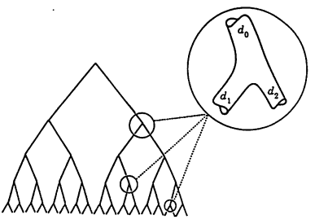
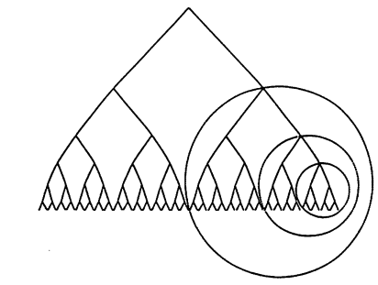
Depiction of arterial trees where it is assumed that each arterial tree has only two children [M.Zamir, on fractal properties of arterial trees]

Slide 13
OBJECTIVE
Our objective in this paper is to visualise and understand the deviation in flow of blood while at high pressures such as during a flight manuver at high speeds.
The effect of pressure at different bifurication points ie the point at where the artery splits into two children roots. We try to capture the pressure drop, change or fluctuation of velocity in the arterial flow assuming pulsatile flow inside arterial flow.
By this we expect results that help visualising the flow of blood and thereby understanding its properties at the assumed condition.

Slide 14
METHODOLOGY
The flow of research methodology is described in the following steps:
Collecting numerical data i.e the flow field characteristics of blood flow such as pressure drop and velocity at the parent and children vessel branches for possible configurations (dihedral angle of 30°,60°,85°, )
Training the neural networks to estimate the pressure drop and mean velocity on the provided CFD data to predict the values of future children nodes
Training the Generative Adversarial Neural Networks (GANs) using different datasets of vascular network images, such as medicals scans or simulated data( We used simulated data ).

Slide 15
Methodology
Here, there are two parts of the network that is the Generator and Discriminator. The Generator learns to synthesise vascular networks that create results or images that resemble the simulated inputs. The discriminator provides feedback as trues and false and improves the quality and similarity of the generated vascular networks.
4.) Combining the results of these two neural network outputs to create pressure contour output.

Slide 16
Boundary conditions
Boundary Conditions used in the Ansys Fluent solver to calculate the pressure drop at different children outputs:
3D steady state non Newtonian form of governing equations
convergence criteria set to 1e-5
Viscosity of blood | 0.0043kg/m-s
Density of blood | 1060 - 1070kg/m3
Density of arterial wall | 1200kg/m3
Velocity of blood considered (steady state) | 0.8m/s
pressure | 3127pa

Slide 17
Results and discussion
The Vascular network:
The GANs neural network provided the result of comprehensive simulation of vascular system ie the structure of the vascular tree and the assignment of the children diameter. The parent vessel is divided into two children accordingly by the inputs taken from the work of M .Zamir on arterial trees.
The divergence of area ratio and branching exists minimally and the vessel tree is colour graded according to the radii of the vessel.

Slide 18
Results and discussion
CFD RESULTS AND DISCUSSIONS:
Computational Softwares such as Ansys fluent and python libraries such as tensor flow have been used to compute the fluid behaviour in the given boundary conditions. As we considered arterial flow inside the vascular network we considered parabolic inlet velocity over a time period with viscosity of blood being 0.0043kg/m-s and density of blood being 1060kg/m3. The results show a parabolic inlet and exit velocity which is varying along the radius is seen.
At parabolic flow is considered to be transient in nature ie its varying with time and distance. During the flow simulation, the maximum velocity across the pipe is assumed to be the sum of squares of the axis that the flow is perpendicular to. Here we assume the flow in z axis then
umax = x**2+y**2
u_transient = umax*(sin(omega*time)*0.1-1)

Slide 19
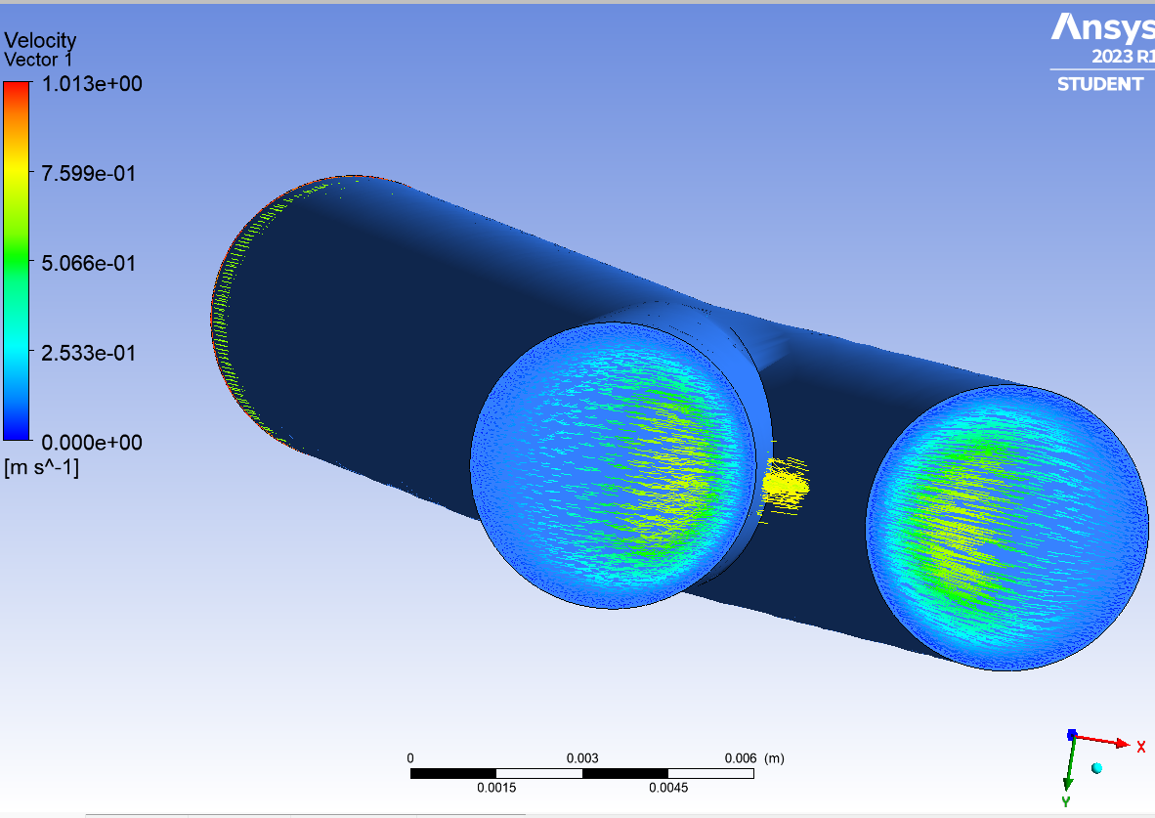
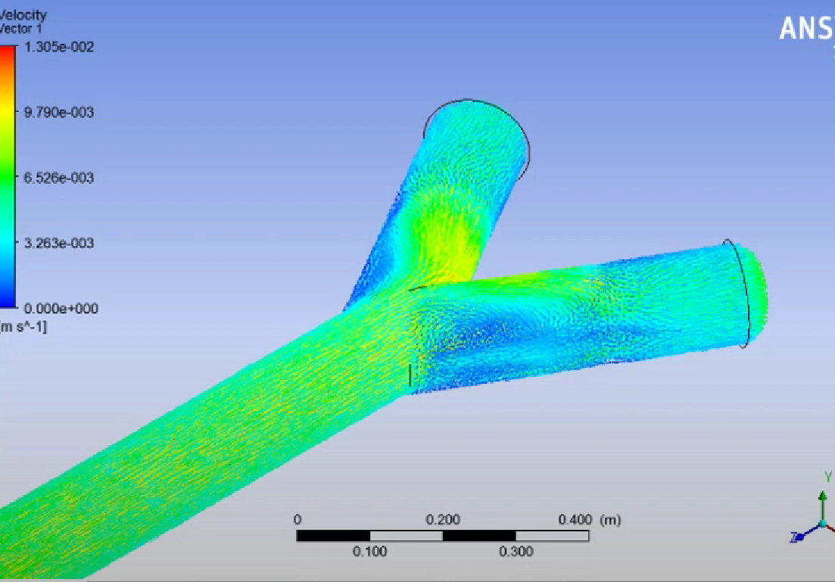

Slide 20
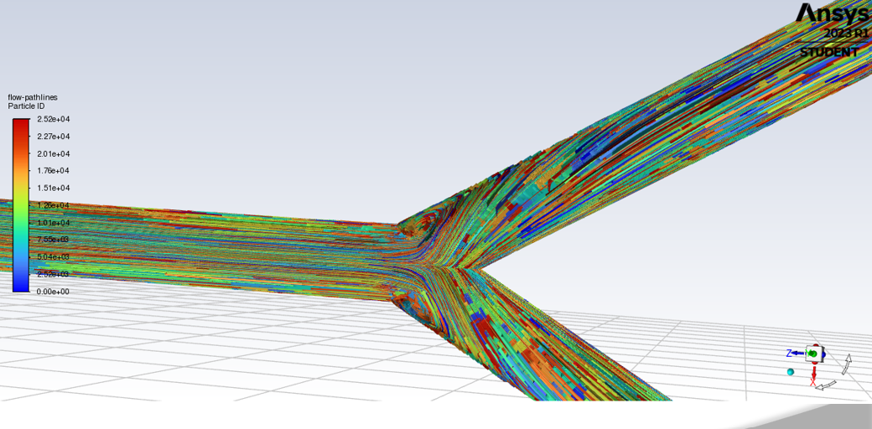

Slide 22
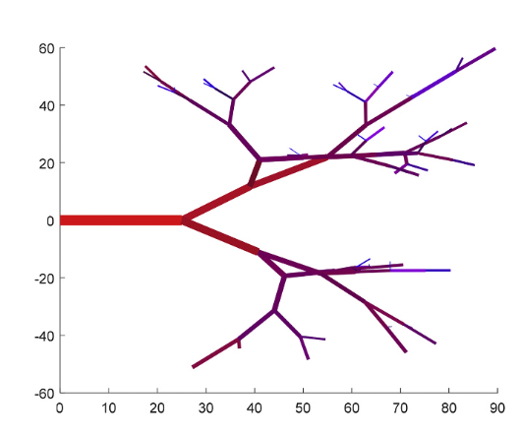
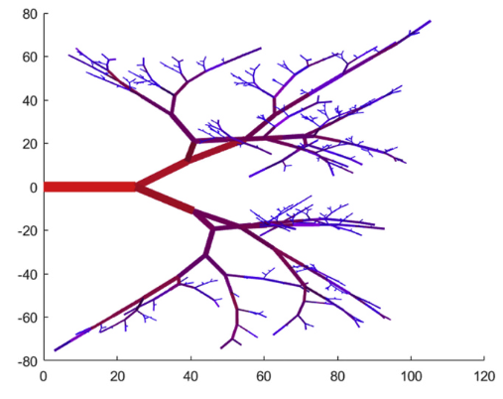
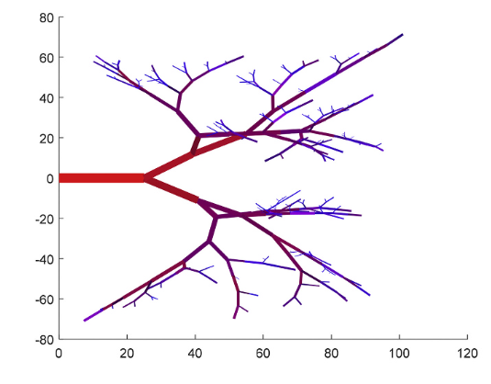
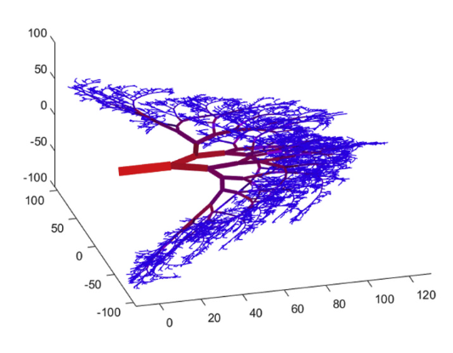
Branching pattern of micro vessels along x and y axes(micrometer)with various number of micro vessels
From top left:
A = 144
B = 544
C = 2682
D = 20,756(3d)

Slide 23
Conclusions
In this study we tried to understand the properties of arterial flow under pulsating velocity to determine the pressure and velocity distribution within the vascular system. The GANs algorithm is capable to create images using deep learning models offering solutions for data augmentation, research simulation, and medical imaging tasks. We tried to simulate blood vessels using relations given by Murray’s method for any kind of human tissue. The flow field simulations are run by neural networks and the results obtained are highly accurate and reliable on which is seen by the graphs. By this we conclude that the flow field simulated can perfectly predict the pressure and velocity at every point in the vascular network.

Slide 24
Thank you

