Slide 1
MIS311 Term Project Snort
17030411002 Ersan ŞEN
17030411017 Ali Rahmi ATALAY
17030411032 Berke AKKUŞ

Slide 2
Content
Project Description
Introducing Programs That We Used
Use of programs and examples

Slide 3
Project Description

Slide 4
Project Description
In this project, we want to address various attacks and brute force (password) attack detection attempts using Hydra, Snort and other tools.

Slide 5
Introducing Programs That We Used

Slide 6
What is Hydra ?
Hydra is a password detection (cracking) application that can be used in various situations. To give an example of various situations, password detection in authentication-based forms in web applications etc.

Slide 7
What is Hydra …
If we take the working principle simply, it tries a dictionary attack or uses brute force to try different password combinations and connection groups in the form field on the login page. It works fast and stable enough. It can quickly cause dictionary attack against more than 50 protocols including Telnet, FTP(File Transport Protocole), HTTP, HTTPS .. etc.

Slide 8

What is Snort ?
Snort is a free open-source network intrusion detection system (IDS) and intrusion prevention system created in 1998.
Snort performs protocol analysis, content searching and matching.

Slide 9
What is Snort…
Snort's open-source network-based intrusion detection/prevention system (IDS/IPS) is capable of performing real-time traffic analysis and packet logging on Internet Protocol (IP) networks.
The program may also be used to detect probes or attacks, including but not limited to operating system fingerprinting attempts, semantic URL attacks, buffer overflows, server message block probes, and stealth port scans.

Slide 10
What is Snort…
Snort can be configured in three main modes:
Sniffer,
The program will read network packets and display them on the console.
Packet logger,
In packet logger mode, the program will log packets to the disk.
Network intrusion detection.
In intrusion detection mode, the program will monitor network traffic and analyze it against a rule set defined by the user. The program will then perform a specific action based on what has been identified.

Slide 11
Implementation

Slide 12
Implementation
In the implementation step, we have three different attack simulation attempts. We will consider them in this section.
Ping Attack
TCP DoS Attack
Using Hydra Sample Brute Force Attack

Slide 13
How install requirement programs ?
We briefly discussed the programs we will use earlier. Here we will show you how to install it on Linux distributions.
We run the programs we want to install in Linux distributions in the terminal as « sudo apt-get install will be installedProgramName» .
In this direction, we installed both programs on our system with the help of these commands. On the application video you can find a piece of sample video of how to install tools.

Slide 14
I. Ping Attacks
Ping Attack, in short, a denial-of-service attack in which an attacker sends ICMP (ping) packet requests continuously to render the target system unusable is called ping flood (ping attack).

Slide 15
II. TCP DoS Attacks
This attack type uses TCP's 3-way handshake vulnerability. The source (Attacker) sends SYN packets to the destination. (1st handshake) The target responds to the SYN packet as a SYN ACK. (2nd handshake) The source sends a new SYN packet without replying to the incoming packet, and the target remains in a state that constantly waits for a response. In this way, the communication network becomes inoperable.

Slide 16
III. Brute Force Attacks
A brute force attack consists of an attacker sending many password combinations or username values to the system in the hope of correctly guessing a combination.
At this point, the program we need is Hydra. We've already explained what happened. We also need a file that stores passwords or usernames with different combinations.

Slide 17
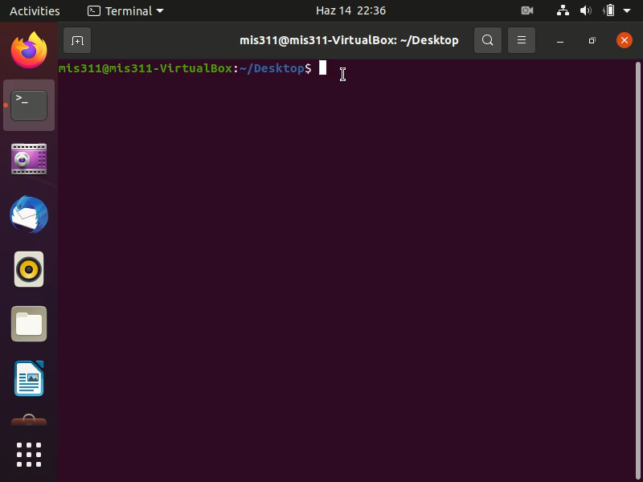
III. Brute Force Attacks…
Here we will try to monitor a brute force attack in its simplest form.

Slide 18
III. Brute Force Attacks…
To briefly summarize, we first create a file where passwords are stored named «passwords.txt». Then we enter values into it and determine its path. After that, using the alerts and config files previously addressed by Ersan, we activate snort on the terminal, and then we run Hydra on a different terminal screen and define the passwords.txt path that we have defined. By Hydra, we send and try the values in the "passwords.txt" file that we created earlier to our local IP (127.0.0.1 address). At this point, Snort detects this movement and blocks this attack.

Slide 19
..Thank you for your Listening..
Now, it is time to apply, so we will show some basic examples about how to use Snort. Let’s move to application video…

