Slide 1

Final Presentation for Capstone Project
Professor: Dr. Marko Schütz-Schmuck

Slide 2
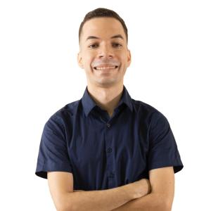

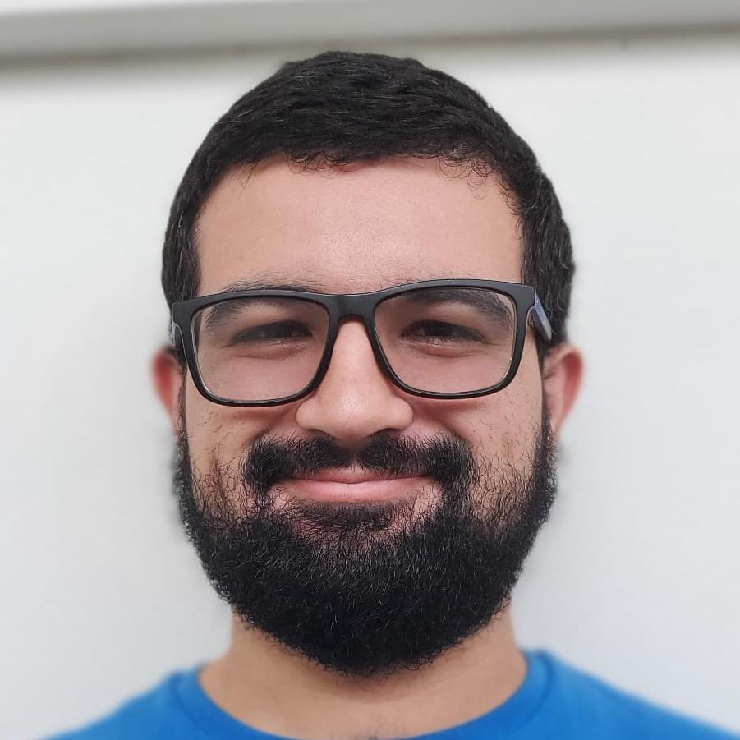
About the team
Felix Dasta - INSO
Emma Hernandez - CIIC​
Armando Leon - INSO

Slide 3
Problem Statement
Some colleges lack the resources necessary to assist students in effectively planning their academic lives. Free apps handle functions such as GPA computation, but they lack features such as storing and organizing courses taken so that the user may see their academic progress at a glance.
There are also tools to see feedback from professors with whom the students would like to take a class, but these tools often do not provide specific feedback based on a certain course and section.
Finally, many students want to compare their performance to that of their classmates in order to determine if they are on track throughout their academic careers. However, there is no publicly available platform that allows us to extrapolate data from persons who have taken the same courses as the student anonymously.

Slide 4
Main Objectives
Provide a unique user system
Provide a performance reviewer
Provide details regarding courses
Provide a functional curriculum viewer
Notes:
Regarding a Unique User System: We wanted to limit the amount of spammers in the system, given that we wanted the users statistics to be as accurate as possible. To achieve this we limited registration to only academic institution email addresses. A process of verification is also required.
Regarding the performance reviewer. We wanted to provide a way in which users of our platform could see how their peers were performing and how their performances compared. We were able to achieve this through the use of publicly available data provided by the University, regarding grades obtained.
Regarding the provision of course details: We wanted to make details such as which professors or instructors have given courses, as well as other relevant info such as student reviews, accessible and simple to find.
Regarding a functional curriculum viewer: By providiing users with a curriculum viewer, we are providing them with an easy way to keep track of their academic progress in a persistent and accesible way.

Slide 5

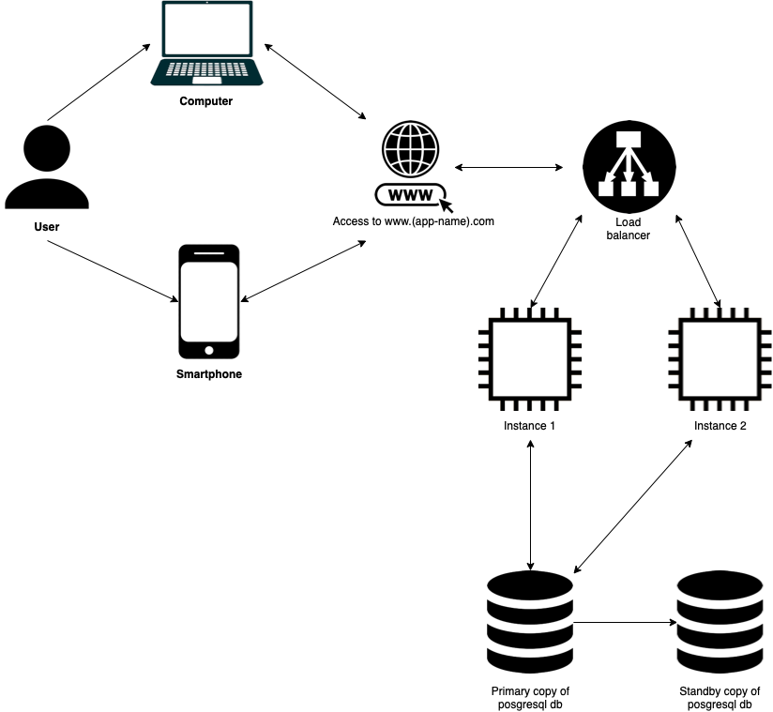
System Architecture Diagram
Notes:
In order for the user to be able to use our application, they will need a device that can connect to the internet and has a web browser. However, from the owner's perspective, given that in the future, the application is expected to be utilized for many colleges it is highly likely that there will be many users connected simultaneously. As a result, the server must be capable of load balancing.
AWS appears to be a plausible choice for us based on our research, as the hosting fee will be proportional to the amount of use, and they have servers in several regions around the world, allowing users to connect to the nearest availability zone.
Additionally, in order to increase application performance and save money, the majority of requested data can be cached on the server utilizing AWS caching techniques (such as Redis), so that the information does not have to be looked up in the database all of the time.
When a user connects to the app and is redirected to the website by connecting to the nearest availability zone, it's very likely that some data about their university is already in the server cache, because users from a specific geographic location are more interested in learning about a university that is closer to them.

Slide 6






Tech Stack
Front-End
Back-End

Slide 7
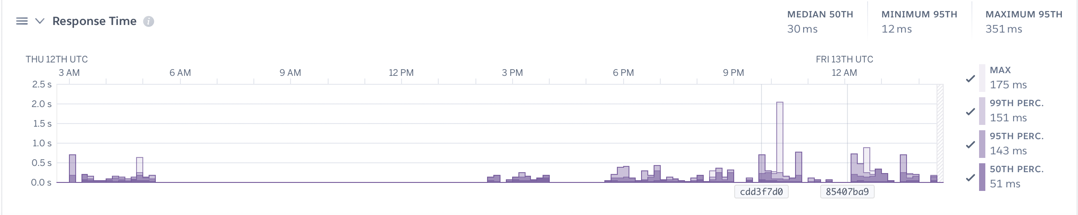

Performance Improvements and Results

Slide 8
Demo

Slide 9
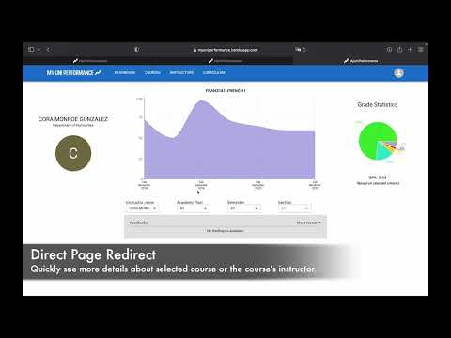

Slide 10
Questions?

