Slide 1
Instruction Manual for Setting up Database

Slide 2
Main Content
Setup a New Local Database
Setup an Existing Database

Slide 3
Setup a New Local Database
Pre-requisite:
XAMPP.
Note:
Please refer to instruction Manual: Guide to install XAMPP.

Slide 4
Setup a New Local Database
For an example in this guideline, we will use a sample database as below :
DB_HOST:localhost
DB_PORT:3306
DB_DATABASE:test
DB_USERNAME:root
DB_PASSWORD:

Slide 5
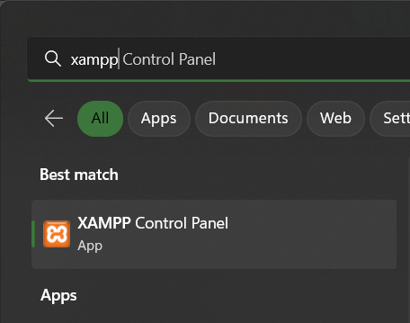
Setup a New Local Database
Using XAMPP:
Open XAMPP control Panel by searching ‘XAMPP’ in the Windows search bar.
Click the XAMPP Control Panel app appeared at the ‘Best match’ section.

Slide 6
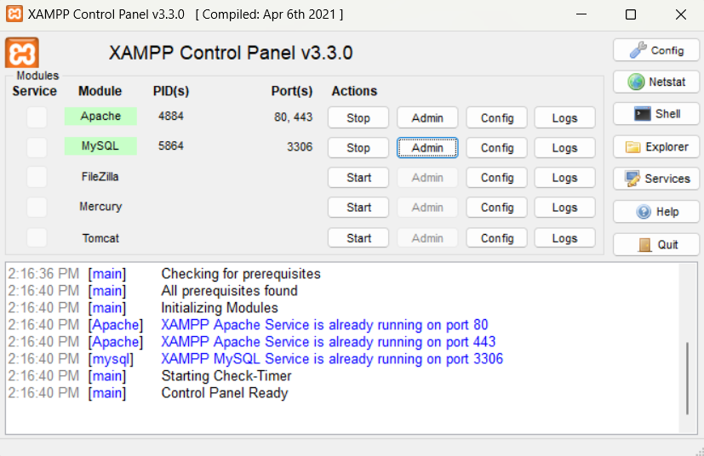
Setup a New Local Database
Using XAMPP:
After clicking at the application, the XAMPP control panel will appear.
Click ‘Start’ buttons at Apache and MySQL module.

Slide 7
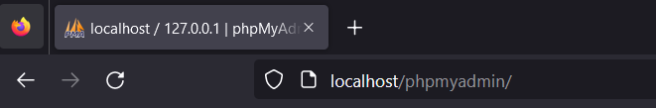
Setup a New Local Database
Using XAMPP:
After Apache and MySQL are successfully run, click Admin button to go to phpMyAdmin homepage, or directly type ‘localhost/phpmyadmin/’ in any browser and click enter.
OR

Slide 8
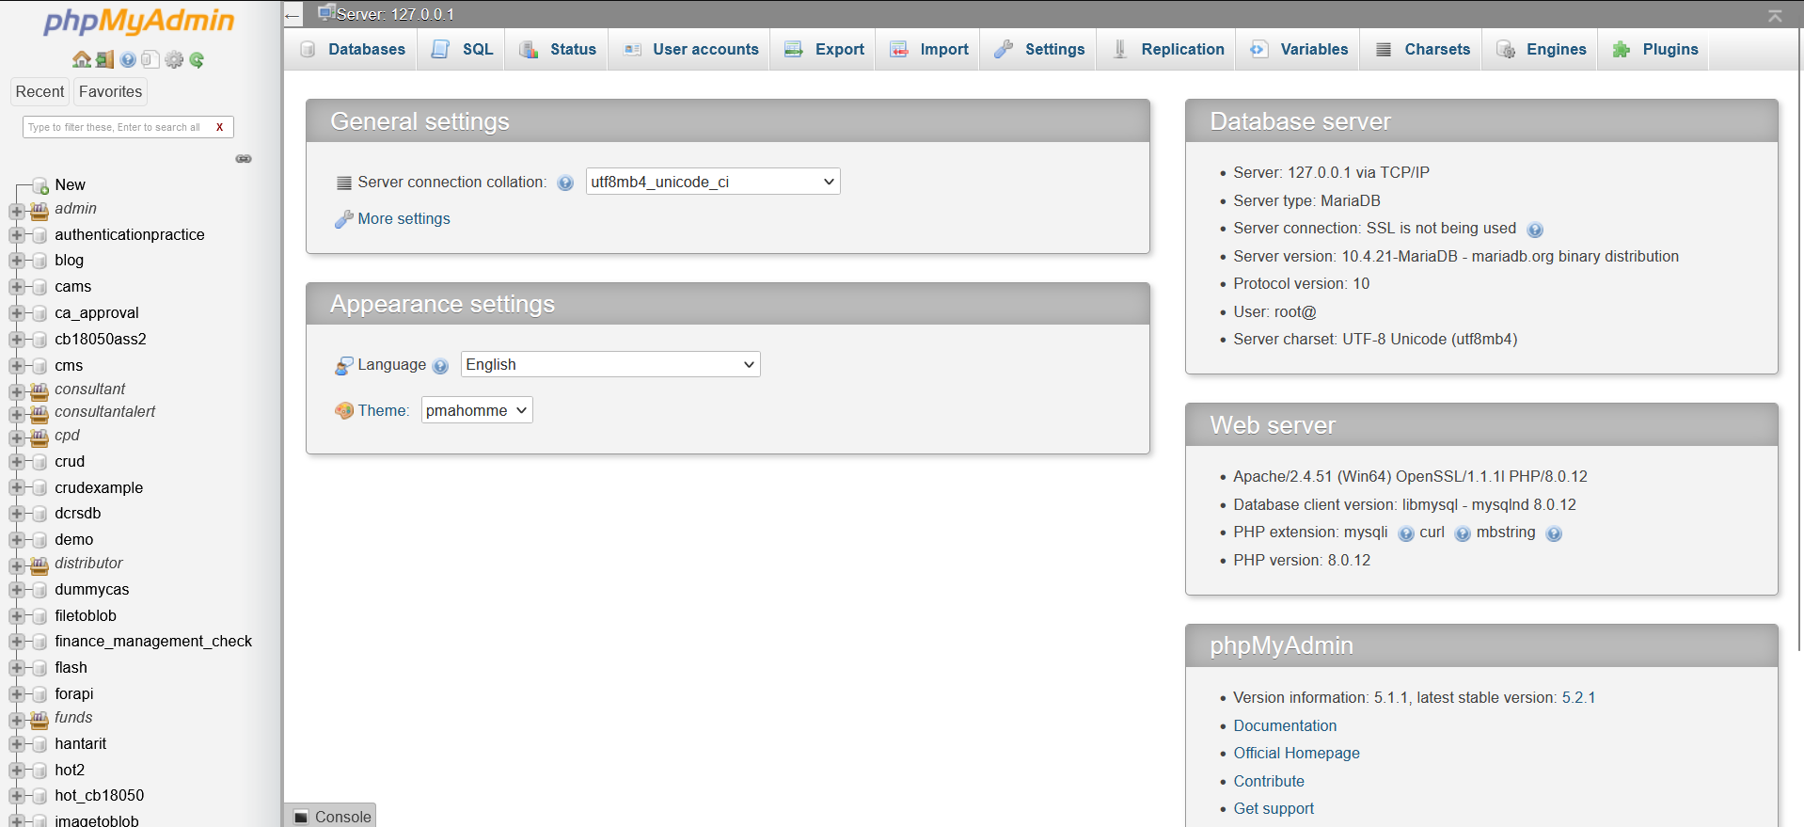
Setup a New Local Database
Using XAMPP:
The phpmyadmin homepage will appear. To create a new database, click ‘New’ button.

Slide 9
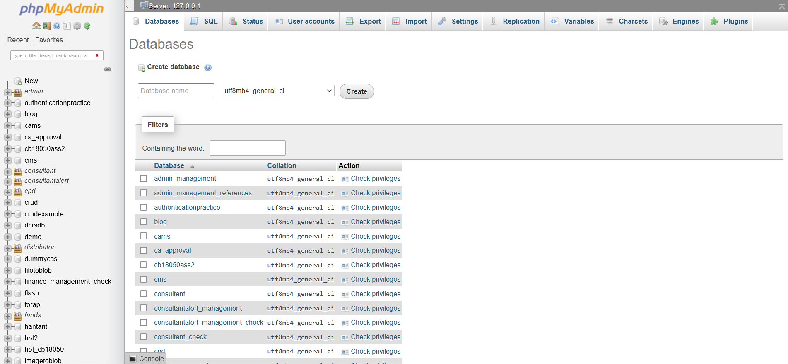
Setup a New Local Database
Using XAMPP:
The page under Databases tab will appear.

Slide 10
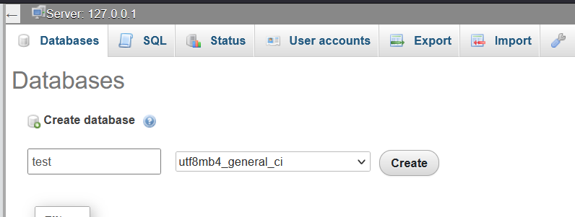
Setup a New Local Database
Using XAMPP:
Fill out the name of the database. Please ensure the name follows the naming convention that has been set.
Click ‘create’ button after filling out the database name.

Slide 11
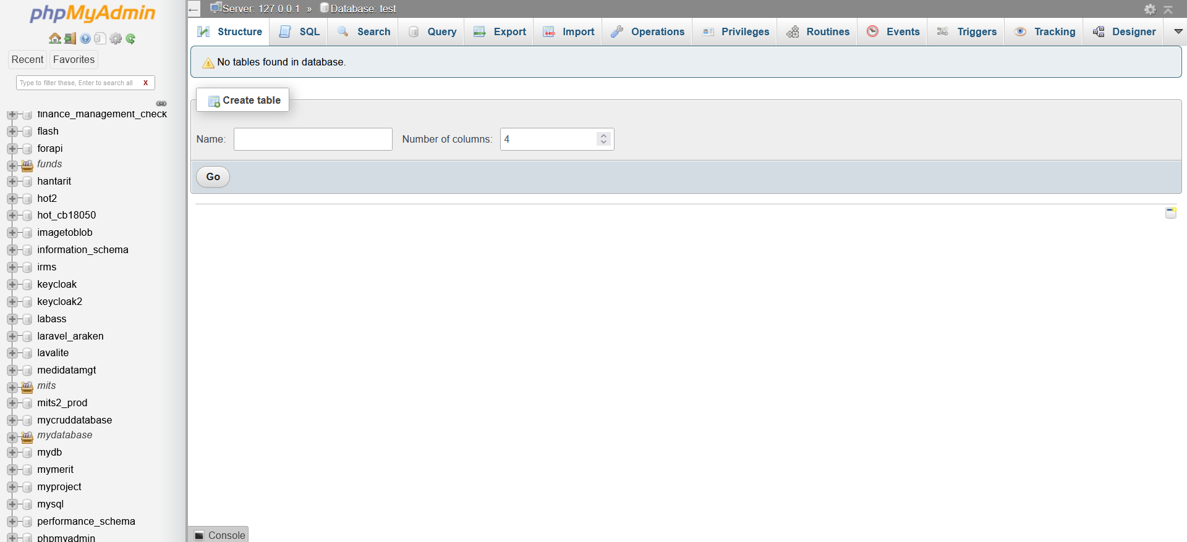
Setup a New Local Database
Using XAMPP:
The database is successfully created.

Slide 12
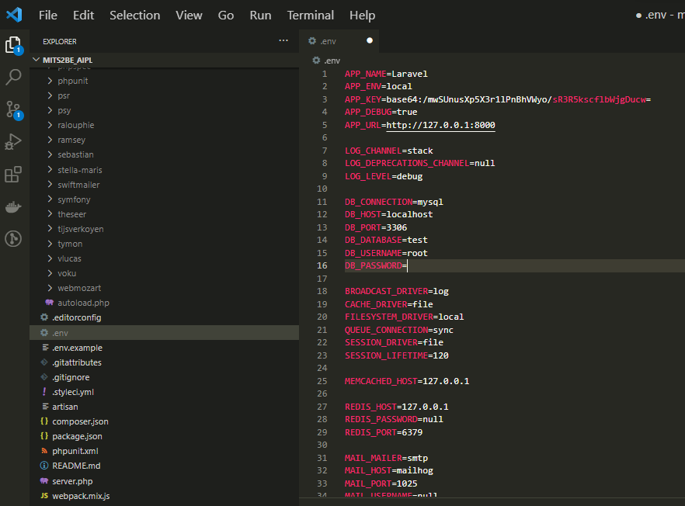
Setup a New Database
Using MySQL Workbench:
Open the Laravel project.
Under the .env file located at “[Project_name]/.env”, at default, change:
DB_HOST = localhost
DB_PORT = 3306
DB_DATABASE = test
DB_USERNAME = root

Slide 13
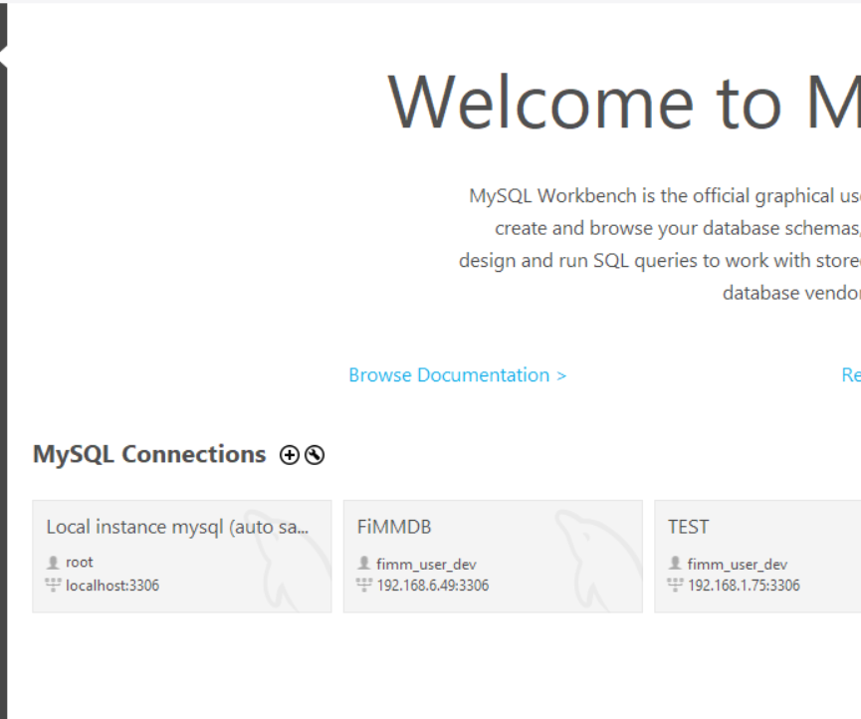
Setup a New Local Database
Using MySQL Workbench:
Open MySQL Workbench.
Click the “+” button as shown in the diagram.

Slide 14
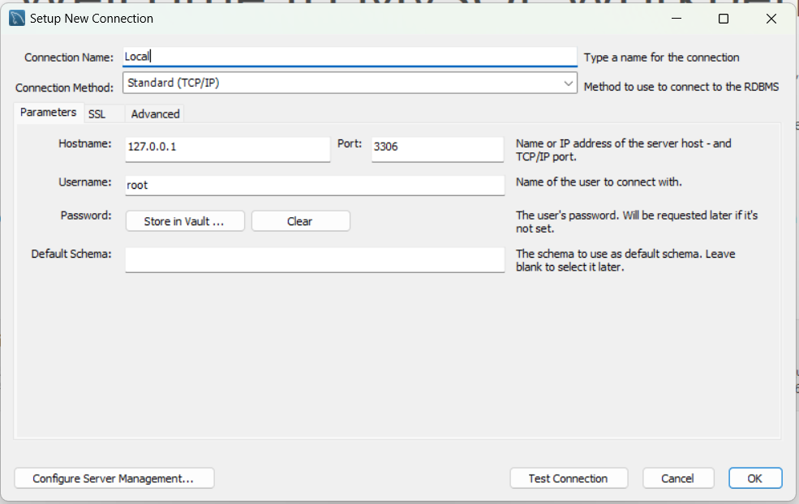
Setup a New Local Database
Using MySQL Workbench:
Setup new connection. In this case, you can set up with a local server or a provided server to connect to the database.
Fill up the textboxes as shown in the diagram.

Slide 15
Setup a New Local Database
Using MySQL Workbench:
Click the “Store in Vault” button to fill up your password (if any). On default, there is no password.
Click “Test Connection” button.

Slide 16
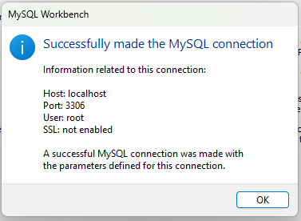
Setup a New Local Database
Using MySQL Workbench:
A success modal pop-up will be appeared if the connection is successful.

Slide 17
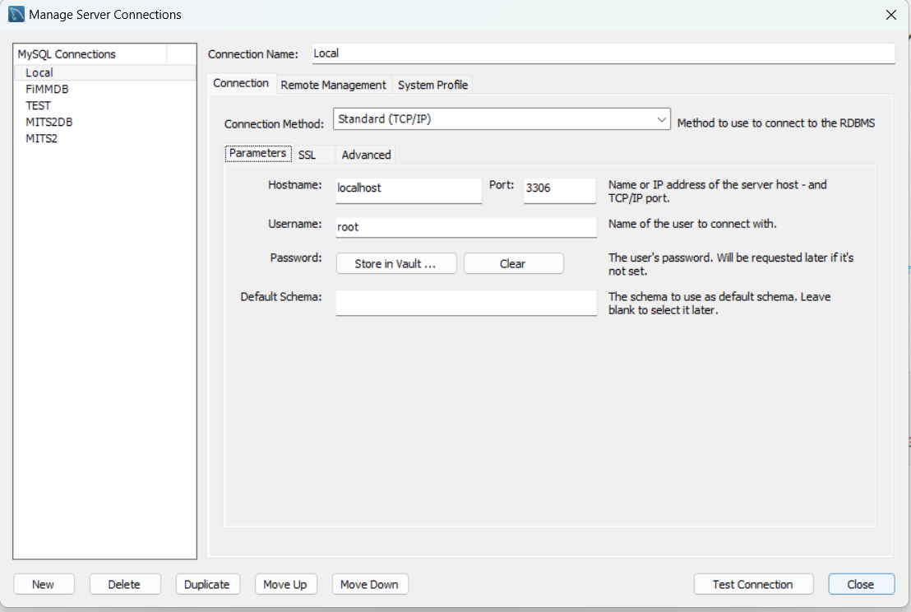
Setup a New Local Database
Using MySQL Workbench:
Click “Close” button after connection is successfully tested.

Slide 18
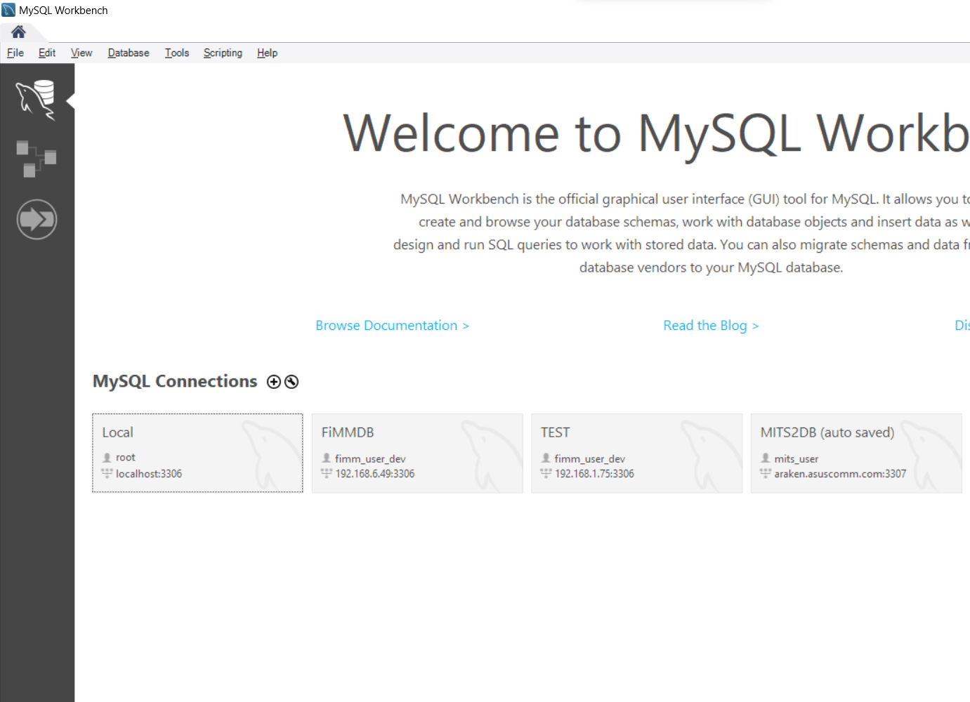
Setup a New Local Database
Using MySQL Workbench:
Find a tab which contains saved connection name. In this case the connection is previously named as “Local”.
Click at the tab.

Slide 19
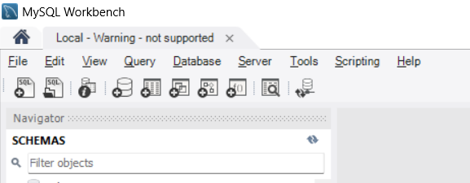
Setup a New Local Database
Using MySQL Workbench:
Click the database icon to create new database schema.

Slide 20
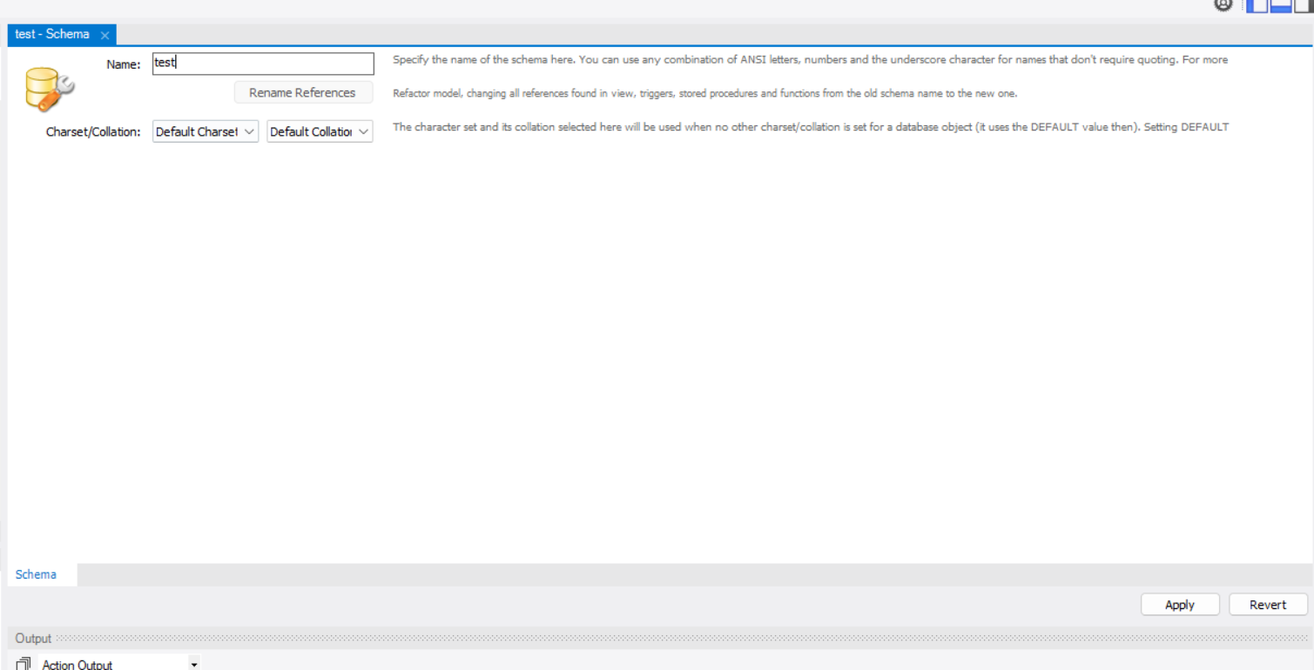
Setup a New Database
Using MySQL Workbench:
Fill out the name of the database. Please ensure the name follows the naming convention that has been set.

Slide 21
Setup a New Database
Using MySQL Workbench:
Click “Apply” button to create a new database.

Slide 22
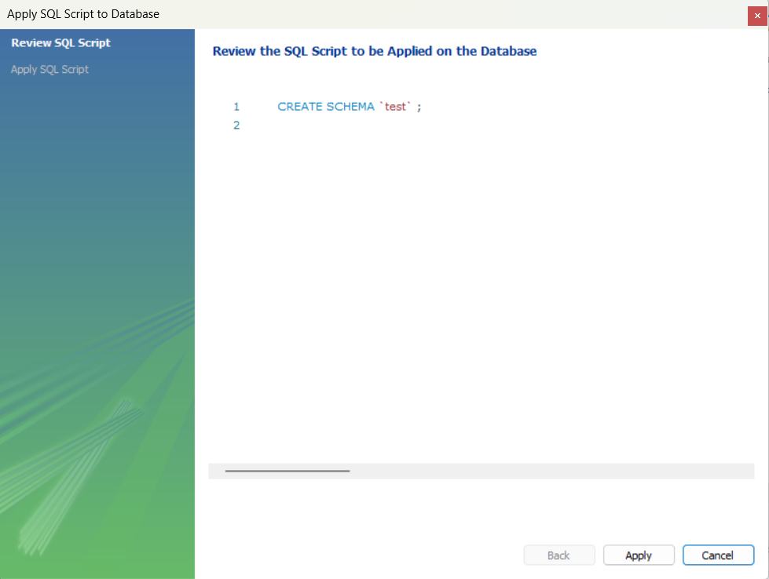
Setup a New Database
Using MySQL Workbench:
A confirmation modal will be popped up with SQL script to ensure that what is applied is correct.
Click “Apply” button if everything is correct.

Slide 23
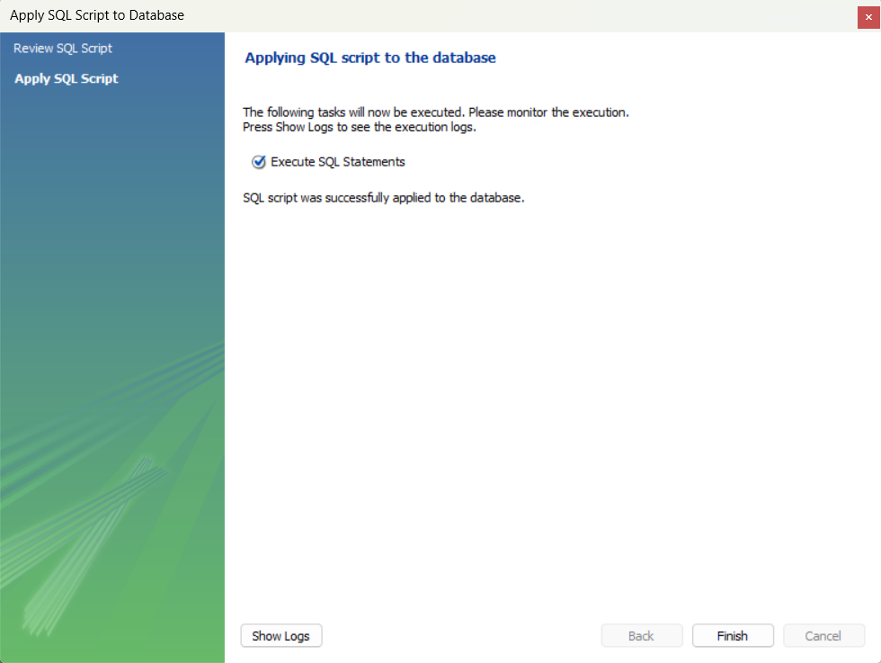
Setup a New Database
Using MySQL Workbench:
The new database is successfully created.

Slide 24
Setup a New Database
Using MySQL Workbench:
Open the Laravel project.
Under the .env file located at “[Project_name]/.env”, at default, you can change;
DB_HOST = localhost
DB_PORT = 3306
DB_DATABASE = [DB_NAME]
DB_USERNAME = root

Slide 25
Main Content
Setup a New Database
Setup an Existing Database

Slide 26
Setup an Existing Project Database
Pre-requisite:
MySQL Workbench.
Note:
Please refer to instruction Manual: Guide to install MySQL Workbench.

Slide 27
Setup a New Local Database
For an example in this guideline, we will use a sample database as below :
Connection Name: MITS2DB
Hostname: araken.asuscomm.com
Port: 3307
Username: mits_user
Password: @Bcd1234

Slide 28
Setup an Existing Project Database
Open MySQL Workbench.
Click the “+” button as shown in the diagram.

Slide 29
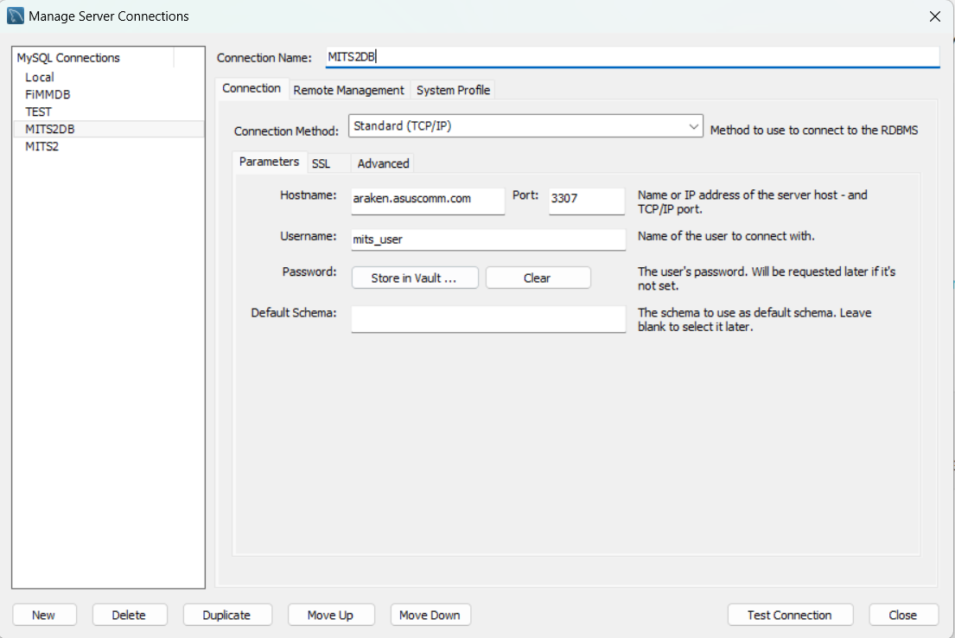
Setup an Existing Project Database
Setup new connection. In this case, you can set up with a local server or a provided server to connect to the database.
Fill up the textboxes as shown in the diagram.

Slide 30
Setup an Existing Project Database
Click Store Vault to insert password.

Slide 31
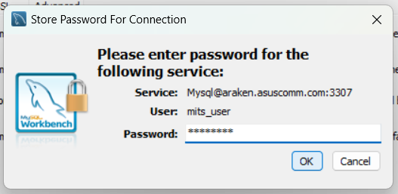
Setup an Existing Project Database
Insert password and click “OK”.

Slide 32
Setup an Existing Project Database
Click “Test Connection” button.

Slide 33
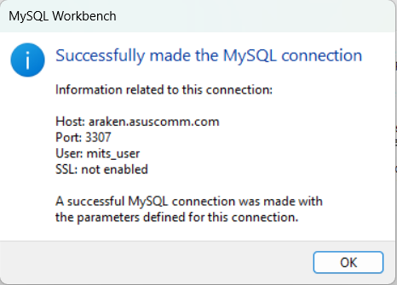
Setup an Existing Project Database
A success modal pop-up will be appeared if the connection is successful.
Click “OK”.

Slide 34
Setup an Existing Project Database
Click “Close” button after connection is successfully tested.

Slide 35
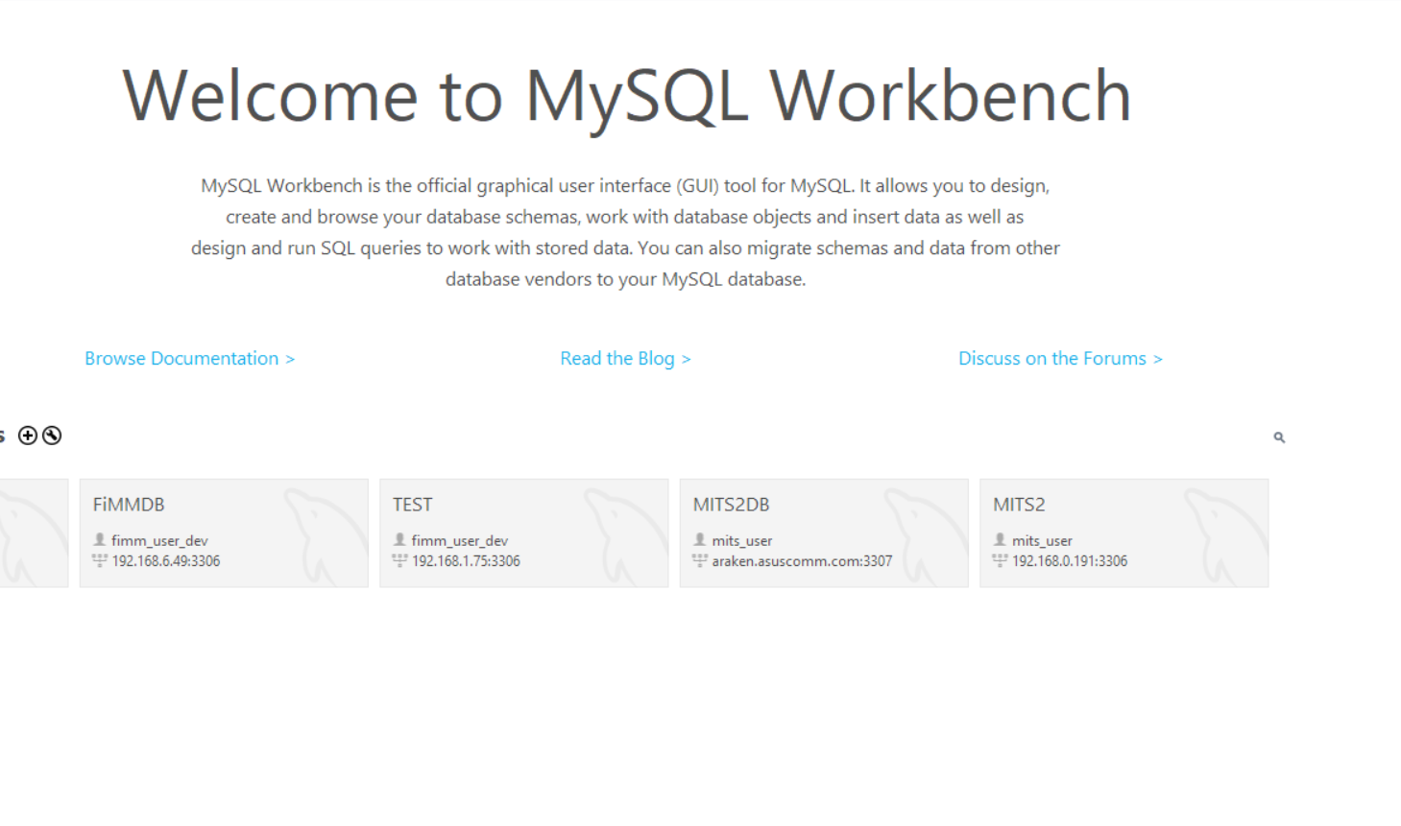
Setup an Existing Project Database
Find a tab which contains saved connection name. In this case the connection is previously named as “MITS2DB”.
Click at the tab.

Slide 36
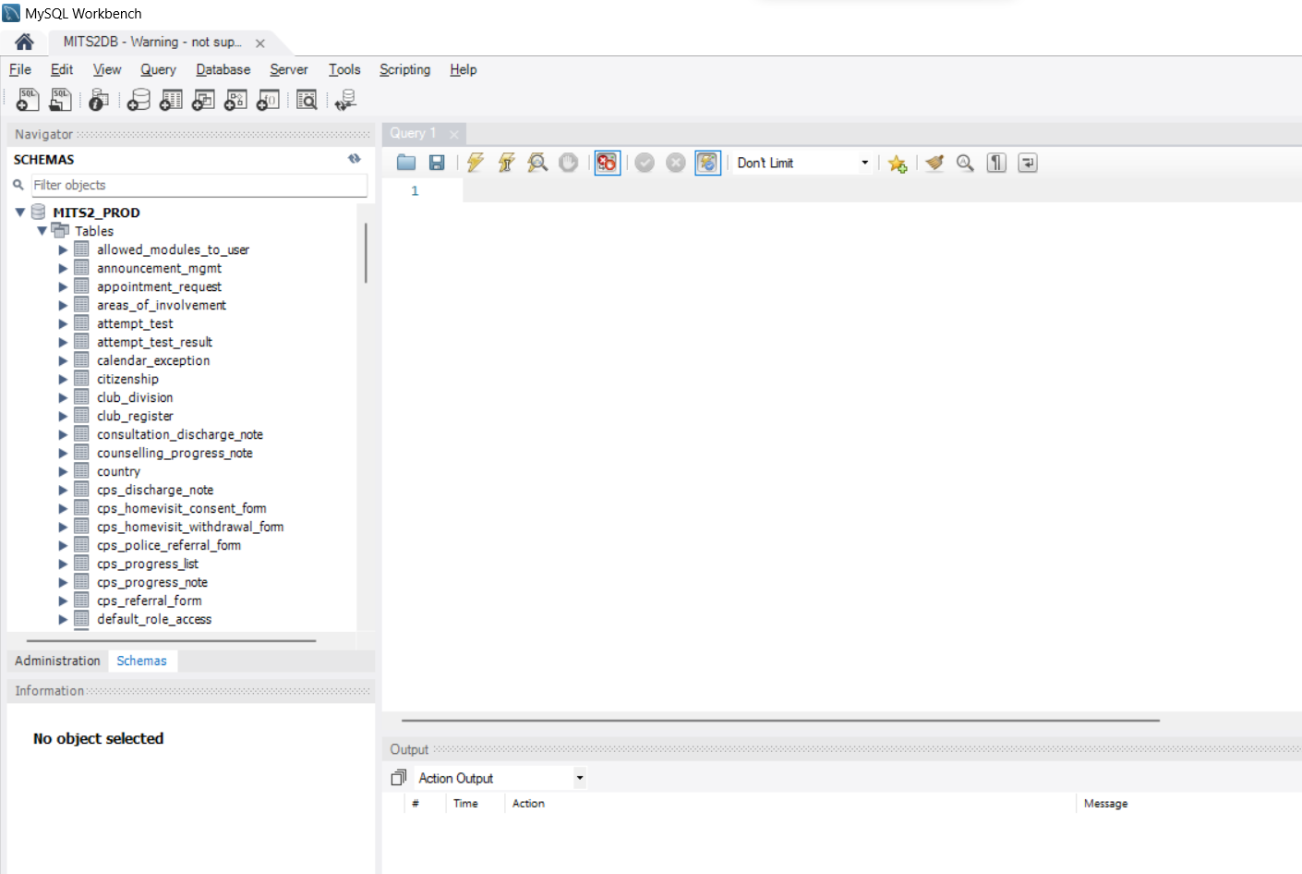
Setup an Existing Project Database
Existing database schema can be accessed on the left side of the MySQL Workbench app.

Slide 37
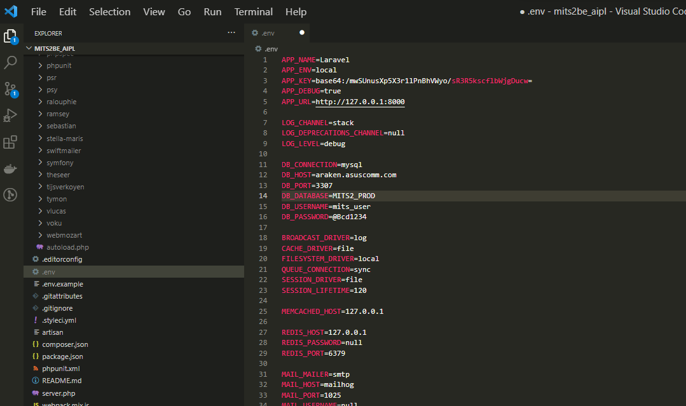
Setup a New Database
Open the Laravel project.
Under the .env file located at “[Project_name]/.env”, change;
DB_HOST = araken.asuscomm.com
DB_PORT = 3307
DB_DATABASE = MITS2_PROD
DB_USERNAME = mits2_user
DB_PASSWORD = @Bcd1234

