Slide 1
Agile Software Development
SCRUM
www.InstigateMobile.com

Slide 2
Overview
SCRUM Team
  Product Owner
  Scrum Master
  Development Team
SCRUM Events
  Sprint Planning
  Sprint Demo
  Sprint Retrospective
  Daily SCRUM
SCRUM Artifacts
  Product Backlog,Sprint Backlog
  Sprint Goal
  Definition of Done (DoD)
  Velocity, User Story, Burn Down Chart

Slide 3
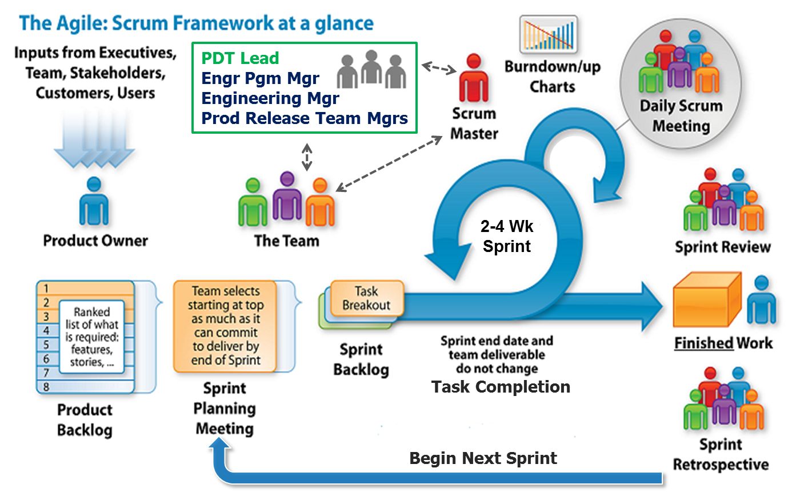
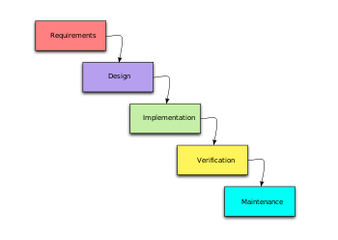
Waterfall and Agile

Slide 4
Traditional software development
Traditional software development
Traditional software development
Agile software development model
Pre-defined set of features, low requirements churn
Delivering large pieces of software or entire product (waterfall) at once → longer development periods → less stability
Dynamically defined/ prioritized set(s) of feature
Delivering smaller pieces, one by one → shorter development periods → more stability

Slide 5
Form a SCRUM team
Scrum Master (maintains the process)
Product Owner (represents the stakeholders)
Team (cross-functional group – Dev, QA, Architects, etc.)
Team size: 3-7, co-located

Slide 6
SCRUM Master
Watches that all Scrum processes are followed
Leads the team
Facilitates and coordinates everything
Help removing the obstacles
Can be anyone with necessary skills

Slide 7
Product Owner
Business-oriented, defines product backlog
Prioritizes features
Owns vision of the product
Owns release dates/costs
Open to negotiations with the Team
Can be Product/ Project/Marketing Manager

Slide 8
Team
Developers, QAs, Architects, Analysts, Tech Writers, etc.
Actually does the work
Responsible for estimates and planning the work/risks
Does everything to deliver on schedule

Slide 9
Product Backlog:
Prioritized list of features
Defined by Product Owner/Team
Prioritized by Product Owner
Reviewed and re-prioritized before project starts and before each Sprint

Slide 10
Sprint
Basic unit of development in SCRUM
Timesboxed (restricted to a specific duration) effort of a constant length
Team decide the duration
Typically – 1 to 4 weeks
Before Sprint: sprint planning meeting
After sprint: review/demo and retrospective

Slide 11
Sprint Planning Meeting
Held at the beginning of the sprint
Product Owner selects what work is to be done
Details the time it will take to do that work, with the entire team
Product owner usually checks the estimated time by asking questions
  Do you considered time for installing the necessary versions of browsers or considered only testing time?
Eight hours limit

Slide 12
Definition of Done (DoD)
What “Done” means should be defined BEFORE sprint Starts
All team members should agree
Cannot be change once Sprint starts
DoD should be concrete and masurable
“Sashimi” - a term that something is done

Slide 13
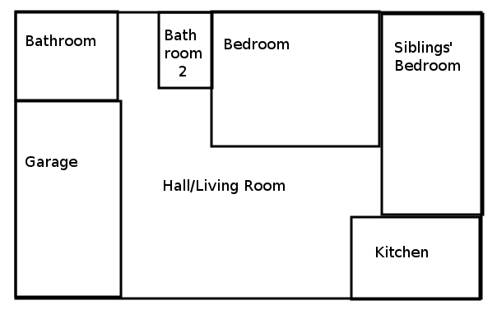
Sprint Planning Example

Slide 14
Sprint Review/Demo Meeting:
Held at the end of each Sprint cycle
Review the work that was completed and not completed
Present the completed work to the stakeholders
Incomplete work cannot be demonstrated
Four hour time limit

Slide 15
Daily Scrum/Standup
Held daily, same location and the same time every day
The meeting start precisely on time
All are welcome, but normally only core roles speak
The meeting is timeboxed to 15 minutes
Each team member answers three questions:
  What have you done yesterday?
  What are you planning to do today?
  Any impediments/stumbling blocks?
Impediments are soled by Scrum Master outside the daily Scrum Meeting

Slide 16
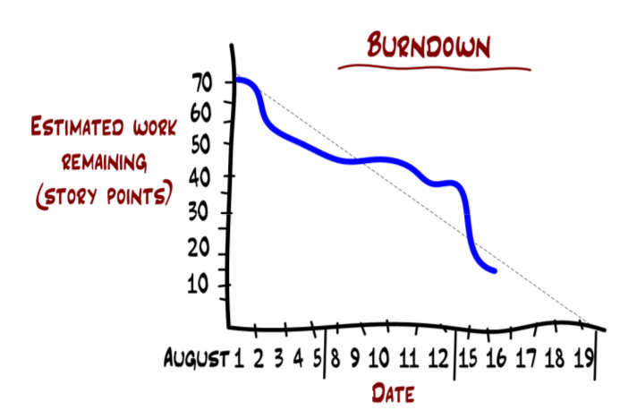
How the burndown chart works?

Slide 17
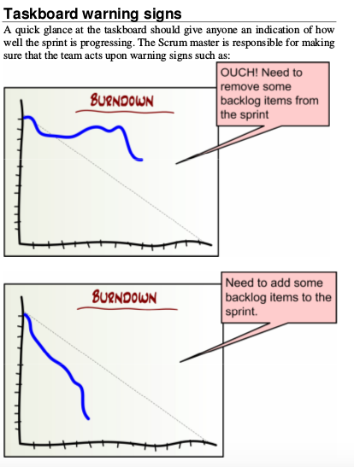
Taskboard warning signs

Slide 18
Sprint Results
If at the Sprint Review Meeting the acceptance criteria of “Done” are not met – the item(s) is NOT DONE and Sprint failed.
There are not partially done sprints.
All not Done Stories go to the product backlog and are prioritized by Product Owner again

Slide 19
Question 1
Which one of the following is not a Scrum role?
  A. Product Owner
  B. Scrum Master
  C. Product Manager
  D. Team

Slide 20
Question 2
Which of the following meeting is not part of Scrum?
  A. Product review meeting
  B. Sprint review meeting
  C. Sprint planning meeting
  D. Sprint retrospective meeting

Slide 21
Question 3
Name the meeting during which the Team demonstrates to the Product Owner and any other interested parties what it was able to accomplish during the Sprint.
  A. Sprint retrospective meeting
  B. Product review meeting
  C. Sprint review meeting
  D. Stakeholder Review Meeting

Slide 22
Question 4
Name the meeting during which the Team demonstrates to the Product Owner and any other interested parties what it was able to accomplish during the Sprint.
  A. Sprint retrospective meeting
  B. Product review meeting
  C. Sprint review meeting
  D. Stakeholder Review Meeting

Slide 23
Question 5
Who is responsible for prioritizing product backlog
  A. Team
  B. Scrum Master
  C. Product Owner
  D. Product Owner and Team

Slide 24
Instigate Mobile CJSC
58/1 K. Ulnetsu, Yerevan 0069, Armenia
www.instigatemobile.com
Armenia +374 60 464700
USA (VoIP) +1 408 625 7509
Germany (VoIP) +49 893 8157 1771

