Slide 1


Apache Maven

Slide 2

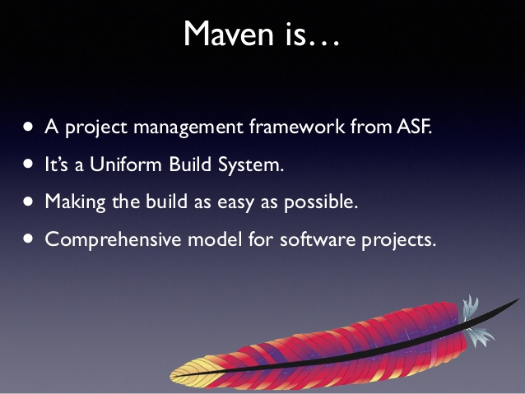

Slide 3
Maven, a Yiddish word meaning accumulator of knowledge, was originally started as an attempt to simplify the build processes in the Jakarta Turbine project. The result is a tool that can now be used for building and managing any Java-based project.

Slide 4
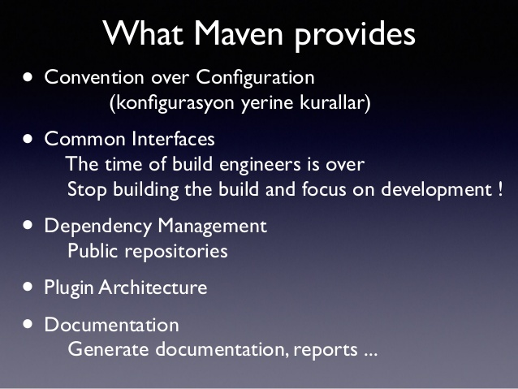

Slide 5
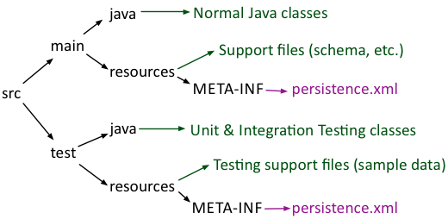

Slide 6

POM xml
POM stands for "Project Object Model".
It is an XML representation of a Maven project held in a file named pom.xml
It gathers:
Project configuration Project description
Project dependencies Project inheritance
Project aggregation

Slide 7
Key elements of initial pom xml:
1. project
2. modelVersion(version of the object model this POM is using)
3. groupId
4. artifactId( <artifactId>-<version>.<extension>)
5. packaging
6. version
7. name
8. url
9. description

Slide 8
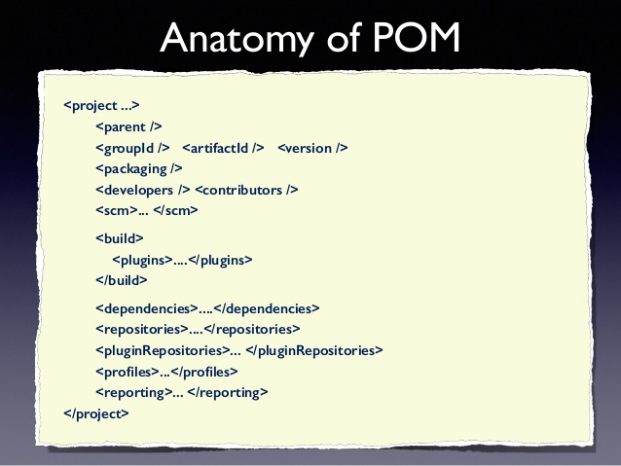

Slide 9
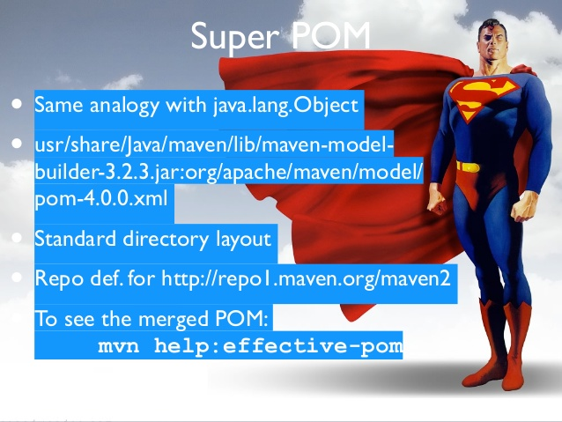

Slide 10
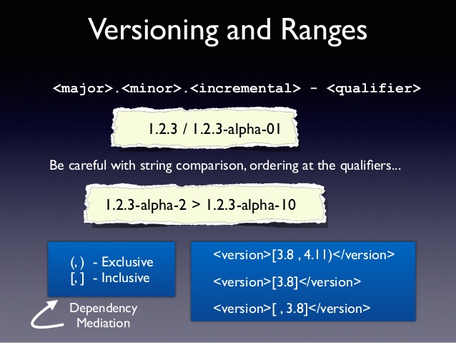

Slide 11
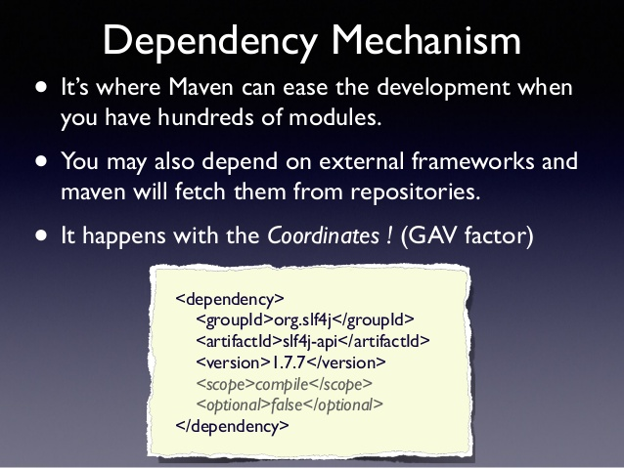

Slide 12
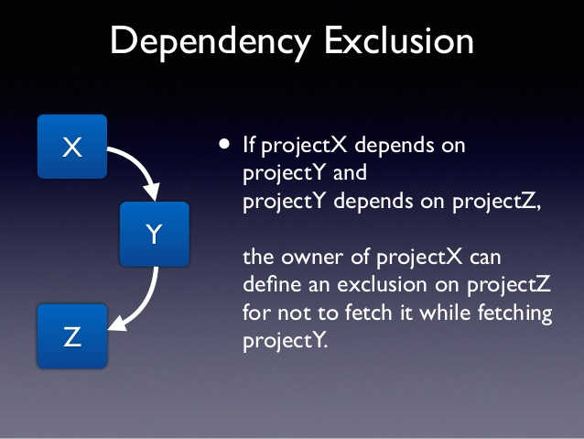

Slide 13
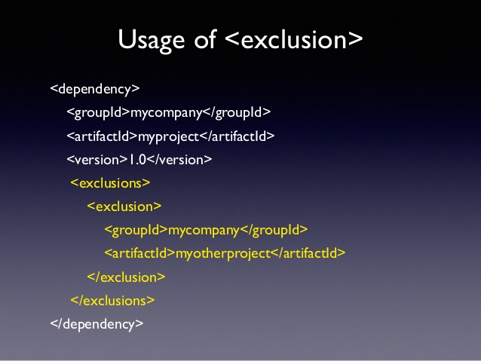

Slide 14
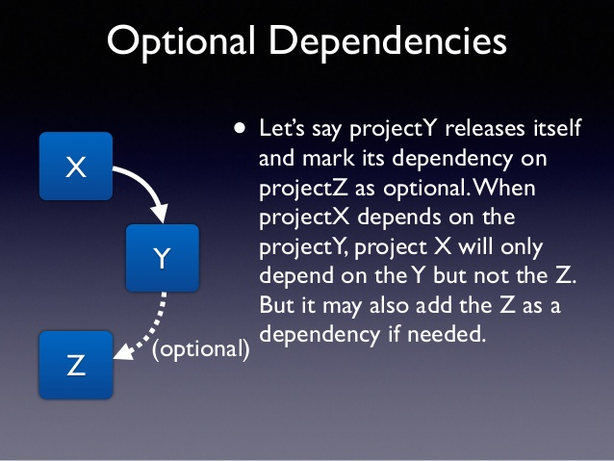

Slide 15
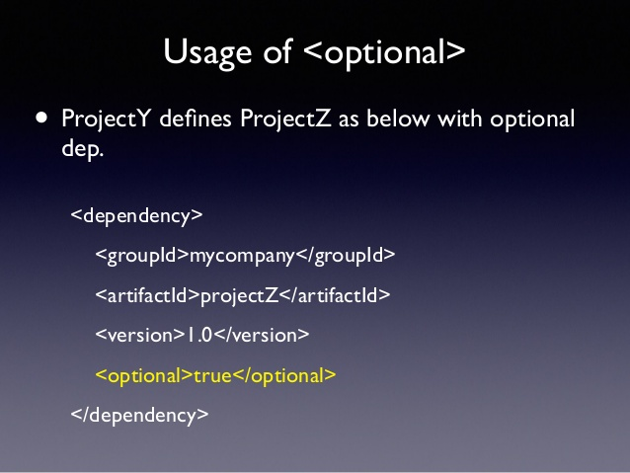

Slide 16
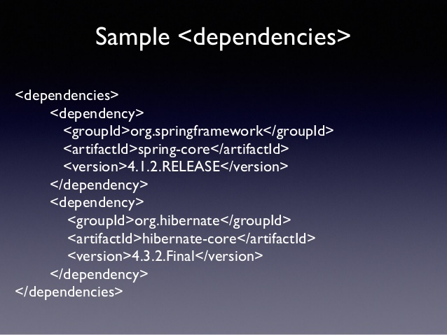

Slide 17
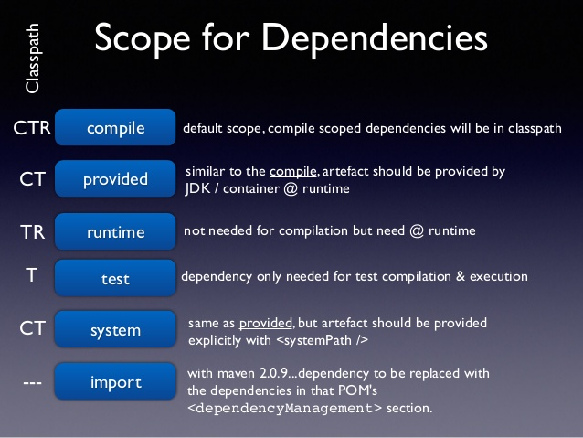

Slide 18
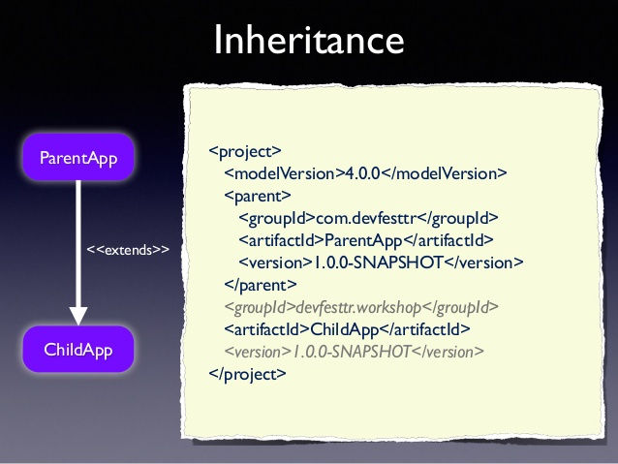

Slide 19
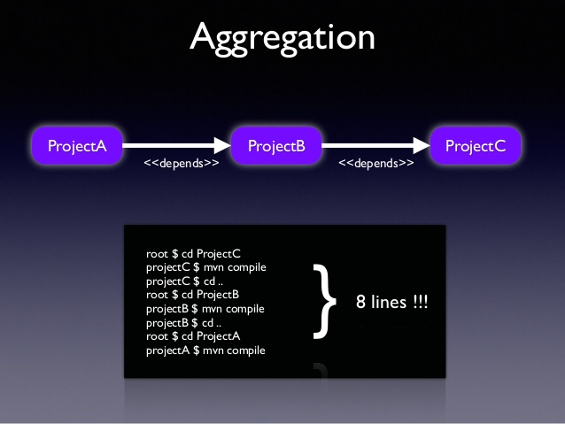

Slide 20
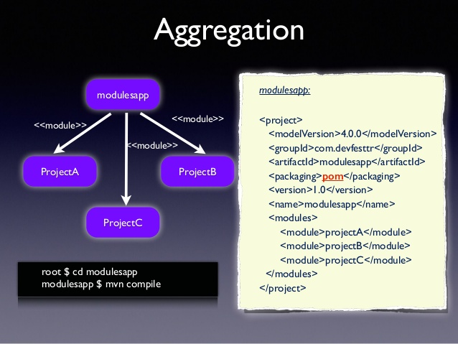

Slide 21
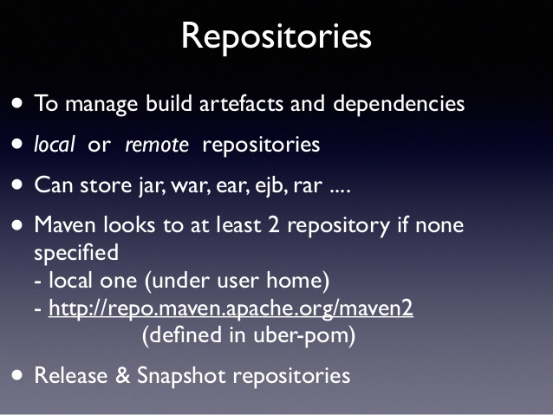

Slide 22
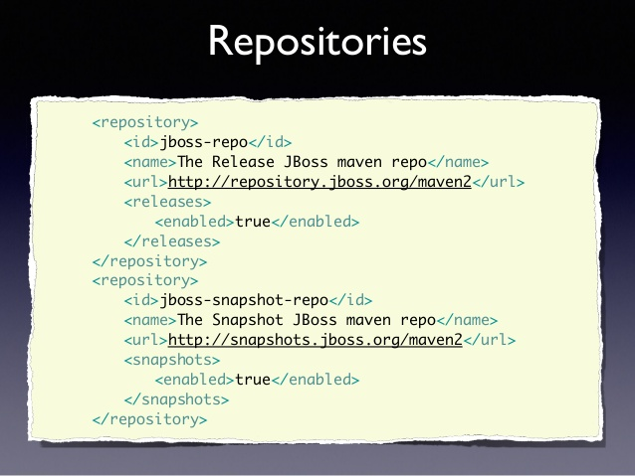

Slide 23
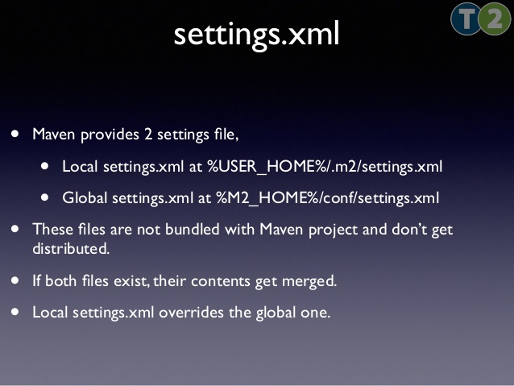

Slide 24
Properties
${X}, where X is the property.
env.X: ${env.PATH} contains the PATH environment variable.
project.x: ${project.version}.
Settings.x: ${settings.offline}.
${java.home}.
x: Set within a <properties /> element in the POM. ${someVar}.

Slide 25
Plugins
Configuration - to specify which of the project's config is important
Executions - to specify how will work that plugin(with goals and phases)
goals:. In this case, a list of plugin goals which are being specified by this execution block.
phase: This is the phase that the list of goals will execute in. This is a very powerful option, allowing one to bind any goal to any phase in the build lifecycle, altering the default behavior of Maven.

Slide 26
clean Clean up after the build
compiler Compiles Java sources
deploy Deploy the built artifact to the remote repository.
failsafe Run the JUnit integration tests in an isolated classloader.
install Install the built artifact into the local repository.
resources Copy the resources to the output directory for including in the JAR.
site Generate a site for the current project.
surefire Run the JUnit unit tests in an isolated classloader.
verifier Useful for integration tests - verifies the existence of certain conditions.

Slide 27
The default lifecycle
The default lifecycle comprises of the following phases:
validate - validate the project is correct and all necessary information is available
compile - compile the source code of the project
test - test the compiled source code using a suitable unit testing framework. These tests should not require the code be packaged or deployed
package - take the compiled code and package it in its distributable format, such as a JAR.
verify - run any checks on results of integration tests to ensure quality criteria are met
install - install the package into the local repository, for use as a dependency in other projects locally
deploy - done in the build environment, copies the final package to the remote repository for sharing with other developers and projects.

Slide 28
It is strongly recommended to use the latest release version of Apache Maven to take advantage of newest features and bug fixes.
Maven 3.5.0
Why not Maven 3.4.0?
After Maven 3.3.9 was released, the Eclipse Aether project was retired and the code base was migrated to the Apache Maven project.
The decision was taken to forever burn the 3.4.x release line.

Slide 29
Overview about the changes
console output colors
The JAVA_HOME - check if JAVA_HOME is set or not then trying to discover via which java,
M2_HOME is removed
mvn script is updated
Corrected memory management related to big amount of modules
Replaced Eclipse Aether with Maven (lib to work with artifacts and repos)
.mvn/maven.config file can be overwritten via command line

Slide 30


