Slide 1
Arrays and Character Sequences

Slide 2
Arrays
T[size] is the type “array of size elements of type T”, elements are indexed from 0 to size - 1
e.g. float a1[3];
char* a2[5];
Array elements can be accessed using [] subscript operator or through a pointer
Access out of array range causes out of bounds error
Can be allocated statically on the stack and dynamically on the free store
int arr[20]; // static allocation on stack
int* p = new int[size]; // dynamic allocation on free store
delete [] p; // memory deallocation
The static array size must be a constant expression

Slide 3
Introduction
Represents a sequence of objects of the same type in memory
Is a good solution for representing a fixed-sized sequence of objects of a given type
An example is zero terminated array of chars, that is how the strings are stored
Built-in array is a low level facility and should b used inside higher level data structures

Slide 4
Array Initializers
Can be initialized by a list of values:
int arr[] = {1, 2, 3, 4};
If size is not specified, it is calculated, otherwise the number of elements should not exceed the size
char arr[2] = {'a', 'b', 0}; // error: too many initializers
If the number of elements is fewer, the default value is used for the rest.
There is no assignment operator for the arrays (vector is used for that reason)
arr1 = arr2; // error: array type is not assignable
Similarly, arrays can't be passed by value

Slide 5
String Literals
Is a character sequence enclosed within double quotes: “String”
It contains one more character terminating the string ('\0'): sizeof(“String”) == 7
“String” is an array of const characters
char* p = “String”; // error in c++11 (optimization to store and access)
To be able to modify string use non-const array:
char p[] = “String”;
p[1] = 'p';

Slide 6
Backslash in String Literals
The backslash is a convention for non-graphic characters within the string
Allows to represent double quote in a string (\”)
A common use is newline character (\n)
String termination character (\0)
C++ provides raw string literals where backslash is just a backslash (no special signs):
string s = R”(string “r”)” // the value is string “r”
Raw strings can contain a newline:
R”(1
22
333)”;

Slide 7
Larger Character Sets
String with a prefix L is a string of wide characters
Terminated by L'\0'
Supports Unicode
wchar_t, wstring

Slide 8
Pointers into Arrays
The name of the array is a pointer to the initial element
It is possible to navigate an array using pointer arithmetic operations

Slide 9
Passing Arrays
Cannot be passed by value
Passed as a pointer to the first element
int print(int* m, int size1, int size2);

Slide 10
Homework
Labyrinth traversal
The grid of hashes (#) and dots (.) is a two-dimensional array representation of a maze. In the two-dimensional array, the hashes represent the walls of the labyrinth and the dots represent squares in the possible paths through the labyrinth. Moves can be made only to a location in the array that contains a dot.
There is a simple algorithm for walking through a labyrinth that guarantees finding the exit (assuming that there is an exit). If there is not an exit, you’ll arrive at the starting location again. Place your right hand on the wall and begin walking forward. Write recursive function traverse to walk through the labyrinth. The function should receive arguments that include a 12-by-12 character array representing the labyrinth and the starting location. As traverse attempts to locate the exit, it should place the character X in each square in the path. The function should display the labyrinth after each move, so the user can watch.

Slide 11
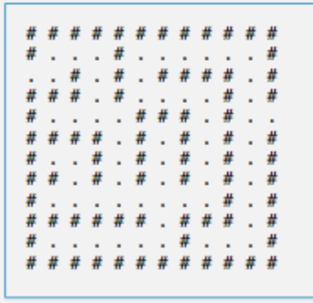
Labyrinth example

