Slide 1
Pointers and References

Slide 2
Introduction
Pointers and references are the basic language mechanisms for referring to memory
Objects reside at a specific address in the memory and can be accessed by address and type
Pointers and references are used for holding and using addresses

Slide 3
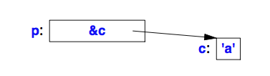
Pointers
T* is the type “pointer to T”, can hold an address of an object of type T
e.g. char c = 'a';
char* p = &c;
Here p holds the address of c, & is address-of operator.
int* pi; // pointer to int
int* f(char*); // function f takes char* argument, returns int*
int (*fp)(char*); // pointer to function taking char*, returns int, used as function arguments

Slide 4
Operations on Pointers
Dereferencing (indirection) is an operation on a pointer used for referring to the object pointed by a pointer:
char c = 'a';
char* p = &c;
char c2 = *p; // c2 == 'a';
Arithmetic operations on pointers:
string s = “Hello”;
char* p = &s.at(0); // *p == 'H';
p++; // *p = 'e';
char x = *++p;
x = ++*p;
Print a string adding spaces using a char*

Slide 5
void*
Used to store an address of memory location without knowing its type
Can be assigned to a typed pointer (but not function pointer)
int a = 1;
int* pi = a&;
void* p = pi;
*p; // error: cannot dereference
++p; //error: cannot increment
It is not safe to cast void pointer to a type (int vs double)
Used at the very lowest level of the system where real hardware resources are manipulated

Slide 6
nullptr
A pointer that does not point to an object
Introduced in C++11
NULL is (void*)0, cannot be used in C++11
int* p = NULL; // error cannot assign int* to void*
Using nullptr allows to avoid confusion

Slide 7
Pointers and const
C++ offers 2 meanings of constant
- constexpr //evaluated compile time (c++11)
- const //cannot be modified
const int a = 5;
const int x; // error: not initialized, cannot be assigned to
char* const cp; // const pointer to char
const char* pc; // pointer to const char
char const* pc2; // pointer to const char
const int a = 5;
const int* p = &a;
int* p1 = &a; // error: init of int* with const int*
*p = 4; // error cannot modify const

Slide 8
Pointers and ownership
Distinguish a pointer that owns a resource from one that does not
int* a = new int{4}; //memory is allocated in heap
…
delete a;
Memory acquired by new should be released by delete. A memory block that is no longer accessible but has not been returned to heap is called memory leak and can exhaust available memory and reduce the performance. OS reclaims all program memory on termination.

Slide 9
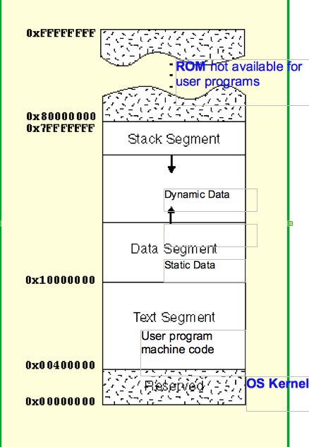
Memory Layout
C++ programs allocate objects in
Run-time stack: local vars. After
reaching enclosing block vars are
popped off (stack pointer is adjusted)
The static data area: global and
static variables
The heap or free store: dynamic data
depending on user input or other events
In stack and static data areas
allocated data size is known compile
time

Slide 10
References
T& is “reference to T”
int a = 4;
int& r {a}; // r and a refer to the same int
int x = r; // x == 4
int& r1; // error initializer missing

Slide 11
Homework
Declare and initialize a string
Revert the string using two chat pointers
Print the string

