Slide 1
Software testing
ggg.instigate.training

Slide 2
Agenda
Introduction
Scope
Verification and Validation
Economics
Testing Methods
  Black-Box Testing
  White-Box Testing
Types of testing
Summary

Slide 3
WHY WE NEED SOFTWARE
TESTING
?

Slide 4
              WHY SOFTWARE FAILS?
To understand what is going on we need to start at the beginning, with the people who design systems. Do they make mistakes? Of course they do. People make mistakes because they are fallible.

Slide 5

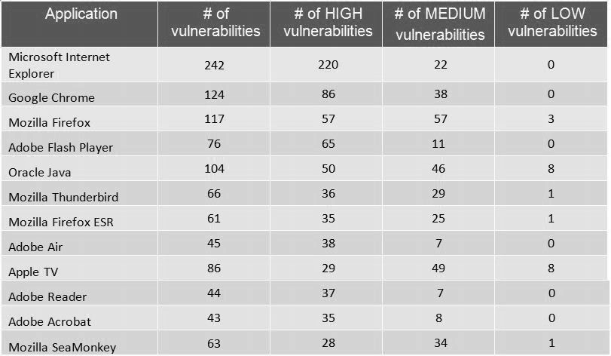
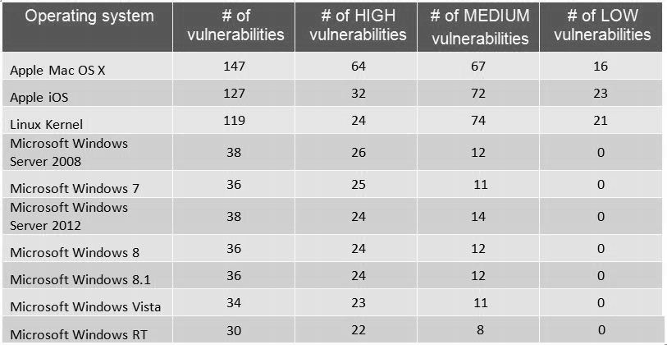
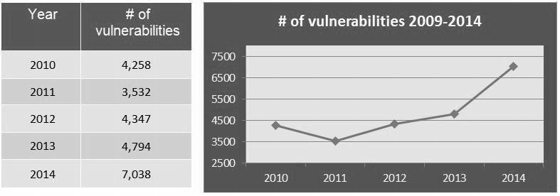
An average of vulnerabilities per day were reported in 2004

Slide 6
Incorrect software can harm:
people (e.g. by causing an aircraft crash in which people die, or by causing a hospital life support system to fail);
companies (e.g. by causing incorrect billing, which results in the company losing money);
the environment (e.g. by releasing chemicals or radiation into the atmosphere).
Software failures can lead to:
Loss of money
Loss of time
Loss of business reputation
Injury
Death

Slide 7
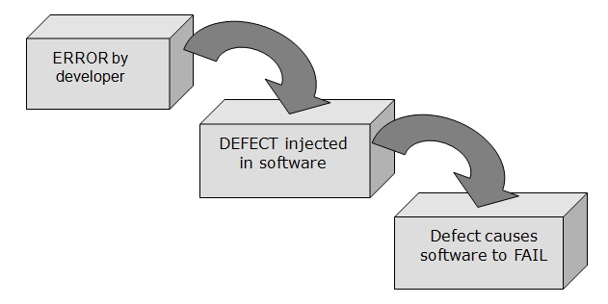
Effect of an Error
An error (or mistake) leads to a defect, which can cause an observed failure

Slide 8
KEEPING SOFTWARE UNDER CONTROL
CONTROL
Exhaustive testing of complex systems is not possible
If the right sort of testing was not done(not the enough) the problem won’t be detected.
Testing and risk
There is a greater probability of failure in the more complex system and the impact of failure is also greater. What we test, and how much we test it, must be related in some way to the risk. Greater risk implies more and better testing.

Slide 9
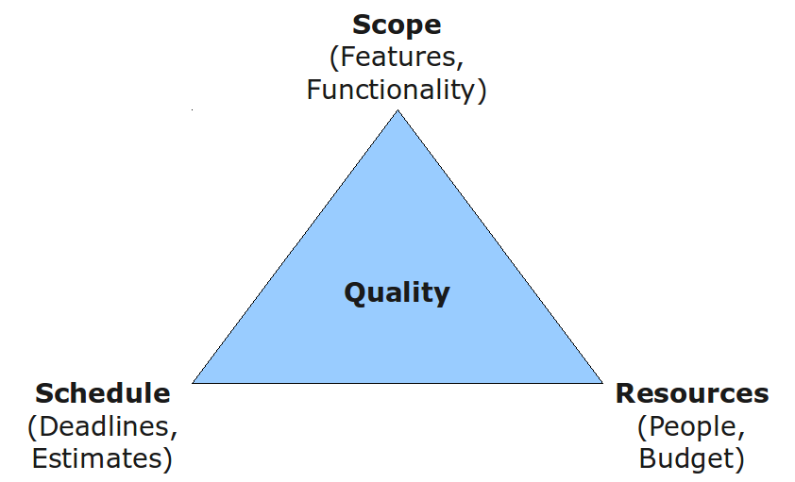
Testing and quality
These three affect one another, and also influence the features that are or are not included in the delivered software.
Testing is one component in the overall quality assurance activity that
seeks to ensure that systems enter service without defects that can lead to serious failures.

Slide 10
Deciding when ‘enough is enough’
The most important aspect of achieving an acceptable result from a finite and
limited amount of testing is prioritization.
The most important tests will be those that test the most important aspects of the system: they will test the most important functions as defined by the users or sponsors of the system, and the most important non-functional behavior, and they will address the most significant risks.
The next most important aspect is setting criteria that will give you an objective test of whether it is safe to stop testing, so that time and all the other pressures do not confuse the outcome.

Slide 11
Introduction
Software testing is the process of
  analyzing a software item to detect the differences between existing and required conditions (that is, bugs)
  evaluating the features of the software item
Each software product has a target audience. Software testing is the process of attempting to make an assessment, whether the software product will be acceptable to its target audience.
Software testing is an activity that should be done throughout the whole development process
Testing is an important part of the Software Quality Assurance (SQA) process, which encompasses all business process

Slide 12
Scope
Primary purpose for testing is to detect software failures so that defects may be corrected
  testing under all possible conditions is not feasible
Testing can never completely establish the correctness of software, it compares the state/behavior of the product against a specification
  "Program testing can be used to show the presence of bugs, but never to show their absence!" - Edsger Dijkstra
Testing can only establish that product does not function properly under specific conditions
  types of quality - usability, scalability, performance, compatibility, etc. can be subjective: while being sufficient for one, they can be intolerable to someone else

Slide 13
Scope
Primary purpose for testing is to detect software failures so that defects may be corrected
  testing under all possible conditions is not feasible
Testing can never completely establish the correctness of software, it compares the state/behavior of the product against a specification
  "Program testing can be used to show the presence of bugs, but never to show their absence!" - Edsger Dijkstra
Testing can only establish that product does not function properly under specific conditions
  types of quality - usability, scalability, performance, compatibility, etc. can be subjective: while being sufficient for one, they can be intolerable to someone else

Slide 14

        Testing Principle
Early testing
Testing activities should start as early as possible in the software or system development life cycle and should
be focused on defined objectives.

Slide 15
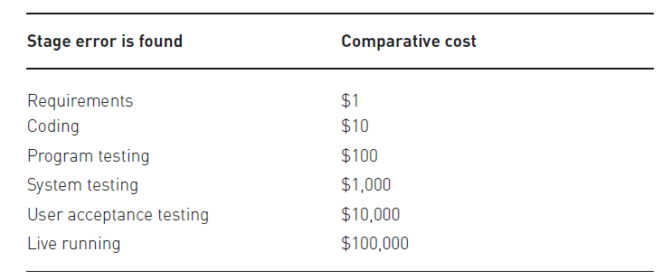


Slide 16
Verification and Validation (V&V)
Software testing is one of the “verification and validation”
  Verification (the first V): To ensure that the product is being built according to the requirements and design specifications. In other words, to ensure that work products meet their specified requirements.
  Validation: To ensure that the product actually meets the user’s needs and that the specifications were correct in the first place. In other words, to demonstrate that the product fulfills its intended use when placed in its intended environment.
Verification - “Are we building the product right?”
Validation - “Are we building the right product?”

Slide 17
Testing Methods
There are two basic classes of software testing, black box testing and white box testing
  Black box testing (also called functional testing) is testing that ignores the internal mechanism of a system or component and focuses solely on the outputs generated in response to selected inputs and execution conditions
  White box testing (also called structural testing and glass box testing) is testing that takes into account the internal mechanism of a system or component
  Gray-box testing is a combination of white-box testing and black-box testing. The aim of this testing is to search for the defects if any due to improper structure or improper usage of applications.

Slide 18
Testing Levels
Unit testing
Integration testing
Functional and system testing
  Stress testing
  Performance testing
  Usability testing
Acceptance testing
Beta testing
Regression testing
  Smoke tests

Slide 19
Unit Testing
Unit testing is the testing of individual hardware or software units or groups of related units
  Using white box testing techniques, testers (usually the developers creating the code implementation) verify that the code does what it is intended to do at a very low structural level
  Unit testing is generally done within a class or a component

Slide 20
Integration Testing
Integration test is testing in which software components, hardware components, or both are combined and tested to evaluate the interaction between them
  Using both black and white box testing techniques, the tester (still usually the software developer) verifies that units work together when they are integrated into a larger code base
  To plan these integration test cases, testers look at high- and low-level design documents

Slide 21
System and Functional Testing
Using black box testing techniques, testers examine the high-level design and the customer requirements specification to plan the test cases to ensure the code does what it is intended to do
Functional testing involves ensuring that the functionality specified in the requirement specification works
System testing involves putting the new program in many different environments to ensure the program works in typical customer environments with various versions and types of operating systems and/or applications

Slide 22
System and Functional Testing
Because system test is done with a full system implementation and environment, several classes of testing can be done that can examine non-functional properties of the system
  Stress testing – testing conducted to evaluate a system or component at or beyond the limits of its specification or requirement
  Performance testing – testing conducted to evaluate the compliance of a system or component with specified performance requirements
  Usability testing – testing conducted to evaluate the extent to which a user can learn to operate, prepare inputs for, and interpret outputs of a system or component

Slide 23
Acceptance Testing
Acceptance testing is formal testing conducted to determine whether or not a system satisfies its acceptance criteria (the criteria the system must satisfy to be accepted by a customer) and to enable the customer to determine whether or not to accept the system
  Customers generally do not specify a “complete” set of acceptance test cases. Their test cases are no substitute for creating your own set of functional/system test cases
  Whenever possible, we should run customer acceptance test cases ourselves so that we can increase our confidence that they will work at the customer location

Slide 24
Regression Testing
Regression testing is selective retesting of a system or component to verify that modifications have not caused unintended effects and that the system or component still complies with its specified requirements
These test cases are re-run often, after any significant changes (bug fixes or enhancements) are made to the code
A smoke test is a group of test cases that establish that the system is stable and all major functionality is present and works under “normal” conditions
  The smoke tests might be run before deciding to proceed with further testing (why dedicate resources to testing if the system is very unstable)

Slide 25
Beta Testing
When an advanced partial or full version of a software package is available, the development organization can offer it free to one or more (and sometimes thousands) potential users or beta testers
These users install the software and use it as they wish, with the understanding that they will report any errors revealed during usage back to the development organization
These users are usually chosen because they are experienced users of prior versions or competitive products

Slide 26
Beta Testing
The advantages of running beta tests are as follows
  Identification of unexpected errors because the beta testers use the software in unexpected ways
  A wider population search for errors in a variety of environments (different operating systems with a variety of service releases and with a multitude of other applications running)
  Low costs because the beta testers generally get free software but are not compensated

Slide 27
Beta Testing
The disadvantages of beta testing are as follows
  Lack of systematic testing because each user uses the product in any manner they choose.
  Low quality error reports because the users may not actually report errors or may report errors without enough detail.
  Much effort is necessary to examine error reports particularly when there are many beta testers

Slide 28
Test Planning
A test plan is a document describing the scope, approach, resources, and schedule of intended test activities
An important component of the test plan is the individual test cases. A test case is a set of test inputs, execution conditions, and expected results developed for a particular objective, such as to exercise a particular program path or to verify compliance with a specific requirement
Write the test plan early in the development cycle when things are generally still going pretty smoothly and calmly. This allows you to think through a thorough set of test cases

Slide 29
Performing White-box Testing
Basis path testing is a means for ensuring that all independent paths through a code module have been tested. An independent path is any path through the code that introduces at least one new set of processing statements or a new condition
Method coverage is a measure of the percentage of methods that have been executed by test cases. Undoubtedly, your tests should call 100% of your methods
Statement coverage is a measure of the percentage of statements that have been executed by test cases. Your objective should be to achieve 100% statement coverage through your testing

Slide 30
Performing White-box Testing
Branch coverage is a measure of the percentage of the decision points (Boolean expressions) of the program have been evaluated as both true and false in test cases
Condition coverage is a measure of percentage of Boolean sub-expressions of the program that have been evaluated as both true or false outcome [applies to compound predicate] in test cases
1 int foo (int a, int b, int c, int d, float e)
2 float e;
3 if (a == 0) {
4 return 0;
5 }
6 int x = 0;
7 if ((a==b) OR ((c == d) AND bug(a) )) {
8 x=1;
9 }
10 e = 1/x;
11 return e;
12 }

Slide 31
Static vs. Dynamic Testing
Dynamic testing – involves execution of actual software product
Static testing includes
  Code Review (Peer Review) - systematic examination of computer source code
  Inspection - formal type of peer review with a well-defined process to find defects
  Walkthrough - leader or designer presents software product to development team or interested parties

Slide 32
TERMS:
Bug - A flaw in a component or system that can cause the component or system to fail to perform its required function
Defect – same as bug
Error – A human action that produces an incorrect result.
Failure – Deviation of the component or system from its expected delivery, service or result.
Fault – same as bug
Mistake – Same as error
Quality – The degree to which a component, system or process meets specified requirements and/or user/customer needs and expectations.
Risk - A factor that could result in future negative consequences.
Requirement – A condition or capability needed by a user to solve a problem or achieve an objective that must be met or possessed by a system or system component to satisfy a contract, standard, specification, or other formally imposed document
Test Case–A set of input values, execution preconditions, expected results and execution postconditions, developed for a particular objective or test condition, such as to exercise a particular program path or to verify compliance with a specific requirement.
Testing – The process consisting of all lifecycle activities, both static and dynamic, concerned with planning, preparation and evaluation of software products and related work products to determine that they satisfy specified requirements, to demonstrate that they are fit for purpose and to detect defects.
Test Objective – A reason or purpose for designing and
executing a test.

Slide 33
Instigate Training Center Foundation
134/1 Tsarav Aghbyur Str 0054, Yerevan Armenia
+374.60.510.710
ggg.instigate.training

