Slide 1


Continuous Integration (CI)

Slide 2
Topics
What is Continuous Integration.
What is Jenkins - an Introduction.
Installing and Configuring Jenkins.
Managing Security.
Creating a job with Jenkins.
Hands on CI with Jenkins.
References

Slide 3
What is Continuous Integration
Continuous integration (CI) is a software development practice in which each member of a development team integrates his work with that produced by others on a continuous basis.
Implementing continuous integration provides several benefits:
  Merge hell, that is, endless merge conflicts while merging code into the mainline
  Allows detecting errors quickly as automated tests run on every single commit that checks-in the remote repository. Hence, fewer bugs get shipped to production.
  When an error is detected, it’s much easier to fix because the amount of code involved in each commit is much smaller.
  Building the release is easy as all integration issues have been solved early

Slide 4
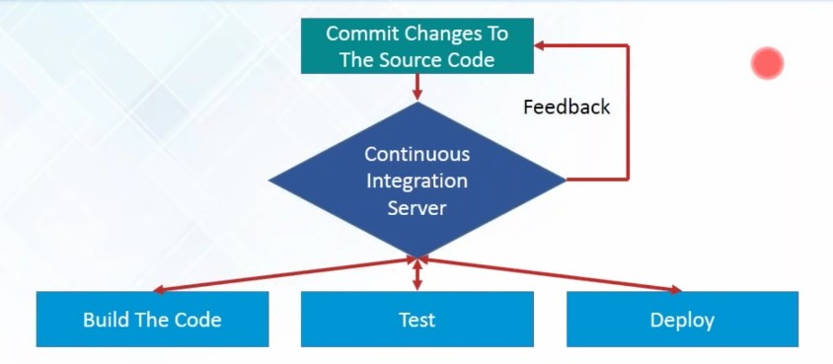
What is Continuous Integration ...

Slide 5
Principles of Continuous Integration
The maintenance of a code repository
Automating the build process
Making the build self-testing
Everyone committing to the baseline every day
Every commit to baseline should be build
Keeping the build fast
Testing in a clone of the production environment
Make it easy to get the latest deliverables
Everyone can see the results of the latest build
Automatic deployment

Slide 6
How Does Continuous Integration Work?
Developers input code into their private terminals.
After that is done, they commit the changes to the shared repository.
The CI server monitors the repository and analyzes changes as they occur.
Continuous Integration builds the system and runs unit and integration tests.
The server also releases deployable artefacts for testing.
The CI server assigns a build tag to the version of the code it just built.
The Continuous Integration server gives the team reports of the successful build.
If the build or tests fail, the server alerts the development team.
The team will fix the issues as soon as is possible.
It continues to integrate and run tests throughout the entire project

Slide 7
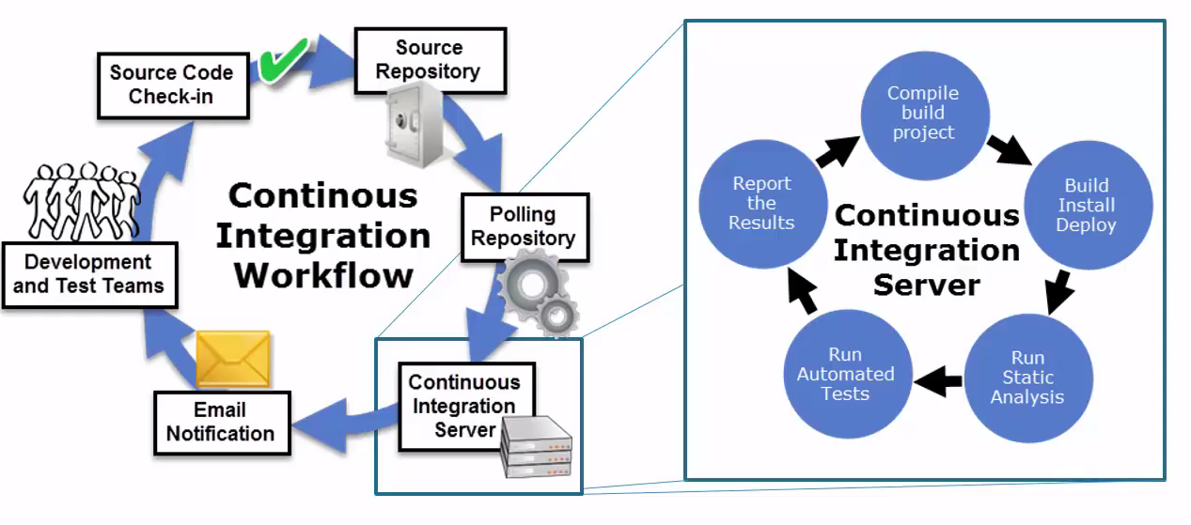
Build Lifecycle: Phases

Slide 8
What is Jenkins - an Introduction
Jenkins is the leading open source continuous integration tool.
Jenkins was originally developed as the Hudson project. Hudson's creation started in summer of 2004 at Sun Microsystems.
In November 2010, an issue arose in the Hudson community with respect to the infrastructure used. Negotiations were held between the principal project contributors and Oracle; a key sticking point was the control of the name "Hudson" itself, which Oracle claimed, and on January 11, 2011, aproposal was made to change the project name from "Hudson" to "Jenkins".

Slide 9
What is Jenkins...
On February 1, 2011, Oracle said that they intended to continue development of Hudson, and considered Jenkins a fork rather than a rename. As of December 2016, the Jenkins organization on Git Hub had 638 project members and around 1,800 public repositories, compared with Hudson's 32 project members and 17 public repositories.
Hudson is not maintained anymore, Jenkins is the replacement for it.
Jenkins builds and tests our software continuously and monitors the execution and status of remote jobs, making it easier for team members and users to regularly obtain the latest stable code.

Slide 10
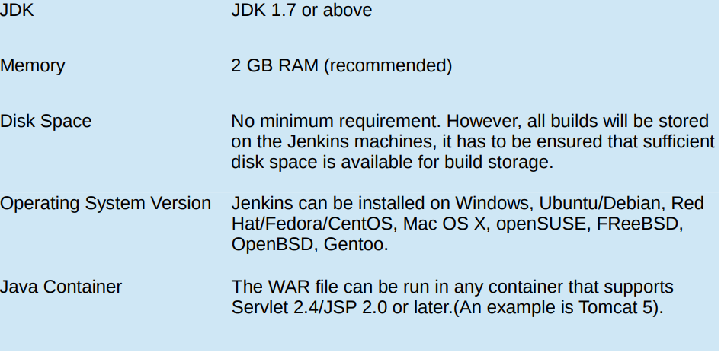
Installing and Configuring Jenkins

Slide 11
Installing and Configuring Jenkins...
Download Jenkins: Open the official website of Jenkins : https://jenkins.io/index.html
Click on Download Jenkins and download the LTS Release.
From the command prompt, browse to the directory where the jenkins.war file is present. Run the following command:
java -jar jenkins.war
Extraction of the war file is done by an embedded webserver called
winstone.
Jenkins by default runs on port 8080, but we can run it on different port by issuing following command:
java -jar jenkins.war --httpPort=8181

Slide 12
Installing and Configuring Jenkins...
Open http://localhost:8080/jenkins to check the Jenkins Dashboard.
We can now get the Jenkins-git setup enabled by clicking the Manage Jenkins option and then click the Available tab and enter the search keyword ie; git.
Install the git plugin and restart Jenkins by issuing this command in the browser:
http://localhost:8080/jenkins/restart

Slide 13
Installing and Configuring Jenkins...
Jenkins can run in several different ways:
  It can run as a WAR file deployed to a Servlet container, such as Apache Tomcat
  It can run in a Docker container, either locally or on a public or private cloud
  It can run as a Software as a Service, hosted by a company like CloudBees

Slide 14
Managing Security
There can be multiple users that can operate Jenkins for the same set of project holding different responsibility.
So it is very important to restrict access of users so they can operate on their responsibility in a controlled manner.
To manage access of users :
  Click on Manage Jenkins from the home page.
  Click on the link Configure global security.
  Under “Access Control” you will see an “Authorisation” label.

Slide 15
Creating a job with Jenkins
To create a new build job in Jenkins: from the Jenkins Dashboard, Click on “New Item”, Name your project and select project type.
Next step : setup configurations
  Configuring Global Tool Configuration
  Here you can set JDK path, git configurations and Gradle/ Ant or Maven installations as per your project requirement.
  Creating or updating(if already created during project creation) project configuration settings which may include General settings, Source code management, build triggers, Pre-steps, Build, Post Steps, Emailing notification regarding build and post build actions as per your project need.

Slide 16
Useful links
https://jenkins.io/doc/
https://www.quora.com/What-is-Jenkins-When-and-why-is-it-used
https://www.tutorialspoint.com/jenkins/index.htm

