Slide 1
Software development process
ggg.instigate.training

Slide 2
Agenda
Software Development Process
Extreme Programming
Instigate's Approach
CMM/CMMI

Slide 3
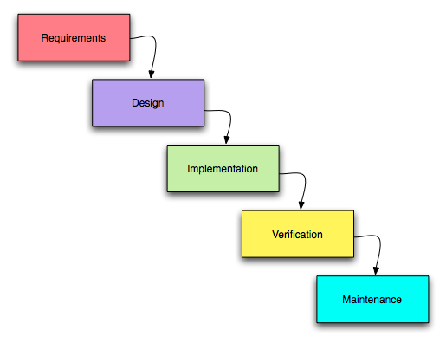
Software Development Process
Structure defining development of software product
  Software life-cycle, software process
Several models, each describing approaches for its specific tasks and activities
  Iterative processes
    Dynamic products
  Waterfall processes
    Large and very risky products
Main activities include
  Requirements analysis
  Design (Specifications, Architecture)
  Implementation, Testing and documenting
  Deployment and maintenance
Often programmers remember about defined software development process, when they are in trouble

Slide 4
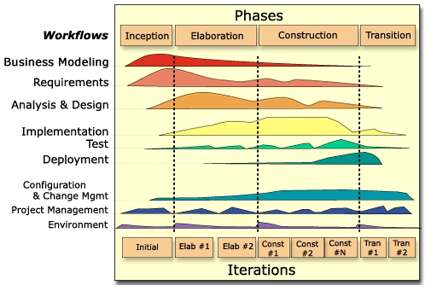
RUP – Rational Unified Processda
Iterative development process
  General framework, collection of adaptable processes
An iteration with phases is illustrated below

Slide 5
XP – Extreme Programming
Iterative, agile software development methodology
Flexible enough to handle dynamically changing requirements, risks.
Defines practices to encourage several values:
  Communication, Simplicity, Feedback, Courage, Respect
Defines 4 activities, which are performed during software development process:
  Planning/Listening
  Coding
  Testing
  Designing

Slide 6
XP – Practices
Fine Scale Feedback
  Pair Programming
    One is coding, other is reviewing and focusing on more higher level picture.
  Planning Game
    User Stories
    Release, Iteration Planning,
    Measure the project velocity
  Test Driven Development
    The code is considered final if programmer cannot find any other condition, on which the code is failing
    Code the unit test first
    All code must have unit tests
  Whole team
    Customer is always available and is considered as a real user of the developed product

Slide 7
XP – Practices
Continuous process
  Continues integration
    When a bug is found tests are created
    Acceptance tests are run often and the score is published
  Design improvement
    Refactor whenever and wherever possible
    Leave optimization till last
  Small releases
    No functionality is added early

Slide 8
Instigate's Approach - Described
Is generally based on XP approach:
  Management Experience
  Dynamic Requirements, Risky Projects
Pair Programming
Defined documentation to be created during product development

Slide 9
Instigate's Approach – Illustrated

Slide 10
Instigate's Approach – Summary
Requirements
  PRD
  Main Use-Scenarios (Use-Cases document)
Specifications
  Shell version
  Detailed Use-cases (Use-Cases document)
  Acceptance tests (Test-plan)
  Functional Specification
Architecture, Design
  Prototyping
  Black-box tests (Test-plan)
  Development/Architectural Specification

Slide 11
Instigate's Approach – Summary (cont'd)
Implementation, Testing
  Unit, integration testing
  White-box tests (Test-plan)
  Continuous integration
  Iteratively growing functionality
  Alpha release (basic functionality)
  Beta release (full functionality, not stable)
  Release
Deployment
  User Guides, Tutorials
  Packaging
Maintenance
  Support, critical bug fixing

Slide 12
CMM/CMMI
Capability Maturity Model – is maturity model of software engineering capabilities.a
It is community developed and owned model for software development and maintenance.
Is based on common-sense application of process management and quality improvement concepts.
Provides software organizations with guidance in:
  how to control their processes for developing and maintaining software.
  selecting process improvement strategies by determining current process maturity and identifying the few issues most critical to software quality and process improvement.
Has been superseded by CMMI (Capability Maturity Model Integration).

Slide 13
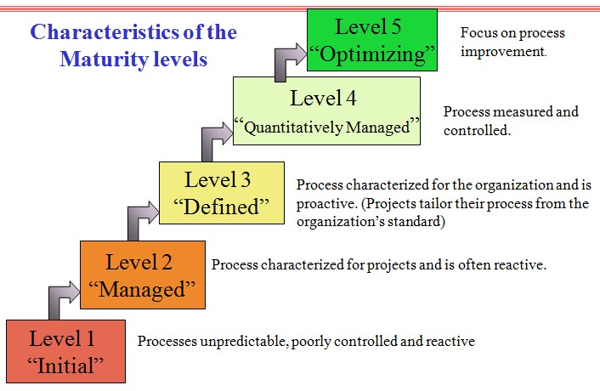
Maturity Models

Slide 14
Maturity Models - Described
Level 1 – Initial
  The software process is characterized as ad hoc, and occasionally
  even chaotic. Success depends on individual effort.
Level 2 – Repeatable
  Basic project management processes are established to track cost,
schedule, and functionality. The process discipline repeats earlier projects
with similar applications.
Level 3 – Defined
  The software process for both management and engineering
  activities is documented, standardized. All projects use organization's standard software process tor developing and maintaining software.
Level 4 – Managed
  Detailed measures of the software process and product quality
  are collected. Both the software process and products are measured.
Level 5 – Optimizing
  Continuous process improvement is enabled by quantitative
  feedback from the process and from piloting innovative ideas and technologies
Maturity Models - Described

Slide 15
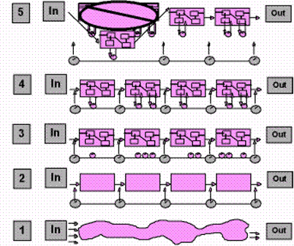
Maturity Models - Illustrated

Slide 16
Instigate Training Center Foundation,
134/1 Tsarav Aghbyur 0054, Armenia
+374.60.510.710
ggg.instigate.training

