Slide 1

JAVA
EXCEPTION

Slide 2
Exception
What is Exception in Java?
Keywords
  Throw
  Throws
  Try-catch
  Finally

Slide 3
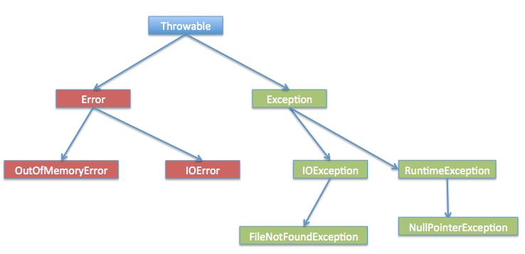
Exception Hierarchy

Slide 4
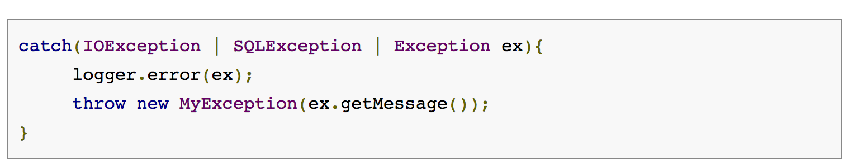
Catch multiple exceptions

Slide 5
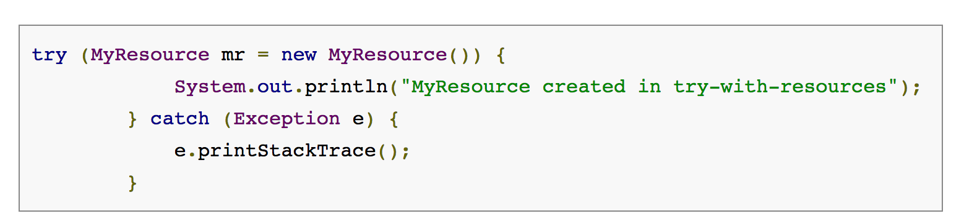
Try-with-resources

Slide 6
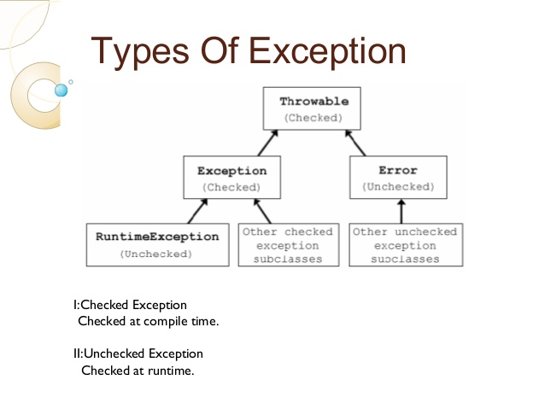
Checked and Unchecked Exceptions

Slide 7
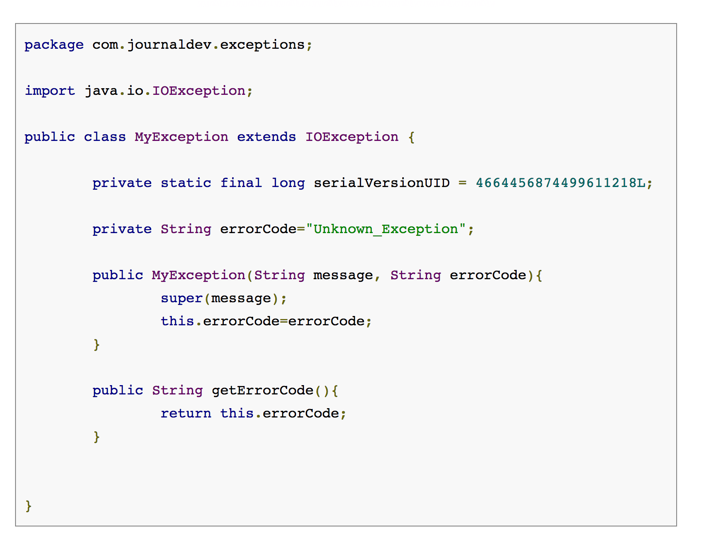
Custom exception in Java

Slide 8
OutOfMemoryError
java.lang.OutOfMemoryError: Java heap space
java.lang.OutOfMemoryError: PermGen space
java.lang.OutOfMemoryError: GC overhead limit exceeded
java.lang.OutOfMemoryError: unable to create new native thread
java.lang.OutOfMemoryError: nativeGetNewTLA
java.lang.OutOfMemoryError: Requested array size exceeds VM limit
java.lang.OutOfMemoryError: request <size> bytes for <reason>. Out of swap space?
java.lang.OutOfMemoryError: <reason> <stack trace> (Native method)
https://plumbr.eu/blog/memory-leaks/understanding-java-lang-outofmemoryerror

Slide 9
What happens when exception is thrown by main method?
When exception is thrown by main() method, Java Runtime terminates the program and print the exception message and stack trace in system console.

Slide 10
Exception Handling Best Practices
Use Specific Exceptions for ease of debugging.
Throw Exceptions Early (Fail-Fast) in the program.
Catch Exceptions late in the program, let the caller handle the exception.
Use Java 7 ARM feature to make sure resources are closed or use finally block to close them properly.
Always log exception messages for debugging purposes.
Use multi-catch block for cleaner close.
Document the Exceptions Thrown by a method using @throws in javadoc.
Exceptions are costly, so throw it only when it makes sense. Else you can catch them and provide null or empty response.

Slide 11
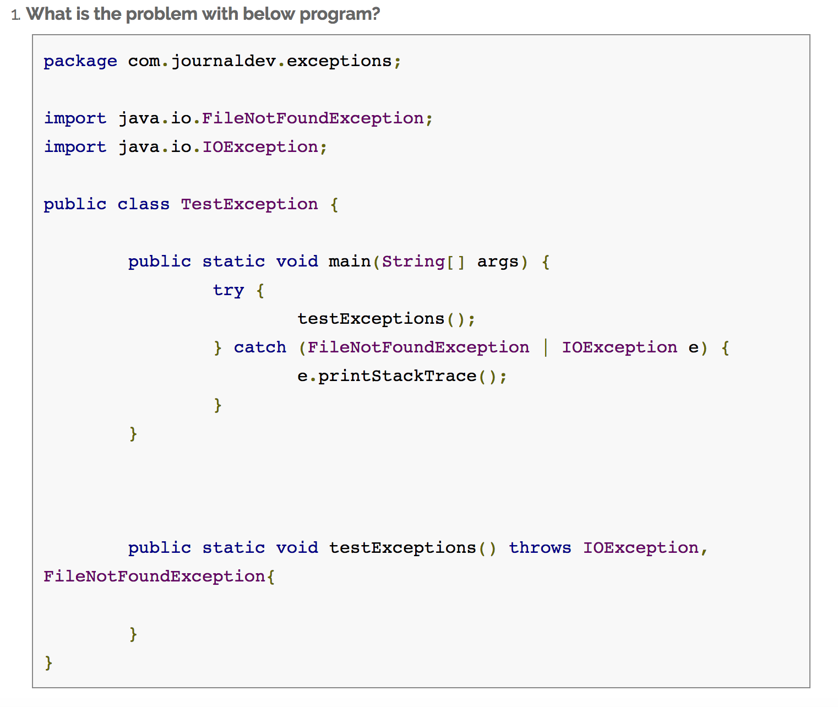

Slide 12
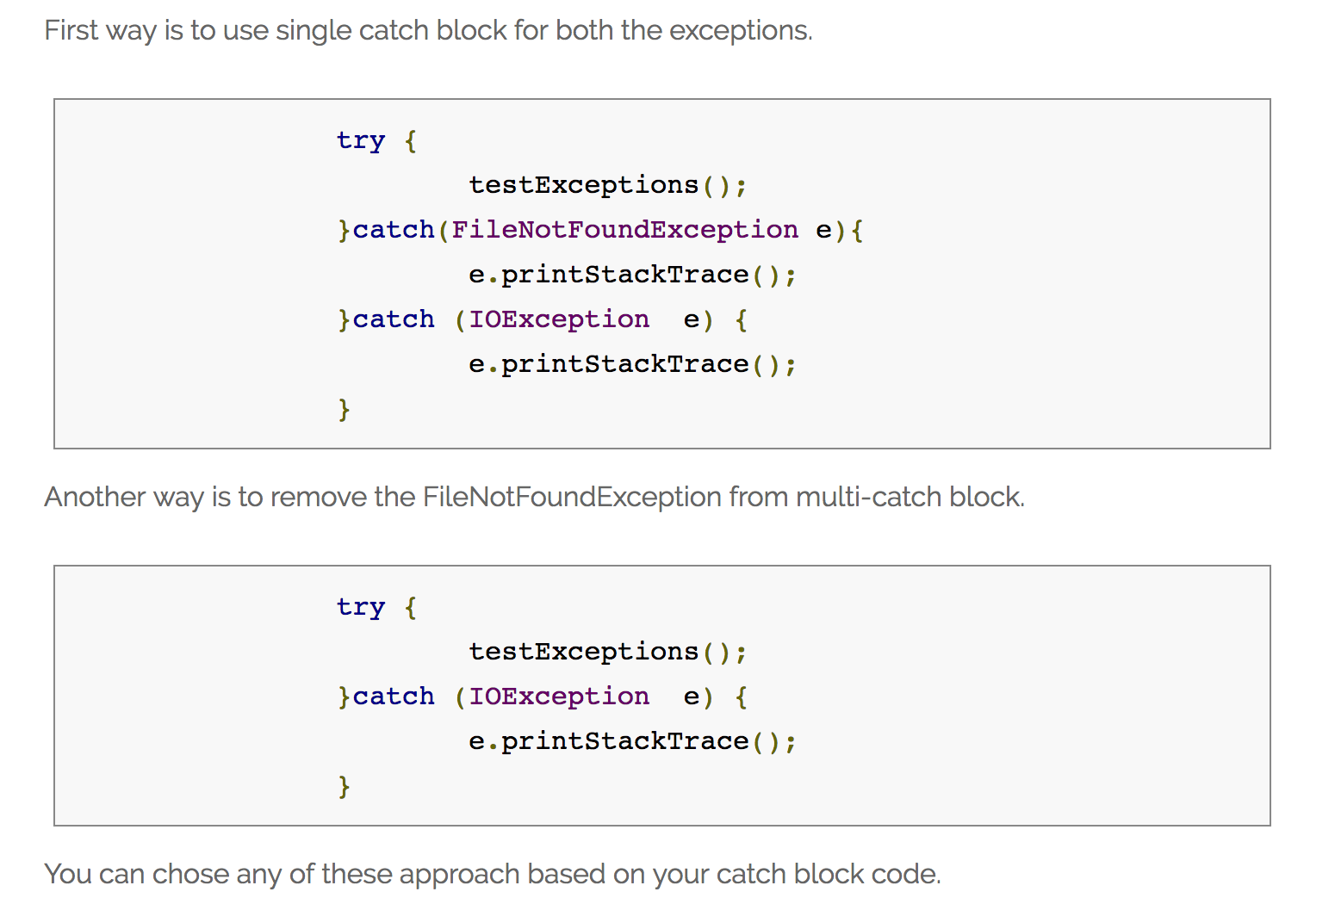

Slide 13
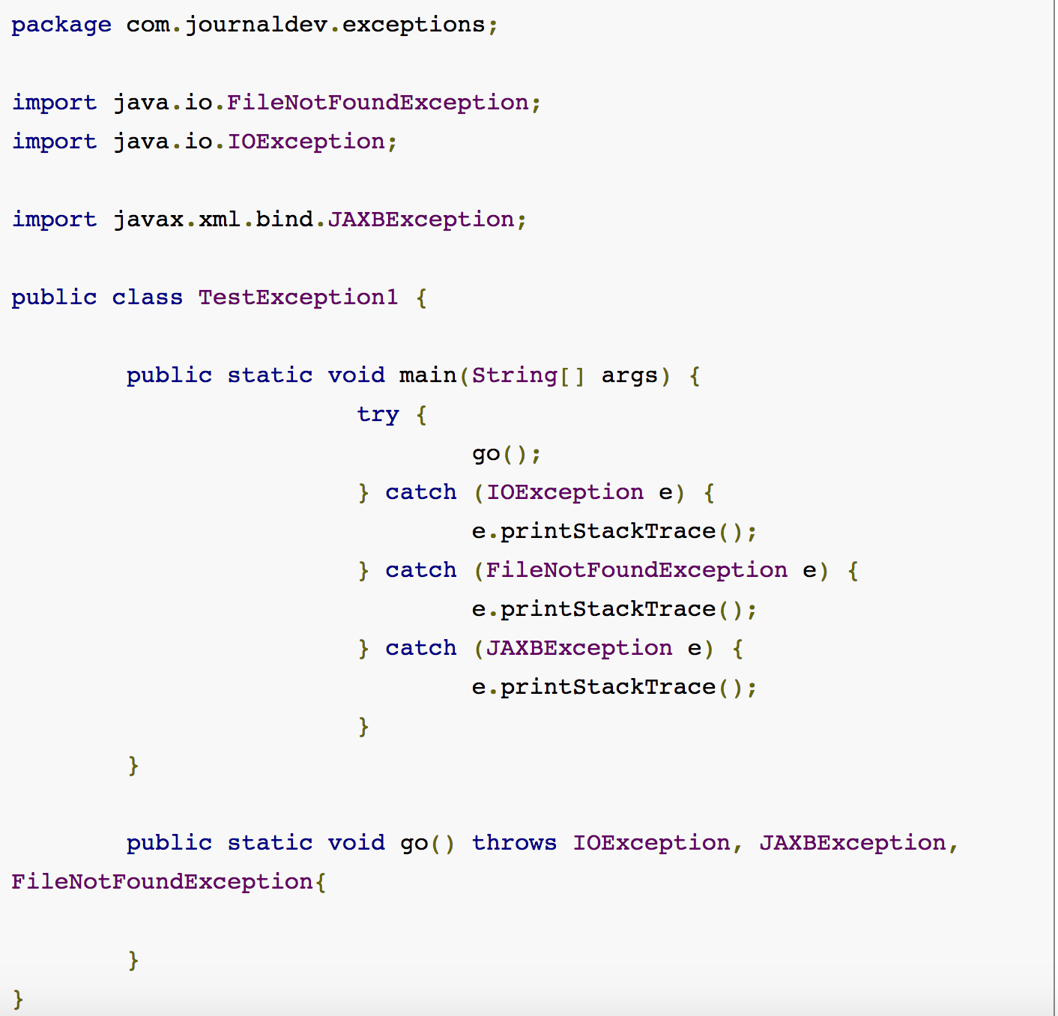

Slide 14
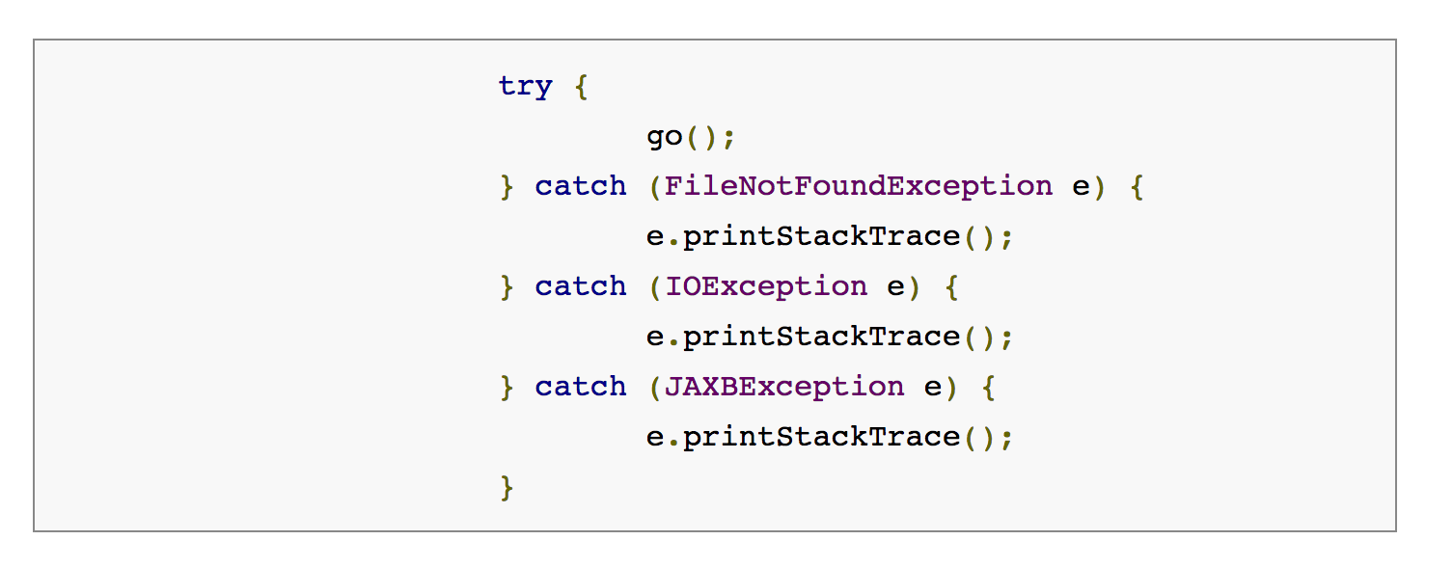

Slide 15
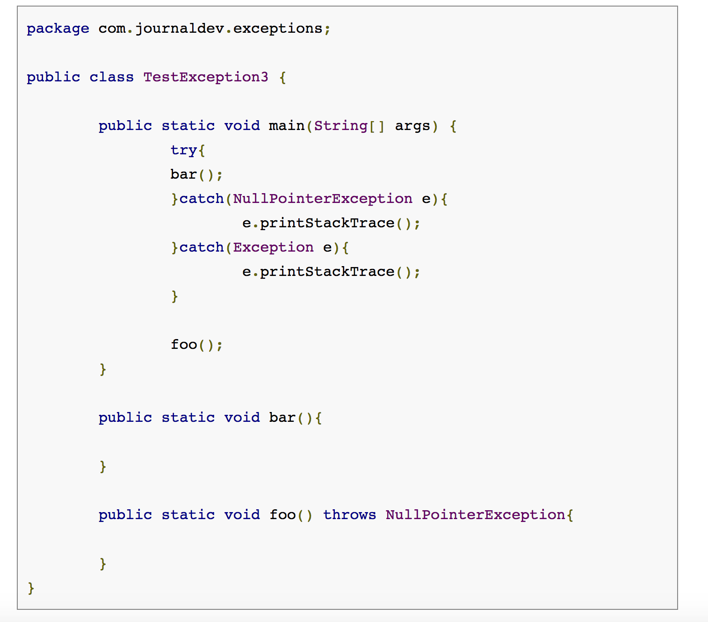

Slide 16
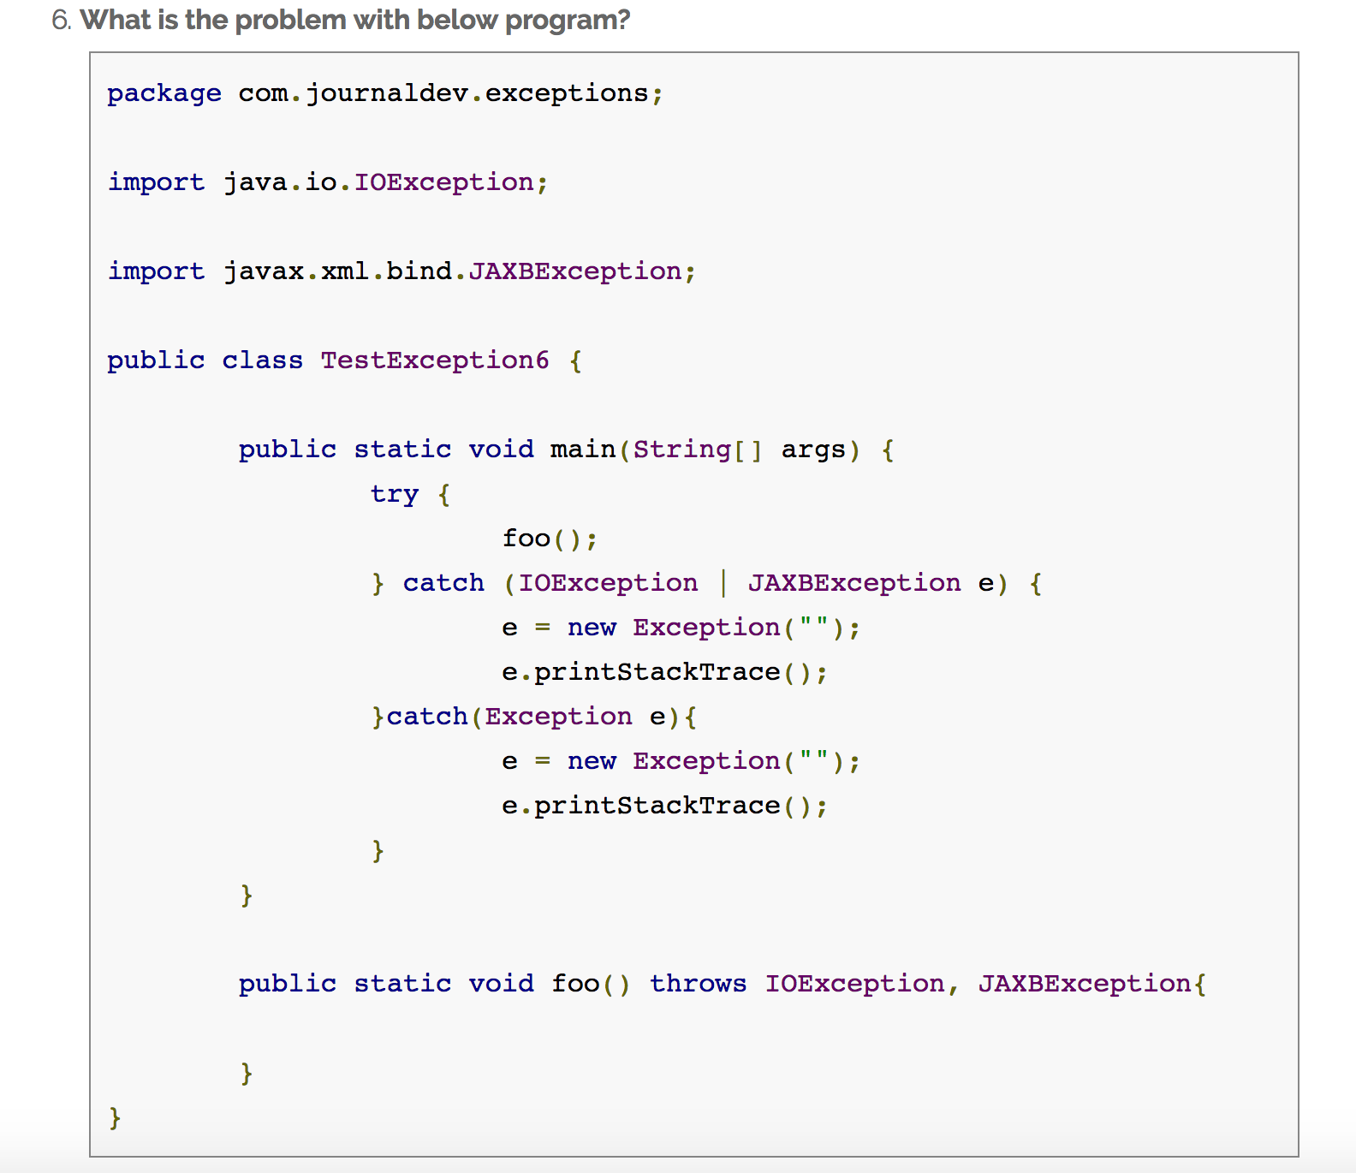

Slide 17

THANKS

