Slide 1
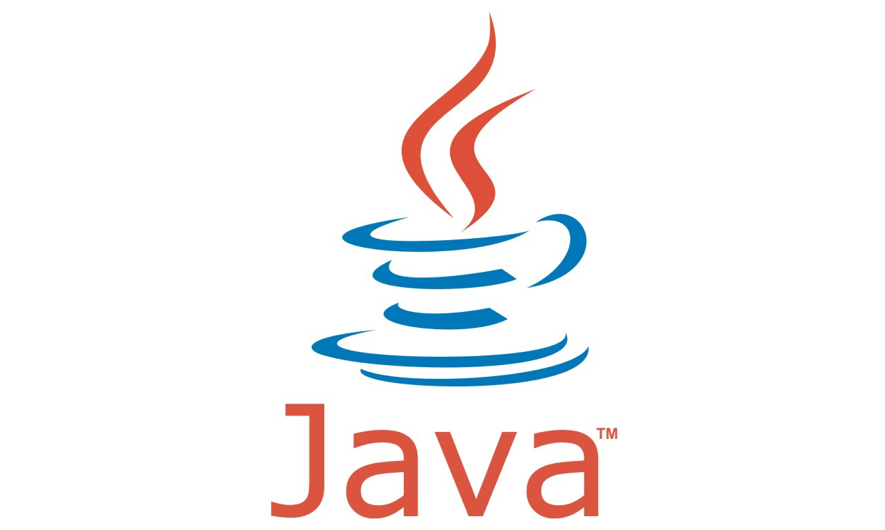
JAVA
Why Java

Slide 2
Why Java
Open source programming language
Platform Independent (JVM)
  The JVM performs following operation:
    Loads code
    Memory area

Slide 3
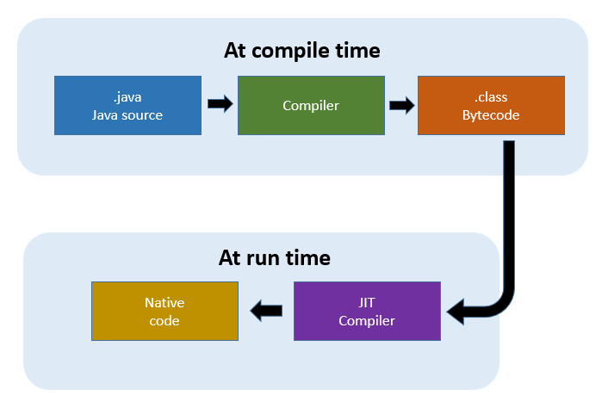
Why Java
Secure Language
Fast language (JIT Just In Time)

Slide 4
Why Java
Memory Management (GC)
Statically-typed language
Single inheritance

Slide 5
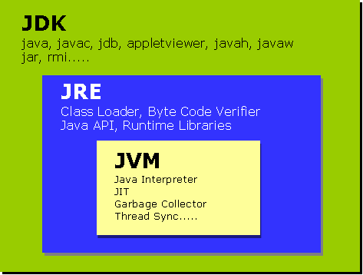
JDK vs JRE vs JVM

Slide 6
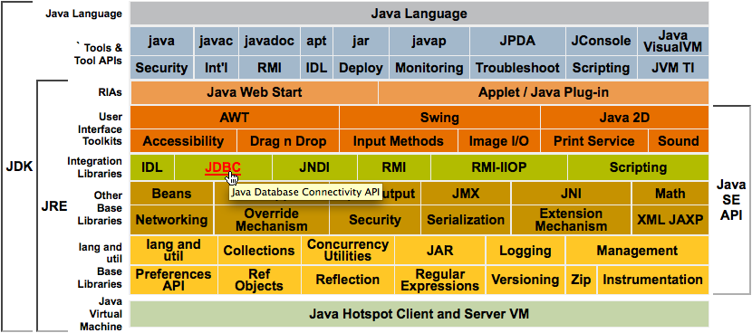
JDK vs JRE vs JVM

Slide 7
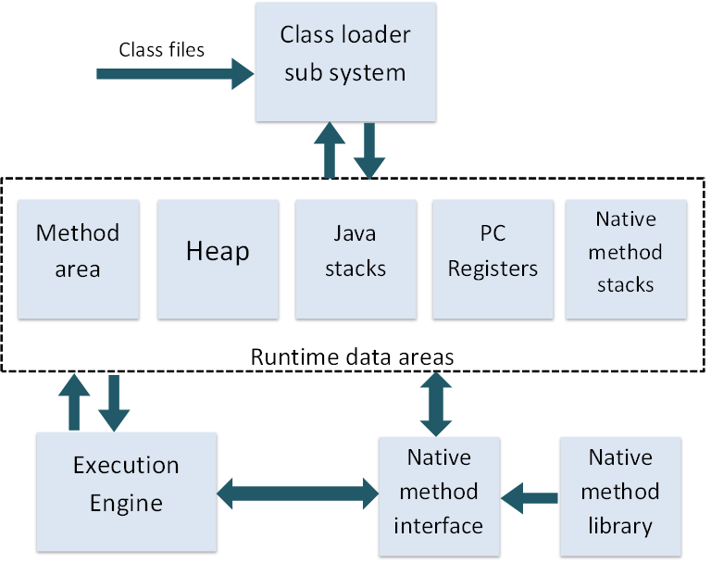
JVM Structure

Slide 8
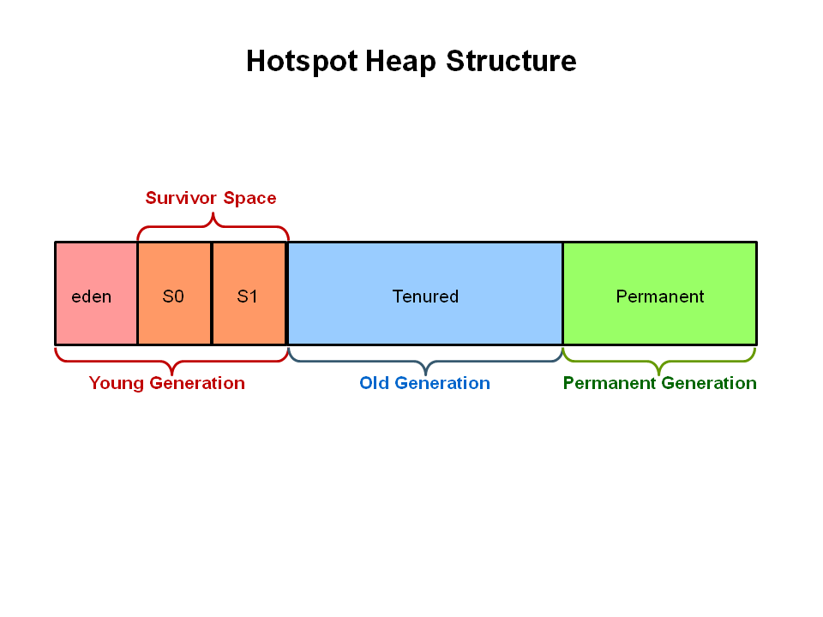
Heap Structure

Slide 9


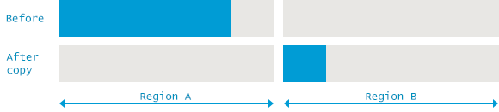
GC Algorithms - Mark and Sweep
Mark and Sweep
Mark and Sweep – Compact
Mark and Sweep – Copy

Slide 10
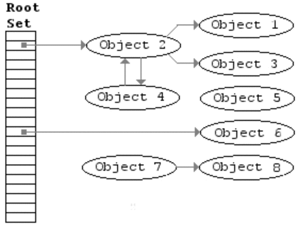
Mark and Sweep

Slide 11
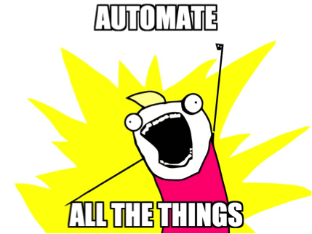
THANKS

