Slide 1
GIT
ggg.instigate.training

Slide 2
Agenda
Getting started
Git basics
Git Branching
Git on the server
Git and other systems
Git internals

Slide 3


Getting started

Slide 4
Getting started
Centralized version control diagram.
  everyone knows to a certain degree what everyone else on the project is doing.
  If that server goes down for an hour, then during that hour nobody can collaborate at all or save versioned changes to anything they’re working on
Distributed version control diagram.
  clients don’t just check out the latest snapshot of the files: they fully mirror the repository. Thus if any server dies, and these systems were collaborating via it, any of the client repositories can be copied back up to the server to restore it.
Git advantages
  Speed
  Simple design
  Strong support for non-linear development (thousands of parallel branches)
  Fully distributed
  Able to handle large projects like the Linux kernel efficiently (speed and data size)

Slide 5

Getting started – Git workflow
The basic Git workflow goes something like this:
  You modify files in your working directory.
  You stage the files, adding snapshots of them to your staging area.
  You do a commit, which takes the files as they are in the staging area and stores that snapshot permanently to your Git directory.

Slide 6
Getting started
Installing
  You can install git from source or to install an existing package for your platform.
Git setup
  You need to setup your preferred editor, diff tool and check your settings.

Slide 7
Git basics
Initializing a Repository in an Existing Directory
  git init
  git add *.c
  $ git add README
  $ git commit -m 'initial project version'
Cloning an Existing Repository
  git clone git://github.com/schacon/grit.git
  git clone git://github.com/schacon/grit.git mygrit
Checking the Status of Your Files
  git status
  # On branch master
  nothing to commit (working directory clean)

Slide 8

Git basics
vim README
$ git status
$ git add
$ git commit
$ git diff
$ git rm
$ git mv file_from file_to
$ git log
$ git log -p -2 // last 2 commits and diff
$ git log –stat
git log –pretty=oneline
$ git log --since=2.weeks

Slide 9
Git basics
Changing Your Last Commit
  git commit –amend
Unstaging a Staged File
  git reset HEAD benchmarks.rb
Unmodifying a Modified File
  git checkout – file_name
Showing Your Remotes
  git remote //-v
Adding Remote Repositories
  git remote add [shortname] [url]:
  git fetch pb
Fetching and Pulling from Your Remotes
  git fetch [remote-name]
Pushing to Your Remotes
  git push origin master
Inspecting a Remote
  git remote show [remote-name]
Removing and Renaming Remotes
  git remote rename
Listing Your Tags
  git tag
Creating Tags
  Annotated Tags - git tag -a v1.4 -m 'my version 1.4'
  Signed Tags - git tag -s v1.5 -m 'my signed 1.5 tag'
  Lightweight Tags - git tag v1.4-lw
Sharing Tags
  git push origin v1.5

Slide 10
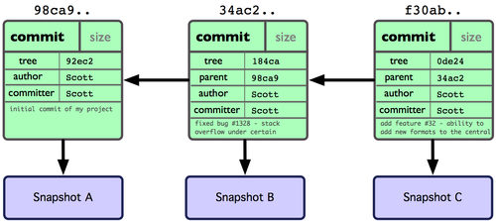
Git Branching
If you make some changes and commit again, the next commit stores a pointer to the commit that came immediately before it. After two more commits, your history might look this.
A branch in Git is simply a lightweight movable pointer to one of these commits. The default branch name in Git is master. As you initially make commits, you’re given a master branch that points to the last commit you made.

Slide 11
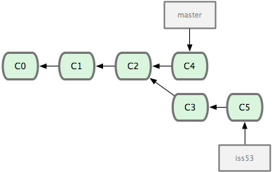
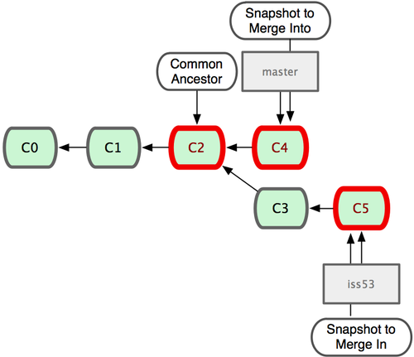
Git Branching & merging

Slide 12
Git on the server
Git can use four major network protocols to transfer data: Local, Secure Shell (SSH), Git, and HTTP.
$ git clone --bare my_project my_project.git = $ cp -Rf my_project/.git my_project.git
Initialized empty Git repository in /opt/projects/my_project.git/

Slide 13
Git and other systems
One of Git’s great features is a bidirectional bridge to Subversion called git svn
git svn clone file:///tmp/test-svn -T trunk -b branches -t tags
Committing Back to Subversion
  git commit -am 'Adding git-svn instructions to the README'
  git svn dcommit

Slide 14
References
http://git-scm.com/documentation
http://sixrevisions.com/resources/git-tutorials-beginners/
http://www.vogella.com/articles/Git/article.html

Slide 15
Instigate Training Center Foundation
134/1 Tsarav Aghbyur Str, Yerevan, 0054, Armenia
+374.60.510710
ggg.instigate.training

