Slide 1



SMART INDIA HACKATHON 2026
Problem Statement ID – SIH26055
Problem Statement Title – Smart Scan strategy for Electronic Warfare
Theme – Robotics and Drones
PS Category – Software
Team ID – 120057
Team Name – Evinco
Notes:
SIH 2026, problem statement SIH26143 (NTRO). Live prototype: https://evinco-sih.centralindia.cloudapp.azure.com

Slide 2
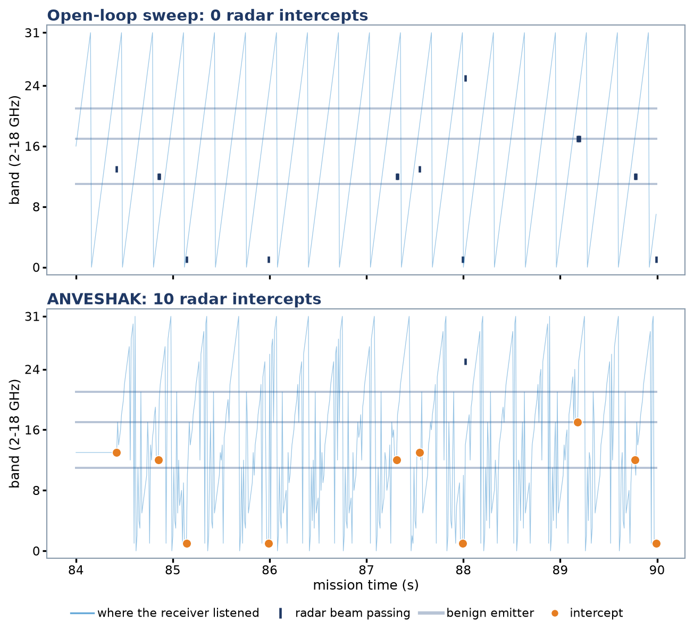
Evinco
ANVESHAK
Proposed Solution :
ANVESHAK — a machine-learning scheduler for an Electronic Support receiver that learns, from its own hits and misses, where and when to listen. With no emitter library or pre-mission data, it discovers emitters, measures their scan periods and dwells exactly when their beams return, while still guaranteeing every band is searched.
Addressing the Problem :
Innovation and uniqueness :
An open-loop sweep gives equal time to empty bands, harmless beacons and live threats.
A fixed sweep can fall into lock-step with a radar's scan: a 32-band sweep never sees a 3.2 s radar for 15 of 16 phase offsets.
Without prior intelligence, nothing tells the receiver where a new or threatening emitter is.
Hit → confirm → lock: after a first hit it camps one scan to measure the period, then dwells only on predicted beam passes (95% within ±20 ms).
Learns from hits and misses: a gradient-boosted hit model, trained on simulator truth, ranks where to search — 15× better than chance at spotting a new threat.
Earliest-deadline-first revisit floor: every band re-checked within 1.28 s — no learned policy can starve part of the spectrum.
2
Notes:
Detection is on the image; drift and attribution need a georeference. Without one the pipeline withholds a position rather than inventing one.

Slide 3
Evinco
TECHNICAL APPROACH
Technologies :
Step I: Simulate the RF scene — 32 bands × 10 ms slots, 6 emitter families, ground truth
Predicted window
A locked radar's beam is due now — the receiver dwells exactly on it.
Python 3.12 · NumPy · SciPy
Marcum-Q detection model (Pd from SNR at set Pfa)
Discounted Beta-Bernoulli Thompson sampling
Approximate-GCD scan period / phase estimator
XGBoost hit model trained on simulator truth
Seeded RF scenario generator with ground truth
FastAPI band-state console: CRUD + live scoring
Docker, deployable on Microsoft Azure
Step II: Detect — Marcum-Q Pd from SNR, Pfa 10⁻⁴ per dwell
Step III: Learn — band posteriors and per-emitter period / phase from hits and misses
DWELL
Confirm camp
First hit on an unknown emitter — stay one scan to measure its period.
Step IV: Schedule — predicted window › confirm camp › model-ranked search, under the revisit floor
Step V: Score against truth — intercept ratio, Pd, Pfa, intercept time, prediction error
Search
Hit model ranks bands by chance of a new threat; every band revisited within 1.28 s.
3
Notes:
End to end the deployed prototype runs a case in about 21 seconds: 16.6 s detection, 1.3 s screening, 2.5 s drift, 0.4 s self-audit, 0.4 s attribution.

Slide 4
Evinco
FEASIBILITY AND VIABILITY
Feasibility :
Challenges in blind spectrum search (team estimate) :
Already running – the simulation core runs a 120 s, 32-band mission in about a second on one CPU core.
No prior intelligence
No library, no frequency plan: every emitter is discovered, timed and tracked online from hits and misses.
Scan-on-scan sync
Commensurate periods hide radars from a fixed sweep; randomised search plus phase lock removes the trap.
No hardware needed – a seeded RF environment with per-slot ground truth, exactly as the PS asks.
Frequency-agile emitters
No stable period to learn; the hit model ranks their bands instead, our hardest case: 0.16 vs 0.12 for rules alone.
Benign emitters
Only new intercepts earn reward, so always-on beacons are seen once and then left alone.
Low cost – NumPy / SciPy on commodity CPUs; no GPU for training or inference.
Pop-up threats
The revisit floor bounds blind time to 1.28 s per band, whatever the policy prefers.
False period locks
Largest-consistent-period estimator; three missed predicted windows drop the lock.
Modular design – environment, receiver, belief and scheduler swap independently; a real ES receiver plugs in behind the same interface.
4
Notes:
Percentages are our own weighting of where attribution cases actually fail, used to prioritise engineering effort.

Slide 5
Evinco
IMPACT AND BENEFITS
Impacts :
4.8× the threat intercepts of an open-loop sweep
9× the sweep where radar scans fall in lock-step with it
Next radar beam pass predicted within ±20 ms, 95% of the time
Hit model: 15× better than chance at finding new threats
No band left unwatched for more than 1.28 s
4.8×
9×
95%
15×
threat-weighted intercepts
in the sync trap
beam passes within ±20 ms
hit model vs chance (AUC-PR)
Revisit guarantee: earliest-deadline-first floor → rules + hit-model scores → dwell. Worst revisit in every simulated mission = 128 slots (1.28 s), exactly the bound.
Benefits :
Operational
Strategic
Economic
Threats are intercepted far more often, so warning and jamming cues are more reliable.
Receiver time goes to new and threatening emitters, not known beacons.
Works with no pre-mission intelligence — suited to new theatres and unknown emitters.
Measured scan periods and phases build an emitter library as a by-product.
A software-only upgrade to existing ES receivers; no new RF hardware.
The same receiver sensitivity yields more intercepts, extending the value of fielded sets.
5
Notes:
The refusal case matters as much as the naming case: an attribution system that always names someone is not usable as evidence.

Slide 6
Evinco
RESEARCH AND REFERENCES
A. Research
Scan-on-scan: with a radar window of τr slots every Tr and a receiver window of τs every Ts, an intercept is possible for only min(1, (τr+τs−1)/gcd(Tr,Ts)) of phase offsets — so a fixed 32-band sweep misses 15/16 of 3.2 s radars entirely. Randomised search and phase lock remove the trap.
Detection follows a square-law, non-fluctuating model (Marcum Q): Pd = 0.9 needs 11.7 dB SNR at Pfa 10⁻⁴ (13.2 dB at 10⁻⁶). Measured Pfa in simulation, 0.7–1.0 × 10⁻⁴, matches the set value.
Across 100 held-out missions (20 per scenario suite, none used in training or tuning) ANVESHAK beat the open-loop sweep in 99 of 100 (paired Wilcoxon p < 10⁻⁴ in every suite). The XGBoost hit model reaches AUC-PR 0.135 against 0.0088 for chance; an externally supplied model scored 0.010. Rules + model beat rules alone on hopping emitters (0.158 vs 0.119, p < 0.001).
Trade-off we report rather than hide: the pop-up radar is found more often (100% vs 95%) but first intercept is later (median 9.0 s vs 3.0 s), because confirm camps delay search; the revisit floor sets the balance.
B. References
1. R. G. Wiley, ELINT: The Interception and Analysis of Radar Signals, Artech House, 2006.
2. J. I. Marcum, “A statistical theory of target detection by pulsed radar,” IRE Trans. Information Theory, 1960.
3. T. Chen, C. Guestrin, “XGBoost: A scalable tree boosting system,” Proc. ACM SIGKDD, 2016.
4. W. R. Thompson, “On the likelihood that one unknown probability exceeds another,” Biometrika, 1933.
5. A. Garivier, E. Moulines, “On upper-confidence bound policies for switching bandit problems,” ALT, 2011.
6. SIH 2026 Problem Statement SIH26055, Defence Research and Development Organisation (DRDO).
Simulation core, hit model and benchmark — Python · NumPy · SciPy · XGBoost, 126 contract tests
6

