Slide 1

SMART INDIA HACKATHON 2026
SIH 2026 OFFICIAL IDEA SUBMISSION
OPERATIONAL & DOMAIN METRICS
• Problem Statement ID – 26143
• Problem Statement Title – Leveraging satellite imagery to determine Oil spills at sea along with AIS data correlations to identify vessel responsible for the spill.
• Theme – Disaster Management
• PS Category – Software
• Team Name – MarSlick
• Idea Title – MAR-SLICK: Autonomous Satellite Oil Spill Detection & AIS Vessel Attribution Platform
• Primary Beneficiary:
Indian Coast Guard (ICG) Maritime Rescue Coordination Centres (MRCC) & DG Shipping
• Surveillance Scope:
Indian EEZ (2.37 Million km²), Mumbai High, Gulf of Kutch, Bay of Bengal tanker corridors
• Satellite Inputs:
ESA Copernicus Sentinel-1 C-Band SAR (10m GRD), Sentinel-2 MSI Multi-Spectral Optical
• Telemetry Data:
ITU-R M.1371 Class-A AIS streams & MarineCadastre vessel archives
• System Readiness:
TRL-4 Working Prototype with 13/13 passing automated unit & integration tests
@SIH Idea submission - Template | Problem Statement ID: 26143
1

Slide 2
MarSlick
MAR-SLICK: AUTOMATED OIL SPILL ATTRIBUTION
Detailed Explanation of the
Proposed Solution
How It Addresses
the Problem?
Innovation and
Uniqueness of the Solution
• Dual-Sensor Remote Sensing: Ingests Sentinel-1 C-band SAR and optical imagery to detect dark oil slicks via radar backscatter damping.
• Overlapping U-Net Tiling: Splits large SAR scenes into 256x256 tiles with 32px overlap, stitching confidence masks without tile border seams.
• Lagrangian Drift Hindcast: Simulates backward-in-time drift using ocean surface currents and a 3% wind factor to pinpoint release origin.
• Vectorized AIS Query: Screens vessel traffic in a 50 km / 48 hr spatio-temporal cylinder of the origin in under 100 milliseconds.
• Forensic Suspect Scoring: Ranks suspect vessels combining spatial proximity, temporal delta, and navigational anomaly heuristics.
• Solves Attribution Gap: Bridges the historical gap between detecting an oil slick and identifying the culprit vessel responsible for illicit dumping.
• Eliminates Manual Delays: Replaces slow 48-72h manual GIS plotting with a sub-60-second automated forensic intelligence pipeline.
• Corrects for Ocean Drift: Accounts for wind and surface current displacement so ships are matched to release coordinates, not drifted positions.
• Unmasks Dark Vessels: Detects transponder shutoffs, loitering, and sudden speed drops used by polluters to obscure illicit discharge.
• Court-Admissible Dossier: Synthesizes GeoJSON polygons, drift tracks, and ranked MMSI profiles into evidence-grade reports for enforcement.
• Multi-Modal Closed Loop: Seamlessly unifies SAR radar imagery, real-time hydrodynamic ocean models, and global AIS telemetry.
• Sub-100ms Vectorization: Replaces heavy spatial database joins with vectorized NumPy math, screening 10,000+ vessel pings in milliseconds.
• Dynamic Met-Ocean Caching: Live environmental data queries (Open-Meteo & CMEMS) with automated Redis caching and uncertainty cones.
• Multi-Layer Safeguard Gates: Out-of-Domain gate rejects optical non-SAR photos and Georeference gate enforces spatial anchoring.
• Self-Contained Deployment: Fully containerized architecture capable of air-gapped operation in coastal maritime rescue coordination centers.
@SIH Idea submission - Template | Problem Statement ID: 26143
2

Slide 3
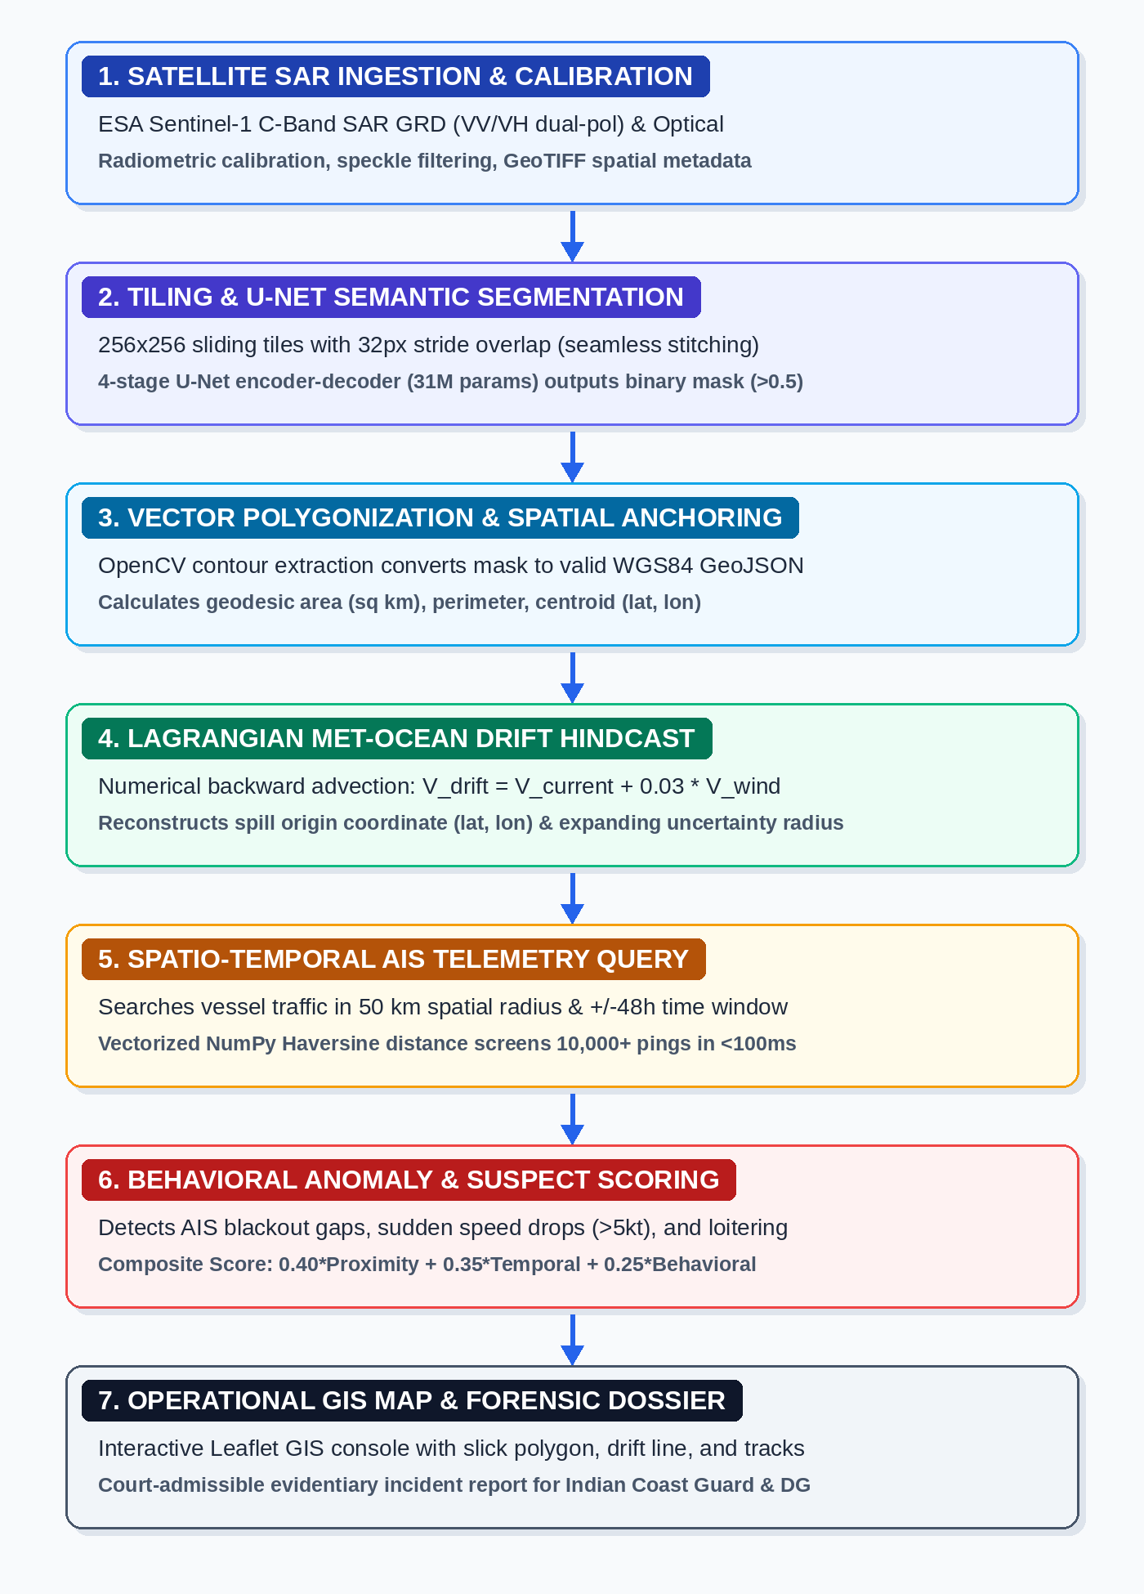
MarSlick
TECHNICAL APPROACH
ARCHITECTURE & CORE SUBSYSTEMS
• SAR Vision Subsystem: 4-stage U-Net CNN (31M params), 256x256 sliding tiles with 32px overlap, OpenCV contour-to-GeoJSON extraction.
• Ocean Advection Subsystem: Lagrangian backward trajectory advection: V_drift = V_current + 0.03*V_wind with expanding uncertainty envelope.
• AIS Correlation Subsystem: MarineCadastre CSV streaming parser, vectorized Haversine proximity screening, and kinematic anomaly detection (gaps, speed drops).
• Command Console & APIs: Django REST Framework, Celery asynchronous queue orchestrator, Leaflet.js mapping, and OpenAPI 3.0 documentation.
TECHNOLOGY STACK SPECIFICATIONS
• Deep Learning & Vision: PyTorch 2.0+, Torchvision, OpenCV, Albumentations, CUDA acceleration
• Backend & Task Queue: Python 3.12, Django 5.x, Django REST Framework, Celery 5.x, Redis 7.x
• Hydrodynamics & Math: Lagrangian Particle Engine, Open-Meteo Marine API, Copernicus CMEMS, NumPy
• Geospatial & Telemetry: Leaflet.js, PostGIS / SpatiaLite, Shapely, MarineCadastre AIS, NMEA 0183
@SIH Idea submission - Template | Problem Statement ID: 26143
3

Slide 4
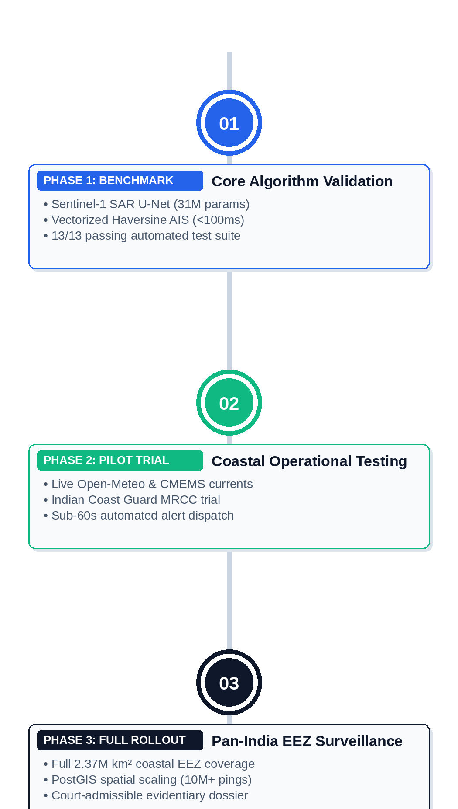
MarSlick
FEASIBILITY AND VIABILITY
ANALYSIS OF THE FEASIBILITY OF THE IDEA
• Technical Feasibility: Proven U-Net segmentation achieving <2s per tile; vectorized advection and scoring running in <100ms. 13/13 passing automated tests.
• Operational Feasibility: Direct ingestion of standard maritime telemetry (NMEA 0183 / MarineCadastre AIS) without requiring vessel transponder modifications.
• Economic Viability: Built on open-source frameworks and public European Space Agency Sentinel-1 satellite feeds, eliminating enterprise licensing fees.
POTENTIAL CHALLENGES AND RISKS
• Look-Alike False Positives: Natural biogenic slicks, low-wind calm ocean surfaces (<3 m/s), and algal blooms mimicking radar backscatter damping in SAR.
• Met-Ocean Grid Resolution: Gaps or coarse spatial resolution in real-time ocean current models near complex coastlines and shallow archipelagos.
• Dark Vessels & AIS Blackouts: Deliberate transponder shutdown or spoofed MMSI identity during illegal night-time bilge discharges.
STRATEGIES TO OVERCOME CHALLENGES
• Multi-Feature SAR Rejection: Texture analysis (GLCM), backscatter ratio profiling, and wind-speed threshold gating (>3 m/s) to reject look-alikes.
• Dynamic Environmental Blending: Hierarchical fallback between coastal HF-radar, Open-Meteo, and Copernicus CMEMS global currents with uncertainty cones.
• Kinematic Gap & Anomaly Scoring: Automated detection of AIS blackout gaps, sudden speed drops, and track extrapolation to unmask non-broadcasting vessels.
@SIH Idea submission - Template | Problem Statement ID: 26143
4

Slide 5
MarSlick
IMPACT AND BENEFITS
OPERATIONAL IMPACT
OPERATIONAL USER SCENARIO (INDIAN MARITIME DOMAIN)
• 85% Latency Reduction: Slashes spill origin attribution from 48-72 hours manual plotting to <60s automated pipeline.
• Evidentiary Traceability: Generates legally defensible dossiers linking IMO/MMSI numbers with spatio-temporal overlap.
• Persistent EEZ Surveillance: Expands autonomous maritime domain awareness across India's 2.37 million km² coastal EEZ.
• Deterrence Against Dumping: High attribution probability actively deters commercial ships from nocturnal bilge washing.
Target User & Deployment Environment
Indian Coast Guard Maritime Rescue Coordination Centre (MRCC) & Directorate General of Shipping operating in national coastal surveillance.
Surveillance Incident
A Sentinel-1 SAR acquisition over the Arabian Sea tanker corridor (Bombay High offshore zone) detects a 4.2 km² dark oil slick.
Autonomous Attribution Workflow
1. U-Net extracts slick polygon boundary and computes centroid (19.42°N, 71.85°E).
2. Lagrangian hindcast steps 16 hours backward against current and wind, locating origin 18.4 nm upstream.
3. Vectorized AIS engine screens 34 commercial vessels in the spatio-temporal corridor.
Forensic Finding
Flags Crude Carrier (MMSI: 413289000) with a 0.94 composite suspect score, identifying a 42-minute AIS transponder blackout gap and a 6.5-knot speed drop at the reconstructed spill release point.
Enforcement Outcome
Evidentiary dossier dispatched to Coast Guard interceptor vessel in under 90 seconds, securing legal prosecution under Indian Merchant Shipping Act 1958.
ENVIRONMENTAL & ECONOMIC BENEFITS
• Ecosystem Preservation: Protects sensitive mangroves, coral reefs, and fisheries from toxic hydrocarbon contamination.
• Cost Recovery Enforcement: Enables port authorities and Coast Guard to recover million-dollar cleanup costs under Polluter Pays.
• Inter-Agency Compatibility: Standard GeoJSON and RESTful APIs integrate with Indian Coast Guard (ICG) MRCC systems.
• Operational Scalability: Asynchronous multi-queue processing handles nationwide satellite passes without extra personnel.
@SIH Idea submission - Template | Problem Statement ID: 26143
5

Slide 6

MarSlick
RESEARCH AND REFERENCES
Synthetic Aperture Radar (SAR) Oil Detection
Deep Learning Semantic Segmentation
• European Space Agency (ESA) Sentinel-1 C-Band SAR User Guide & Copernicus Open Access Hub.
• CleanSeaNet Operational Satellite Monitoring Methodology, European Maritime Safety Agency (EMSA).
• Ronneberger et al., 'U-Net: Convolutional Networks for Biomedical Image Segmentation', MICCAI.
• Solberg et al., 'Algorithms for Oil Spill Detection in SAR Imagery', IEEE Trans. Geosci. Remote Sensing.
Hydrodynamic & Ocean Drift Modeling
Meteorological & Current Forcing Datasets
• NOAA GNOME (General NOAA Operational Modeling Environment) Technical Suite.
• Dagestad et al., 'OpenDrift: An open-source trajectory framework for ocean drift modeling', GMD.
• Copernicus Marine Environment Monitoring Service (CMEMS Global Ocean Current Analysis).
• European Centre for Medium-Range Weather Forecasts (ECMWF) ERA5 Atmospheric Wind Vectors.
Automatic Identification System (AIS) Standards
Maritime Environmental Law & Regulatory Frameworks
• International Telecommunication Union (ITU-R M.1371) Technical characteristics for AIS.
• Bureau of Ocean Energy Management (BOEM) & NOAA, MarineCadastre.gov National AIS Database.
• IMO MARPOL 73/78 Annex I: Regulations for the Prevention of Pollution by Oil from Ships.
• Government of India, Merchant Shipping Act 1958 (Part XIA: Prevention of Pollution of Sea by Oil).
@SIH Idea submission - Template | Problem Statement ID: 26143
6

