Slide 1
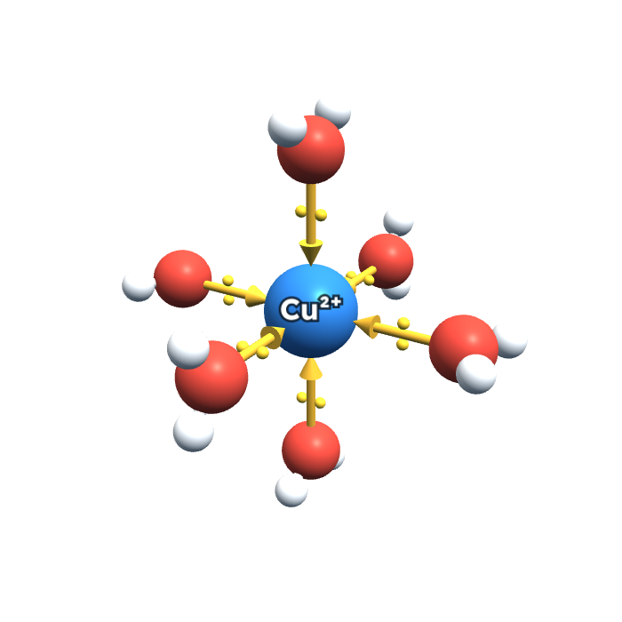
AQA A-LEVEL CHEMISTRY · 3.2.6 REACTIONS OF IONS IN AQUEOUS SOLUTION
Aqueous ions: complexes, colours and test-tube reactions
One big pattern, three exceptions. Built up one step at a time.
How to use this deck
Yellow slides are questions. Try them first.
Blue-tint slides are the answers, step by step.
"Lesson map" (top right) jumps to any section.
The website version has the 3D models to turn and tap, plus a virtual lab.
[Cu(H₂O)₆]²⁺

Slide 2
Eight short sections, then a summary
LESSON MAP
Lesson map
A
Complex ions
B
The four ions
C
Why 3+ is acidic
D
The big pattern
Go →
Go →
Go →
Go →
E
The exceptions
F
Carbonate
G
Identify the ion
H
Exam practice
Go →
Go →
Go →
Go →
The whole topic in one line: a base pulls H⁺ off the water ligands until the complex has no charge, then it falls out as a precipitate.
Spotted in the notes: p7 iron(II) + NH₃ starts "2OH⁻" but should be 2NH₃. p8 last equation: the hydroxide [Cu(H₂O)₄(OH)₂] has no charge, and the deep blue product is [Cu(H₂O)₂(NH₃)₄]²⁺. Both are corrected in Sections D and E.

Slide 3
What is a complex ion?
SECTION A · FROM THE CLASS NOTES
Lesson map
Central metal ion: Cu²⁺
THE PICTURE
Six water molecules crowd round the metal ion. Each one gives the metal a pair of its OWN electrons. Metal + ligands = one complex ion.
Ligand: a water molecule
Coordinate bond (arrow)
Donated lone pair
READ THE NAME
Hexa = 6, aqua = water. A hexa aqua ion has 6 water ligands, coordination number 6, octahedral shape.

Slide 4
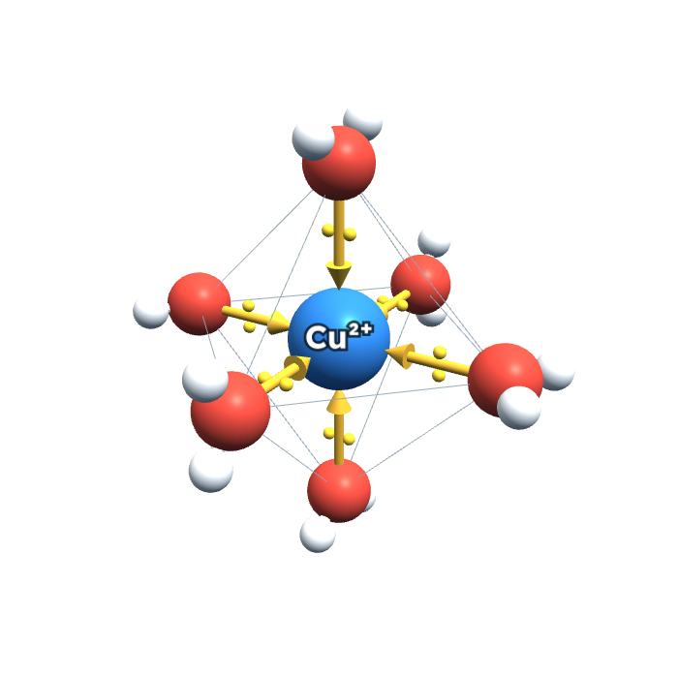
The four definitions
SECTION A · FROM THE CLASS NOTES
Lesson map
Complex ion
A central atom or ion surrounded by ligands.
Ligand
An ion or molecule with a lone pair of electrons which can form a coordinate bond with a metal ion.
Coordinate bond
A shared pair of electrons which have both come from the same atom.
Coordination number
The number of coordinate bonds a metal ion forms.
Octahedral: all angles 90°
The notes say "transition metal ion" in the last definition, but it works for Al³⁺ too.

Slide 5
Check your understanding
CHECK A · TRY FIRST, ANSWERS ON THE NEXT SLIDE
Lesson map
NEW QUESTION
NEW QUESTION
1. Match each term to its definition:
Ligand · Coordinate bond · Coordination number · Complex ion
a) A shared pair of electrons, both from the same atom
b) Has a lone pair; forms a coordinate bond with a metal ion
c) The number of coordinate bonds the metal ion forms
d) A central atom or ion surrounded by ligands
2. In [Cu(H₂O)₆]²⁺, where do the two electrons in each coordinate bond come from?
A One from Cu²⁺, one from the oxygen
B Both from a lone pair on the oxygen of water
C Both from the Cu²⁺ ion

Slide 6
Check A: answers and why
CHECK A · ANSWERS
Lesson map
1. Matches
Ligand → b
Coordinate bond → a
Coordination number → c
Complex ion → d
2. B
Both electrons come from a lone pair on the water's oxygen. That's what makes it a coordinate bond. The metal ion only accepts the pair.
Next: Section B →

Slide 7
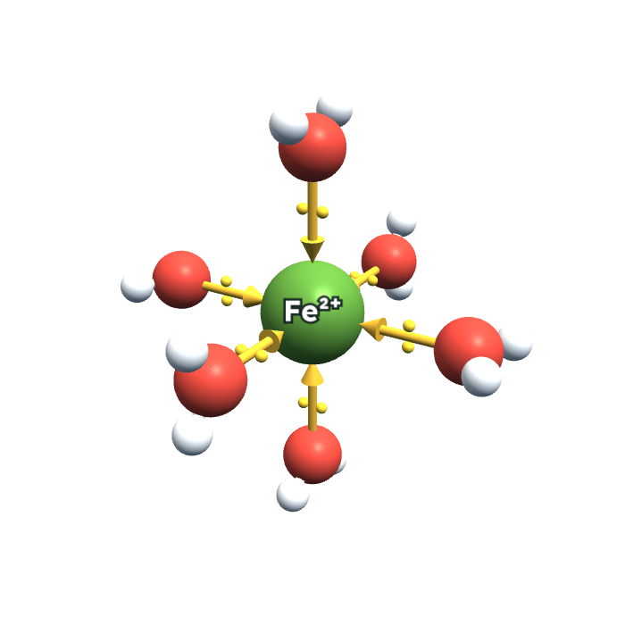
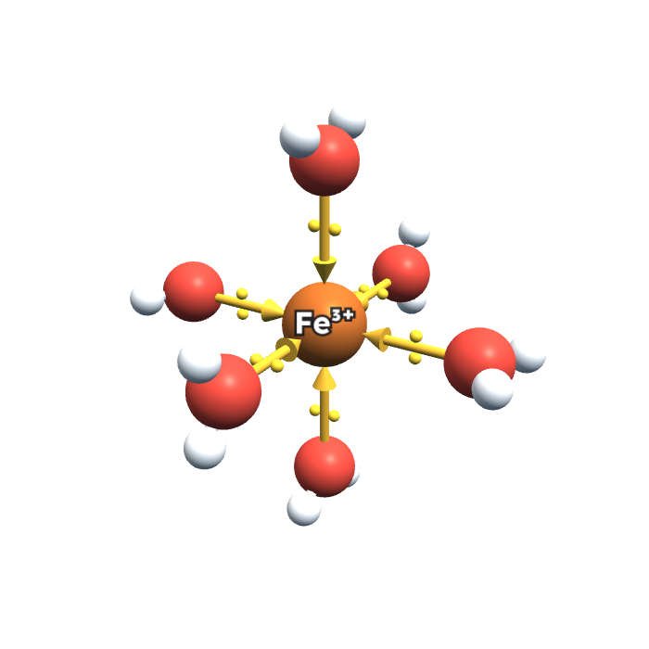
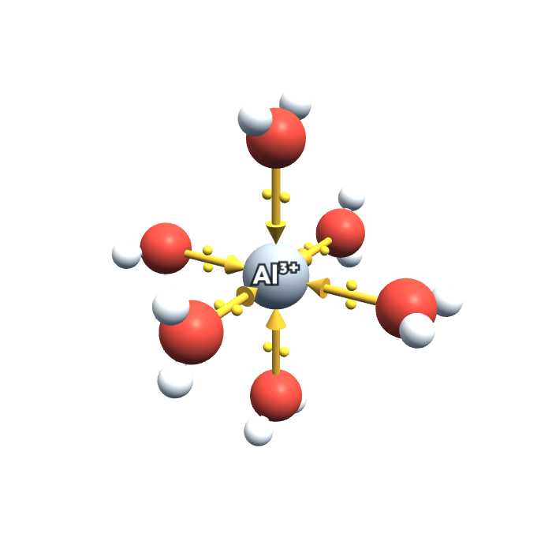
Meet the four ions
SECTION B · FROM THE CLASS NOTES
Lesson map
[Cu(H₂O)₆]²⁺
[Fe(H₂O)₆]²⁺
[Fe(H₂O)₆]³⁺
[Al(H₂O)₆]³⁺
blue
pale green
yellow-brown (really purple)
colourless
MEMORY TRICK
Copper is Cool blue. Iron(II) green like new leaves; iron(III) brown like rust. Al is always clear.
WHY "PURPLE" BUT YELLOW-BROWN?
Pure [Fe(H₂O)₆]³⁺ is pale purple, but some always loses H⁺ to form yellow-brown [Fe(H₂O)₅(OH)]²⁺ (Section C).

Slide 8
Check your understanding
CHECK B · TRY FIRST, ANSWERS ON THE NEXT SLIDE
Lesson map
NEW QUESTION
Give the colour of each solution:
[Cu(H₂O)₆]²⁺ [Fe(H₂O)₆]²⁺ [Fe(H₂O)₆]³⁺ [Al(H₂O)₆]³⁺
LOOK CLOSELY AT THE 3D MODELS
Which two central ions are drawn smaller? (Hint: their charge is higher.)

Slide 9
Check B: answers
CHECK B · ANSWERS
Lesson map
[Cu(H₂O)₆]²⁺
blue
[Fe(H₂O)₆]²⁺
pale green
[Fe(H₂O)₆]³⁺
yellow-brown
[Al(H₂O)₆]³⁺
colourless
The smaller ions
Fe³⁺ and Al³⁺ are smaller than Cu²⁺ and Fe²⁺. Higher charge, smaller size: that matters in Section C.
Next: Section C →

Slide 10
Why 3+ ions are more acidic
SECTION C · FROM THE CLASS NOTES (HANDWRITTEN)
Lesson map
Fe²⁺
Fe³⁺
O
O
H⁺ leaves
2+: lower charge, bigger → weak pull
3+: higher charge, smaller → strong pull
Higher charge/size ratio
More polarising
Weakens O–H bonds
H⁺ released more easily
EXAM TRICK
Four links, four marks-worth of words: charge/size → polarising → weakens O–H → releases H⁺.

Slide 11
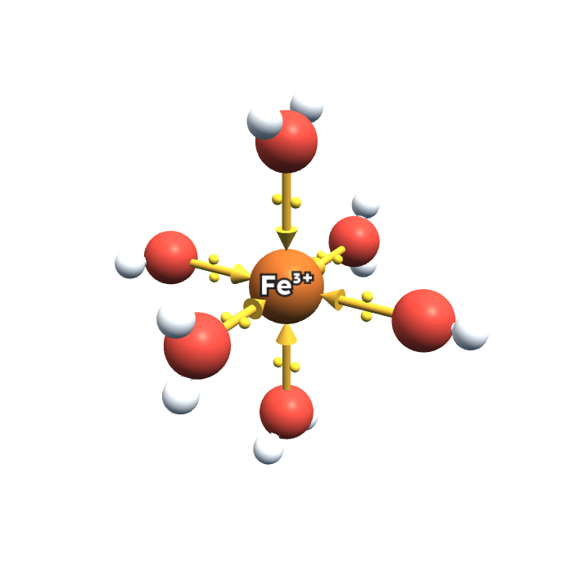
Writing it as an equation
SECTION C · FROM THE CLASS NOTES
Lesson map
[Fe(H₂O)₆]³⁺ ⇌ [Fe(H₂O)₅(OH)]²⁺ + H⁺
[Al(H₂O)₆]³⁺ ⇌ [Al(H₂O)₅(OH)]²⁺ + H⁺
JUST LIKE ANY ACID
HA ⇌ H⁺ + A⁻. One water ligand gives away an H⁺ and the charge drops by 1.
RULE
The M³⁺ aqua ion is always more acidic than the M²⁺ aqua ion. (The notes use →; it's really ⇌.)
one water → OH⁻ ligand

Slide 12
Check your understanding
CHECK C · TRY FIRST, ANSWERS ON THE NEXT SLIDE
Lesson map
NEW QUESTION
NEW QUESTION
[3 marks]
1. Why is [Fe(H₂O)₆]³⁺ more acidic than [Fe(H₂O)₆]²⁺?
A Fe³⁺ has more water ligands
B Fe³⁺ is a bigger ion
C Fe³⁺ has a higher charge/size ratio, so weakens O–H bonds more
2. Explain, in terms of charge/size ratio, why [Al(H₂O)₆]³⁺ is more acidic than [Fe(H₂O)₆]²⁺.

Slide 13
Check C: answers and why
CHECK C · ANSWERS
Lesson map
1. C
Both have 6 waters (A is wrong), and Fe³⁺ is smaller, not bigger (B).
2. Model answer (3 marks)
✓ Al³⁺ has a higher charge and is smaller, so it has a higher charge/size ratio and is more polarising.
✓ It weakens the O–H bonds in the water ligands more.
✓ So H⁺ ions are released more easily:
[Al(H₂O)₆]³⁺ ⇌ [Al(H₂O)₅(OH)]²⁺ + H⁺
Next: Section D →

Slide 14
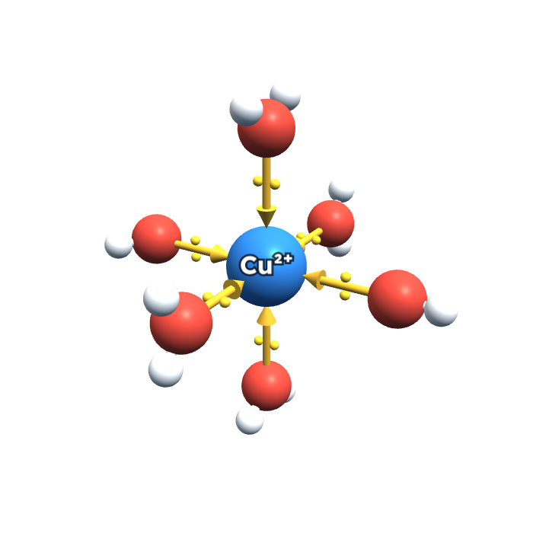
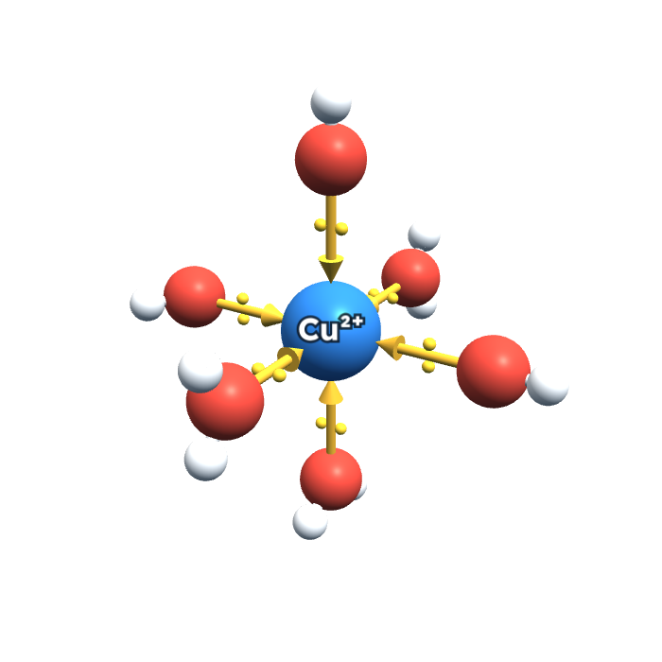
The big pattern: bases pull off H⁺
SECTION D · THE MOST IMPORTANT IDEA
Lesson map
− H⁺
− H⁺
[Cu(H₂O)₆]²⁺
[Cu(H₂O)₅(OH)]⁺
[Cu(H₂O)₄(OH)₂]
charge 2+ · dissolved
charge 1+ · dissolved
charge 0 · PRECIPITATE
Each H⁺ removed turns an H₂O ligand into OH⁻ and drops the charge by 1. At charge 0 the complex can't stay dissolved: precipitate.

Slide 15
The rule that writes the formulas
SECTION D · FROM THE CLASS NOTES AND AQA SHEET
Lesson map
Start | H⁺ removed | Precipitate | Colour
[Cu(H₂O)₆]²⁺ | 2 | [Cu(H₂O)₄(OH)₂] | blue
[Fe(H₂O)₆]²⁺ | 2 | [Fe(H₂O)₄(OH)₂] | green → brown in air
[Fe(H₂O)₆]³⁺ | 3 | [Fe(H₂O)₃(OH)₃] | brown
[Al(H₂O)₆]³⁺ | 3 | [Al(H₂O)₃(OH)₃] | white
TRICK: CHARGE = NUMBER OF OH
2+ loses 2 H⁺ → 2 OH. 3+ loses 3 H⁺ → 3 OH. Waters + OHs always add up to 6.
With NaOH: by-product water
[Fe(H₂O)₆]²⁺ + 2OH⁻ → [Fe(H₂O)₄(OH)₂] + 2H₂O
With a little NH₃: by-product ammonium
[Fe(H₂O)₆]²⁺ + 2NH₃ → [Fe(H₂O)₄(OH)₂] + 2NH₄⁺
CORRECTION (NOTES P7)
The NH₃ equation is written with "2OH⁻". With ammonia the base is 2NH₃.
BALANCING TRICK
All the numbers equal the charge: 2+ → all 2s, 3+ → all 3s.

Slide 16
Check your understanding
CHECK D · TRY FIRST, ANSWERS ON THE NEXT SLIDE
Lesson map
NEW QUESTION
NEW QUESTION
1. Complete: [Cu(H₂O)₆]²⁺ + __OH⁻ → ________ + __H₂O
2. Complete: [Fe(H₂O)₆]³⁺ + __NH₃ → ________ + ______
NEW QUESTION
3. Why does [Cu(H₂O)₄(OH)₂] form a precipitate?
A It has no overall charge, so it's insoluble
B It has lost some of its ligands
C Copper has been oxidised

Slide 17
Check D: answers and why
CHECK D · ANSWERS
Lesson map
1. All 2s
[Cu(H₂O)₆]²⁺ + 2OH⁻ → [Cu(H₂O)₄(OH)₂] + 2H₂O
2. All 3s
[Fe(H₂O)₆]³⁺ + 3NH₃ → [Fe(H₂O)₃(OH)₃] + 3NH₄⁺
3. A
No charge, so it can't stay dissolved. It still has 6 ligands (B is wrong) and copper stays +2 (C is wrong).
Next: Section E →

Slide 18
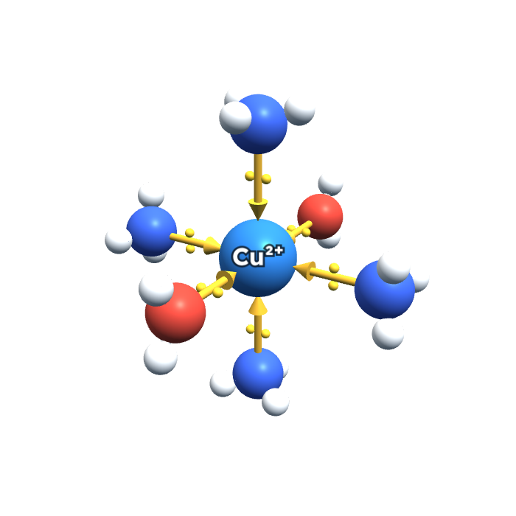
Exception 1: copper + excess ammonia
SECTION E · FROM THE CLASS NOTES (p8)
Lesson map
blue solution
a little NH₃: blue ppt
excess: deep blue
[Cu(H₂O)₆]²⁺ + 4NH₃ → [Cu(H₂O)₂(NH₃)₄]²⁺ + 4H₂O
[Cu(H₂O)₄(OH)₂] + 4NH₃ → [Cu(H₂O)₂(NH₃)₄]²⁺ + 2OH⁻ + 2H₂O
[Cu(H₂O)₂(NH₃)₄]²⁺: 4 NH₃ replace 4 H₂O
CORRECTION (NOTES P8)
The precipitate has no charge, and the product needs its 2+. Charge check: 0 = 2+ + 2(−1) ✓
TRICK
Copper loves ammonia.

Slide 19
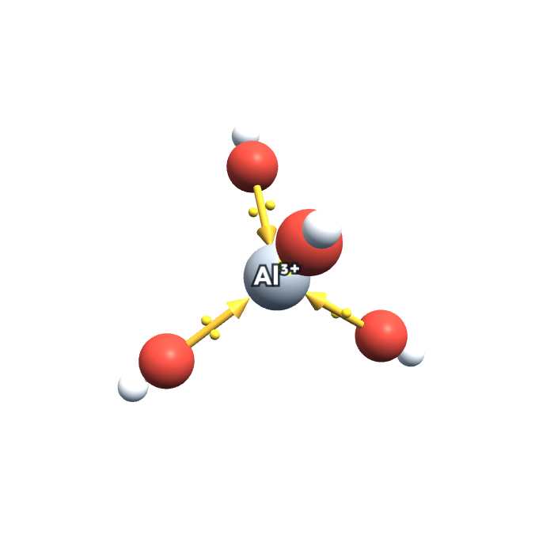
Exception 2: aluminium + excess NaOH
SECTION E · AQA COLOUR SHEET
Lesson map
colourless
a little NaOH: white ppt
excess: colourless again
Amphoteric = reacts with both acids and bases.
acid role: [Al(H₂O)₃(OH)₃] + OH⁻ → [Al(OH)₄]⁻ + 3H₂O
base role: [Al(H₂O)₃(OH)₃] + 3H⁺ → [Al(H₂O)₆]³⁺
[Al(OH)₄]⁻: tetrahedral, colourless solution
TRICK
Aluminium loves hydroxide.
WHY NOT WITH NH₃?
Ammonia is too weak a base. Excess NH₃: white ppt stays.

Slide 20
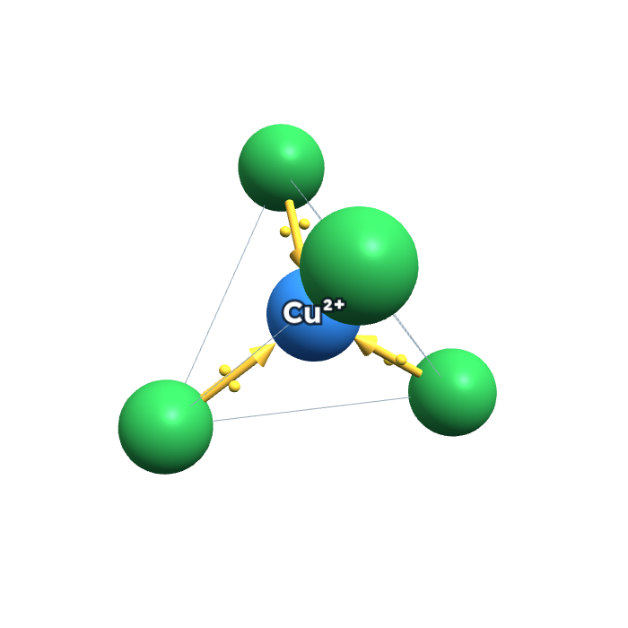
Exception 3: copper + concentrated HCl
SECTION E · FROM THE CLASS NOTES (p9)
Lesson map
TRICK
Chloride is too fat for six.
blue
yellow (can look green)
[Cu(H₂O)₆]²⁺ + 4Cl⁻ ⇌ [CuCl₄]²⁻ + 6H₂O
Chloride ions are significantly larger, so fewer fit
Coordination number 6 → 4; octahedral → tetrahedral
Charge: 2+ and 4 × (−1) = 2−
May look green: leftover blue + yellow
[CuCl₄]²⁻: tetrahedral (shape lines shown)

Slide 21
Check your understanding
CHECK E · TRY FIRST, ANSWERS ON THE NEXT SLIDE
Lesson map
NEW QUESTION
NEW QUESTION
1. Which precipitate dissolves in excess ammonia?
A The white one from Al³⁺
B The blue one from Cu²⁺
C The brown one from Fe³⁺
2. Why is [CuCl₄]²⁻ tetrahedral rather than octahedral?
NEW QUESTION
[2 marks]
3. Write two equations to show that aluminium hydroxide, [Al(H₂O)₃(OH)₃], is amphoteric.

Slide 22
Check E: answers and why
CHECK E · ANSWERS
Lesson map
1. B
Copper loves ammonia: deep blue [Cu(H₂O)₂(NH₃)₄]²⁺. Al(OH)₃ dissolves in excess NaOH, not NH₃.
2. Size
Cl⁻ ions are much larger than H₂O, so only 4 fit around the copper ion.
3. Model answer (2 marks)
✓ [Al(H₂O)₃(OH)₃] + 3H⁺ → [Al(H₂O)₆]³⁺ (acts as a base)
✓ [Al(H₂O)₃(OH)₃] + OH⁻ → [Al(OH)₄]⁻ + 3H₂O (acts as an acid)
Next: Section F →

Slide 23
Carbonate: 2+ and 3+ behave differently
SECTION F · FROM THE CLASS NOTES AND AQA SHEET
Lesson map
2+ ions: metal carbonate, no fizz
3+ ions: hydroxide + CO₂ fizz
FeCO₃ green
CuCO₃ blue-green
brown + fizz
white + fizz
[Fe(H₂O)₆]²⁺ + CO₃²⁻ → FeCO₃ + 6H₂O
[Cu(H₂O)₆]²⁺ + CO₃²⁻ → CuCO₃ + 6H₂O
2[Fe(H₂O)₆]³⁺ + 3CO₃²⁻ → 2[Fe(H₂O)₃(OH)₃] + 3CO₂ + 3H₂O
2[Al(H₂O)₆]³⁺ + 3CO₃²⁻ → 2[Al(H₂O)₃(OH)₃] + 3CO₂ + 3H₂O
WHY?
3+ aqua ions are acidic enough to react like an acid: carbonate → CO₂. 2+ ions aren't, so the carbonate just precipitates.
MEMORY TRICK
Three fizzes, two doesn't.

Slide 24
Check your understanding
CHECK F · TRY FIRST, ANSWERS ON THE NEXT SLIDE
Lesson map
NEW QUESTION
NEW QUESTION
[2 marks]
1. What do you see when Na₂CO₃(aq) is added to [Fe(H₂O)₆]³⁺(aq)?
A A precipitate of iron(III) carbonate, no fizzing
B A brown precipitate and fizzing
C A green precipitate and fizzing
2. Explain why CO₂ is given off when Na₂CO₃ is added to Al³⁺(aq) but not to Fe²⁺(aq).

Slide 25
Check F: answers and why
CHECK F · ANSWERS
Lesson map
1. B
Brown [Fe(H₂O)₃(OH)₃] and bubbles of CO₂. Only 2+ ions form carbonates.
2. Model answer (2 marks)
✓ [Al(H₂O)₆]³⁺ is more acidic (higher charge/size ratio, releases H⁺ more easily).
✓ So it reacts with carbonate to release CO₂; [Fe(H₂O)₆]²⁺ isn't acidic enough, so FeCO₃ precipitates.
Next: Section G →

Slide 26
Which ion is it? Add NaOH, then look
SECTION G · PUTTING IT TOGETHER
Lesson map
Add NaOH(aq) dropwise
Green ppt
Blue ppt
Brown ppt
White ppt
Fe²⁺
turns brown in air
Cu²⁺
excess NH₃ → deep blue solution
Fe³⁺
with Na₂CO₃: fizzes
Al³⁺
dissolves in excess NaOH
ON THE WEBSITE
The virtual lab lets you add any reagent to any ion and see the tube change. "Name that ion" gives endless mystery solutions to practise on.

Slide 27
The copper reaction scheme
SECTION H · ORIGINAL EXAM QUESTION · JUNE 2010
Lesson map
W, X, Y and Z are all copper-containing species.
For W, X, Y and Z: identify it, describe its appearance and write an equation for its formation.
W
concentrated HCl
scrap iron
[Cu(H₂O)₆]²⁺(aq)
dilute NH₃
excess NH₃
Cu(s)
X
Y
Na₂CO₃(aq)
(e)(i) Copper can be extracted from a dilute solution of copper(II) ions using scrap iron. Write an equation and give the colours of the initial and final aqueous solutions.
ATTACK PLAN
HCl → exception 3. Dilute NH₃ → Pattern 1. Excess NH₃ → exception 1. Na₂CO₃ → 2+ carbonate.
Z

Slide 28
June 2010: (a) W, (b) X, (c) Y
SECTION H · ANSWERS
Lesson map
(a) W = [CuCl₄]²⁻
Appearance: yellow (or green) solution
Equation:
[Cu(H₂O)₆]²⁺ + 4Cl⁻ ⇌ [CuCl₄]²⁻ + 6H₂O
Cl⁻ is larger: only 4 fit.
(b) X = [Cu(H₂O)₄(OH)₂]
Appearance: blue precipitate
Equation:
[Cu(H₂O)₆]²⁺ + 2NH₃ → [Cu(H₂O)₄(OH)₂] + 2NH₄⁺
Pattern 1: 2+ → 2 H⁺ removed.
(c) Y = [Cu(H₂O)₂(NH₃)₄]²⁺
Appearance: deep blue solution
Equation (from X):
[Cu(H₂O)₄(OH)₂] + 4NH₃ → [Cu(H₂O)₂(NH₃)₄]²⁺ + 2OH⁻ + 2H₂O

Slide 29
June 2010: (d) Z and (e) scrap iron
SECTION H · ANSWERS
Lesson map
(d) Z = CuCO₃
Appearance: blue-green precipitate
Equation:
[Cu(H₂O)₆]²⁺ + CO₃²⁻ → CuCO₃ + 6H₂O
2+ ion → carbonate forms, no fizz.
(e)(i) Displacement
Equation: Fe + Cu²⁺ → Fe²⁺ + Cu
(or Fe + [Cu(H₂O)₆]²⁺ → [Fe(H₂O)₆]²⁺ + Cu)
Initial colour: blue
Final colour: (pale) green
Iron is oxidised to Fe²⁺; Cu²⁺ is reduced to Cu.
Next: Summary →

Slide 30
The whole topic in one table
SUMMARY · AQA COLOUR SHEET
Lesson map
 | Aqueous ion | NaOH | excess NaOH | NH₃ | excess NH₃ | Na₂CO₃
Fe²⁺ | [Fe(H₂O)₆]²⁺ green solution | [Fe(H₂O)₄(OH)₂] green ppt, browns in air | no further change | [Fe(H₂O)₄(OH)₂] green ppt, browns in air | no further change | FeCO₃ green ppt
Cu²⁺ | [Cu(H₂O)₆]²⁺ blue solution | [Cu(H₂O)₄(OH)₂] blue ppt | no further change | [Cu(H₂O)₄(OH)₂] blue ppt | [Cu(H₂O)₂(NH₃)₄]²⁺ deep blue solution | CuCO₃ blue-green ppt
Fe³⁺ | [Fe(H₂O)₆]³⁺ purple, looks yellow-brown | [Fe(H₂O)₃(OH)₃] brown ppt | no further change | [Fe(H₂O)₃(OH)₃] brown ppt | no further change | [Fe(H₂O)₃(OH)₃] brown ppt + CO₂
Al³⁺ | [Al(H₂O)₆]³⁺ colourless | [Al(H₂O)₃(OH)₃] white ppt | [Al(OH)₄]⁻ colourless solution | [Al(H₂O)₃(OH)₃] white ppt | no further change | [Al(H₂O)₃(OH)₃] white ppt + CO₂
Bold cells are the exceptions and the fizzing.

Slide 31
The rules on one slide
SUMMARY
Lesson map
Complex ion
Metal ion + ligands joined by coordinate bonds (both electrons from the ligand). Hexa aqua: 6 waters, octahedral.
3+ more acidic
Higher charge/size → more polarising → weakens O–H → releases H⁺.
Pattern 1
OH⁻ or NH₃ removes H⁺ until neutral → precipitate. 2+ → M(H₂O)₄(OH)₂; 3+ → M(H₂O)₃(OH)₃.
Exceptions
Cu + excess NH₃ → deep blue. Al + excess NaOH → colourless [Al(OH)₄]⁻. Cu + conc. HCl → yellow [CuCl₄]²⁻.
Carbonate
2+ → MCO₃ ppt, no fizz. 3+ → hydroxide ppt + CO₂.
Iron(II)
Green ppt turns brown in air: Fe²⁺ oxidised to Fe³⁺.

Slide 32
Final quiz
FINAL QUIZ · NEW QUESTIONS · ANSWERS ON THE NEXT SLIDE
Lesson map
1. Coordination number of Cu in [Cu(H₂O)₂(NH₃)₄]²⁺?
A 4 B 2 C 6
2. White ppt dissolves in excess NaOH, not excess NH₃. The ion is…
A Al³⁺ B Fe²⁺ C Cu²⁺
3. Why does the green Fe²⁺ ppt turn brown on standing?
A it dissolves B air oxidises Fe²⁺ to Fe³⁺ C it reacts with CO₂
4. Na₂CO₃ causes fizzing with which pair?
A Cu²⁺, Fe²⁺ B Cu²⁺, Al³⁺ C Fe³⁺, Al³⁺
5. NH₃ + [Al(H₂O)₆]³⁺: the by-product is…
A 3NH₄⁺ B 3H₂O C 3OH⁻
6. Charge on [Fe(H₂O)₅(OH)], from [Fe(H₂O)₆]³⁺?
A 3+ B 2+ C 0

Slide 33
Final quiz: answers
FINAL QUIZ · ANSWERS
Lesson map
1. C: 6
2 water + 4 ammonia = 6 coordinate bonds.
2. A: Al³⁺
Al(OH)₃ is amphoteric.
3. B
Oxygen oxidises Fe²⁺ to Fe³⁺.
4. C
Three fizzes, two doesn't.
5. A: 3NH₄⁺
NH₃ + H⁺ → NH₄⁺, three times.
6. B: 2+
3+ and one OH⁻ (−1) = 2+.
Back to the lesson map · Well done for finishing.

