Slide 2
Spike Frequency Adaptation
Model Sensory Adaptation in Neuromorphic Hardware
  Model Sensory Adaptation using adaptive integrate and fire neurons
    Model the circuit
      Model the submechanism of the circuit
        Model STD
        Model STF
        Model SFA in a manner that let's us build a sensory adaptation network
          Model SFA in a manner that is biologically similar to the neurons we think are present in the cortical circuit
            PC
            SST
            PV
            GN

Slide 3

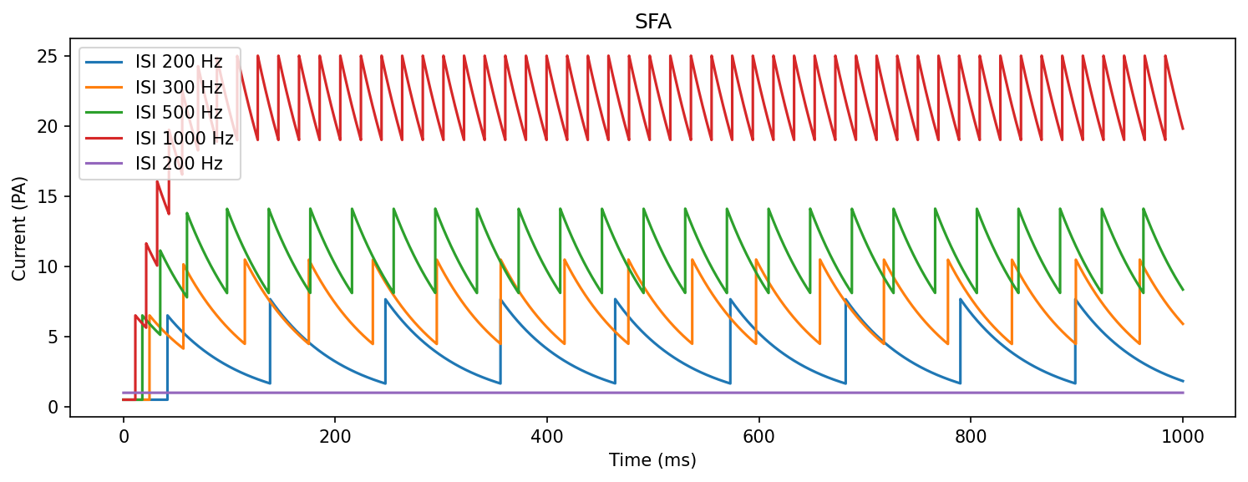

Slide 4
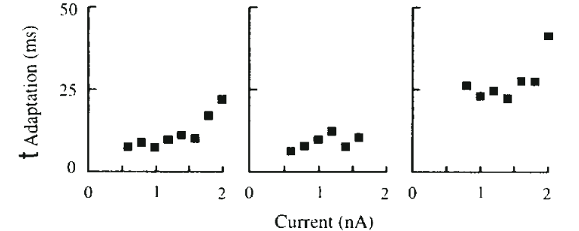
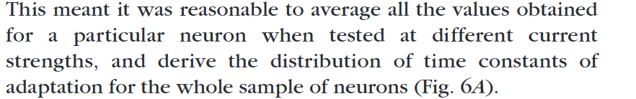

Slide 5
General SFA Metrics
F_adap and T_adap correleate significantly with cortical depth
Layer | 2 to 4 | 5 to 6
T_adap | 3-24 ms | 50 ms
F_adap | 55-80% | 35-65%

Slide 6
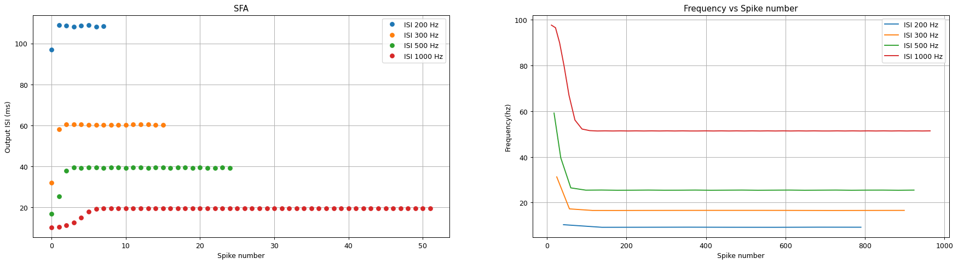

Slide 7
END OF SFA Section
Therefore, Adaptation at a time scale exceeding the 100s of milliseconds is not attributed to single neuron behavior

Slide 8
Signal Chain of Perception
Stage 1: Will we see long term effect of adaptation in this three neuron circuit?
Stage 2
Stage 1
Layer 4 S1
PC
PV
SST
Third order neuron
Second order
neuron
First order
neuron
mechanoreceptors
Stage 3
Layer 6 S1
VPM & VPL
In the thalamus
Gracili & Cuneatus Nuclei in M.O.
Stage 4
Dorsal root Ganglion
Cortex

Slide 9
Question
Stage 1
Layer 4 S1 circuits: What do they know? Do they know things? Lets find out!!!
Will the double inhibition mechanism of layer 4 have any effect in the long time constant scale of 400’s as described in the giacomo valle paper?
  The only way to answer it is to try and model it. Or in vivo experiments, but Im not in that department
Layer 4 S1
Third order neuron

Slide 10
Cell Types in the Somatosensory cortex
Exitatory L4
  Stellate
  Star Pyramid
  Pyramidal Cells
Regular Spiking, local connections within L4
Connections from L4 Stelate
Then out to L2/3
Regular Spiking
Kim, Taehyeon, Bryan M. Hooks, and Claire EJ Cheetham. "Circuit development in somatosensory cortex." Neural Circuit and Cognitive Development. Academic Press, 2020. 143-166.

Slide 11
Cell Types in the Somatosensory cortex
Inhibitory
  PV+
    Basket
    Chandelier
  SST+
    Martinotti
    Non-matinotti
  5HT3aR
    VIP
    Single Basket
    Neurogliaform cells
Fast Spiking
Low threshold spiking?
Not in the model for now
Kim, Taehyeon, Bryan M. Hooks, and Claire EJ Cheetham. "Circuit development in somatosensory cortex." Neural Circuit and Cognitive Development. Academic Press, 2020. 143-166.

Slide 12
PC(Regular Firing)
Property | Value | SD | Sources
Membrane time constant ms | 25.3 | 19.08 | NeuroElectro
Spontaneous Firing rate Hz | 1.5 | .94 | Neuro Electro
SS at Threshold Hz | 12.3* | 5.5 | Beierlein 6 Gibson 2003
Maximal steady-state firing Rate Hz | 59.4 | 13.7 | Beierlein & Gibson 2003
Types
  Pyramidal
  Stellate
  Pyramidal Start
In literature they all seem interchangable, but Stellate receive the inputs
I tau = 2.8pA

Slide 13
PV(Fast Firing)
Property | Value | SD | Sources
Membrane time constant | 9.57 | 4 | NeuroElectro
Spontaneous Firing rate | 5.32 | 3.98 | NeuroElectro
SS at Threshold | 56.5* | 18.6 | Beierlein 6 Gibson 2003
Maximal steady-state firing Rate Hz | 271.1*(80**) | 51.8 | Beierlein & Gibson 2003
Info
  Basket or Chandelier Cells, I believe both behave the same, the projection location is the main difference
  Fast Firing (Both Chandelier and Basket are fast firing)
Tuning Parameters
  I_tau= 7.5 pA
  Alpha<1 for positive second derivative

Slide 14
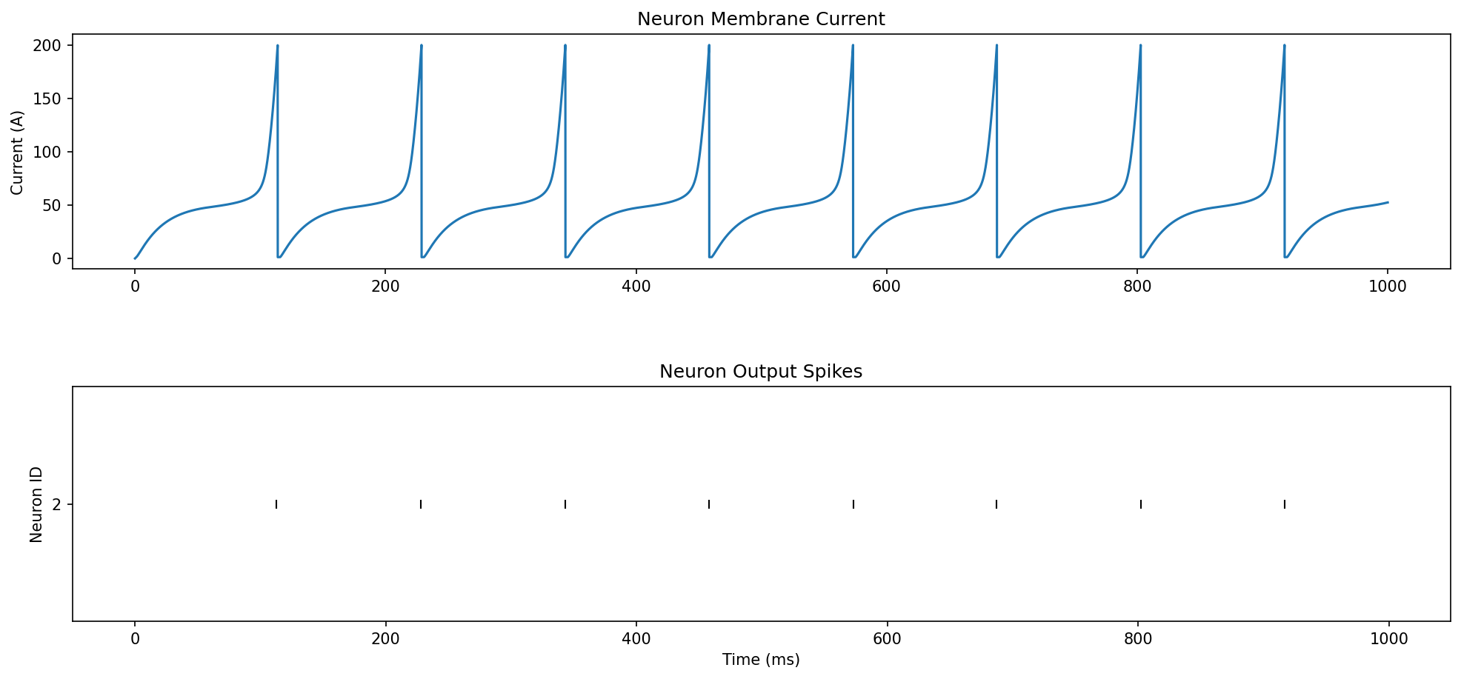
SST(Martinotti Cells)(LTS)
Property | Value | SD | Sources
Membrane time constant | 19.88 | 9.07 | NeuroElectro
Spontaneous Firing rate
SS at Threshold | 17.2* | 7.9 | Beierlein 6 Gibson 2003
Maximal steady-state firing Rate Hz | 120.7 | 41.2 | Beierlein & Gibson 2003
LTF??
Alpha<1 for positive second derivative
I_tau=3.5
PFB could be further tuned
Should only be activated at high frequencies and inhibit PC more closelt

Slide 15
Guidelines to Simulation
PV>PC>SST in terms of time constants and firing rate
1/10 gain from stimulus ??
CV(ISI)² < 1 but as close to one as possible
  Except when the stimulus is on, it can be closer to 0
PV cells should not exhibit adaptation
Maximum firing rate of 200hz for all neurons
SST no spontanous firing rate, PC and PV around 10* (in biology is 1 or 5)
SST shhould be LTS (but this is tricky and counter intuitive, cause its suppose to fire less than the other two)

Slide 16
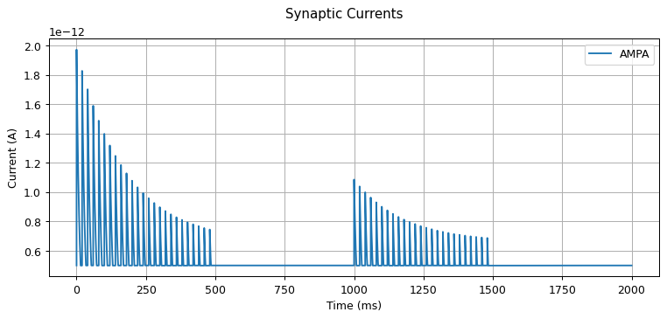
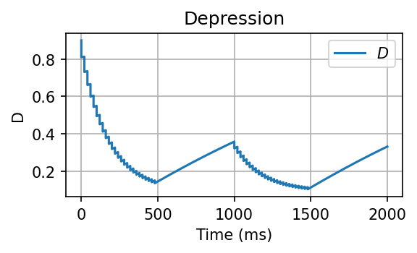
Depression with the old equation but corrected
With update rule on the old code
  dD/dt=M(1-D)
On Pre:
  D = (D*(1-d))*(D<1) + 1*(D>=1)
  Iampa += ((D*(D<1) + 1*(D>=1)))*Iampa_w0*weight

Slide 17
Network Simulations
P=0.9 AMPA
PC
(RS)
P=1 AMPA w =20
P=0.9 AMPA STD
P=0.9 AMPA
P=0.9 GABA_B
P=0.9 GABA_B
P=1 AMPA STD w=5
PV
(FS)
P=0.9 GABA_B
SST
(LTS)
P=1 AMPA w=1
P=0.6 GABA_B
P=0.9 GABA_B
P=0.9 GABA_B
Third order neuron

Slide 18
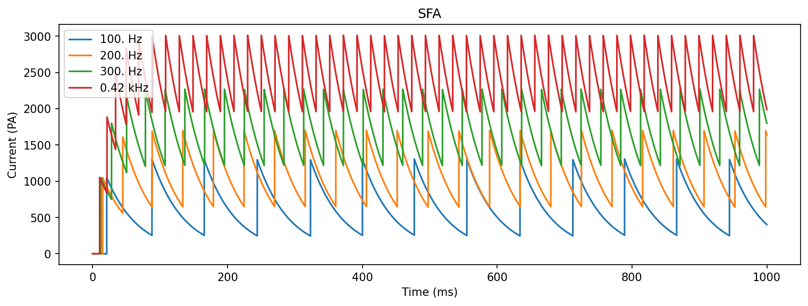
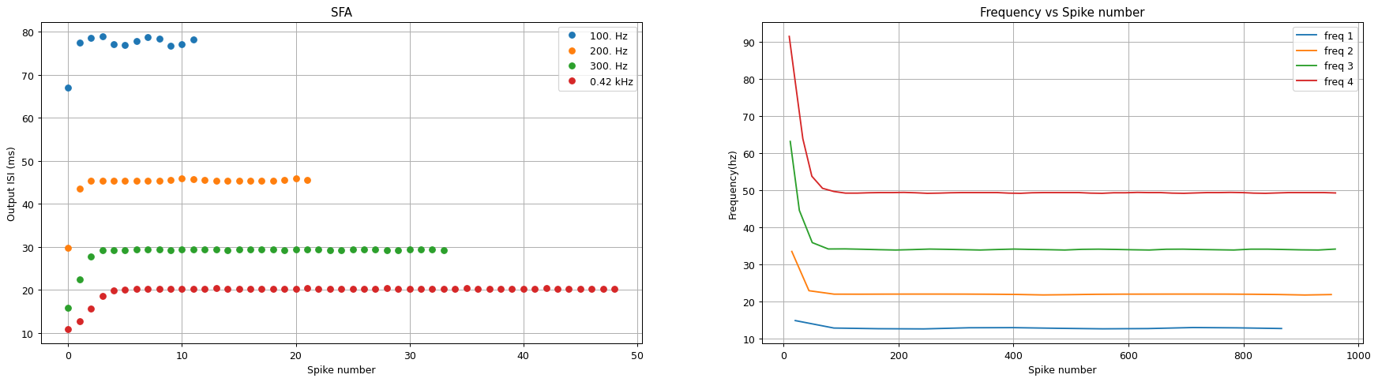
Setting up the simulation from ground up
First, PC neuron Characteristics
Output firing rate 1 = [13.] Hz Output firing rate 2 = [23.] Hz Output firing rate 3 = [35.] Hz Output firing rate 4 = [50.] Hz
Membrane Time Constant= [25.32928065]
Adaptation Time Constant= [47.28132388]
Adaptation of
46.10837438423642
45.901639344262456
34.618755477651206
14.325842696629282
adaptation_conf = {
"Isoma_dpi_tau" : 2.8* pA,
"Isoma_th" : 30 * nA,
"alpha_soma": 4,
"Isoma_ahp_tau": 3 * pA,
"Isoma_ahp_w" : 70 * pA,
"alpha_ahp" : 15,
"soma_refP": 2 * ms,
"Isoma_const": 150 *pA
}
ampa_conf = {"Iampa_tau": 5 * pA,
"alpha_ampa": 4,
"Iampa_w0": 20 * pA}
Long Time Constant
High adaptation ratio (Upward of 40% to 60%)
Fast adaptation (20-60ms)
Low gain 100 to 13hz 1000 to 50hz

Slide 19
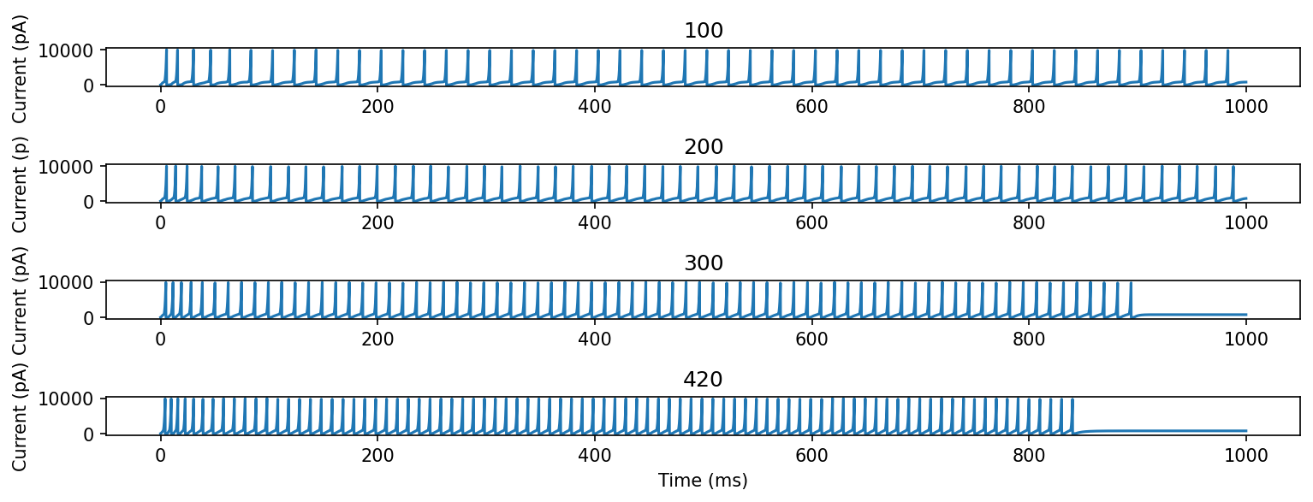
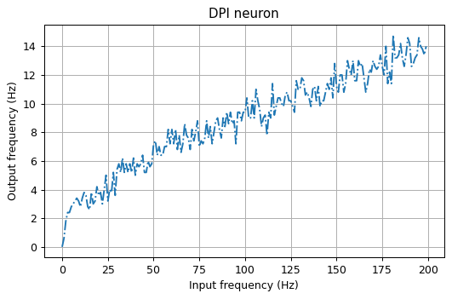
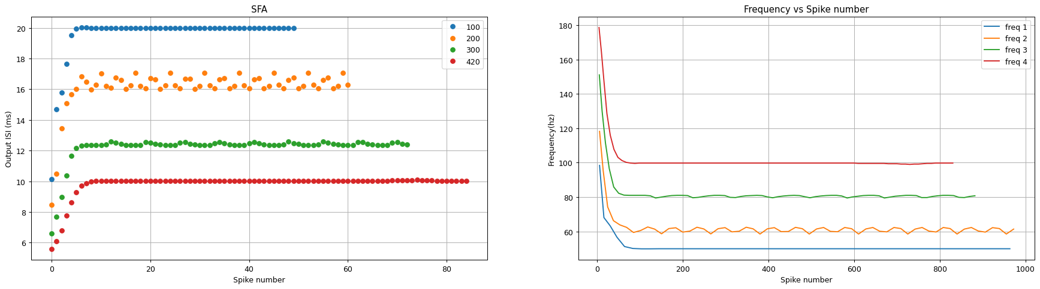
PV Cells now
Adaptation should not occurr

Slide 20
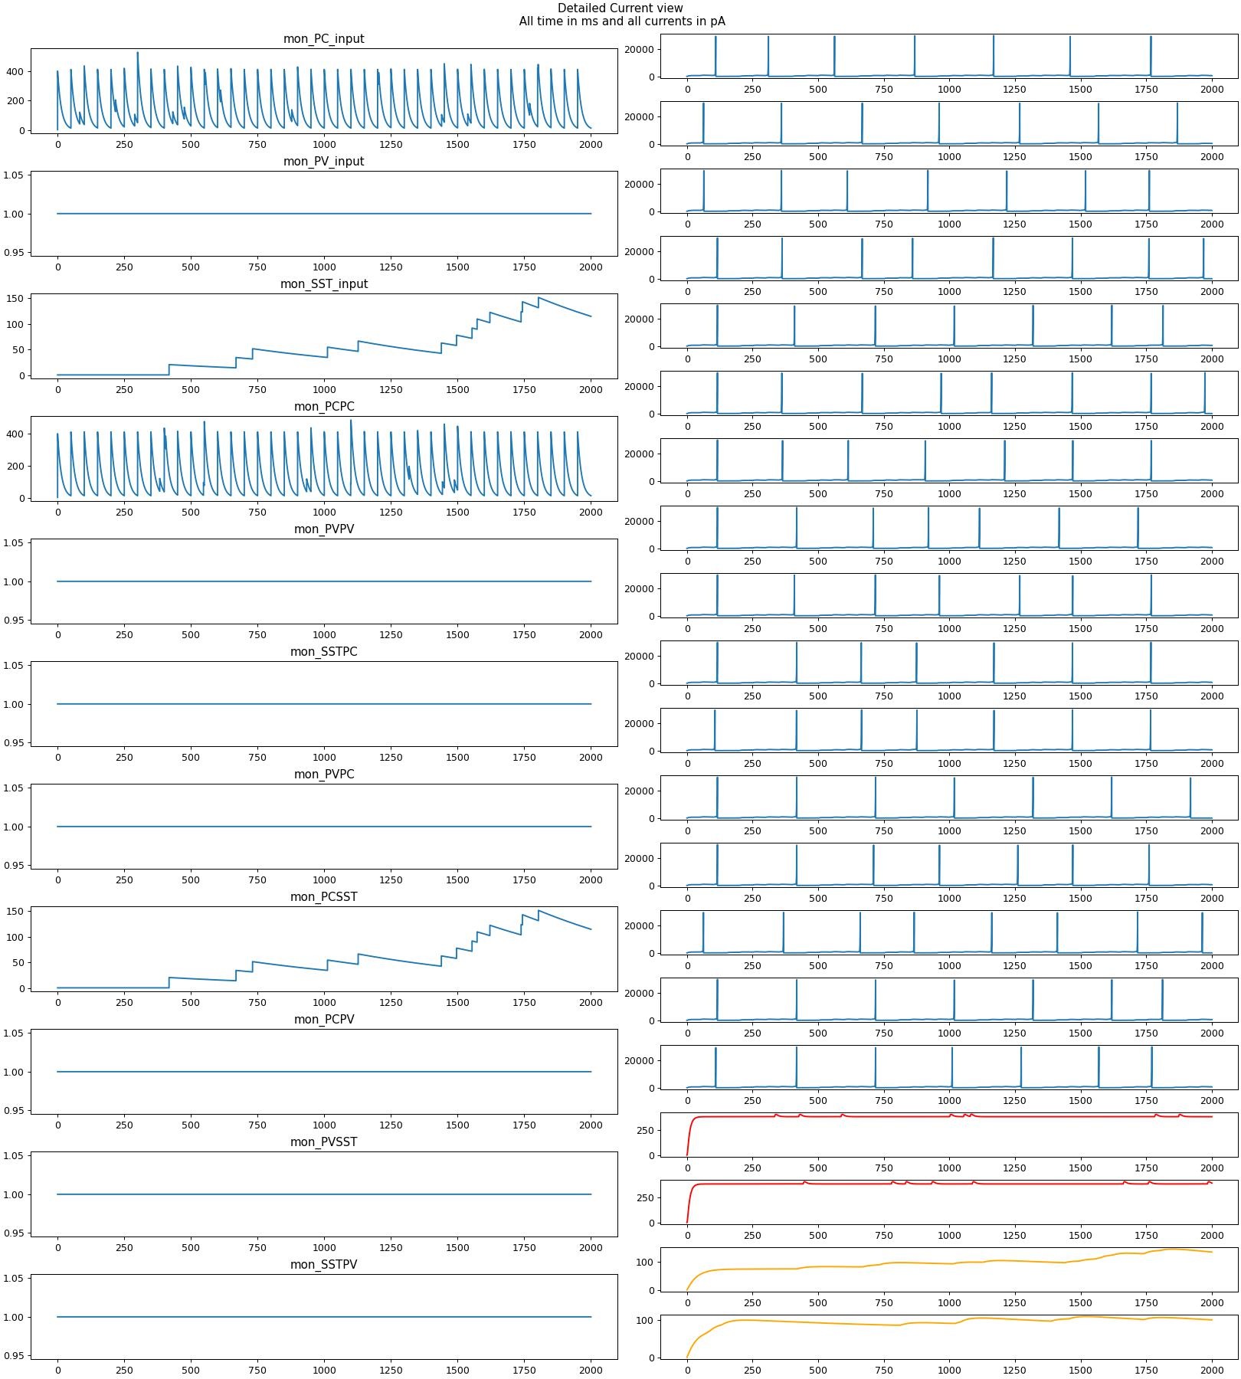
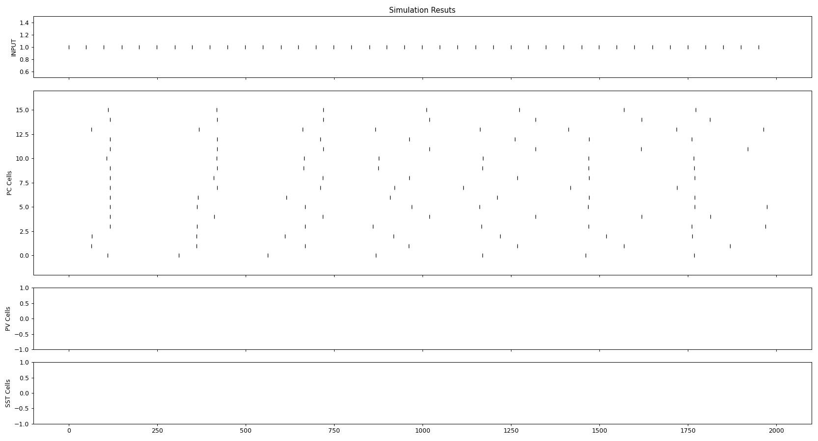
Step 1, just PC
20 hz
No irregularity
No recurrency
Average firing rate in populations PC:3.6 PV: 0 SST: 0
Maximum firing rate in populations PC:4. Hz PV: 0 SST: 0
Cv Squared Values are PC:0.016687296099239787 PV: 100 SST: 100

Slide 21
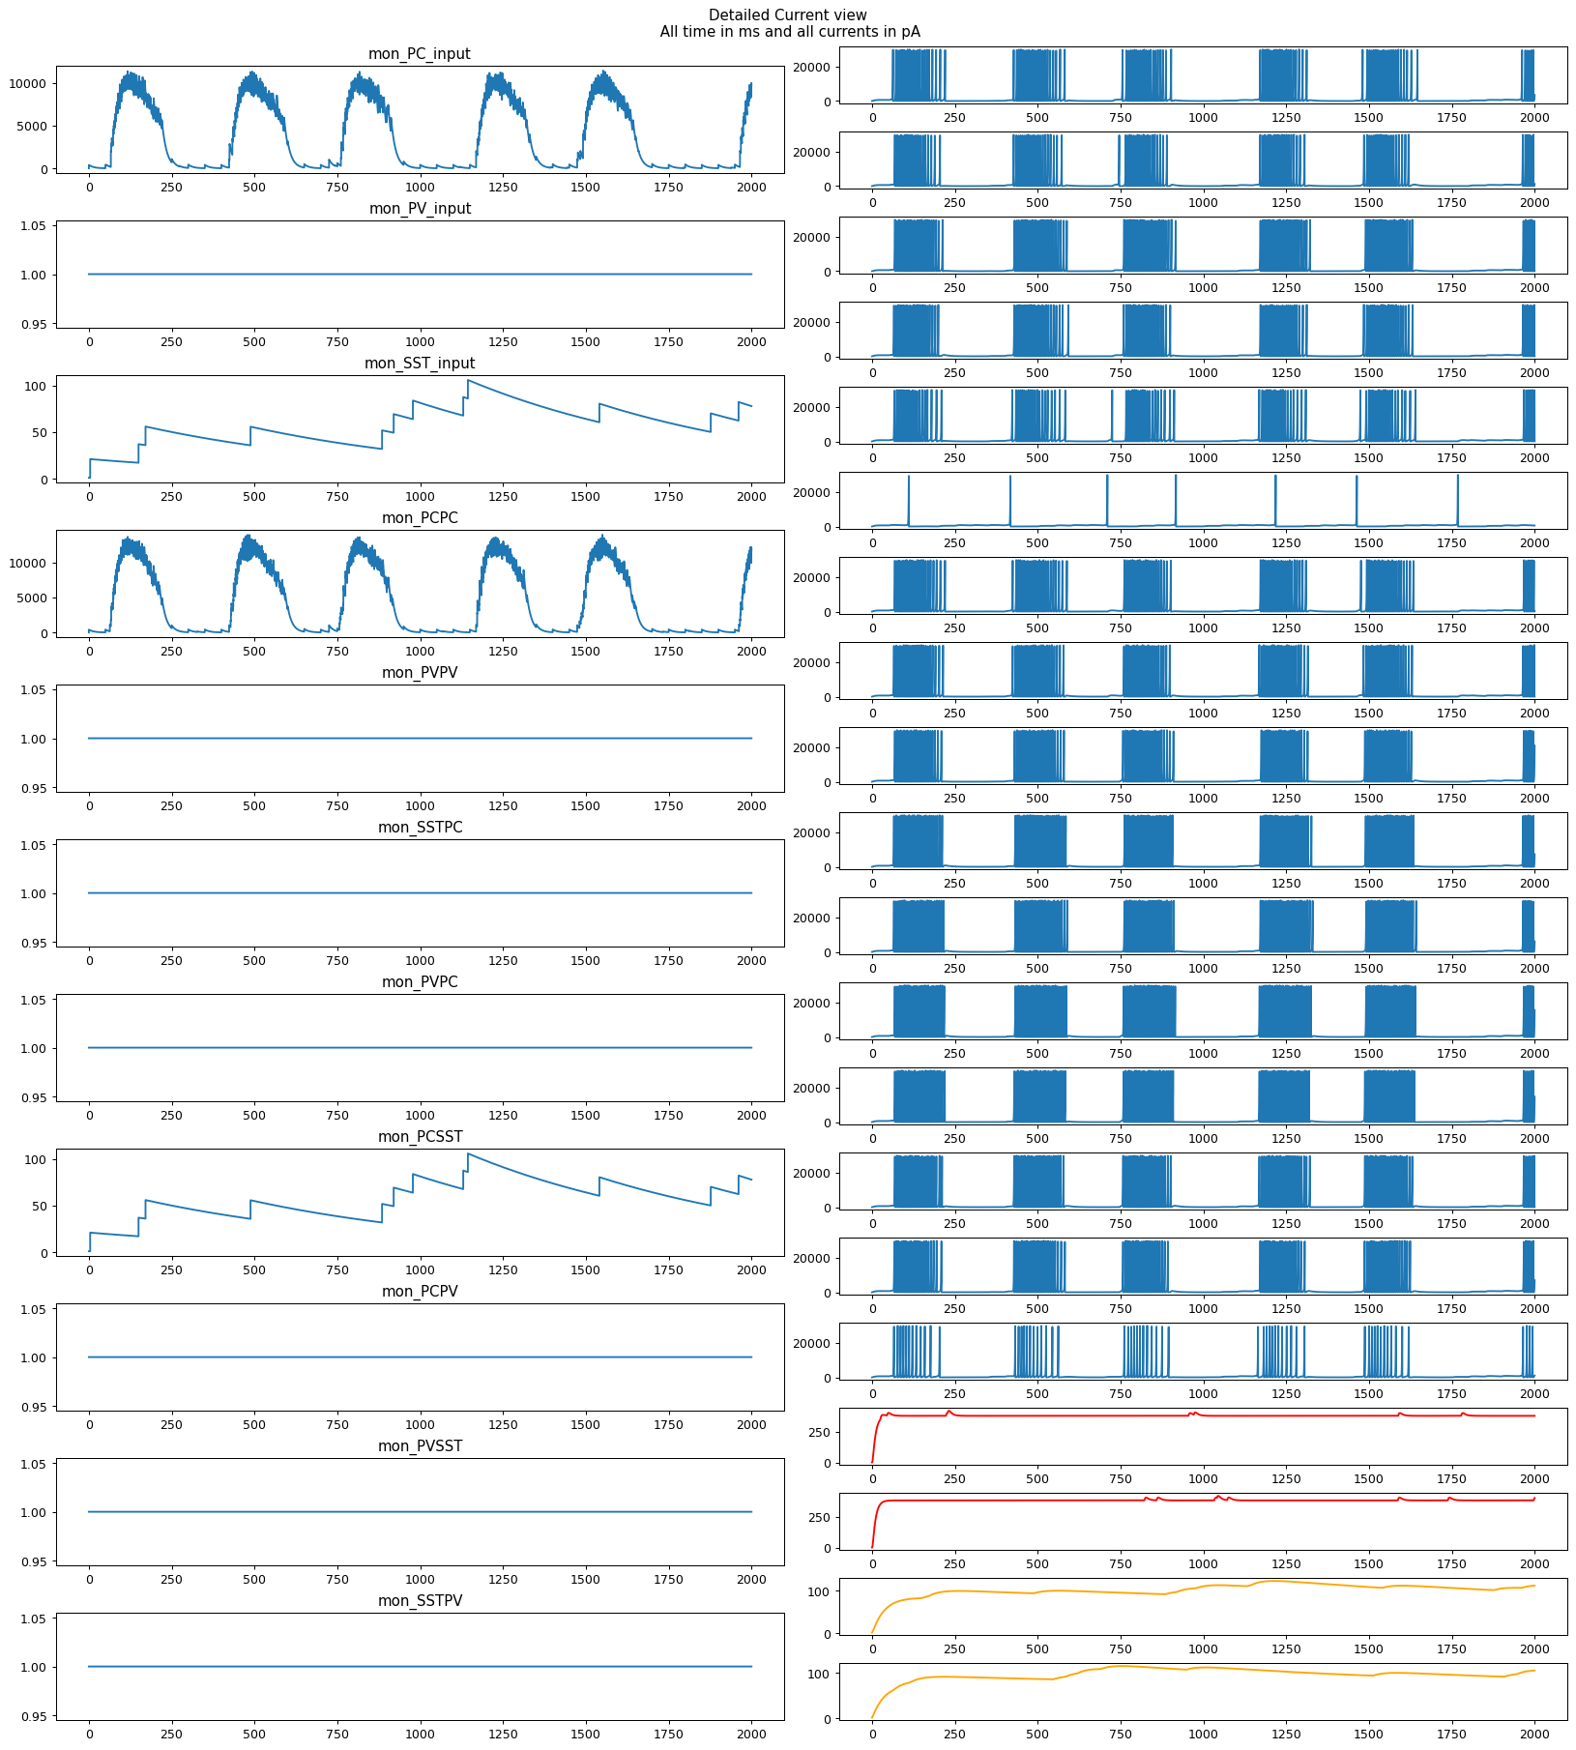
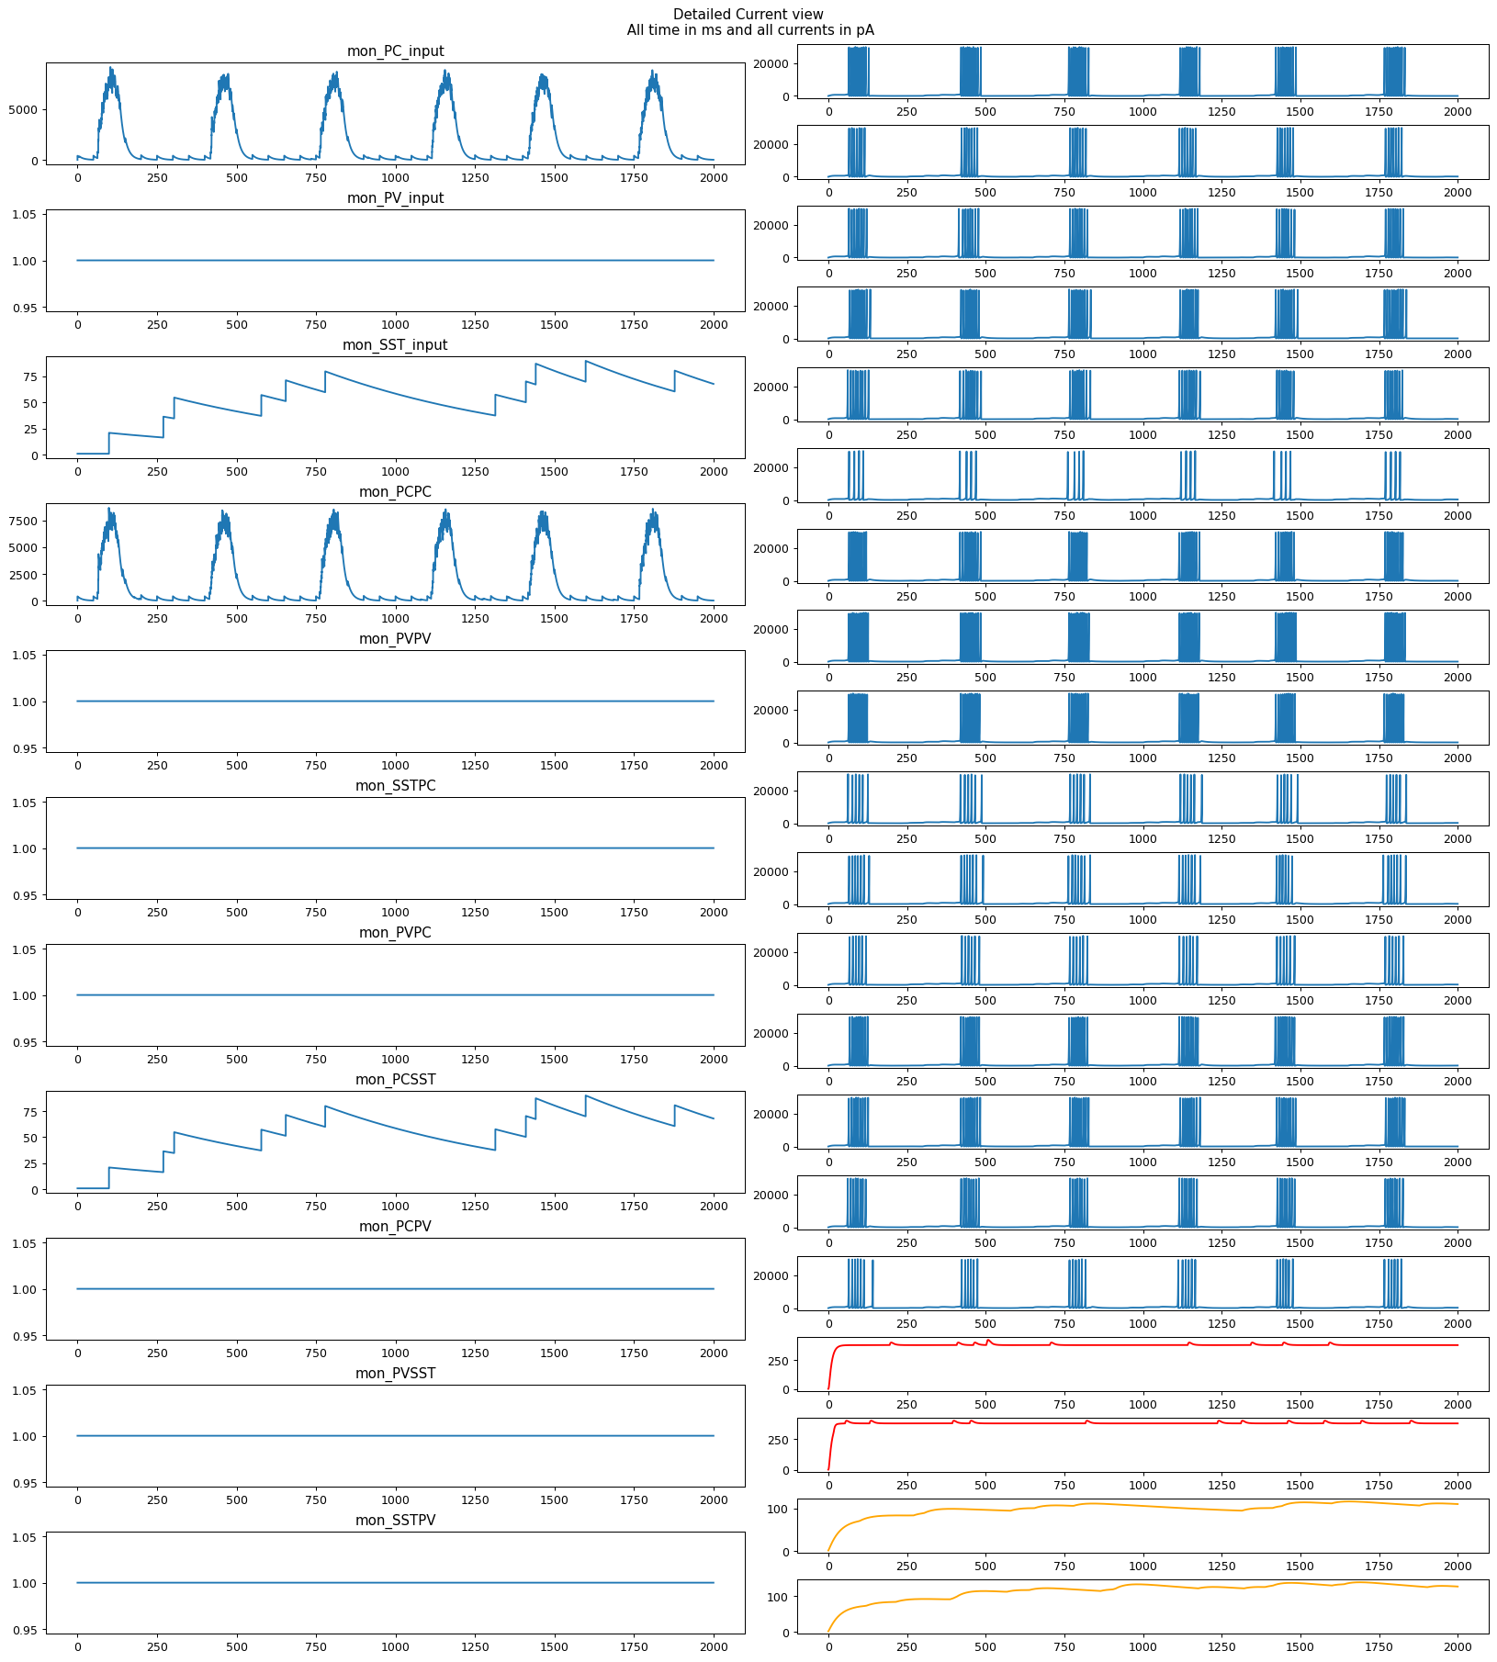
Added Recurrency, burstiness ensued connec prob=.3
w=15
w=10

Slide 22
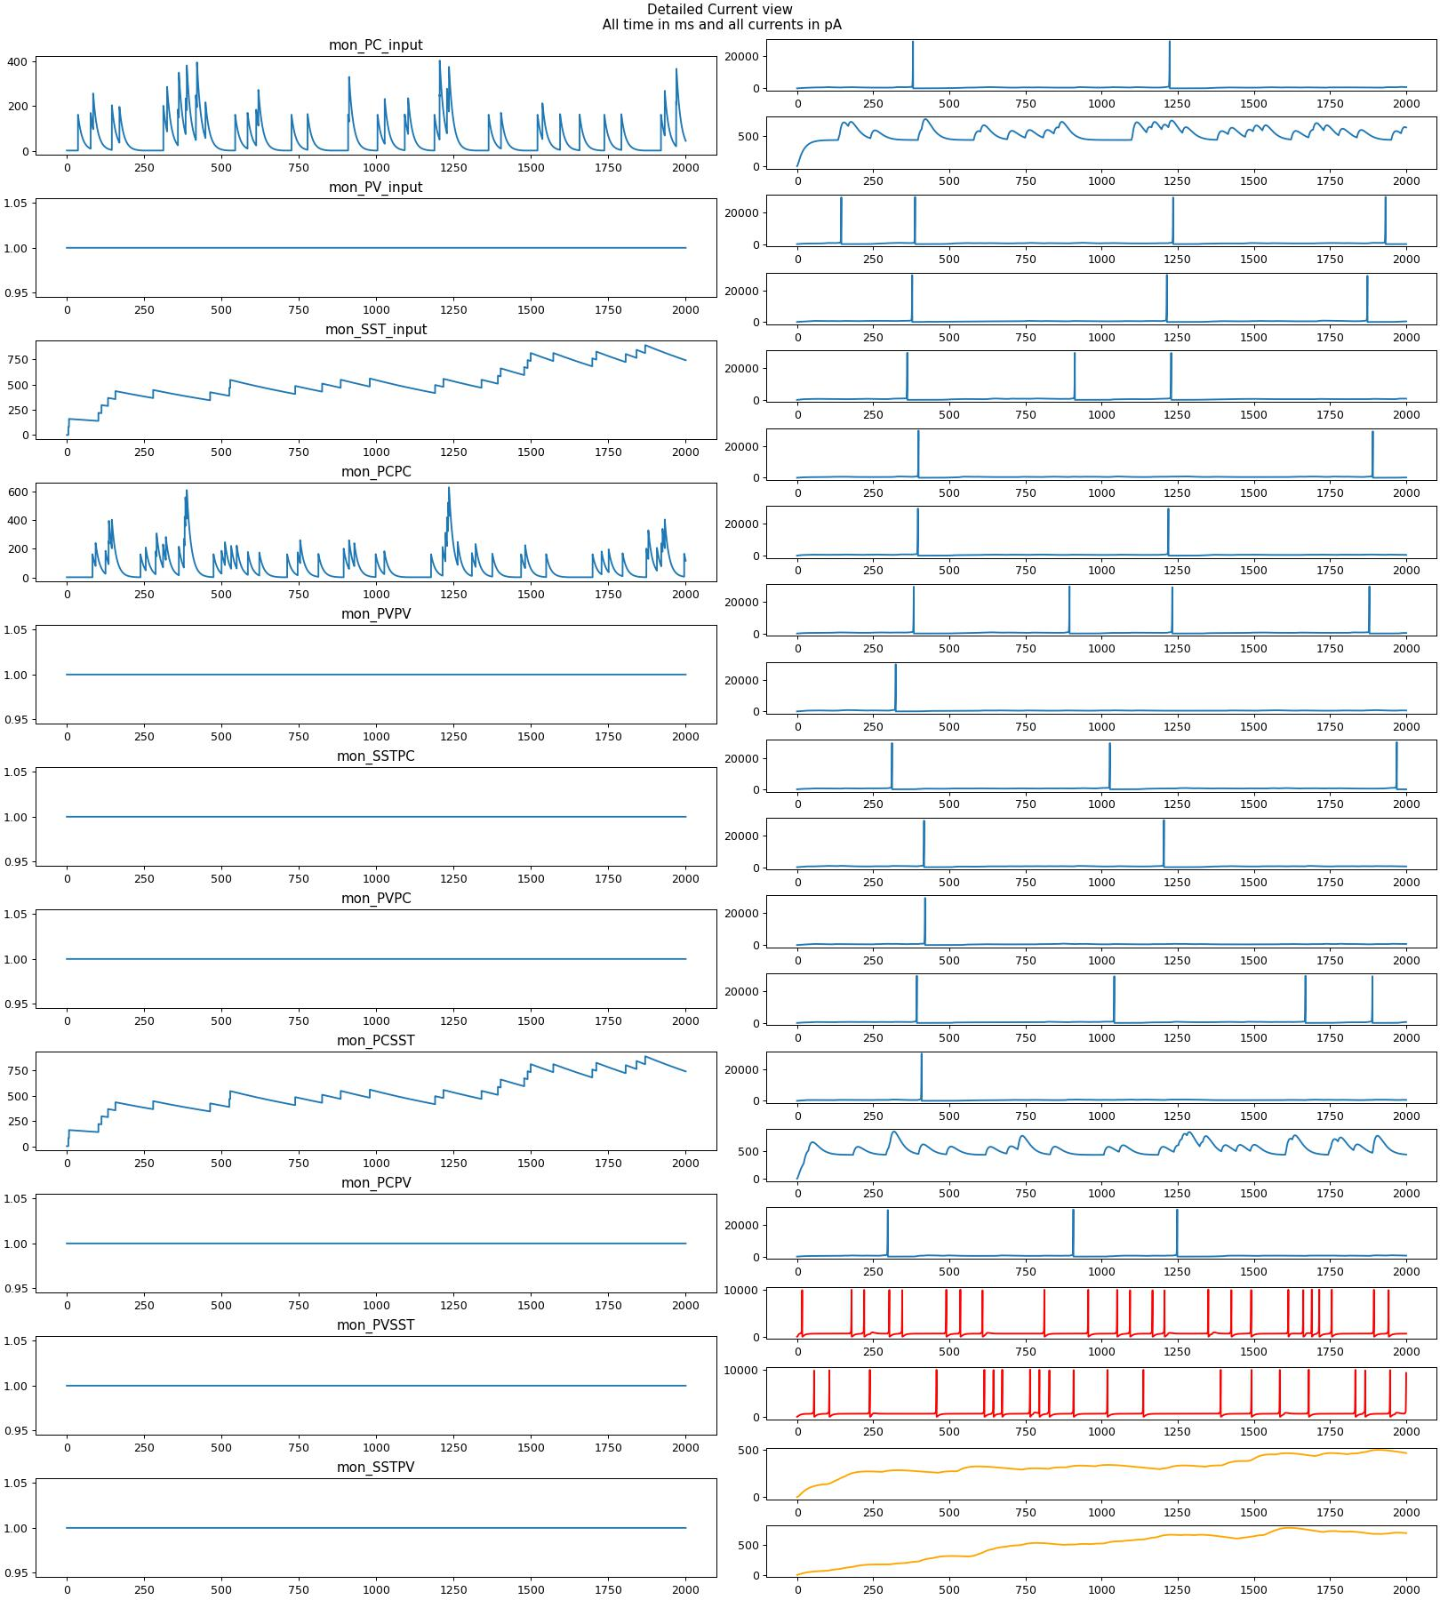
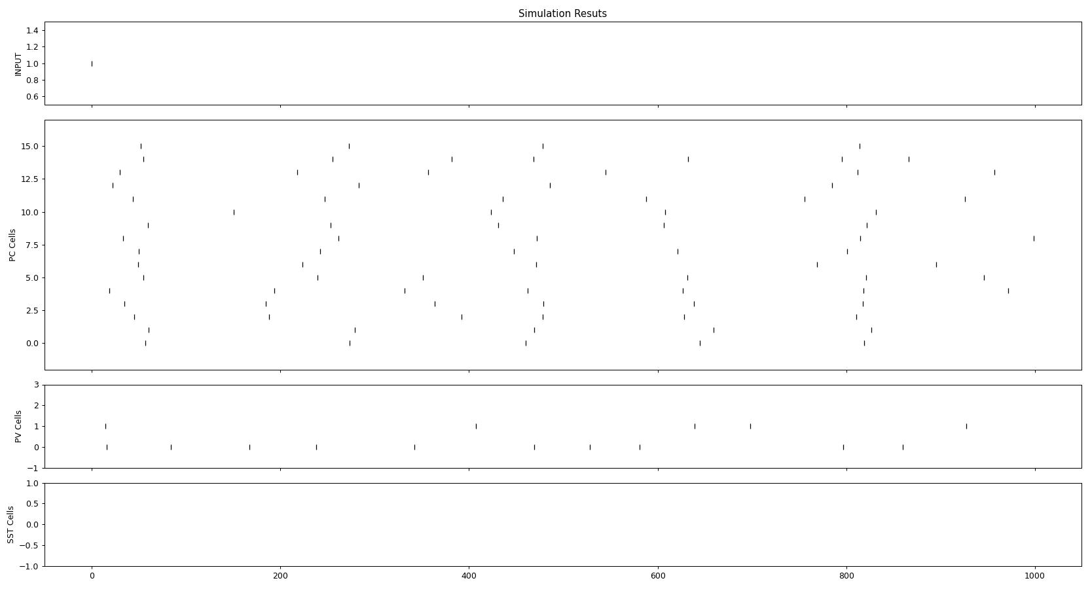
Step 2 Tuned Irregularity
freq 20 and weight 8
No Input No recurrency
SST did not fire in the whole simulation SST has no spikes Average firing rate in populations
PC:2.4 PV: 11.0 SST: 0
Maximum firing rate in populations
PC:5. Hz PV: 11. Hz SST: 0
Cv Squared Values are
PC:0.018805953777693032 PV: 0.3240960228557467 SST: 100
The values are really regular but maybe its ok?, if anything, atleast PV is firing more than PC spontanously

Slide 23
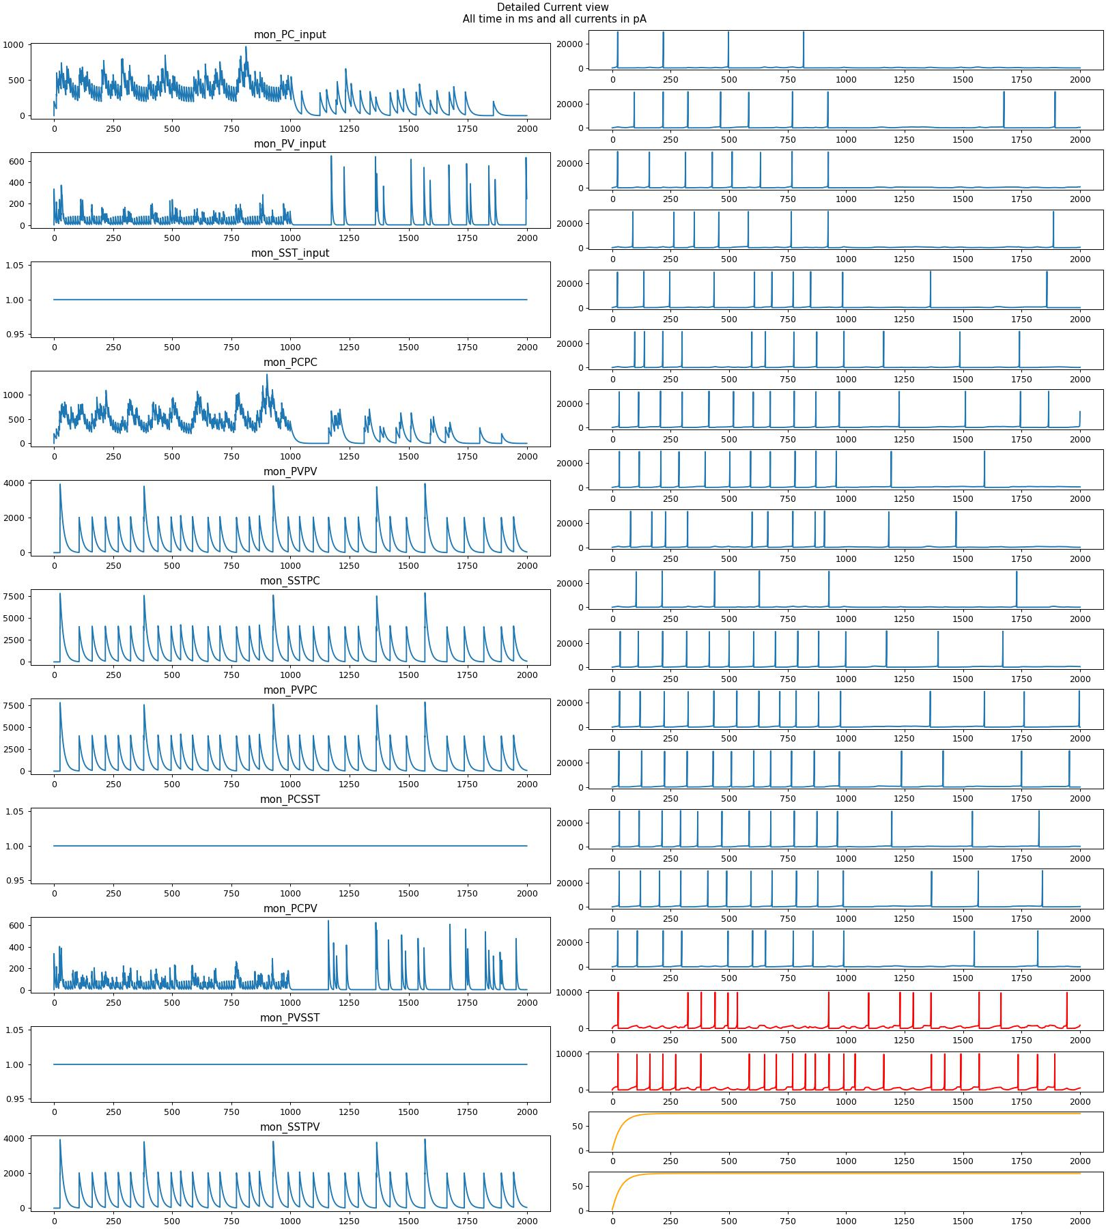
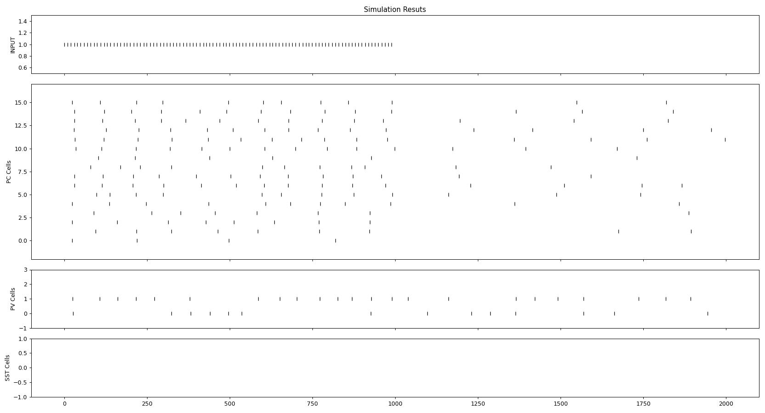
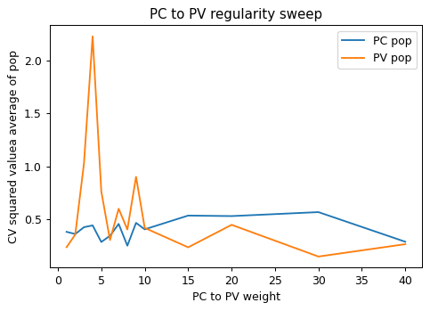
Step 3 EI connected
Input_ 100hz for 1 sec 5 weight PC PV
PVPC and PCPV weight, start at 10 then sweep
CV squared values where ok but we can do better
SST did not fire in the whole simulation
SST has no spikes
Average firing rate in populations PC:5.63 PV: 7.0 SST: 0
Maximum firing rate in populations PC:7.5 Hz PV: 7. Hz SST: 0
Cv Squared Values are PC:0.45285838147728574 PV: 0.428884904394091 SST: 100

Slide 24
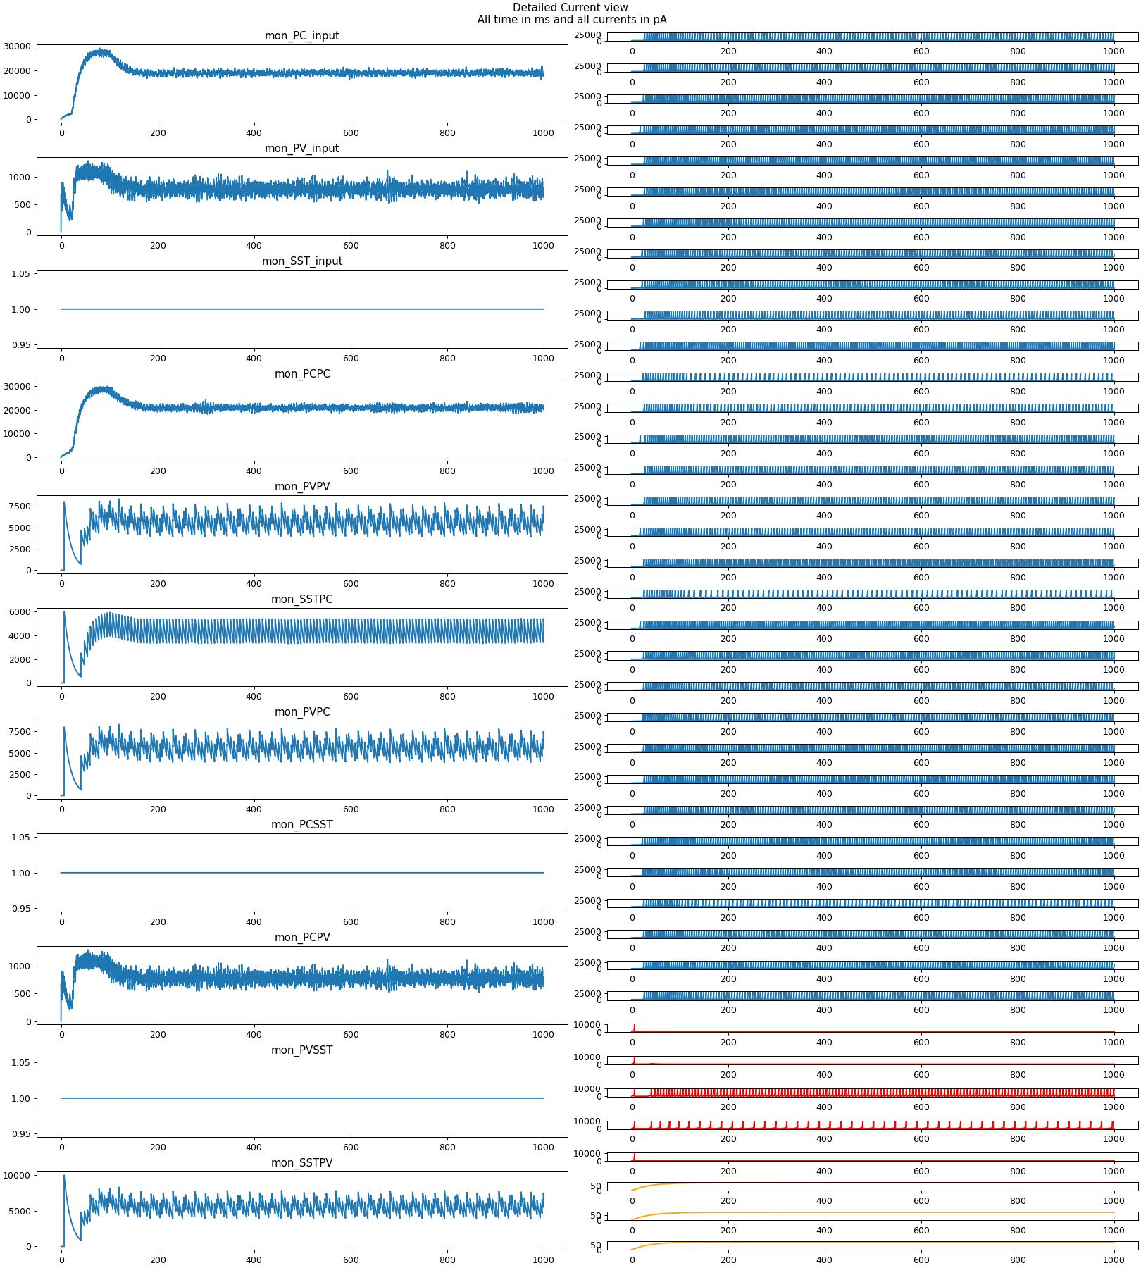
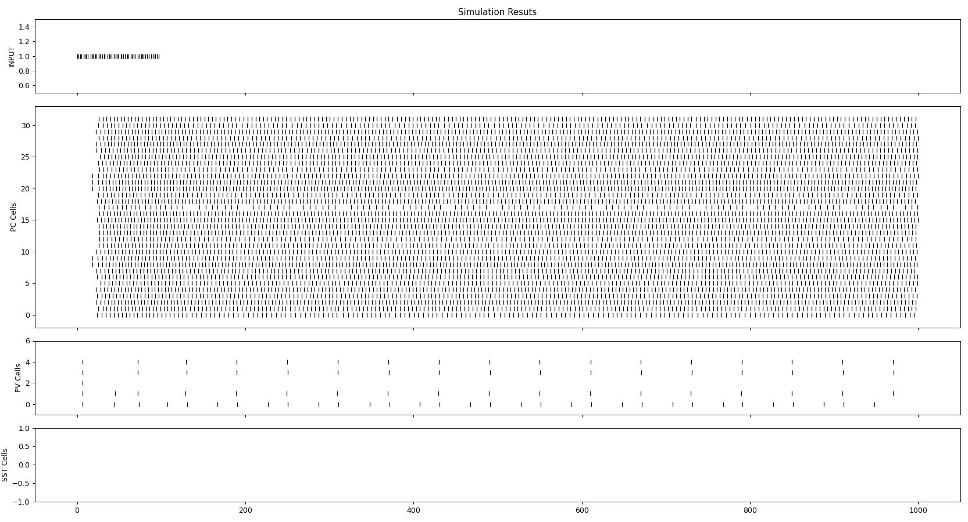
Parameter sweep
At first we got nothing sad
Increased connection probabilities to .6 from .4 and .3 in between PVPC and PCPV
And PC PC to 20
Moved Number of neurons to 40 baseline
Input weight from 5 to

Slide 26
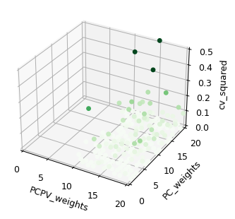
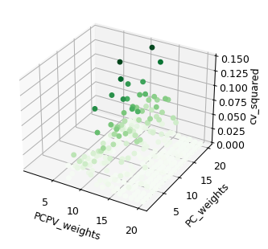

Slide 27
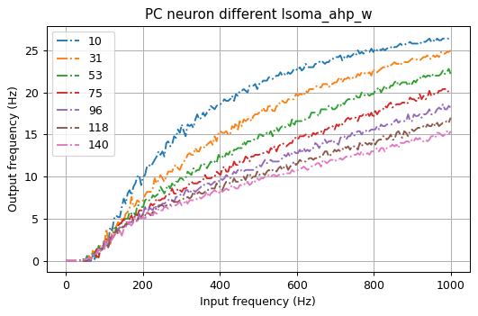
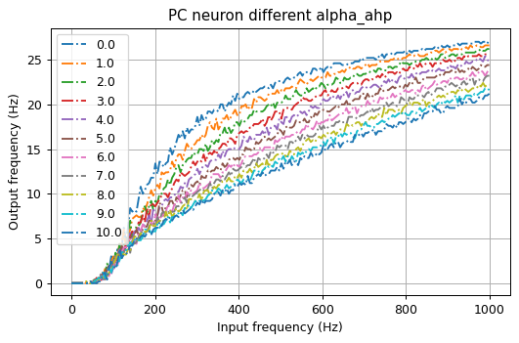
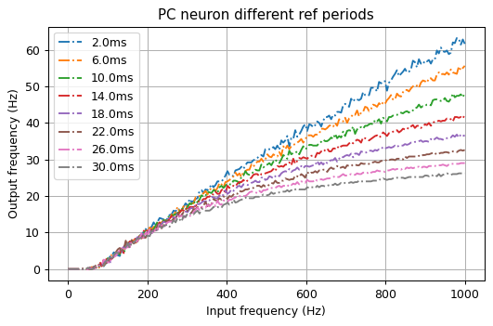
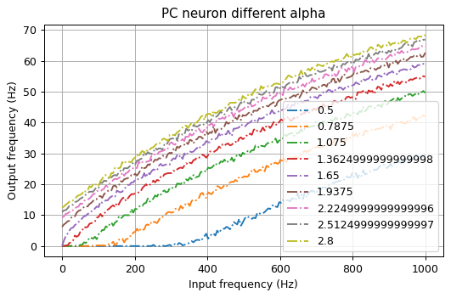
FF Simulations-PC
From Baseline Parameters:
adaptation_conf = {
"Isoma_dpi_tau" : 2.8* pA,
"Isoma_th" : 200*pA,
"alpha_soma": 1,
"Isoma_ahp_tau": 3 * pA,
"Isoma_ahp_w" : 70 * pA,
"alpha_ahp" : 2,
"soma_refP": 10 * ms,
"Isoma_const": 150 *pA }

Slide 28
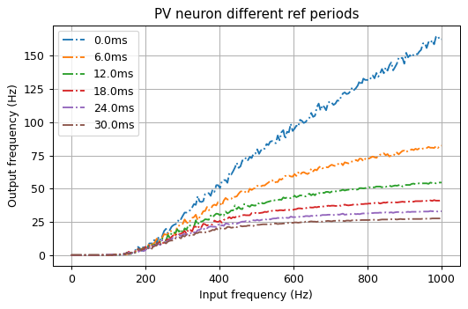
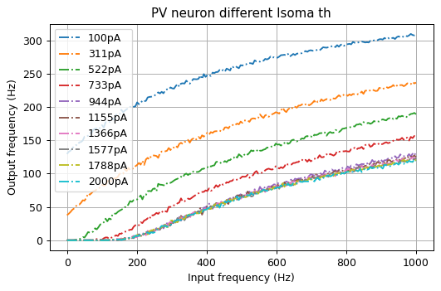
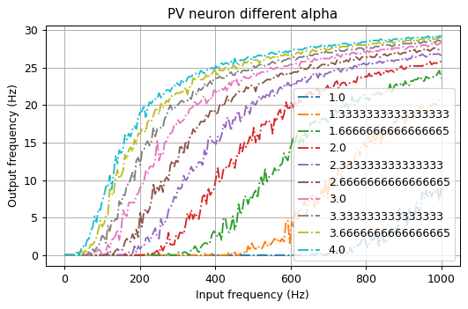
FF Simulations-PV
From Baseline Parameters:
adaptation_conf = {
"Isoma_dpi_tau" : 7.5* pA,
"Isoma_th" : 3* nA,
"alpha_soma": 2.7,
"Isoma_ahp_tau": 0 * pA,
"Isoma_ahp_w" : 0 * pA,
"alpha_ahp" : 1,
"soma_refP": 2.5 * ms,
"Isoma_const": 150 *pA
}

Slide 29
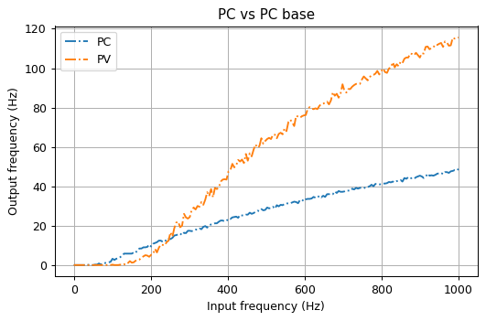
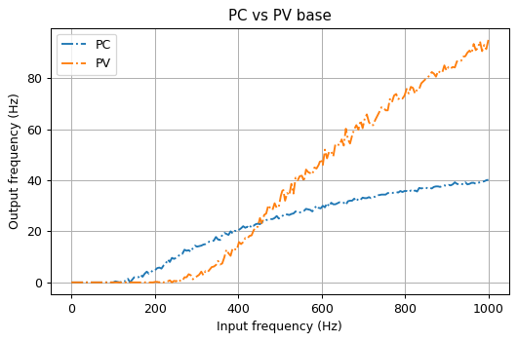
FF final results
From previous 2 tunings
Tuning to make intersection point further along PC

