Slide 1
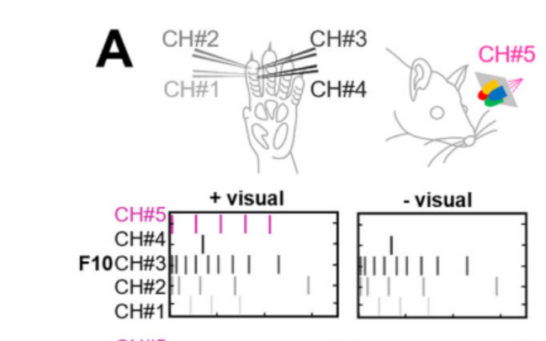
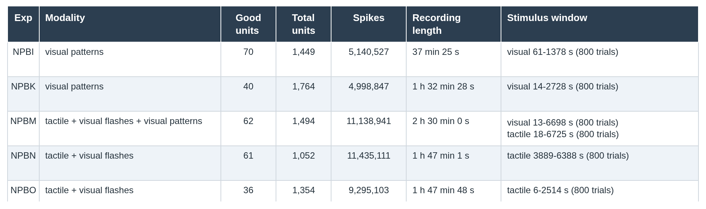
Neuro Pixel Tactile and Visual Experiments
Dataset Descrition
Tactile Stimulation
Visual Stimulation
Cortex Integrates information from all modalities even in specialiced areas (S1)
How does visual activity affect tactile representations?
We can explore this through nueropixel recordisngs with mixed modulation of tactile and visual stimulus
5 Sprague Dawley Rats
  anesthetized
4 tacitle patterns
4 visual patterns
S1 forepaw cortex
K2.5 Manual curation by Phy

Slide 2
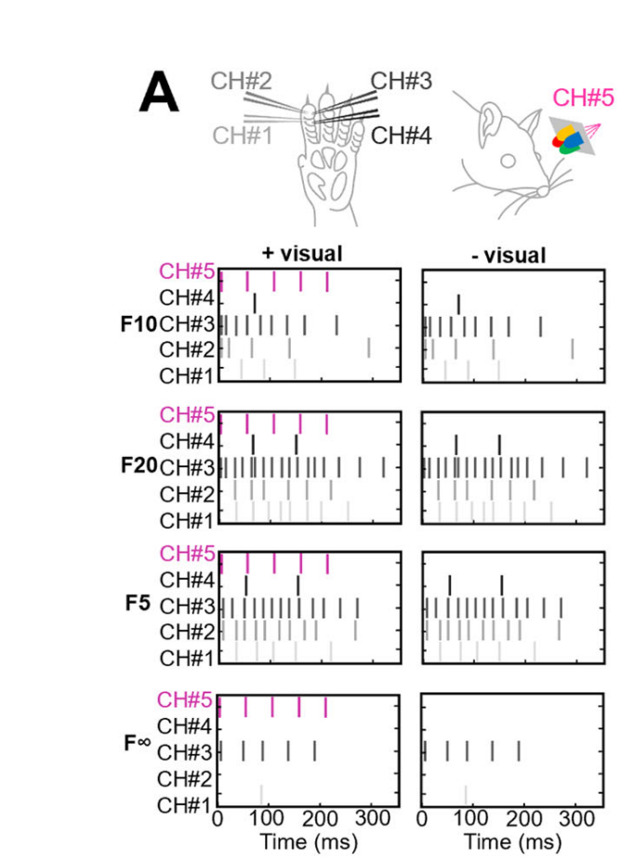
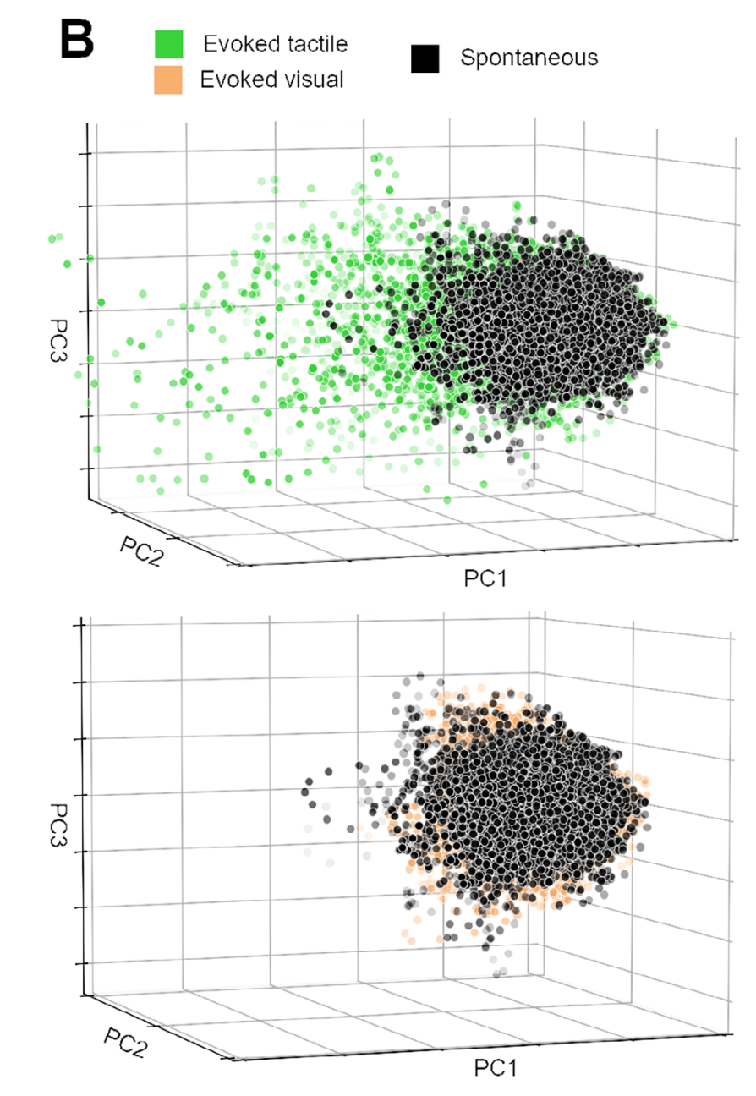
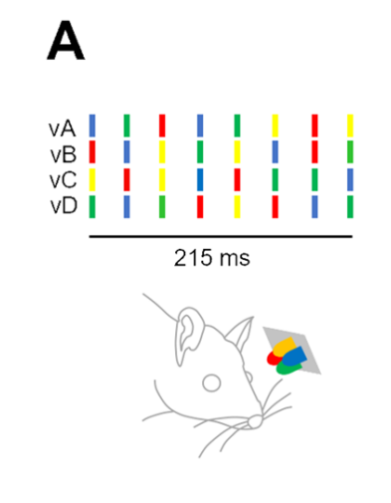
What the stimuli actually are
TOUCH = 0.5 mA electrical pulses through four pairs of needles in the forepaw skin. LIGHT = four coloured LEDs by the eye; vA to vD differ only in the order the colours flash.

Slide 3
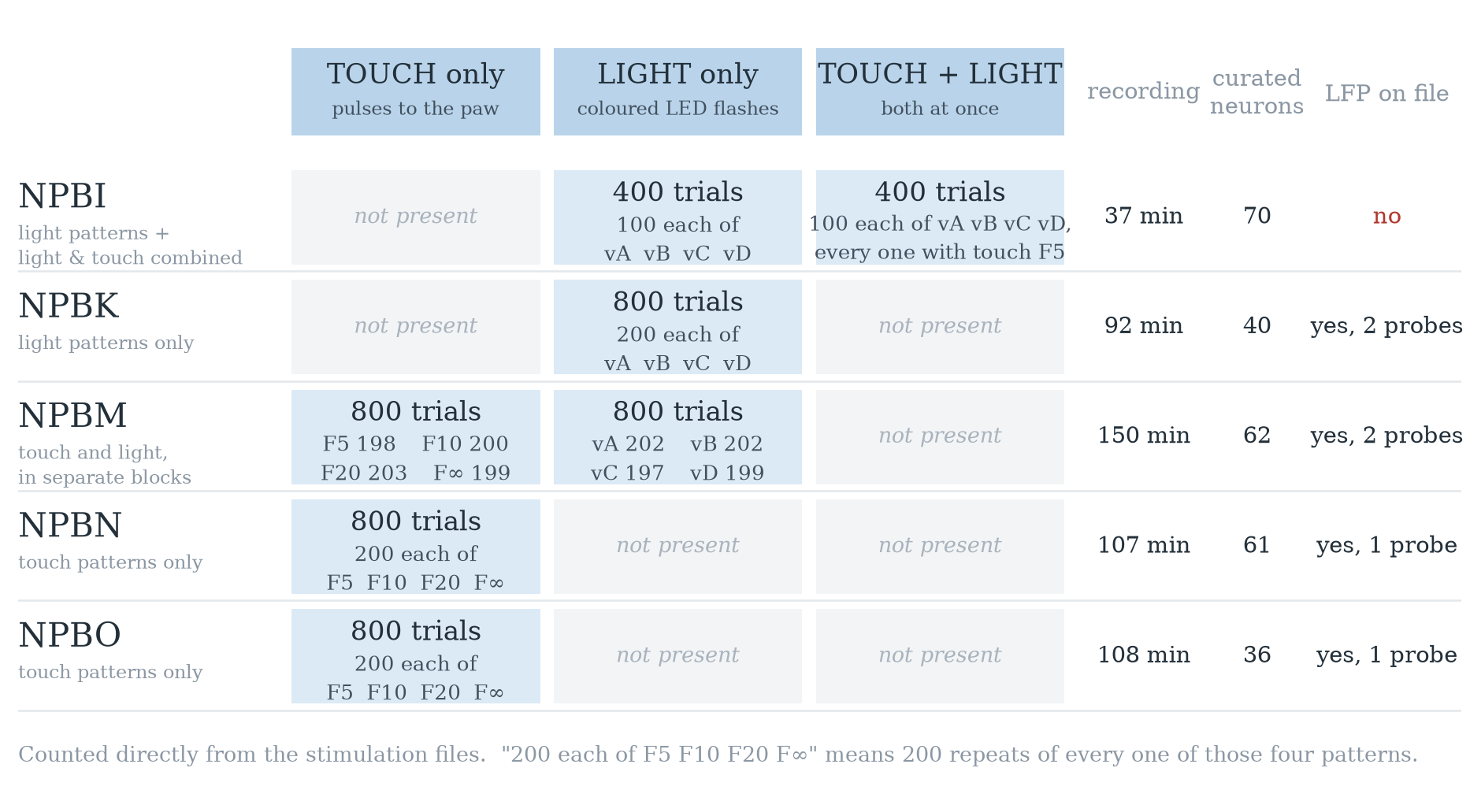
What is in each of the five datasets?

Slide 4
Three things we can do with this data
HOW COMPLEX IS THE ACTIVITY, REALLY?
  Counting PCA axes up to 95% of the variance gives a big number even for pure noise, so on its own it proves nothing. Participation ratio answers it properly.
  Use any experiment. NPBN (61 neurons) and NPBM (62) match the neuron counts the paper quote
DOES THE DECODER REALLY WORK?
  They smoothed over 10 ms, then split single 1 ms samples at random, so near-identical samples of one trial landed in both training and test. Split whole trials instead.
  Use NPBN, NPBO or NPBM for touch, NPBK for light — each has 4 patterns with about 200 repeats.
IS THE LATE "MEMORY" REAL? Their effect is small (F1 0.318 against a 0.303 baseline). The previous trial is only 1.8 s back, and brain state drifts over an hour — either could fake it.
  Use the long recordings — NPBM (150 min), NPBO (108 min), NPBN (107 min).

