Slide 1

A powerpoint presentation
on
Mini Project
Presented by :
Arambh Jha
MCA 1739009

Slide 2

WeatherLive
an android weather app

Slide 3
Introduction
“WeatherLive” is an android weather application which provides the current weather information of the given location.
The location can be either custom defined or the current location can be detected.
Some of the key features include:
allows people to check out the weather in multiple cities worldwide
weather data is dynamic
The mobile app not only show the weather, condition and temperature, but it also uses various icons to represent the weather accordingly
Users can find the information they want in a short time and limited clicks

Slide 4
Requirements
Client:
Operating System – Android
Version - Android Version 4.4+ ( KitKat)
GPS – Yes
Internet Connectivity – Yes
RAM – 1 GB
Developer:
Operating System – Any
IDE – Android Studio / Eclipse
Internet Connectivity - Yes
GPS – Yes
RAM – 4 GB
*Above specifications are mentioned for smooth running of the application

Slide 5
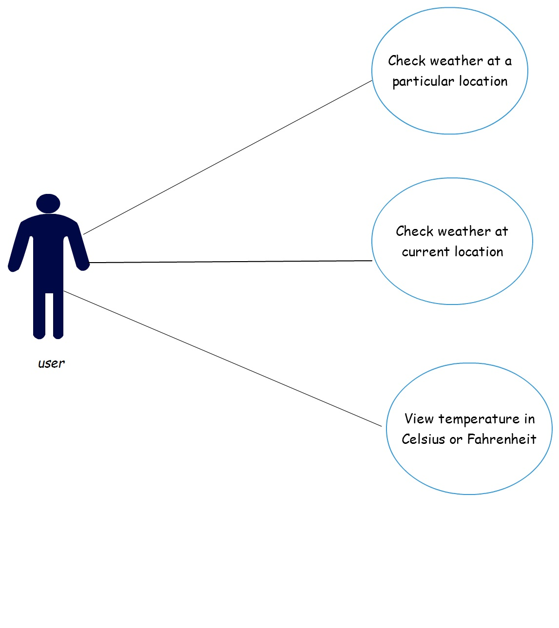
Use Case Diagram

Slide 6
Working
This application has 4 main modules:
Splash Screen : This is the first screen of the application.
Custom Location UI : Here the user has two options, he can input any desired location or he can track his current location.
Current Location UI : Here the system tracks the user’s current location.
Weather Report Screen : The weather report for the entered location is displayed and the user can view the temperature is C or F units.

Slide 7
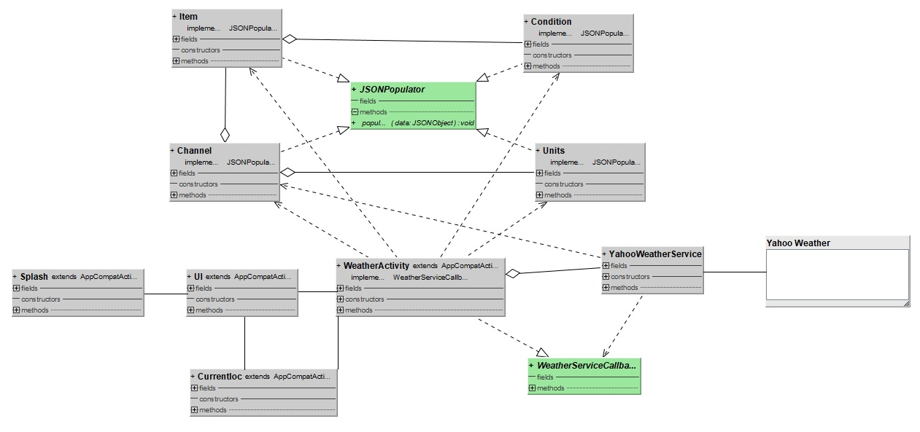
Class Diagram

Slide 8
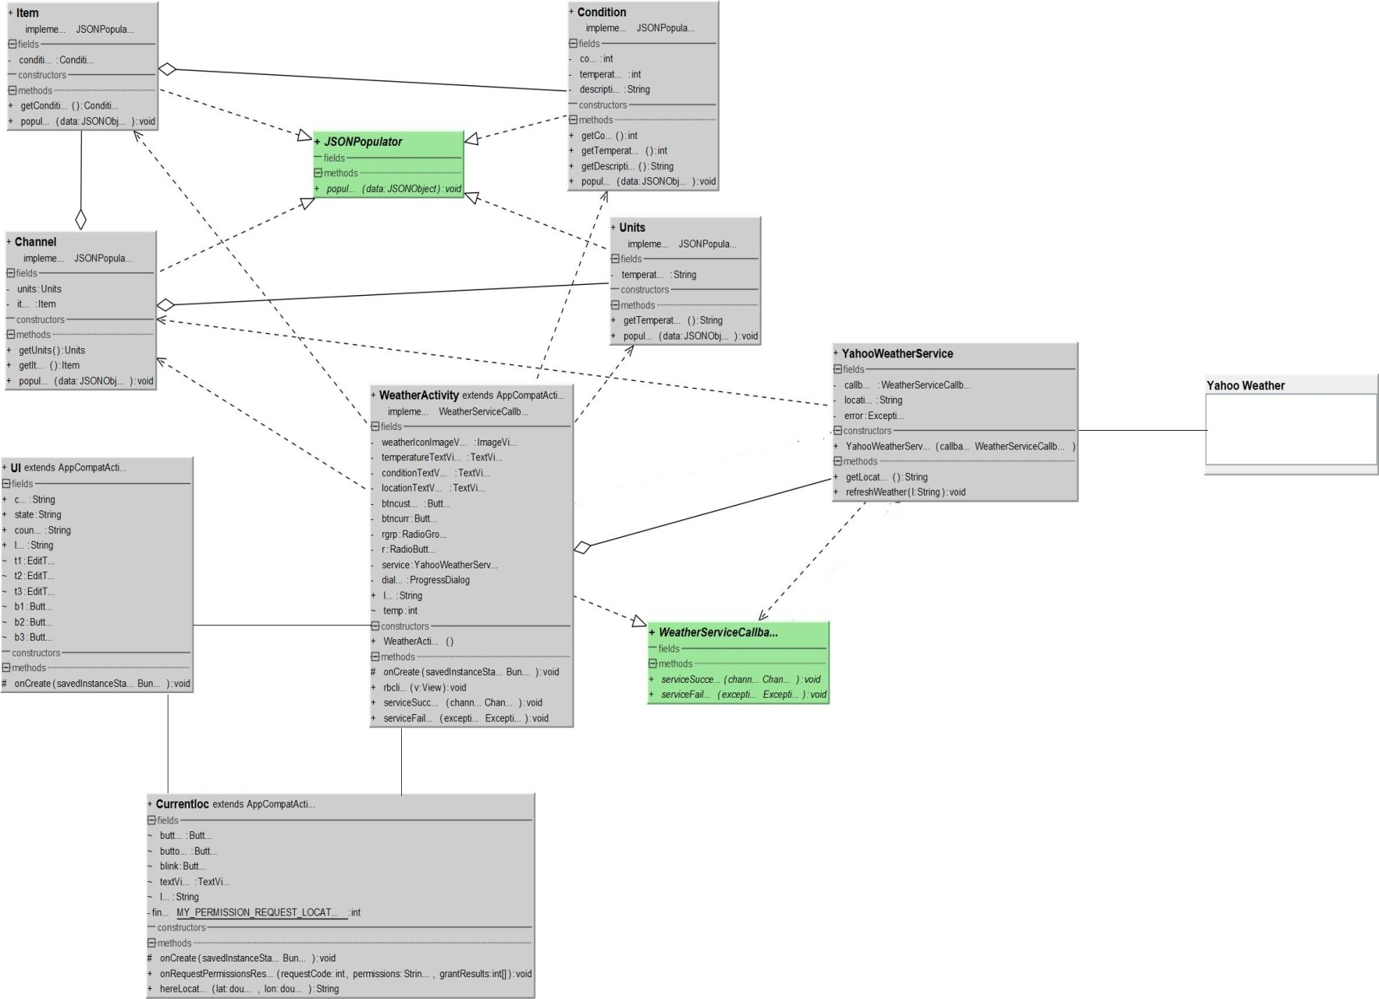
Class Diagram( elaborated)

Slide 9
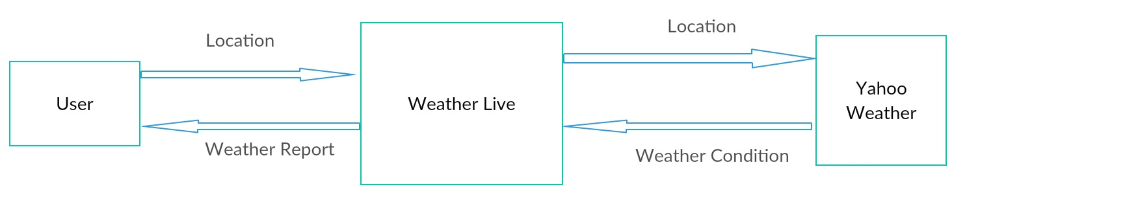
Data Flow Diagram
DFD Level 0

Slide 10
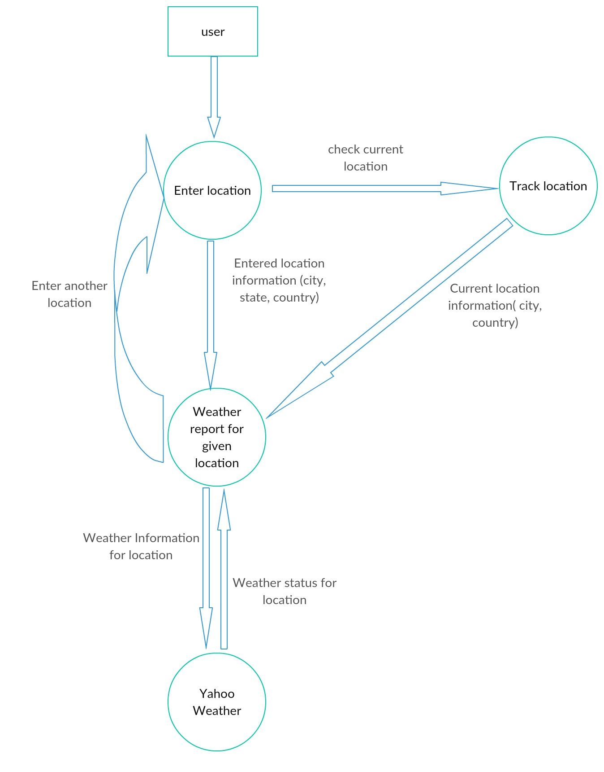
Data Flow Diagram
DFD Level 1

Slide 11
Summary
So at last I want to conclude that this application WeatherLive is free and gives the exact weather information for the entered location information and is very accurate. The location can be from anywhere around the world and he or she can even check his current location. It has easy to use and the work is done with minimal clicks.

Slide 12
Future Enchancement
Here are some of the things that will be added to this project in the near future :-
AutoFill of locations will be implemented using services like Google Places, eliminating the chances of incorrect input
Location search history of user will be saved
More weather information and forecast will be added

Slide 13
References
Application Development :
Google https://www.google.com/
YouTube https://www.youtube.com/
Udemy https://www.udemy.com/
StackOverflow https://stackoverflow.com/
Github https://github.com/
Documentation :
Creatly https://creately.com/

Slide 14
THANK YOU!

