Slide 1



Linear regressions
1

Slide 2
We are trying to find a rule that can be used to describe some data with other data.
Apartment price ~ area, city, district, availability of subway
Disease intensity ~ BMI, cholesterol, other tests

Slide 3
Sales ~ marketing spend, website traffic , state of the economy (total consumption)
Average GPA ~ study time, additional classes, socioeconomic status
Crime ~ budget for the Ministry of Internal Affairs, demography, poverty, immigration

Slide 4
Harvest ~ type of agriculture, assessment of soil quality, weather, import of fertilizers
Life Expectancy ~ GDP, Medical Spending, Happiness Index, Hours Worked, Obesity Index

Slide 5
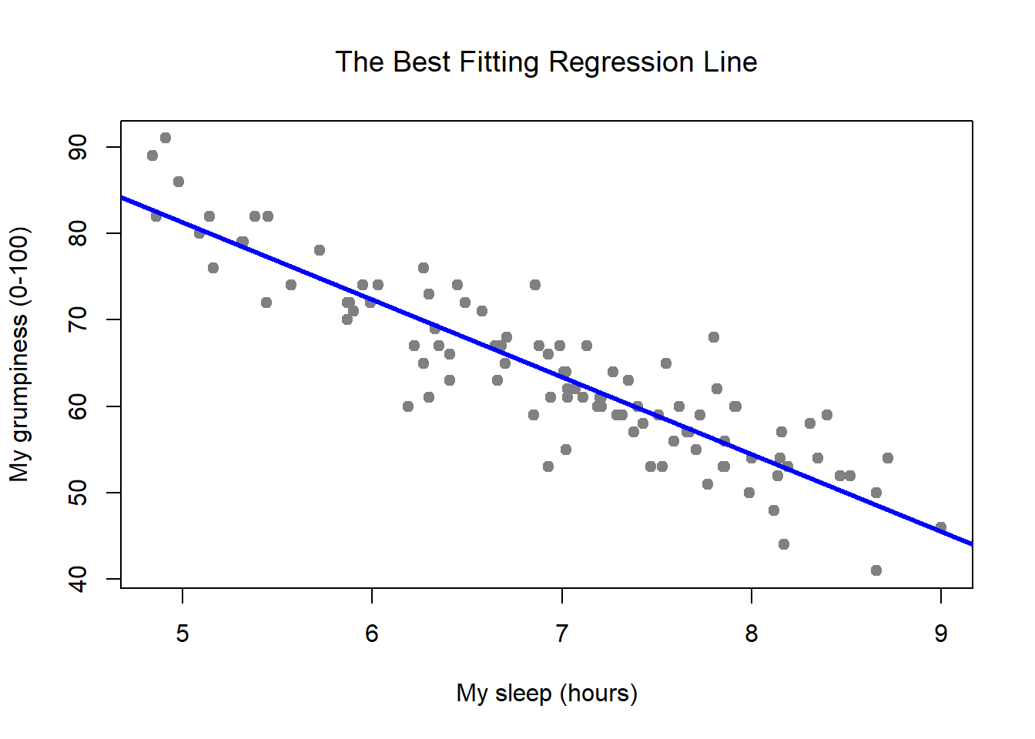
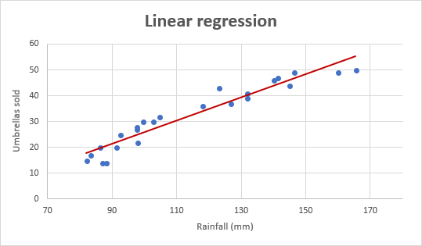

Slide 6
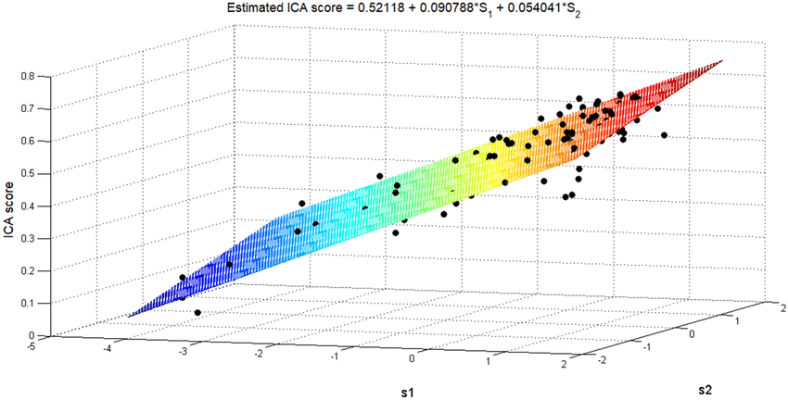

Slide 7
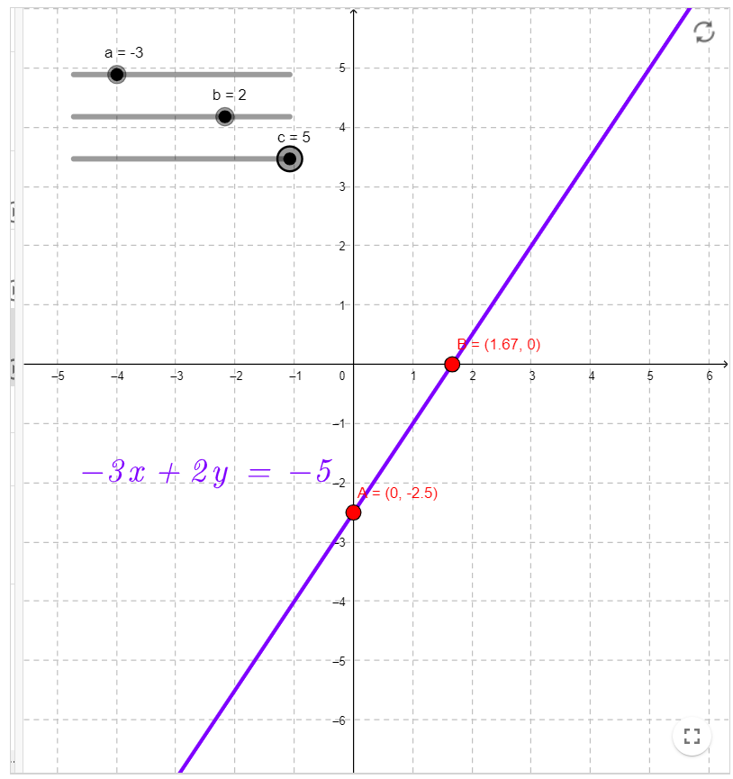
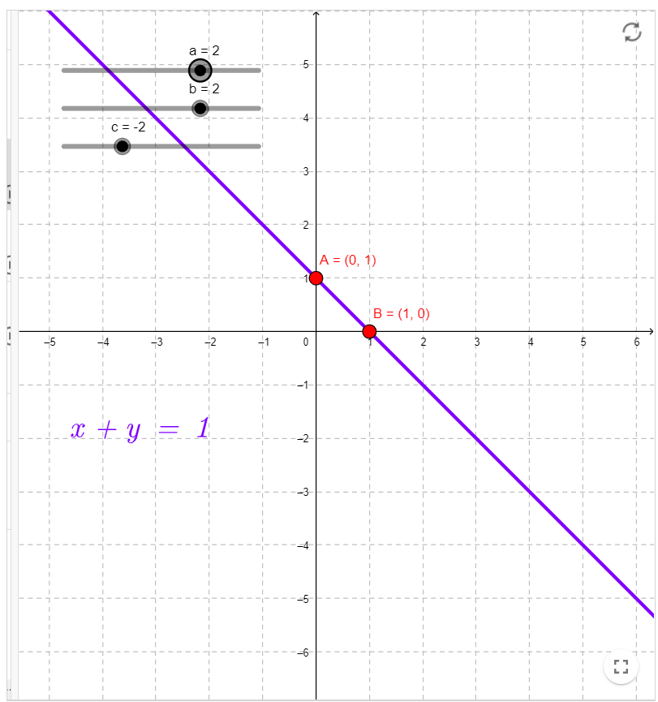
We talk a lot about the line, but how is it set?

Slide 8

$$ax+by+c=0$$
$$\frac{a}{b}x+y=\frac{−c}{b}$$
$$y=kx+b$$

Slide 9
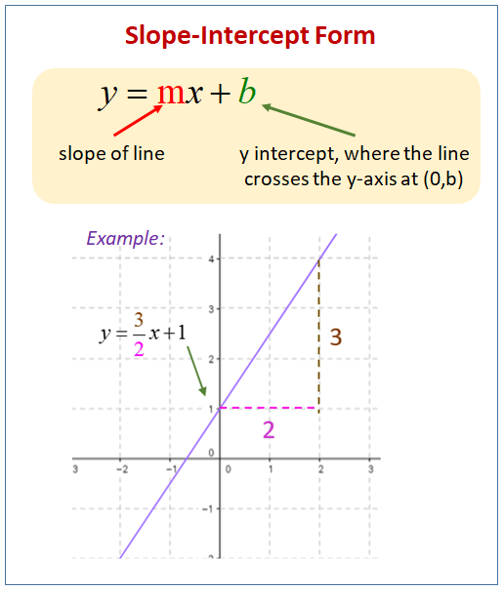

Slide 10
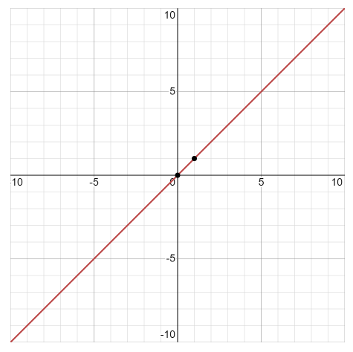
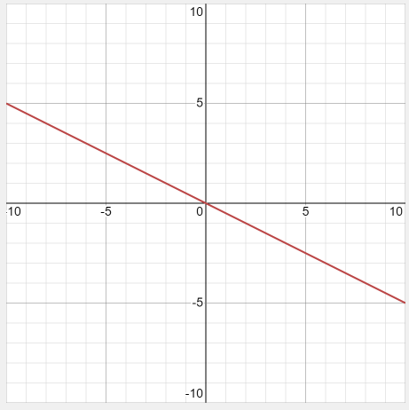
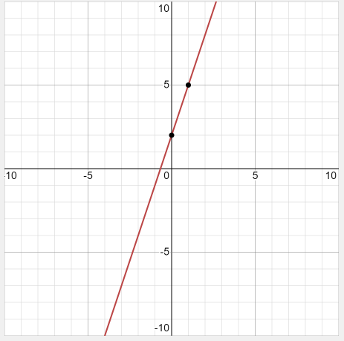



$$y=1x+0$$
$$y=−0.5x+0$$
$$y=3x+2$$

Slide 11
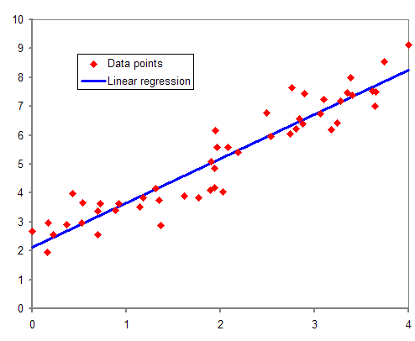
One of the simplest models, nevertheless very effective.
Explains the interaction between two (or more) variables as a line indicating the dependence of one variable on another.
Each point has a value on the X-axis and a Y-axis. A line is a simple rule that roughly explains the value for each point.
The line is not always perfect, but there are already more complex models for this.

Slide 12

The regression equation is almost the same as in the straight line, only the notation and "error" are different:
$$y=β_{0}+β_{1}x+ε$$
$y$– dependent variable; $x$– independent (explanatory) variable; $β_{i}$- regression coefficients that we find (optimize); $ε$- error, that is, the value by which the model is wrong for each observation (because the model is imperfect).
The task of optimization is to make the error as small as possible. It is also important that the error be "random", meaning that it has an average of zero and a normal distribution. If this is not the case, the model is not very good and you need to look for another one.

Slide 13
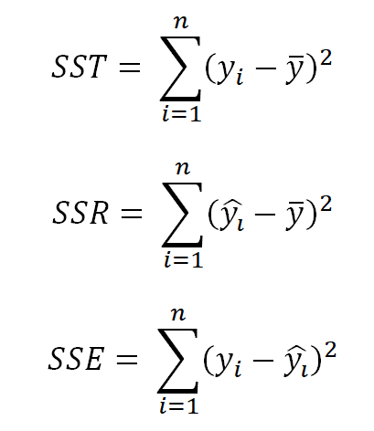
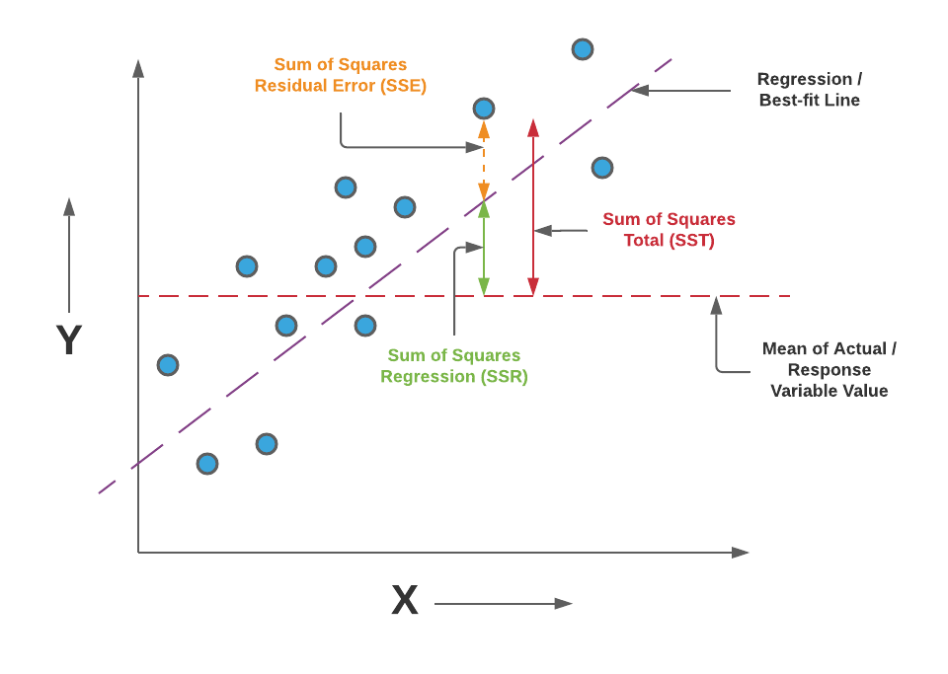

Slide 14
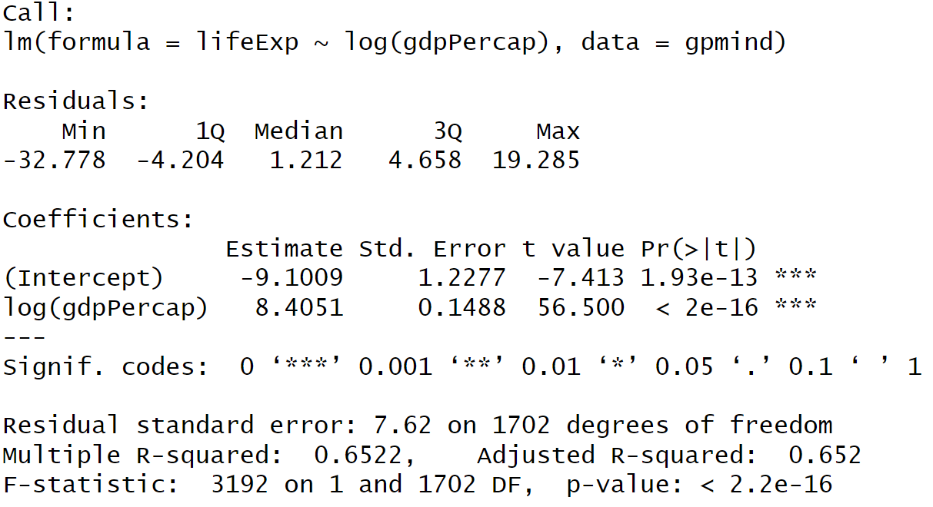

Slide 15

$$y=β_{0}+β_{1}x+ε$$
$$lifeexp=−9.1009+$$
$$8.4051∗log⁡(GDP_{percap})+ε$$

Slide 16
Interpretation
An increase in the logarithm of GDP by 1 (by 100%) increases life expectancy by 8.4 years.

Slide 17
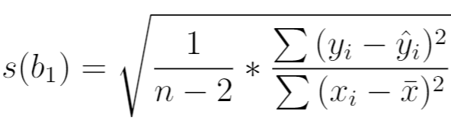
For each coefficient, we calculate the standard error of the coefficient.
This is a measure of confidence in this coefficient, which may deviate from the truth with a certain probability.

Slide 18
There is nothing exact in statistics!
Everything is either probable or improbable.
A hypothesis is a thesis that we are trying to disprove or fail to disprove statistically.
Reject or fail to reject.

Slide 19
Example: a six-sided cube, the hypothesis that it is fraudulent (falls on a side, for example, 6, more times). If sixes fell out in 2-3 throws, he is probably a fraud. If 50 out of 100 times a six came out, it is extremely likely. And we cannot reject the hypothesis of fraud.

Slide 20
Importantly! We cannot "prove" something statistically, because there is always a possibility that we were wrong and it will not be so for the 101st time.

Slide 21
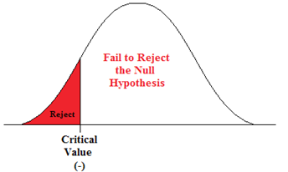
The null (main) hypothesis is a coefficient equal to zero.

Slide 22
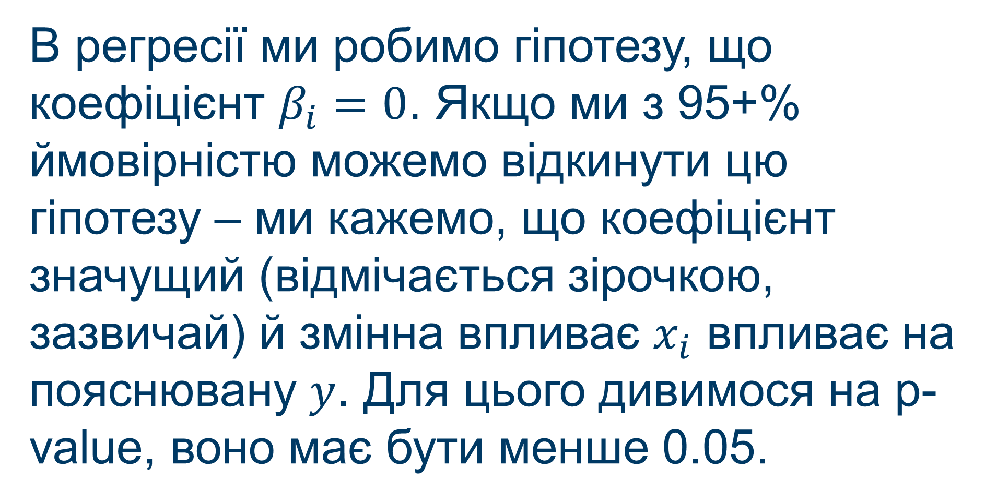
In the regression, we hypothesize that the coefficient $β_{i}=0$. If we can reject this hypothesis with 95+% probability - we say that the coefficient is significant (marked with an asterisk, usually) and the variable affects $x_{i}$the explained variable $y$. To do this, we look at the p-value, it should be less than 0.05.

Slide 24

The regression should explain well all the existing variables, that is, the distance from the points to the line should be minimal.
For this there is $R^{2}$. This is a quantity that describes the percentage of explained variation, a measure of the variation in the data (which we actually explain).

Slide 25
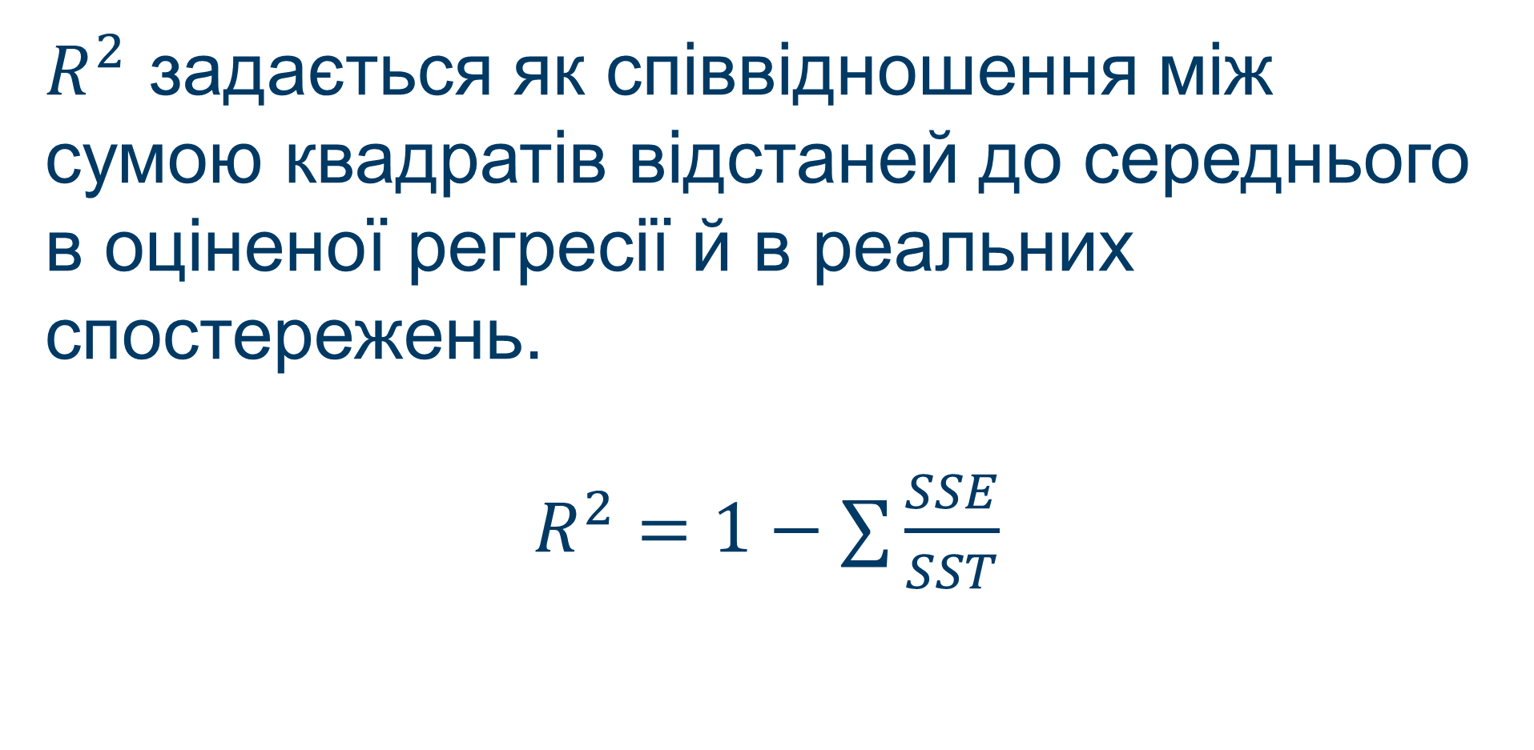
$R^{2}$is given as the ratio between the sum of squared distances to the mean in the estimated regression and in real observations.
$R^{2}=1−∑\frac{SSE}{SST}$

Slide 27
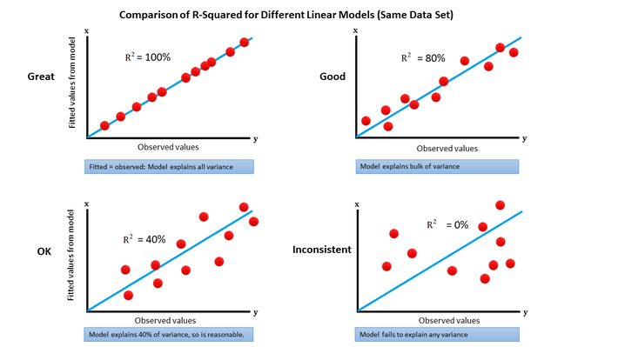

Slide 29
There are many things to control
Linear relationship between the explained variable and the explanatory variables
The variation of residuals must be constant
Remainders should be normally distributed

Slide 30
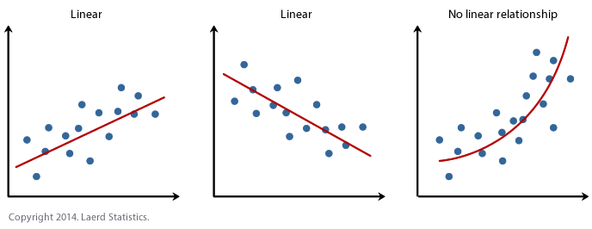
Linearity

Slide 31
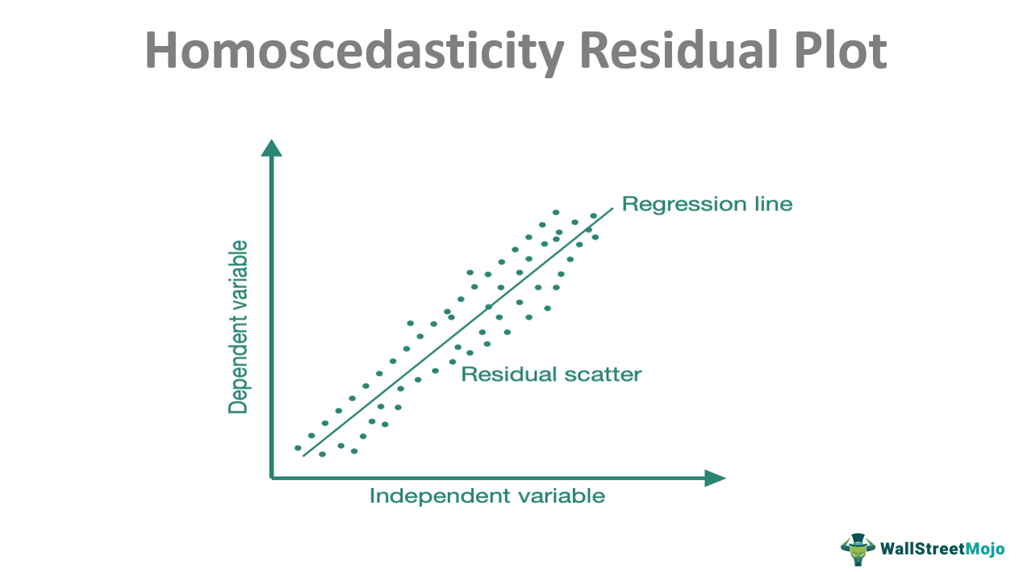
The variation of the residuals must be constant - homoscedasticity .
Or the Breusch-Pagan test

Slide 32
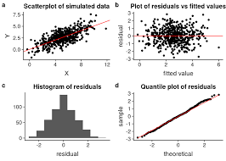
Remainders should be normally distributed.

Slide 34
An exercise for attention.
There are three apartments:
40 squares and costs 35,000
70 squares and costs 50,000
120 square meters and costs 75,000
What coefficients, what R-squared?
15000 + 500*square ; 1

Slide 35
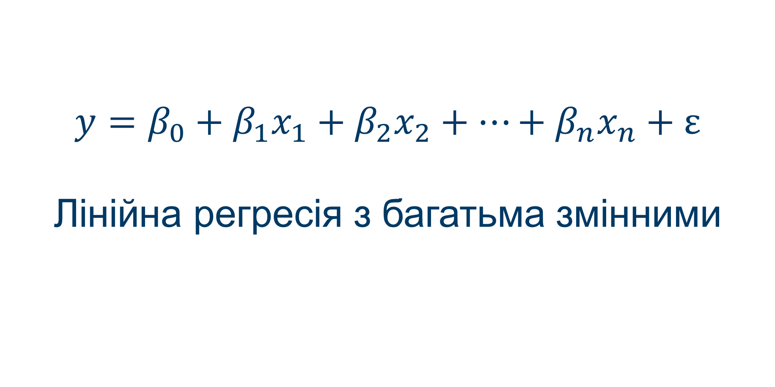
$$y=β_{0}+β_{1}x_{1}+β_{2}x_{2}+…+β_{n}x_{n}+ε$$
Linear regression with many variables

Slide 36
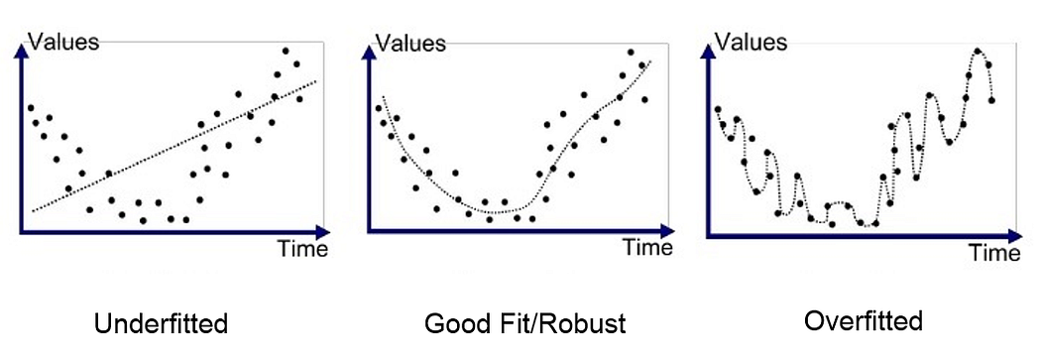
New tricks = new problems
Overfitting

Slide 37
Multicollinearity is a significant interdependence of several explanatory variables.
Interpretation of coefficients deteriorates.
Check – See the correlation between two variables.

Slide 38
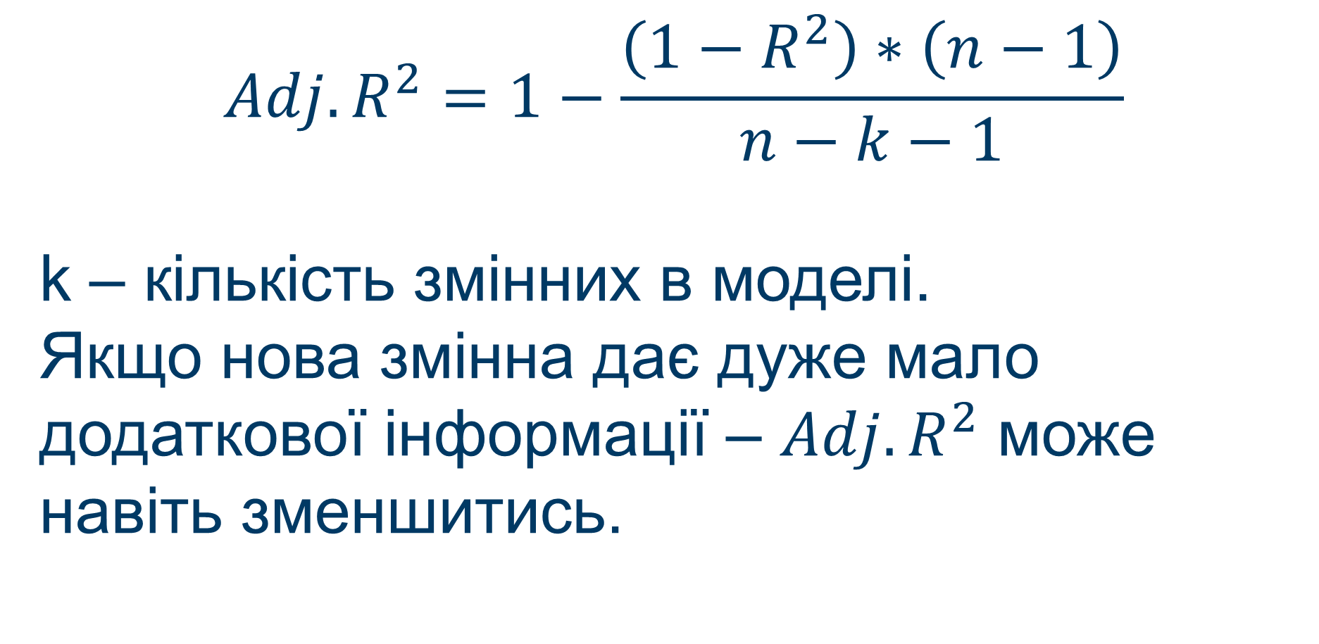
$$Adj.R^{2}=1−\frac{\left(1−R^{2}\right)∗\left(n−1\right)}{n−k−1}$$
k is the number of variables in the model.
If the new variable gives very little additional information -$Adj.R^{2}$ may even decrease.

Slide 39
Models bring discussions to a new level of argumentation, create a discussion about the quality of the model and capture of factors.
Such a discussion is often productive and leads to a deeper understanding of the problem.

